Slide 1
Swarm Intelligence in Graph Coloring
Ema Këpuska, Sai Pavan Dronavalli, Suganthi Silambazhagan

Slide 2
Context
Proposed Algorithm
Local rules
Experiment
Analysis of results
Comparison of results
Conclusion

Slide 3
Graph Coloring Problem

Slide 4
Proposed Algorithm
Introducing MIS algorithm
Modifying MIS by introducing swarm intelligence features:
Decentralization
Local Rules
Possibility of parallelization

Slide 5
Proposed Algorithm
Introducing swarm partitioning to the graph
Introduce leader and subleaders
Finding MIS for each subgraph
Color each subgraph using MIS
Resolve the color conflicts
Merge the subgraphs

Slide 6
Local rules for individual node
Compare weights with neighbors and check if local maxima
Communicate this info with sub-leaders for MIS generation
Check for and resolve color conflicts if border node

Slide 7
Local rules for individual node

Slide 8
Partition the graph into swarms

Slide 9
Select Sub-Leaders Randomly

Slide 10
Assign weights to each node
4
1
8
2
8
-2
6
0
-5
-1

Slide 11
Run MIS on each partition
4
1
8
2
10
9
6
0
-5
-1

Slide 12
Run MIS on each partition
4
1
8
2
10
-2
6
0
-5
-1

Slide 13
Resolve the color conflicts
4
1
8
2
10
-2
6
0
-5
-1

Slide 14
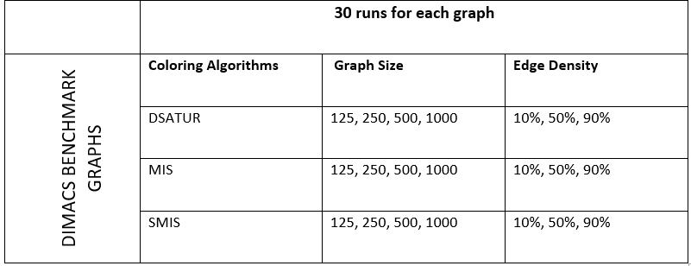
Experiment
DIMACS Benchmark Graphs

Slide 15
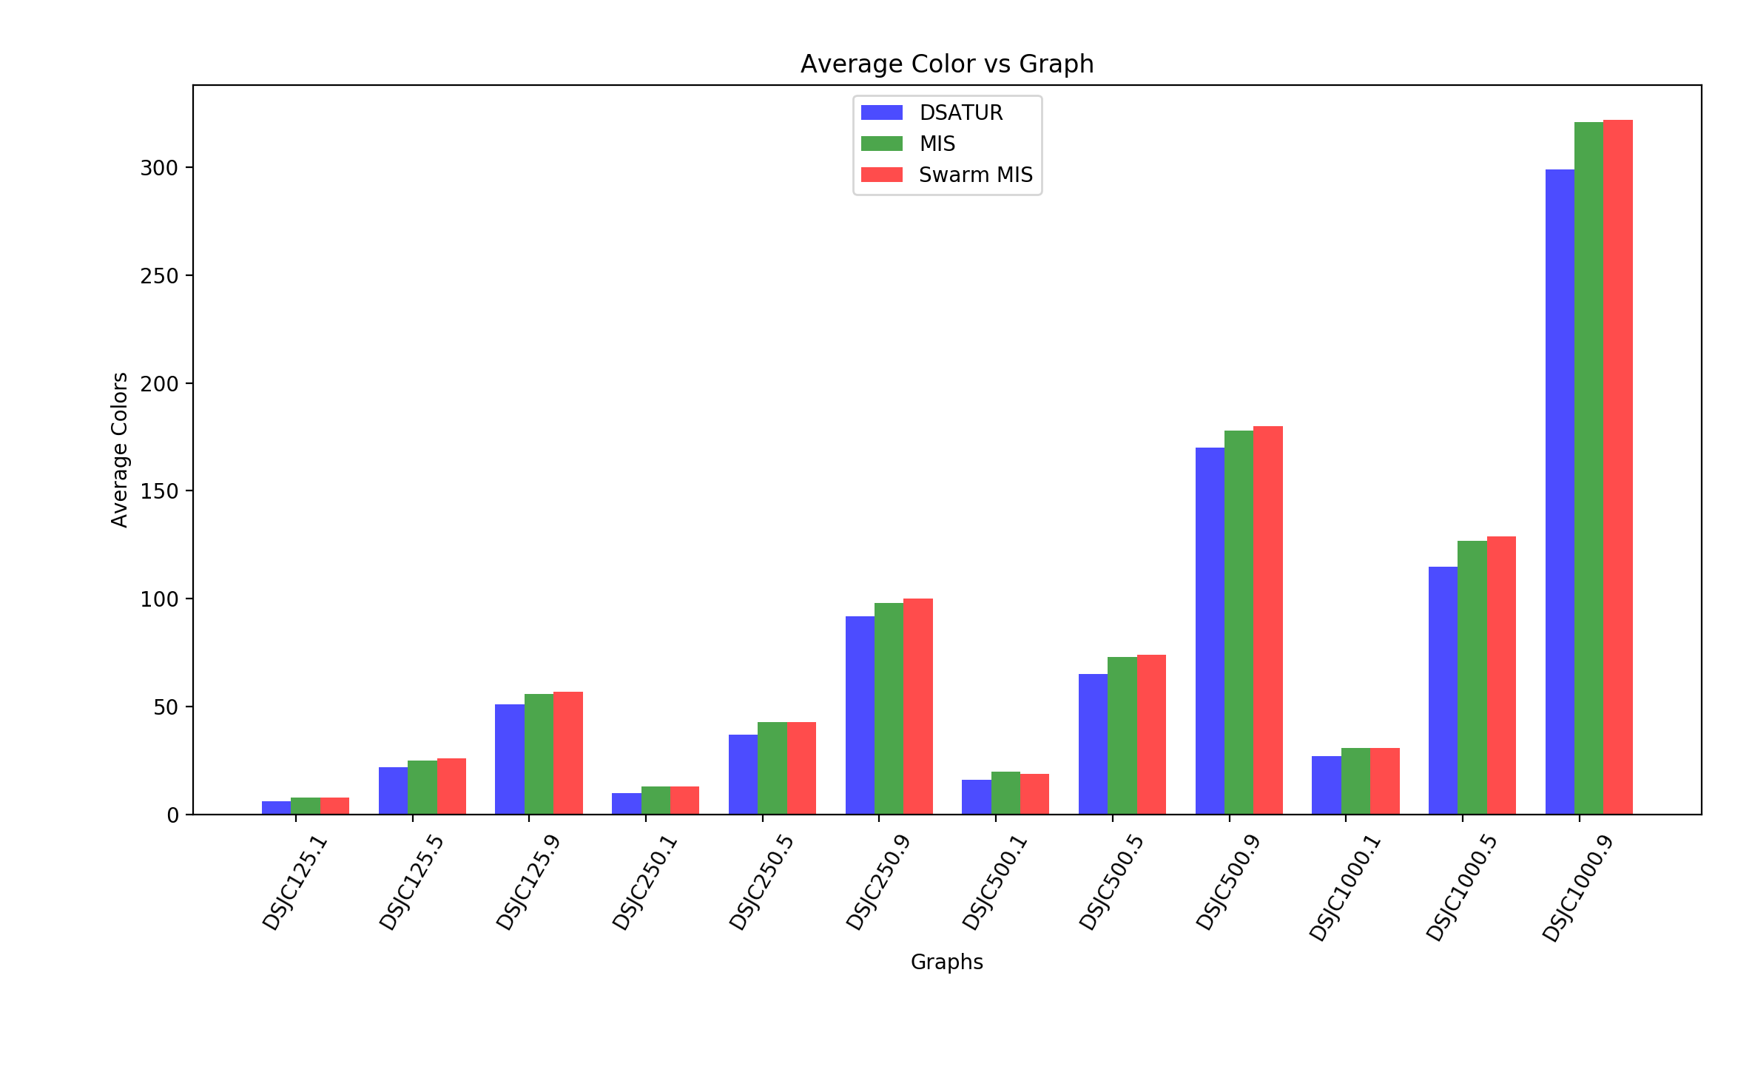
Average Colors for each Algorithm

Slide 16
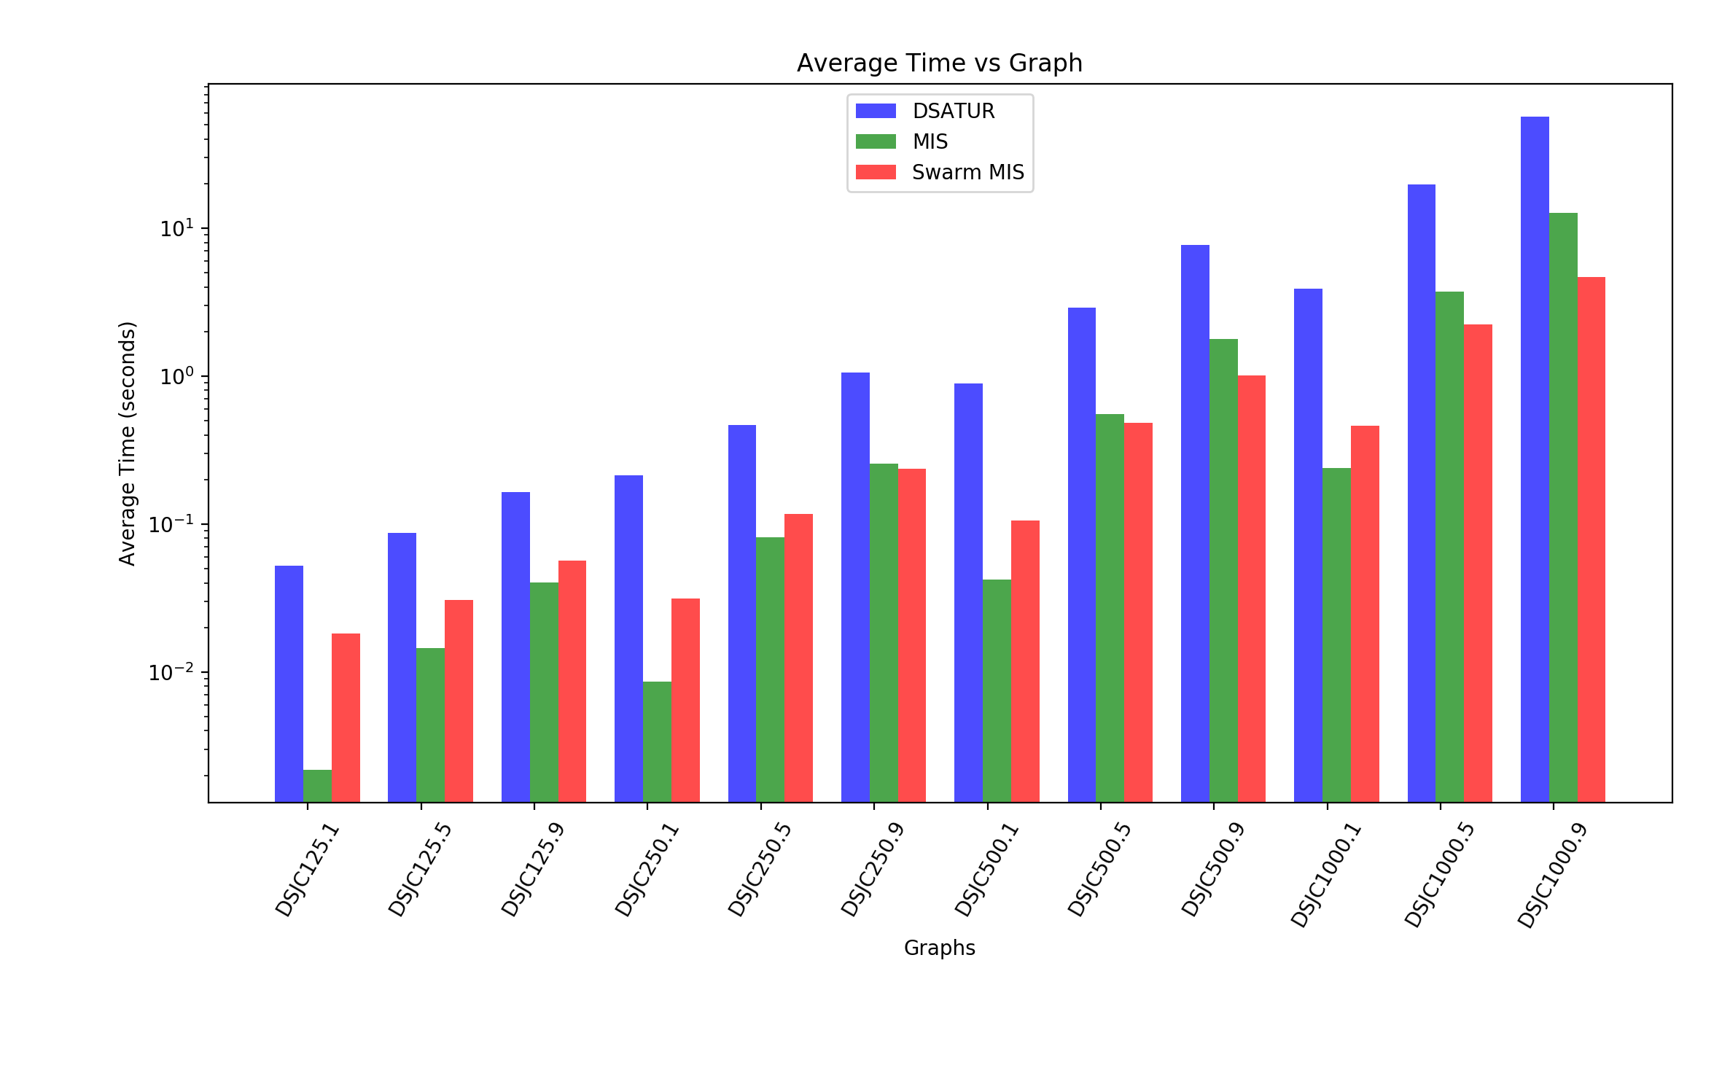
Average Time for each algorithm

Slide 17
Comparison of results from state-of-art algorithms
Pros
Cons
SMIS is at most 5 times faster than DSATUR
SMIS is 2 times faster than MIS
SMIS uses almost the same number of colors as MIS
SMIS uses 5-10% more colors than DSATUR
SMIS is slower for small, less connected graphs

Slide 18
Conclusion
Heuristic approaches may give an optimal chromatic number
They are slow and not scalable
MMIS is more useful in the case of large graphs
More efficient if the cost of communication is high
Even faster when parallelized

Slide 19
THANK YOU FOR YOUR ATTENTION! QUESTIONS?

