Slide 1

FINDMYGURU
Navigating the path to personal and professional growth

Slide 2

INDEX
Project Idea
Scope
Program Analysis
Vision and Motivation
Software Artifact – Tech Stack
UML diagrams
Output Screenshots
Functional Requirements
Non-Functional Requirements
Solution Development
Main Features
Results
Future work

Slide 3
PROJECT IDEA
Our website is designed to help individuals find a suitable mentor who can guide and advise them in their personal or professional growth. With an easy-to-use platform, mentees can search for mentors by field of expertise, schedule mentorship sessions, and communicate with their mentors directly. Mentors, on the other hand, can create detailed profiles, showcase their skills and experience, and help foster meaningful relationships with mentees.

Slide 4
SCOPE
The scope of the mentorship website project includes creating a user-friendly platform that connects mentees with mentors in various fields of expertise. This will involve building a website with a clean and modern design, easy-to-use navigation, and secure login and messaging functionalities. Additionally, the project will include developing a comprehensive database of mentors, categorizing them based on their skills and experience, and providing tools to help mentees and mentors manage their mentorship relationships. The scope of the project may also involve marketing the website to attract both mentees and mentors and promoting the benefits of mentorship.

Slide 5
PROGRAM ANALYSIS
The problem addressed by the "Find my Guru" project is the lack of a centralized platform that connects individuals seeking guidance and mentorship with experienced and knowledgeable mentors worldwide. The current mentorship options are limited and localized, making it challenging for mentees to find the right mentor who can guide them in their personal or professional growth. Additionally, the process of finding and scheduling mentorship sessions is often complicated and time-consuming, leading to missed opportunities for personal and professional development. The "Find my Guru" project aims to solve these problems by providing a user-friendly platform that connects mentees with mentors worldwide, streamlines the scheduling and communication process and promotes the benefits of mentorship.

Slide 6
VISION
Our vision is to build a worldwide community of seekers and guides who share a common goal to make the world an easy and connected place.
MOTIVATION
"Find my Guru" connects seekers with their guides worldwide. Our platform target is to empower users to search for gurus based on location, traditions, and preferences while offering biographies, teachings, and reviews. We aim to create a community of seekers and guides who share a common purpose: to create an easy world by facilitating meaningful connections regardless of background or belief. Our goal is to inspire users to embark on a transformative journey of self-discovery, empowerment, and awakening based on their interest in fields.

Slide 7
SOFTWARE ARTIFACT
TECH STACK
Our project will be built using JavaScript, React, ExpressJS, NodeJS, and MongoDB.
Front-end: HTML, CSS, JavaScript, React.js, and Bootstrap for building a responsive and user-friendly website.
Back-end: ExpressJS and Node.js to build the server-side application and handle the database integration.
Database: MongoDB to store mentor and mentee data, booking information, and messaging history.

Slide 8
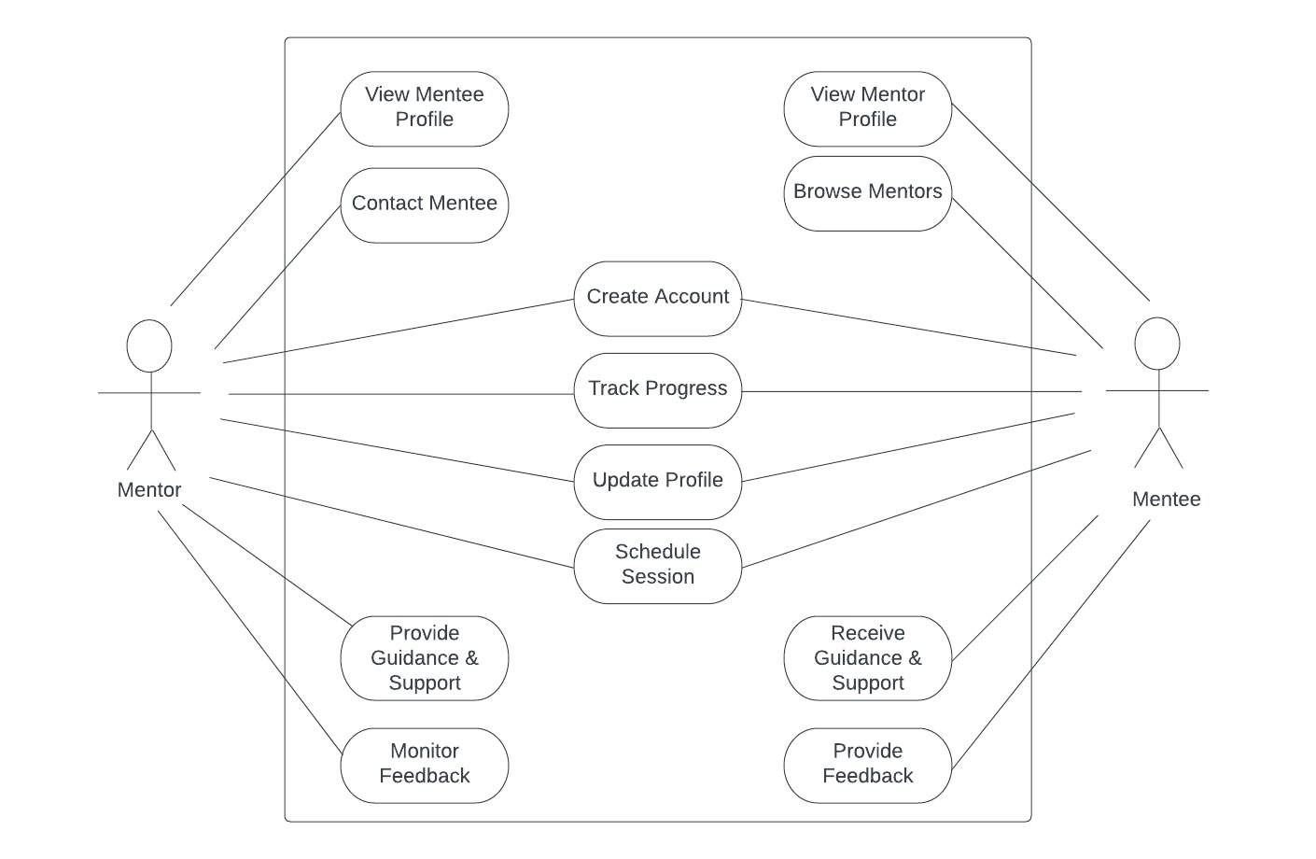
UML DIAGRAMS:
USE CASE DIAGRAM

Slide 9
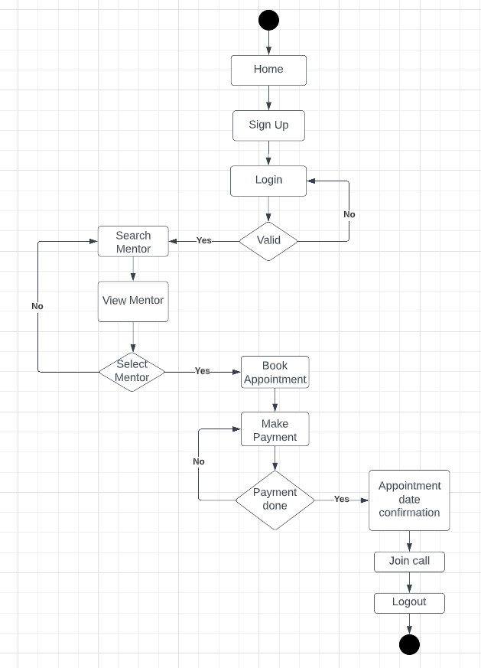
ACTIVITY DIAGRAM

Slide 10
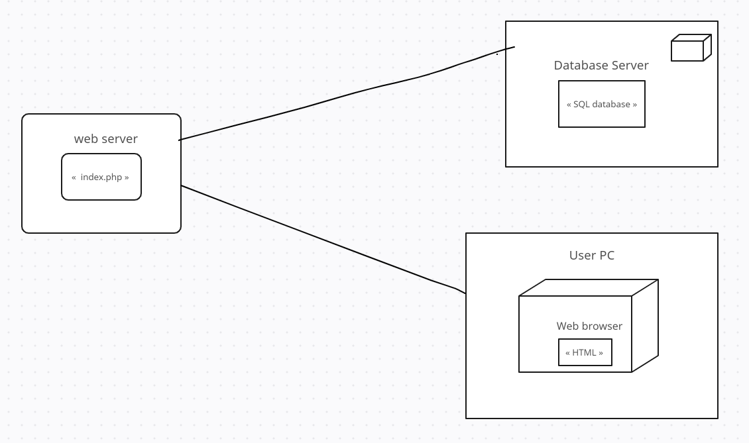
DEPLOYMENT DIAGRAM

Slide 11
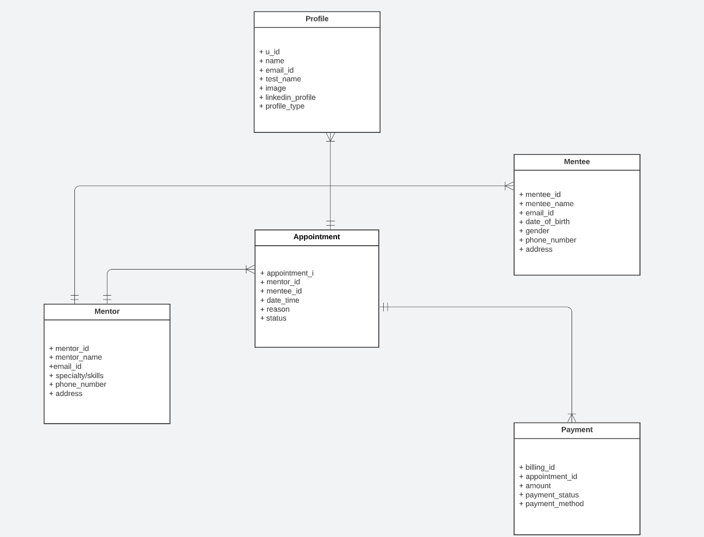
CLASS DIAGRAM

Slide 12
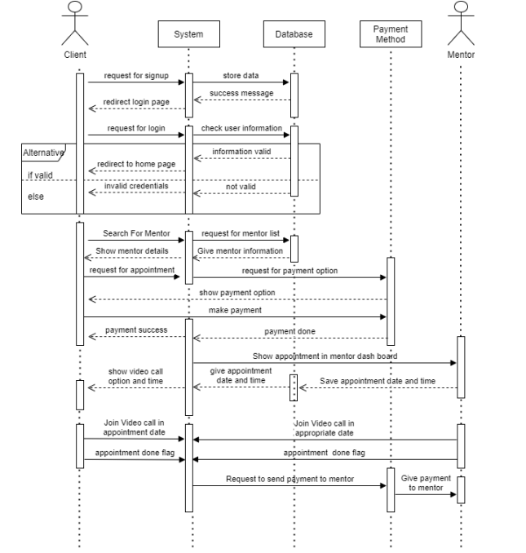
SEQUENCE DIAGRAM
(SYSTEM SEQUENCE DIAGRAM FOR USER/CLIENT)

Slide 13
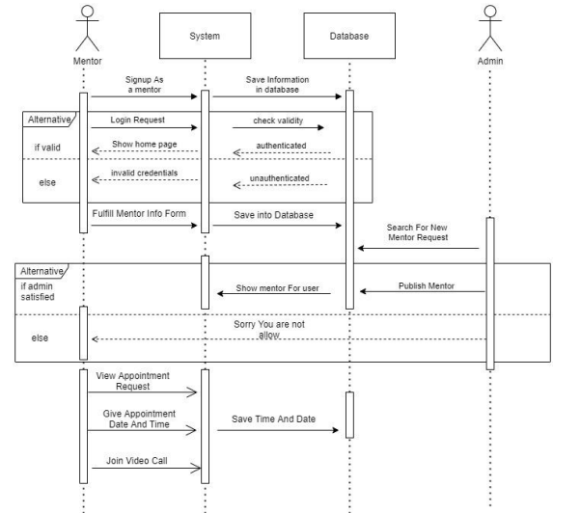
SEQUENCE DIAGRAM FOR MENTOR

Slide 14
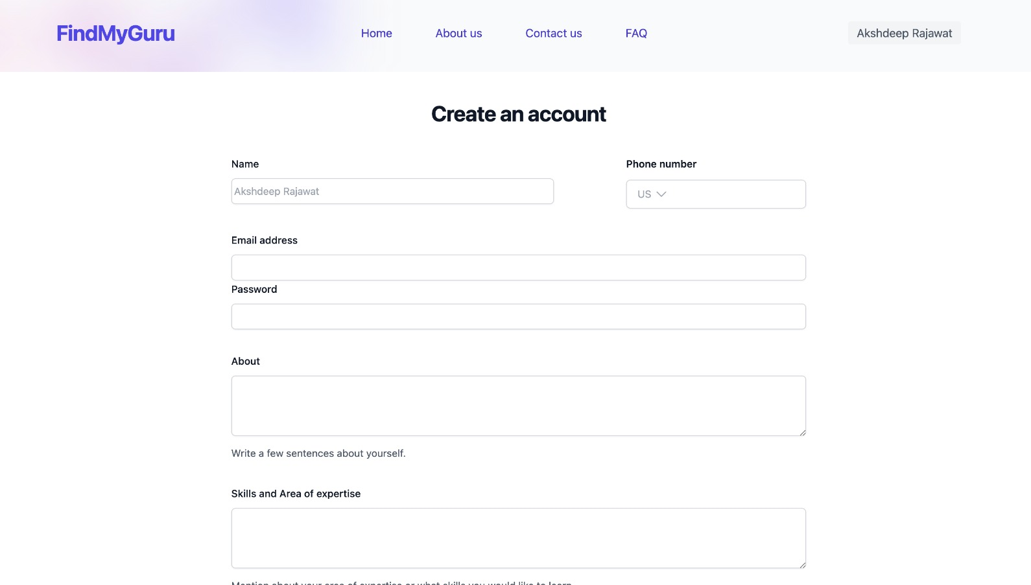
SIGN UP PAGE

Slide 15
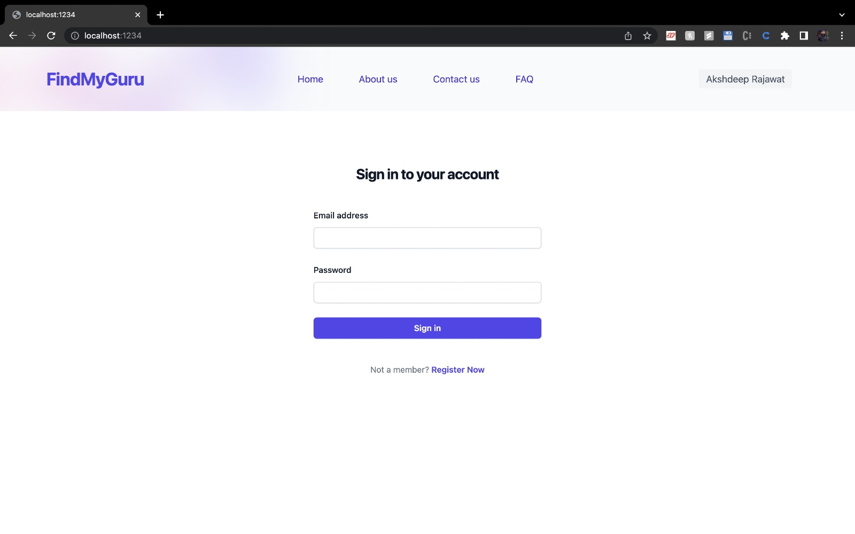
LOGIN PAGE

Slide 16
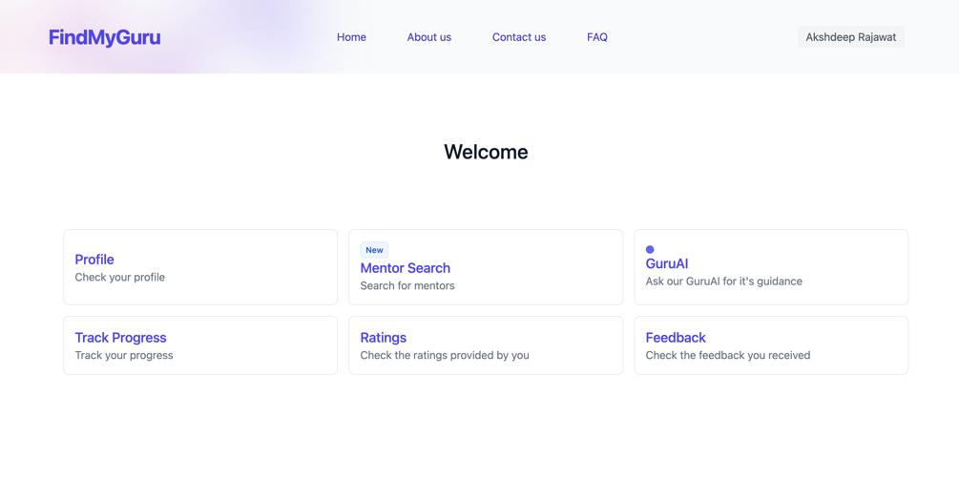
MENTEE DASHBOARD

Slide 17
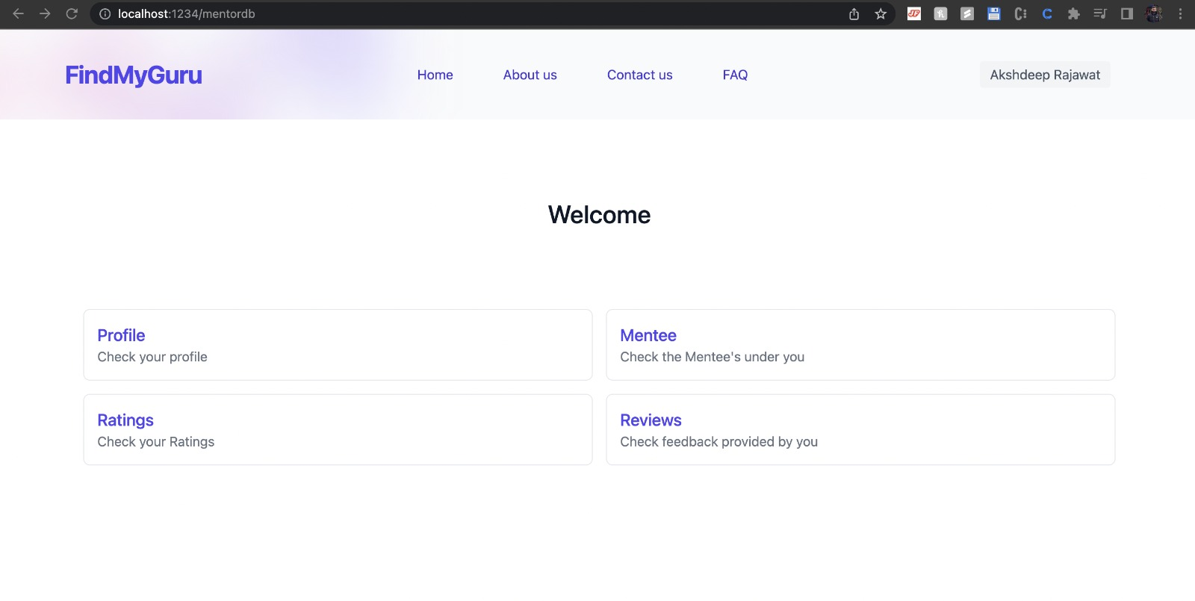
MENTOR DASHBOARD

Slide 18
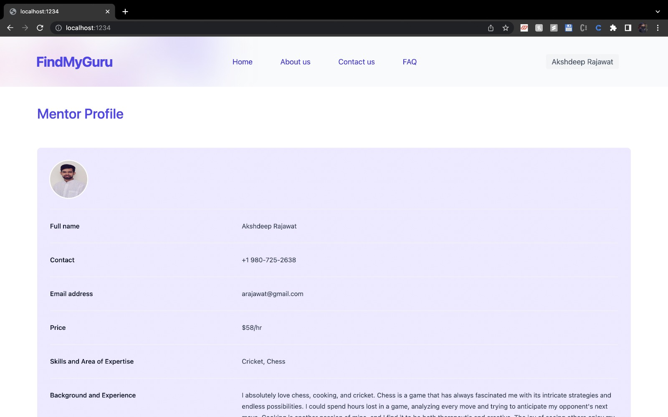
MENTOR PROFILE PAGE

Slide 19
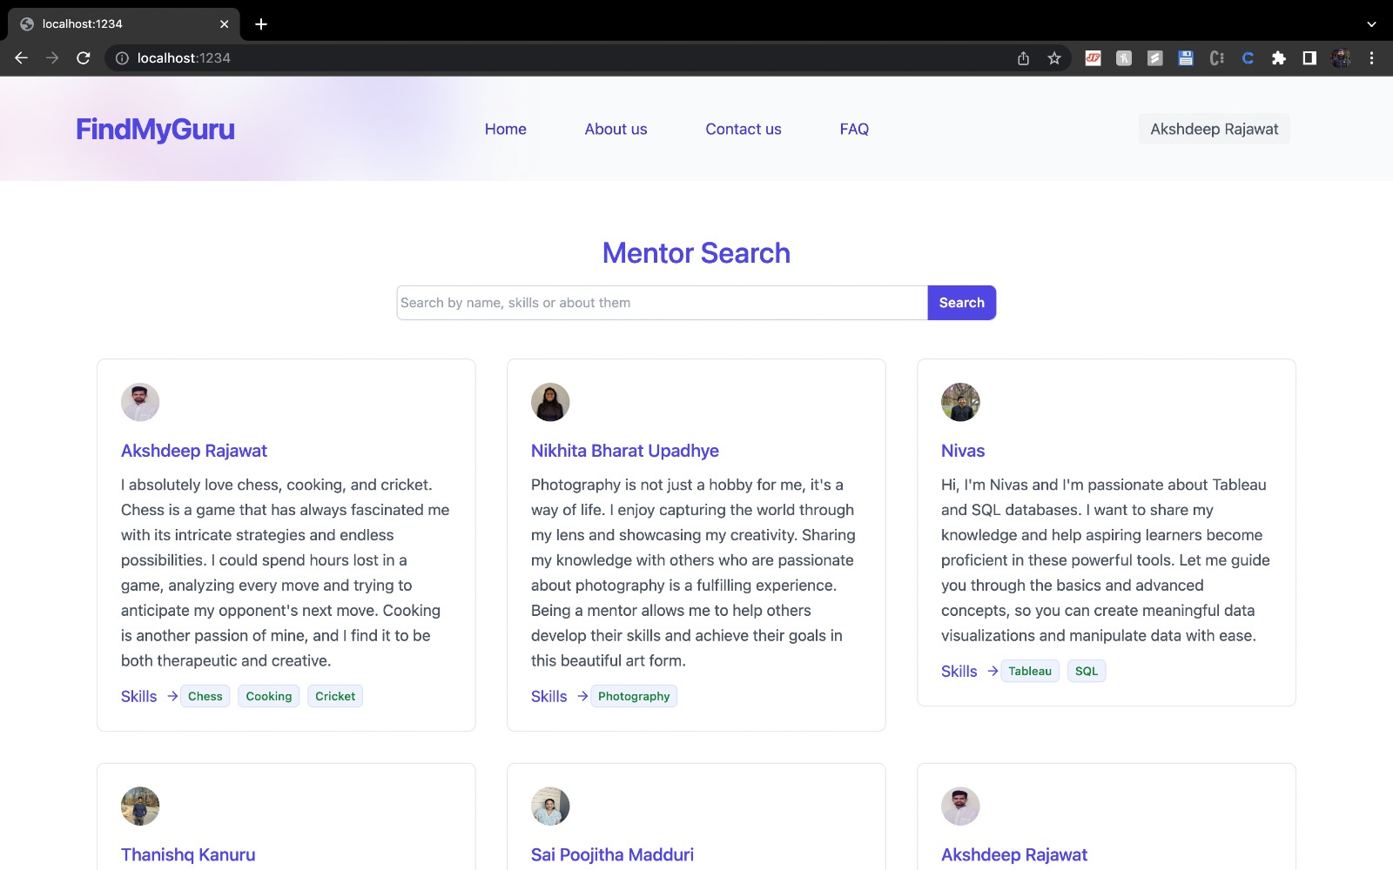
MENTOR SEARCH PAGE

Slide 20
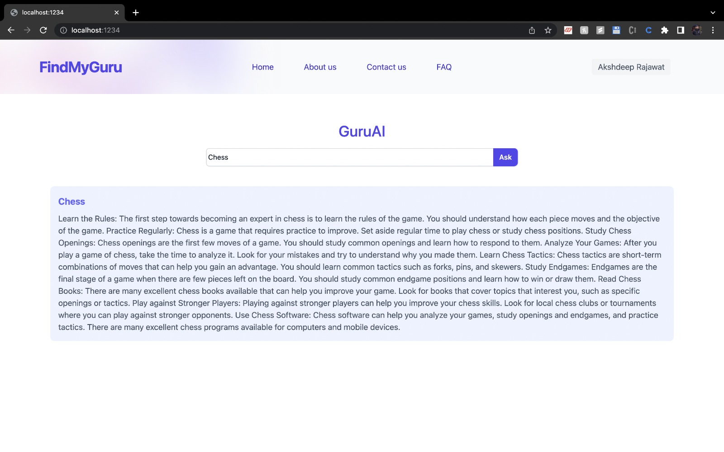
GURU AI

Slide 21
FUNCTIONAL REQUIREMENTS
The website will have the following functionalities but not limited to:
1. User registration and login
2. Mentor and mentee profile creation
3. Search functionality to find mentors by field of expertise and availability
4. Booking system to schedule mentorship sessions with mentors
5. Direct messaging between mentors and mentees to facilitate communication
6. Rating and review system to provide feedback on mentors
7. Payment processing for mentorship sessions
8. Notification system to alert users of upcoming sessions and new messages
9. Dashboard for mentors and mentees to track their mentorship relationships and upcoming sessions

Slide 22
NON-FUNCTIONAL REQUIREMENTS
Top 5 nonfunctional requirements for the mentorship website:
1. Security: Implement appropriate security measures to protect user data.
2. Performance: Ensure fast, responsive performance with minimal downtime.
3. Scalability: Design the website to handle increasing numbers of users and mentors, and support multiple concurrent mentorship sessions.
4. Usability: Ensure the website is easy to use and navigate.
5. Compatibility: Ensure the website is compatible with a wide range of devices, browsers, and operating systems.

Slide 23
SOFTWARE SOLUTION DEVELOPMENT
Glossary of relevant terms for the Find My Guru website:
1. Mentor: An experienced individual who provides guidance, advice, and support to a mentee in a particular field or area of expertise.
2. Mentee: A person who seeks guidance, advice, and support from a mentor to enhance their personal or professional growth.
3. Mentorship session: A scheduled meeting between a mentor and mentee to discuss and work towards achieving the mentee's goals.
4. Profile: A page on the website that contains information about a mentor or mentee, including their skills, experience, and interests.
5. Expertise: A particular field or area of knowledge in which a mentor has significant knowledge, skills, and experience.

Slide 24
6. Schedule: A system for booking and managing mentorship sessions between mentors and mentees.
7. Feedback: Information provided by a mentor to a mentee to help them improve their skills, knowledge, and performance.
8. Progress tracking: The process of measuring and tracking the progress of a mentee towards achieving their goals.
9. Goal setting: The process of defining specific, measurable, achievable, relevant, and time-bound goals for a mentee to work towards with the guidance of their mentor.
10. User: Any individual who accesses and uses the mentorship website, including both mentors and mentees

Slide 25
MAIN FEATURES
Mentor search: Through our platform, mentees can look for mentors who are qualified in their areas of expertise. To locate the mentor that best suits your needs, you can search among a selection of mentors with various backgrounds and areas of expertise. Once you have identified a qualified mentor, you can quickly book sessions at a time that is convenient for you. This function aids in time management and guarantees that you make the most of your mentorship relationship.
Direct communication is made possible by our platform, making it simple to ask questions, discuss ideas, and receive feedback on your development. A strong and meaningful mentor-mentee relationship is fostered by this function.
Mentors can develop comprehensive profiles that highlight their abilities, backgrounds, and experiences. Before choosing a mentor, you can get to know them better, making sure you choose the one who will best suit your needs.

Slide 26
RESULTS
The mentorship website project has the potential to be a valuable resource for individuals seeking guidance and mentorship. The project will address the lack of a centralized platform that connects individuals with experienced and knowledgeable mentors worldwide. The project will also streamline the process of finding and scheduling mentorship sessions and promote the benefits of mentorship. The project is ambitious, but it has the potential to make a real difference in the lives of many people.

Slide 27
FUTURE WORK
Enhancing real-time chat between mentor and mentee by adding support for multimedia files (e.g. images, audio, video) to aid in concept explanation and note sharing, as well as implementing features like notifications, message threading, and message search.
Improve scheduling meetings through our website by integrating with popular calendar apps (e.g. Google Calendar, Outlook, iCal) to enable automatic scheduling and reminders for mentors and mentees, reducing scheduling conflicts and no-shows.
Enhance video calls by adding features such as screen sharing, whiteboard, or live transcription to aid in concept explanation and problem-solving, as well as support for multiple participants, breakout rooms, and recording.
Improve secure payment integration in the website by adding support for multiple payment gateways (e.g. PayPal, Stripe, Square) and features like automatic invoicing, refunds, and dispute resolution, as well as implementing SSL certificates and other security measures to protect sensitive financial information.

Slide 28
THANK YOU

