Slide 1





Planetary Pythons
TEAM ID: T-0863220

Slide 2

Overview and Objective
Data Preprocessing
Data Analysis
Tackling Class Imbalnce
Feature Engineering
CONTENTS
Handling Binned Values
Model Architecture
Model Training
Performance Assesment
Anomaly Detection

Slide 3
Overview
Asteroids are small, rocky objects that orbit the Sun, primarily found in the region between Mars and Jupiter known as the asteroid belt. Asteroid impacts have been a constant force shaping Earth's history. From minor events that leave barely a trace to catastrophic collisions that have caused mass extinctions, these cosmic encounters have played a significant role in our planet's evolution. Given the potential for devastating consequences, scientists worldwide are dedicated to detecting and tracking the asteroid impact threat. To mitigate this risk, it is crucial to identify and analyse asteroids that could pose a hazard.
Objective
Objective: Analyze asteroid data using analytics and machine learning to assess the likelihood of hazards to Earth.
Features Examined: Evaluate characteristics such as size, orbital parameters, velocity, and proximity to Earth's orbit.
Predictive Modeling: Develop models to classify asteroids as hazardous or non-hazardous, aiding in the prioritization of monitoring and mitigation strategies.
Anomaly Detection: Identify asteroids with unusual behavior that may require closer scrutiny.

Slide 4
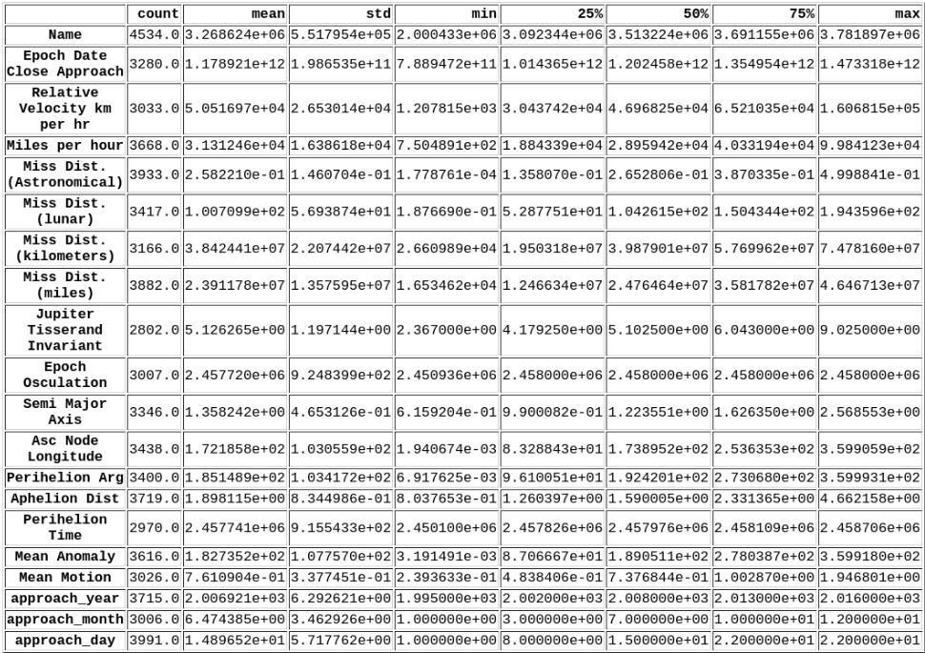
EXPLORATORY DATA ANALYSIS
DATA INSPECTION
Dataset Overview:
Shape: 4,534 records with 24 features.
Feature Types:
Identifier: 1 unique identifier.
Categorical: 3 categorical (including ordinal).
Continuous: 20 continuous features.
Key Insights:
Statistical Summary: Initial summary reveals central tendencies and distributions of continuous features.
Missing Data: 23.32% missing values, necessitating preprocessing for data quality.
This analysis foundation supports further feature exploration and robust model preparation.

Slide 5
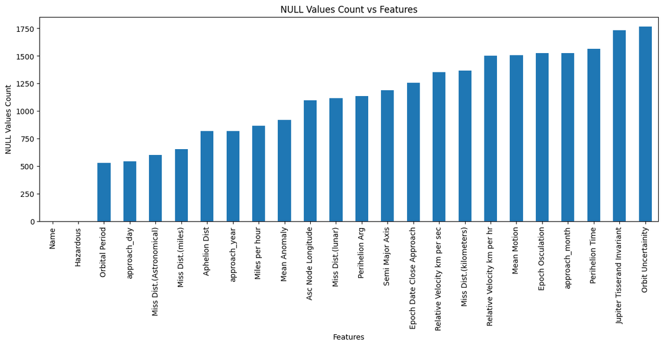
REMOVAL OF NULL VALUES
Null values of features Epoch Date Close Approach, Epoch Osculation, approach_year, approach_month, approach_day, Perihelion Time,Orbit Uncertainity are filled with forward values
Null Values of features Miss dist.(Astronomical), Miss dist.(lunar),Miss dist.(kilometers),Miss dist.(miles) are filled with unit conversion factors as they are the same thing only different due to different units
null values of features Jupiter Tisserand Invariant,Semi Major Axis,Asc Node Longitude,Perihelion Arg,Mean Anomaly,Mean Motion,Aphelion Dist are filled using the k-nearest neighbors approach.(scikit-learn’s KNNImputer is used for this task.
Relative Velocity km per sec categorical feature depends on 'Relative Velocity km per hr’ feature. Orbital Period feature categorical values depend on Semi major Axis(T^2 proportional to a^3). Thus Their Null Values are filled using them.

Slide 6
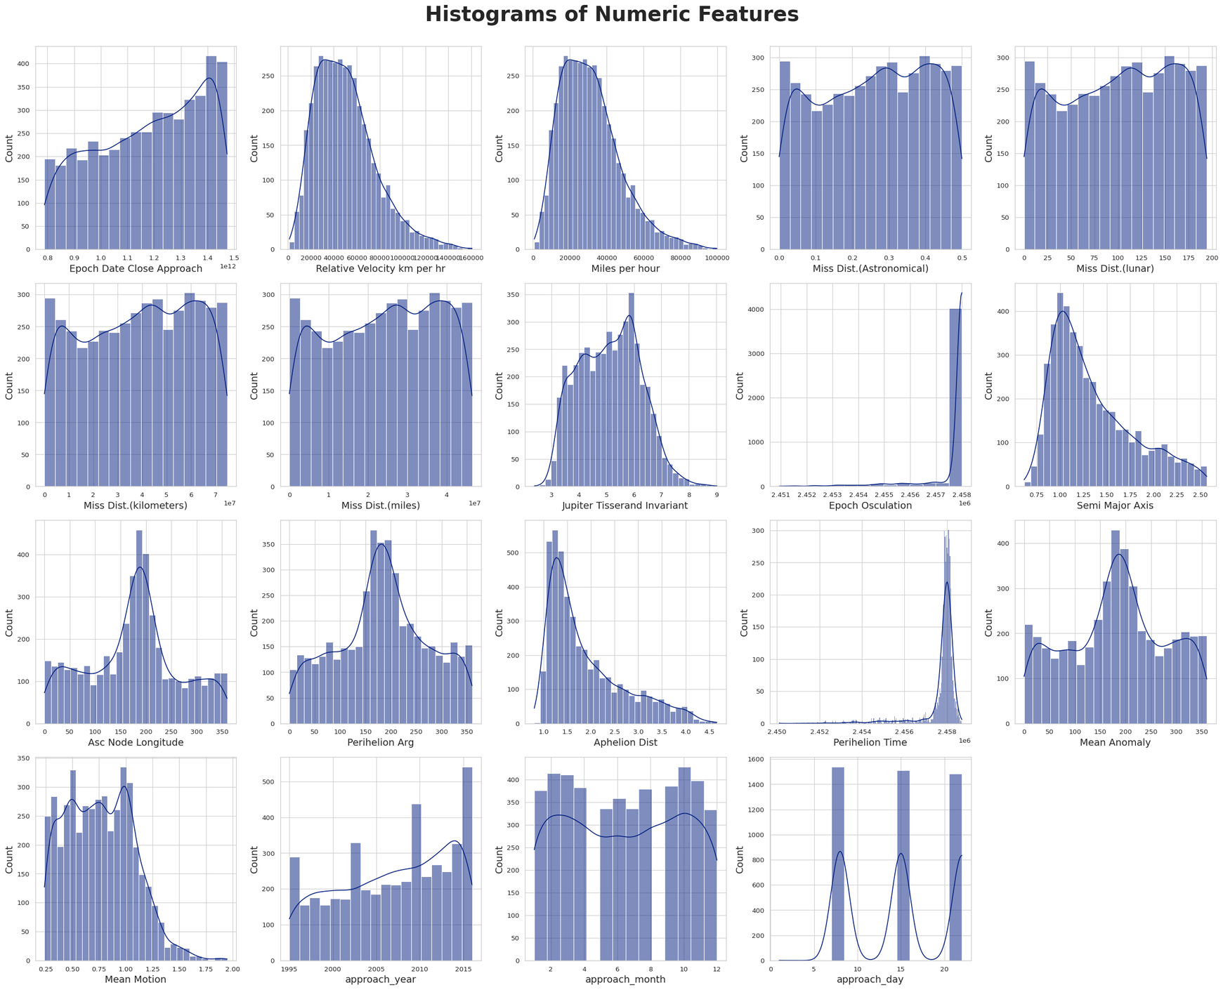
STATISTICAL INFERENCE
Statistical inference is fundamental in transforming raw data into meaningful insights and guiding decision-making processes.
From the following histogram distribution it is evident that Features like Aphelion Dist, Semi Major Axis, Relative Velocity km per hr, Miles per hour, Mean Motion are skewed.
Reducing skewness in dataset features is essential for improving model performance and also lessens the impact of outliers

Slide 7
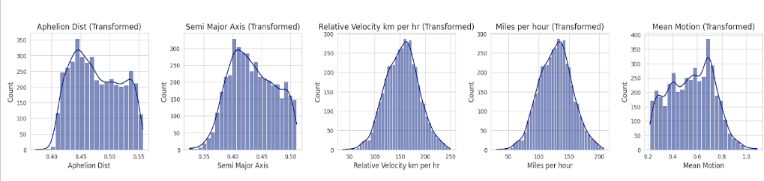
TRANSFORMED FEATURES
Since the features Aphelion Dist, Semi Major Axis, Relative Velocity km per hr, Miles per hour, Mean Motion are skewed, they are Normalized by using YeoJohnson Method which is applicable for both Positively and Negatively Skewed data.
Reducing skewness brings the data closer to a normal distribution, minimizing the influence of outliers. Following graph shows the transformed features with skewness removed

Slide 8
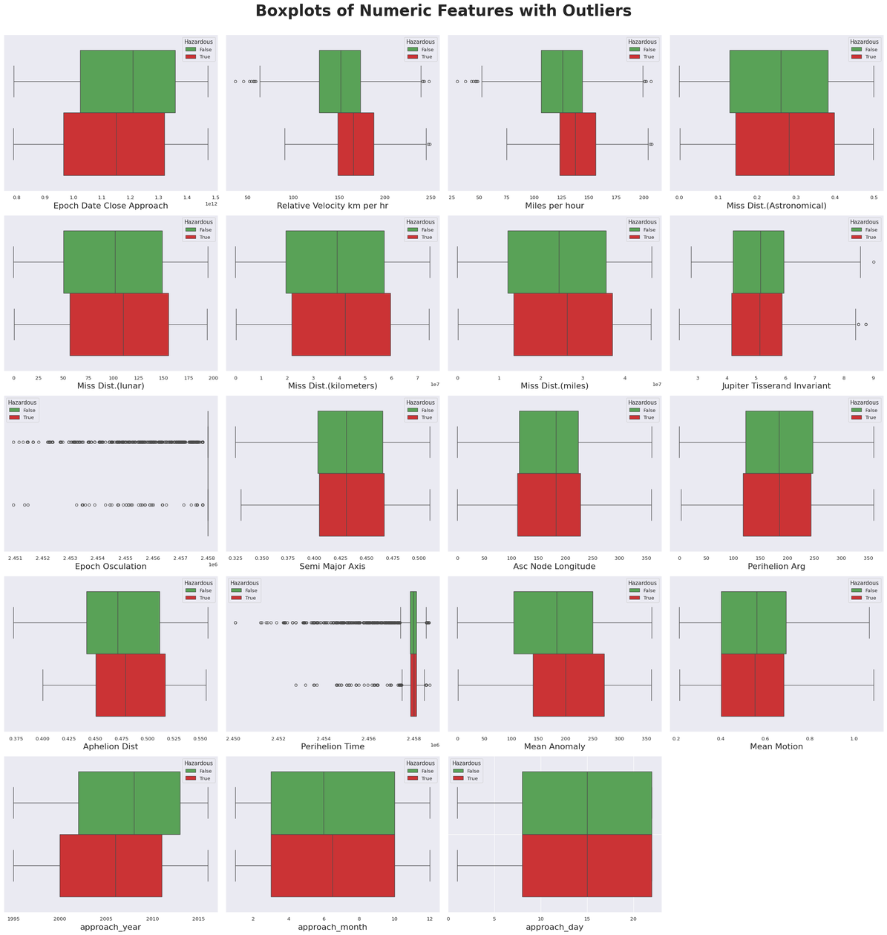
IDENTIFICATION OF OUTLIERS
Outliers can disproportionately influence the results of statistical analyses and machine learning models, leading to inaccurate predictions. Models trained on datasets with outliers may be less robust and generalize poorly to new, unseen data. Removing outliers can lead to a more stable model that performs consistently across different datasets.
Outliers can be identified using boxplot and Z-score.
From The Plot we can see that the Features ‘Relative Velocity km per hr”,’Miles per hour’,’Epoch Osculation’,’Perihelion Time’ have outliers. But there are 23 features and only 4 have outliers. Thus we can avoid these outliers. Removing them will lead to a lot of loss of data so we are not Removing the outliers for these 4 features

Slide 9
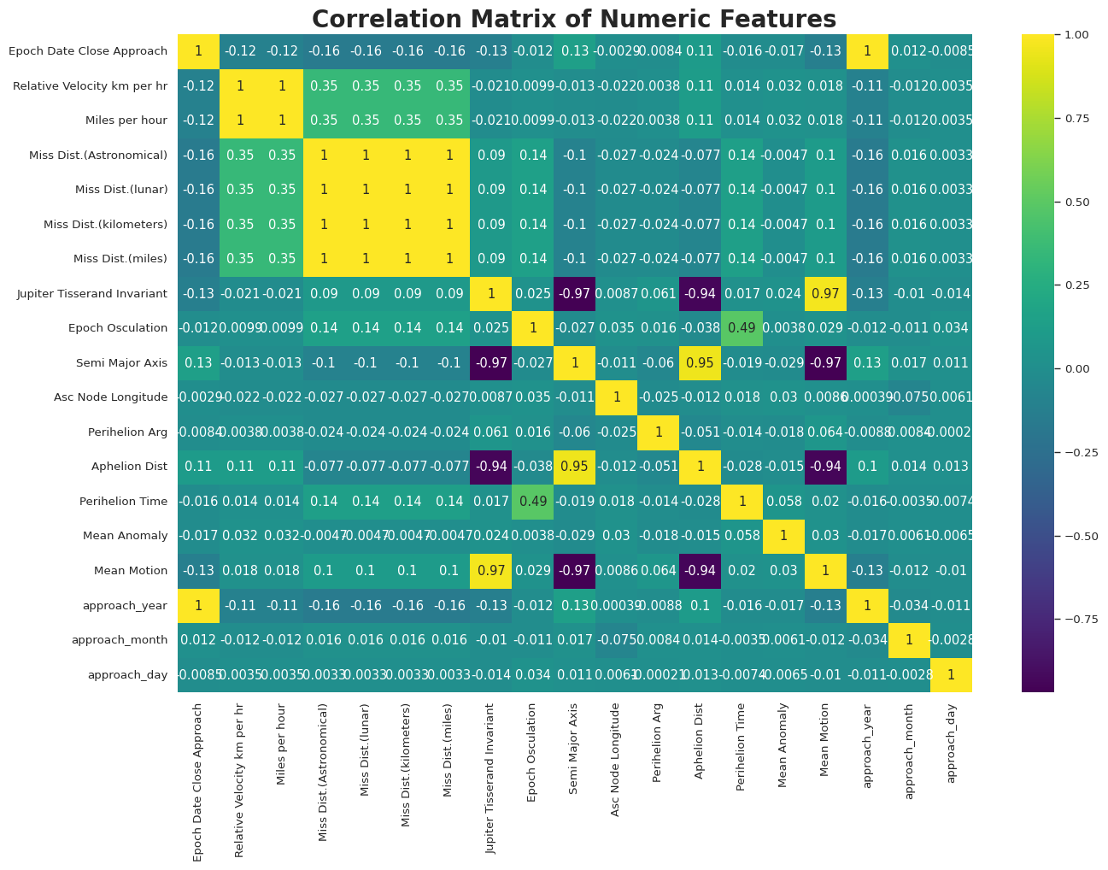
CORRELATION MATRIX
A correlation matrix displays the pairwise correlation coefficients between numeric features, showing how one feature changes in relation to another.
Perfect correlations:
"Relative Velocity km per hr" and "Miles per hour" are perfectly correlated (1.0), indicating they are unit conversions.
All "Miss Distance" variations (astronomical, lunar, kilometers, miles) are also perfectly correlated (1.0), reflecting different units of the same measurement.
Strong correlations:
"Aphelion Distance" and "Semi Major Axis" have a strong positive correlation (0.95), as both describe orbital properties.
"Mean Motion" and "Semi Major Axis" have a strong negative correlation (-0.96), consistent with orbital mechanics where a larger semi-major axis results in slower mean motion.

Slide 10
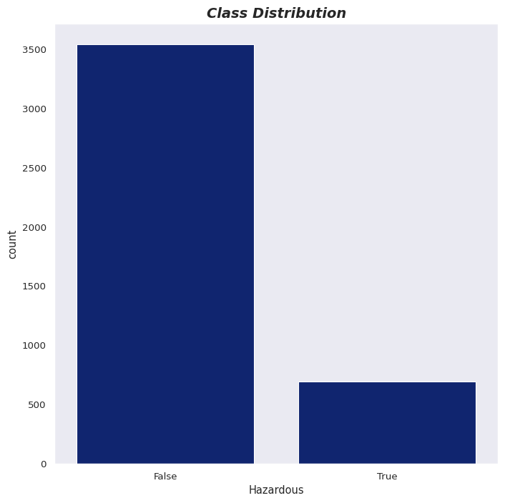
TACKLING CLASS IMBALANCE
Class Distribution :
The dataset shows a significant class imbalance, with 83.63% of instances labeled as "False" (Non-Hazardous) and only 16.37% labeled as "True" (Hazardous), as visualized in the chart
Implications of Imbalance:
Imbalanced data can lead to biased models that favor the majority class, potentially reducing the model's ability to correctly identify hazardous asteroids, which are the minority class in this context.
Strategies for Handling Imbalance:
Data Augmentation: Increase the minority class samples through techniques like SMOTE (Synthetic Minority Over-sampling Technique) to generate synthetic examples.
Algorithm Selection: Use models that handle imbalance well, such as ensemble methods (e.g., XGBoost, CatBoost) or Support Vector Machines (SVM).
Class Weight Adjustment: Prioritize the minority class by adjusting class weights during training, helping the model learn to focus on identifying hazardous asteroids.

Slide 11
FEATURE ENGINEERING
Perfectly correlated features are combined to reduce space and computation costs.
Several new features are added:
Eccentricity
Orbital Period
Average Orbital Velocity
Heliocentric Distance
We have chosen the following Additional Features as they can be important in predicting the hazardous nature of Asteroid.
Velocity Ratio
Orbital Inclination
Orbital Stability Ratio
Escape Velocity
Specific Orbital Energy
Specific Angular Momentum
Velocity at Perihelion
Velocity at Aphelion
Synodic Period
Mean Motion
Reason for choosing these features:
Velocity Ratio:
Indicates speed relative to escape velocity. Higher values suggest greater collision risk, especially near perihelion.
Orbital
Inclination:
Measures orbit tilt. High inclination orbits are more likely to intersect Earth’s path, increasing hazard potential.
Orbital Stability
Ratio:
Assesses long-term orbit stability. Unstable orbits have a higher chance of shifting closer to Earth.

Slide 12
HANDLING BINNED VALUES
Modifying binned (or categorical) features into numeric values is often necessary because many machine learning algorithms require numerical inputs to work effectively. Most machine learning models, especially linear models (like Linear Regression, Logistic Regression) and tree-based models (like Decision Trees, Random Forests), expect numerical input.
Categorical data can be broadly classified into two types: ordinal and nominal.
Nominal: Categorical data with no specific order
Ordinal: Categorical data with a meaningful order but unequal intervals
In our Dataset we have three Categorical Features:Relative Velocity km per sec,Orbital Period,Orbit Uncertainity.Also our dataset has the target ‘Hazardous’ as categorical(True and False).
Relative Velocity km per sec,Orbital Period,Orbit Uncertainity features data that follows an order or we can say ranking (like very slow,slow,fast and very fast, low,medium and high). So for such a feature we used sklearn OrdinalEncoder(). The code for that is given below

Slide 13
Hazardous CLassifier
Increased Minority Class Data using SMOTE
Used K-Fold Cross Validation to get the best K for Hyperparameter tuning
Feature Scaling using MinMaxScalar
Trained the Model using SVM on Training Dataset and checked accuracy on test dataset
Extracted Important Features for Hyperparameter tuining
Splitted the dataset into Training and test dataset
Did Hyperparameter Tuining using RandomSearchCV

Slide 14
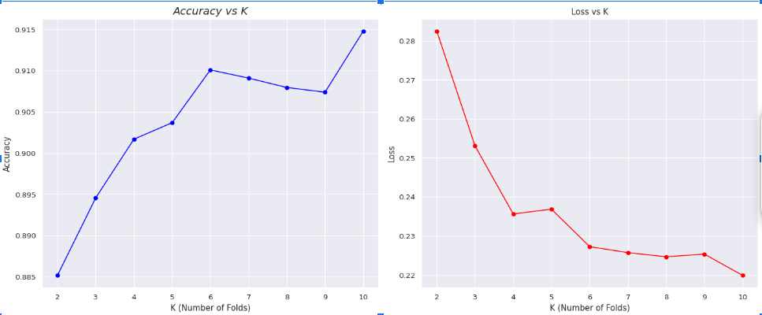
K-Fold Cross Valiidation
We used K-Fold Cross Validation to get the best K for Hyperparameter tuning.
We ran the K-Fold Cross Validation Algorithm for k=2 to 10 and recorded the accuracy and loss for each. The k with better accuracy and loss is chosen for Extracting Important features from dataset and for hyperparameter Tuning. . We have used XGboost as it is faster and more efficient.
Hyperparameter Tuining
After Getting the best K , we used it for Extracting Important Features(Using XGboost Model) which can be used for Hyperparameter tuning. We are doing this because doing hyperparameter tuning on entire dataset features will take a long time. So to make it Faster we are doing this.
After Extracting Important features, for getting the best hyperparameter for training the model using SVM we split the dataset into half and did RandomSearchCv on 50% of data to train Faster

Slide 15
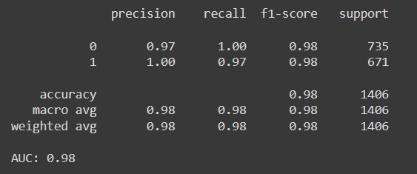
Model Training
For Taining Our model We splitted the Dataset into 80% training and 20% test data. We then Trained our model using SVM(Support Vector Machine).
SVM is preferred because it handles high-dimensional data efficiently, making it suitable for datasets with a large number of features. It performs well with both linear and non-linear separations using kernel functions, allowing flexibility in decision boundaries. SVM excels when there’s a clear margin of separation between classes, minimizes overfitting, and is robust to outliers by maximizing the margin between the decision boundary and the closest data points (support vectors). Its ability to manage high-dimensional spaces makes it ideal for complex datasets.
SVM’s Hyperparamters are found using RandomSearchCV.
We then Tested our model on Our 20% Test Dataset and printed classification Report.
We got Accuracy of 98% and F1 score as 0.98 i.e 98% on our Test Dataset.

Slide 16

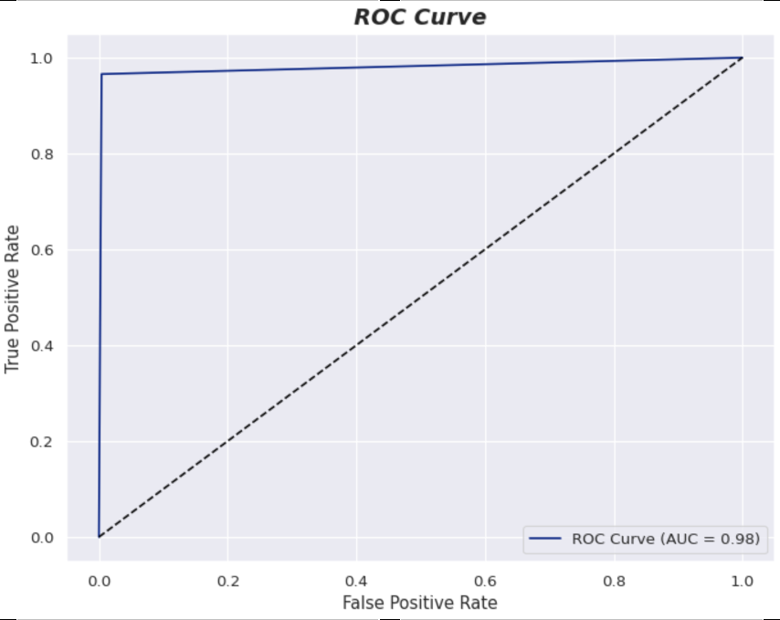
Performance of Model
For Checking Overfittng we calculated the F1 score for both Training set and Test Set and their diiference came 0.019667. This Small difference indicates that the model has learned the data patterns well without over-relying on specific training instances. Thus as F1 score in both cases remain high, it shows that our model is performaing well and there is no overfitting.
The ROC curve is a graphical representation used to evaluate the performance of a binary classifier.
The AUC (Area Under the Curve) quantifies the overall ability of the model to distinguish between the positive and negative classes.
In our case the ROC curve AUC came 0.98 indicating excellent model performance.

Slide 17
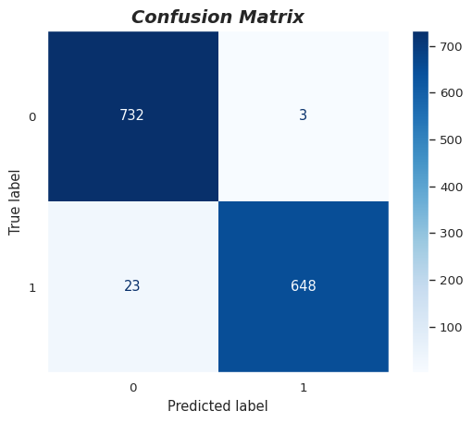
CONFUSION MATRIX
A confusion matrix is a table used to evaluate the performance of a classification model by comparing its predictions to the actual values. It provides detailed insights into the types of errors the model makes.
From The Confusion Matrix we can tell that our
model 732 outputs as False which are actually False.
Models predict 648 output as True which are actually True.
Model predicts 23 outputs as False which are Actually True and
Predicts 3 outputs as True which are actually False.
Overall we can see our model is performing well on the Test dataset.

Slide 18
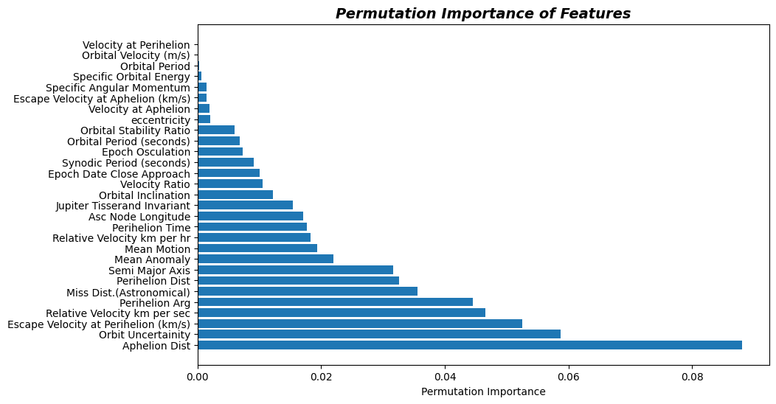
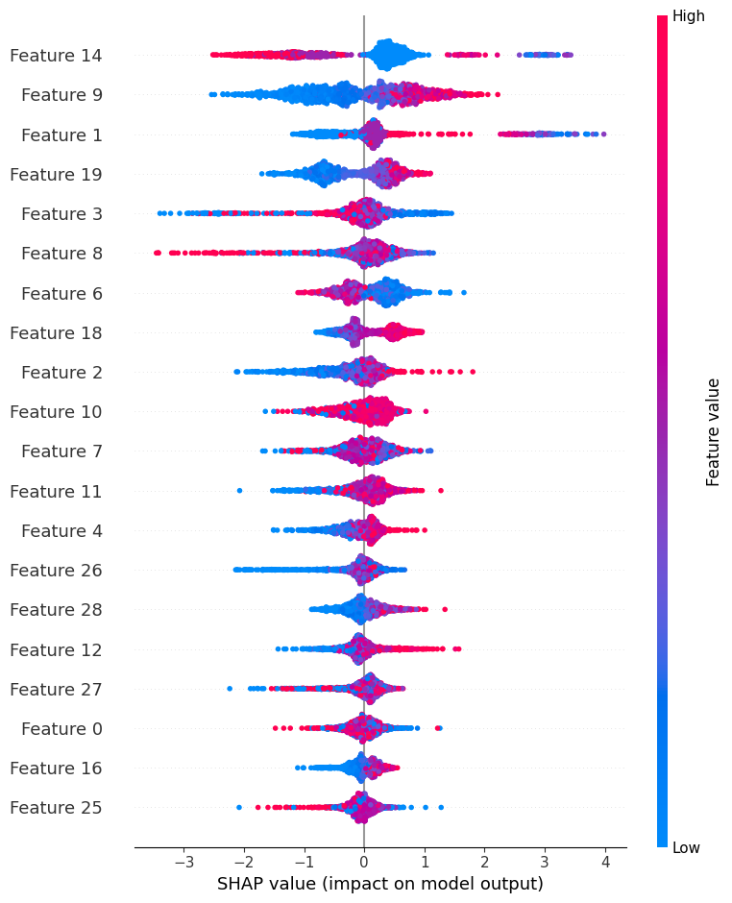
Importance of Feature in Prediction
Permutation Importance measures Important features by randomly shuffling a particular Feature keeping other features fixed and observing performance of the model. If performance changes a lot it means that feature is important.
SHAP calculates the importance of a feature by evaluating how much the model's prediction would change if that feature were removed or its value was changed.Higher absolute SHAP values indicate that the feature has a larger impact on the model's output.

Slide 19
ANOMALY DETECTION
Library based Implementation
Algorithm Selection:
Isolation Forest: Efficiently detects anomalies by isolating data points through random partitions.
Reason for Choosing Isolation Forest:Isolation Forest was chosen for its efficiency in detecting anomalies by isolating data points through random partitions, making it well-suited for high-dimensional datasets.
Parameter Tuning:
Contamination: Set to 0.08 (8% expected anomalies based on tuning).
n_estimators: Set to 100 for improved accuracy
Application:
Model Fitting:Fitted on training data (excluding target labels) to learn patterns without bias.
Anomaly Scoring:Assigned scores to data points, indicating anomaly likelihood (higher scores = higher likelihood).
Result Interpretation:Algorithm assigns -1 if it is predicted as anomaly and 1 if it is predicted as not anomaly.
Total Number of Anomalies Detected:
337

Slide 20
ANOMALY DETECTION
Z-Score based Implementation
Algorithm Selection:
Z-Score : A custom Z-Score-based method was employed to identify anomalies based on how many standard deviations a data point is from the mean.
Reason for Z-Score Algorithm:Chosen for its simplicity, interpretability, efficiency, and effectiveness in detecting outliers in normally distributed data, making it a reliable baseline for comparison with more complex algorithms.
Parameter Tuning:
Threshold: Set at 4 standard deviations. Data points with an absolute Z-Score greater than this threshold are flagged as anomalies. This threshold can be adjusted based on data distribution.
Application:
Calculated the Z-Score for each feature using the formula: Z=(Xi−μ)/σ​, where Xi​ is the data point, μ is the mean, and σ is the standard deviation of that certain feature.
Flagged anomalies if ∣Z∣>4 .
Total Number of Anomalies Detected:
178

Slide 21
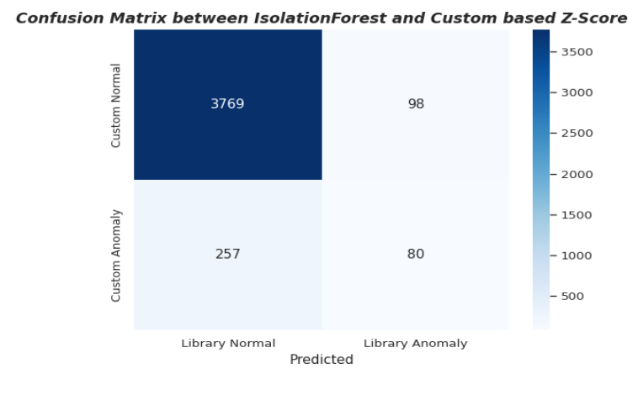
COMPARISION BETWEEN LIBRARY & Z-SCORE APPROACHES
Anomalies Detected by Individual Algorithms:
Isolation Forest: Detected 337 anomalies.
Custom Z-Score Method: Detected 178 anomalies.
Key Insight: This difference can be attributed to the Isolation Forest’s capability to effectively capture anomalies in multi-dimensional datasets, whereas the Z-Score method primarily identifies statistical outliers based on deviations from the mean.
Combined Anomaly Detection Results:
80 anomalies were flagged by both algorithms.
Analysis: The overlap in detected anomalies (80) highlights the strengths of both methods.
Confusion Matrix Analysis:
To further evaluate the performance of both algorithms, a Confusion Matrix was plotted, illustrating the overlap and discrepancies between the anomalies detected by the two methods. This matrix provides insights into how well the algorithms complement each other in identifying outliers.

Slide 22
THANK YOU

