Slide 1
Implementation of face recognition
By
Sai Prajwal Kotamraju

Slide 2
Contents
ROS package used
Package organisation
Necessary changes to be made in package
Steps for executing face recognition
Issues and possible improvements

Slide 3
ROS Package used
For a successful implementation of face recognition, selection of a package from a pool of available open source packages is necessary. face_recognition is the open source ROS package we have used to detect and recognize the faces in a video.
Reference Link: http://wiki.ros.org/face_recognition
ReadMe file, submitted as a part of final assignment, has the necessary instructions to clone the package and to make it functional.

Slide 4
Package Organization
By following the instructions in ReadMe file, you would be able to clone the face_recognition package into your Catkin workspace.
Once you have the package downloaded, catkin_make the catkin workspace to generate executable files.
It is always a good practice to know the file hierarchy of a package. This way, project execution will be easy. There are three main folders in this package-
Procob_functional
Data
Src

Slide 5
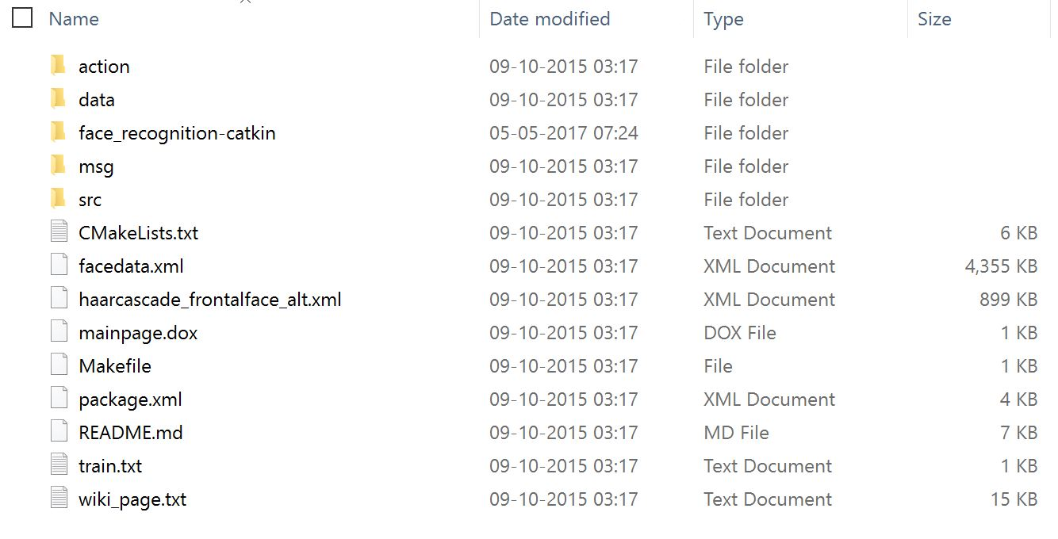
Package Organization continued...
Catkin_ws → src → procob_functional
← Procob_functional

Slide 6
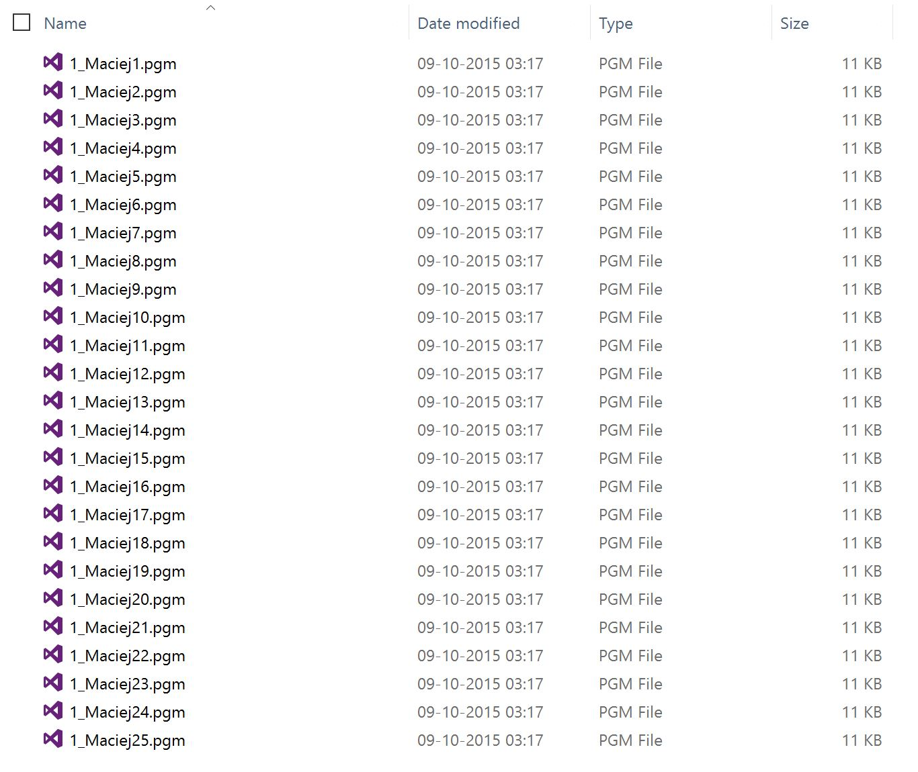
Package Organization continued...
Catkin_ws → src → procob_functional → data

Slide 7
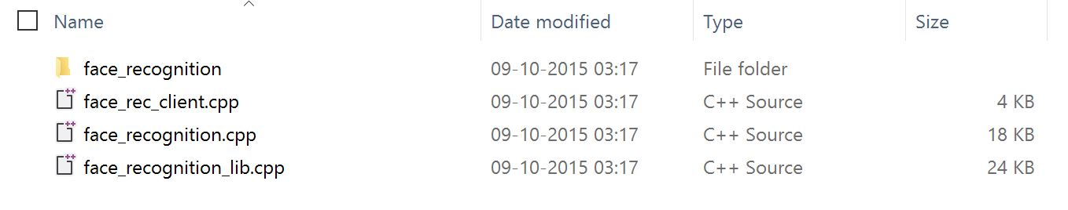
Package Organization continued...
Catkin_ws → src → procob_functional → src

Slide 8
Necessary changes to be made in the package
In face_recognition.cpp code file
Make sure to change the confidence score. The initial confidence score would be 0.88. But in real-time, it’s better to keep it about 0.72~0.75
Change the image topic you’re subscribing to. Remove the default topic and replace it with /astra_usb_cam/image_raw topic.
In procob_functional folder
Add gray scale images of your face into data folder in the format mentioned in ReadMe. Note that images should be of size 120x90. (You can also create database images while running the executable file.)
If new faces are added into database, make sure you delete the facedata.xml file and rerun the Face recognition so that a new facedata.xml file is created.

Slide 9
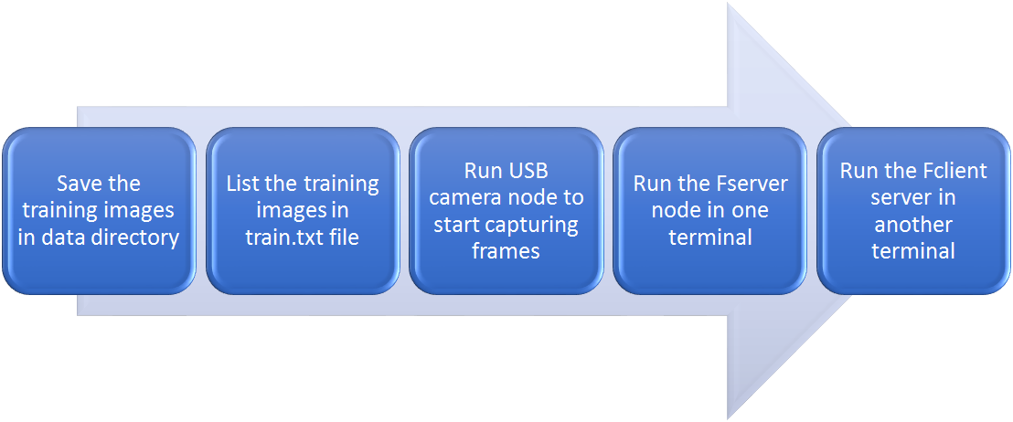
Steps for executing face recognition
Note: A clear set of step-by-step instructions are provided in ReadMe file

Slide 10
Issues and possible improvements
Issues faced
One of the major issues we faced is to publish a string whenever a face is recognized. This is mainly because of the structure of the face_recognition.cpp code file.
Although the face recognition is working fine in low light conditions, it is highly dependent upon the face’s orientation. When we tried recreating our database with different face orientations, we realised that haar face cascade isn’t detecting an inclined face in the first place.
Possible improvements
A better face detection algorithm, which is capable of detecting inclined faces, can be used rather than haar face cascade. This way, the accuracy of face recognition can be increased by a good amount.
Preprocessing the image before passing it on to face detection module will be good idea. In this way, local contrast can be stretched beforehand and problem of low light condition can be avoided.

Slide 11
Summary of all I learned from this course
To start with, I got used to Linux environment by doing multiple assignments for this course. Previously, I had minimal knowledge working on Linux based operating system.
I got a very good idea on ROS packages, topics, nodes, publishing to a topic and subscribing to a topic. These helped me in understanding the communication between nodes. Also, I’m very confident that I will be able to apply these concepts to either simulate or implement a real-time robotic application using turtlebot.
As far as computer vision applications are concerned, I was able to apply the concepts of eigen faces and haar-cascades in real-time. Also, as a part of assignment 2, I had to work on depth images where I had to filter the image and apply a few processing techniques I learned from EEE508 course.

Slide 12
References
http://docs.opencv.org/2.4/modules/contrib/doc/facerec/facerec_tutorial.html
http://docs.opencv.org/trunk/d7/d8b/tutorial_py_face_detection.html
http://wiki.ros.org/ROS/Tutorials
http://wiki.ros.org/face_recognition

