Slide 1
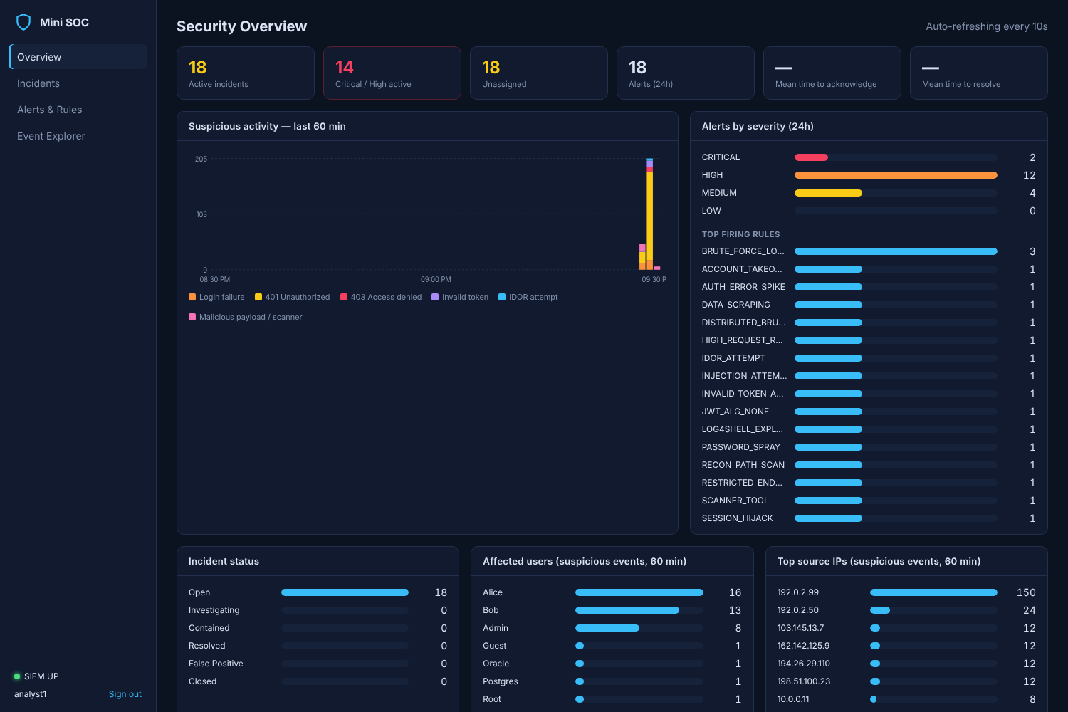
Mini SOC
A miniature Security Operations Center that watches a web application, catches attacks as they happen and helps analysts respond.
Java & Spring Boot · OpenSearch · React · Docker
The live SOC dashboard
Sai Prakash
Notes:
[0:30] Hello everyone. Today I'll walk you through Mini SOC: a small but complete Security Operations Center I built. In about 15 minutes you'll see why it exists, how it is built, what happens when it is attacked, and what an analyst does next. No security background needed - I'll keep the technical parts light.

Slide 2



Why build a mini SOC?
Every online service is attacked constantly - the hard part is noticing in time and responding well
The problem
What a SOC does
What this project shows
Logins are guessed, tokens stolen and APIs scanned - hidden among millions of normal requests.
A Security Operations Center collects logs, detects suspicious patterns and runs incident response.
The complete loop on one laptop: a real app, live detection, an incident workflow and a dashboard.
What you learn from it
Application security
Centralised logging
Threat detection
Incident response
Docker
Notes:
[1:00] Any website with a login gets attacked every day: passwords are guessed, tokens are stolen, APIs are scanned. These attacks hide inside millions of normal requests. Companies run a Security Operations Center - a SOC - to collect logs, spot suspicious patterns and handle incidents. Real SOC tools are big and expensive, so this project rebuilds the whole loop at small scale, on one laptop, so it can be learned, demonstrated and extended.

Slide 3




Who uses it
Four kinds of actors - each gets only the access it needs
Customers
Administrator
alice, bob
admin
Log in, view their own profile and orders, place new orders
Everything a customer can do, plus all orders, the user list and admin tools
SOC analysts
Attackers (simulated)
analyst1, lead
botnets, scanners, insiders
Sign in to the dashboard; triage, investigate and resolve incidents
Generated by six attack simulators to show every detection live
Machines are limited too: the detection engine uses an API key and can open incidents, never close them.
Notes:
[0:45] There are four kinds of users. Customers like alice and bob can log in and see only their own orders. The administrator can see everything and use admin tools. SOC analysts never use the shop - they sign in to the dashboard to investigate and resolve incidents. And there are attackers, which I simulate with scripts. Even the machines have limited rights: the detection engine may open incidents, but it can never close one.

Slide 4





The SOC loop in five steps
From a suspicious request to an incident on screen in under 20 seconds
1. Use
2. Record
3. Collect
4. Detect
5. Respond
The web app receives logins and API calls
Every security event becomes one log line
Logs are shipped into a search engine
16 rules look for attack patterns every 15 s
An incident opens; an analyst investigates
< 20 s
16
8
from attack to incident
detection rules
containers, one command
Notes:
[1:00] This is the whole idea on one slide. One: people use the application. Two: everything security-related is written down as a log line - who, from where, what happened. Three: those lines are collected into a search engine. Four: every 15 seconds, sixteen detection rules look for attack patterns. Five: when a rule matches, an incident is opened and an analyst responds. The whole trip takes less than 20 seconds.

Slide 5
Architecture
Seven building blocks on one private network - only two doors open to the outside
Docker Compose - private network
Users
Target app
logs
Fluent Bit
ship
OpenSearch
customers and attackers
Spring Boot - port 8080
the app being protected
collects the log lines
stores & searches events
(the SIEM)
search
SOC analyst
Dashboard
API
Incident tracker
alerts
Detection service
web browser
React + nginx - port 3000
Spring Boot
cases, notes, history
Spring Boot
16 rules every 15 s
SQL
PostgreSQL
incident database
API
Notes:
[1:30] Here is the architecture. On the left, users and attackers reach the target application on port 8080. The application writes its security log to a file; Fluent Bit picks it up and ships it into OpenSearch, our search engine. The detection service searches OpenSearch every 15 seconds; when a rule matches it sends the alert to the incident tracker, which stores cases in PostgreSQL. Analysts use the dashboard on port 3000, which talks to both services. Everything inside the dotted line runs in Docker on a private network - only ports 8080 and 3000 are exposed.

Slide 6







What each technology does
Mainstream, free, open-source tools - each chosen for one clear job
Java 21 + Spring Boot
Spring Security + JWT
Fluent Bit
Builds the three backend services
Logins, tokens and who may do what
Picks up log lines and ships them
OpenSearch
PostgreSQL
React + Vite
Stores and searches every event - the SIEM
Keeps incidents, notes and history safe
The analyst dashboard in the browser
nginx
Docker Compose
Python
Serves the dashboard and forwards API calls
Starts all 8 containers with one command
Six realistic attack simulators
Notes:
[1:00] Every tool here is free and widely used in industry. Java with Spring Boot builds the three backend services; Spring Security and JWT tokens handle logins and permissions. Fluent Bit ships logs, OpenSearch stores and searches them - that is the SIEM part. PostgreSQL keeps the incident records. The dashboard is React, served by nginx. Docker Compose starts all of it with one command, and Python drives the attack simulators.

Slide 7


Three backend services, one job each
They talk through simple web APIs (REST) inside a private Docker network
Target app
Detection service
Incident tracker
port 8080 - the protected app
port 8082 - the detective
port 8081 - the case file
Login with signed tokens (JWT)
Orders, users and admin APIs
Blocks attack payloads
Writes a log line for every event
16 rules, checked every 15 s
Saves every alert
Avoids duplicate alerts
Retries if the tracker is down
Incidents, owners and status
Investigation notes
Full audit history
Statistics for the dashboard
Writes to: log file > Fluent Bit
Talks to: OpenSearch, incident tracker
Talks to: PostgreSQL
OpenSearch search engine for events and alerts
PostgreSQL database for incidents and history
Notes:
[1:15] The backend is three small Spring Boot services. The target app is the thing being protected - an online-shop style API with logins, orders and admin pages. It blocks obvious attack payloads and writes a security log line for everything. The detection service is the detective: it runs the rules against OpenSearch and turns matches into alerts. The incident tracker is the case file: it stores incidents in PostgreSQL with assignment, status, notes and a full audit history. They talk over HTTP: the detection service uses a secret API key to open incidents, and the tracker uses a normal database connection with versioned schema migrations.

Slide 8
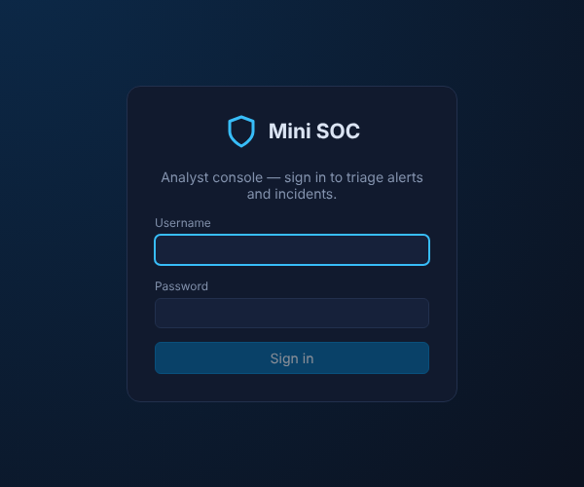



How the dashboard is built
A React single-page app, served by nginx, that refreshes itself every 10-15 seconds
React 18 + Vite
a fast single-page app with five screens
Always live
polls both services every 10-15 seconds
Analyst sign-in
signs out automatically when access ends
Light by design
hand-made charts, no heavy libraries
nginx in front
one address: /tracker and /detection are forwarded
Overview
Incidents
Alerts & Rules
Event Explorer
Notes:
[0:45] The dashboard is a React single-page application built with Vite. Analysts sign in with their own account; the browser then calls the two backend services every 10 to 15 seconds, so the screens are always live. nginx serves the page and forwards API calls on the same address, so no extra ports are opened. The charts are hand-made, so the app is light and fast.

Slide 9
The journey of one request
Every request is checked, answered and written down - in milliseconds
1
Arrives at the target app on port 8080
One recorded event
{
"event_type": "LOGIN_FAILURE",
"username": "alice",
"source_ip": "203.0.113.66",
"outcome": "FAILURE",
"reason": "bad password",
"correlation_id": "8f0c2c1e...",
"@timestamp": "10:15:42.318Z"
}
2
Tagged gets a tracking ID and the caller's IP
3
Inspected attack patterns are blocked (SQL injection, Log4Shell...)
4
Verified token checked: who are you, and are you allowed?
5
Answered success, or a 401 / 403 / 400 error
who, from where, what happened, when
6
Recorded one log line, searchable in about 5 seconds
Notes:
[1:00] Let's follow a single request. It arrives at the target app and immediately gets a tracking number - a correlation ID - plus the caller's IP address. Next it is inspected for known attack patterns such as SQL injection or Log4Shell; those are blocked straight away. Then the login token is checked: who are you, and are you allowed to do this? The app answers - success, or a 401, 403 or 400 error - and finally writes one structured log line. Within about five seconds that line is searchable in OpenSearch. The box on the right is a real example of such a line.

Slide 10
What happens during an attack
Live example: simulator 1 - a credential-stuffing botnet
0 s
+2 s
+3 s
+5 s
≤ 15 s
≤ 20 s
Botnet tries alice's account from 7 different IPs
One bot replays 12 leaked passwords - admin's reused password works
Attacker downloads every order 45 times
All of it is already searchable in OpenSearch
Five detection rules fire
Five incidents with evidence appear on the dashboard
Rules that fire
Account takeover
Distributed brute force
Brute-force login
Password spray
Data scraping
Critical = red, high = orange
Notes:
[1:15] Now the interesting part - an attack. This is simulator 1, a credential-stuffing botnet. At second zero, seven different IP addresses each try a leaked password on alice's account. Then one bot works through a list of twelve leaked username and password pairs - and the admin's reused password works. The attacker immediately downloads all orders forty-five times. Every one of those steps is already in OpenSearch about five seconds later. On the next 15-second check, five rules fire at once, including a critical 'account takeover'. Within roughly twenty seconds, five incidents with full evidence are on the analyst's dashboard.

Slide 11






Six attack simulators
Each plays a different attacker - run any one and watch the dashboard react
1 Credential stuffing
2 Vulnerability scanner
3 Malicious insider
Botnet with leaked passwords: account takeover and data theft
Hidden-file discovery, injection fuzzing, 120+ requests
An employee probing admin pages and other customers' data
4 Session hijack
5 Log4Shell campaign
6 DDoS flood
A stolen login token reused from Tor exits, then forged
Exploit bots spraying the famous Log4j attack
Four hosts sending 640 requests at once
Run one: docker compose run --rm attacker 1_credential_stuffing.py
Notes:
[0:45] Simulator one is just one of six. Each one plays a different kind of attacker: a vulnerability scanner sweeping for hidden files and injection holes, a malicious insider abusing their own access, a thief replaying a stolen login token, bots trying the famous Log4Shell exploit, and a flood of traffic like a small DDoS. Each uses fresh random IP addresses, so every run creates new incidents. Running one is a single command, shown at the bottom.

Slide 12
The dashboard: the whole picture at a glance
Refreshes every 10 seconds - after the simulators, every one of the 16 rules has fired
1
Headline numbers
active, critical, unassigned, time to acknowledge / resolve
1
2
3
2
Live activity
suspicious events per minute, by type
3
Alerts by severity
and which rules fired most
4
Who and where
targeted accounts and attacking IPs
4
Notes:
[1:00] This is the overview screen right after running the simulators. One: the headline numbers - active incidents, how many are critical or high, how many nobody has picked up yet, and how fast the team acknowledges and resolves. Two: a live chart of suspicious activity over the last hour, colour-coded by type. Three: alerts by severity and which rules fired most. Four: which user accounts were targeted and which IP addresses attacked. Below the fold are the open incidents and the latest suspicious events.

Slide 13
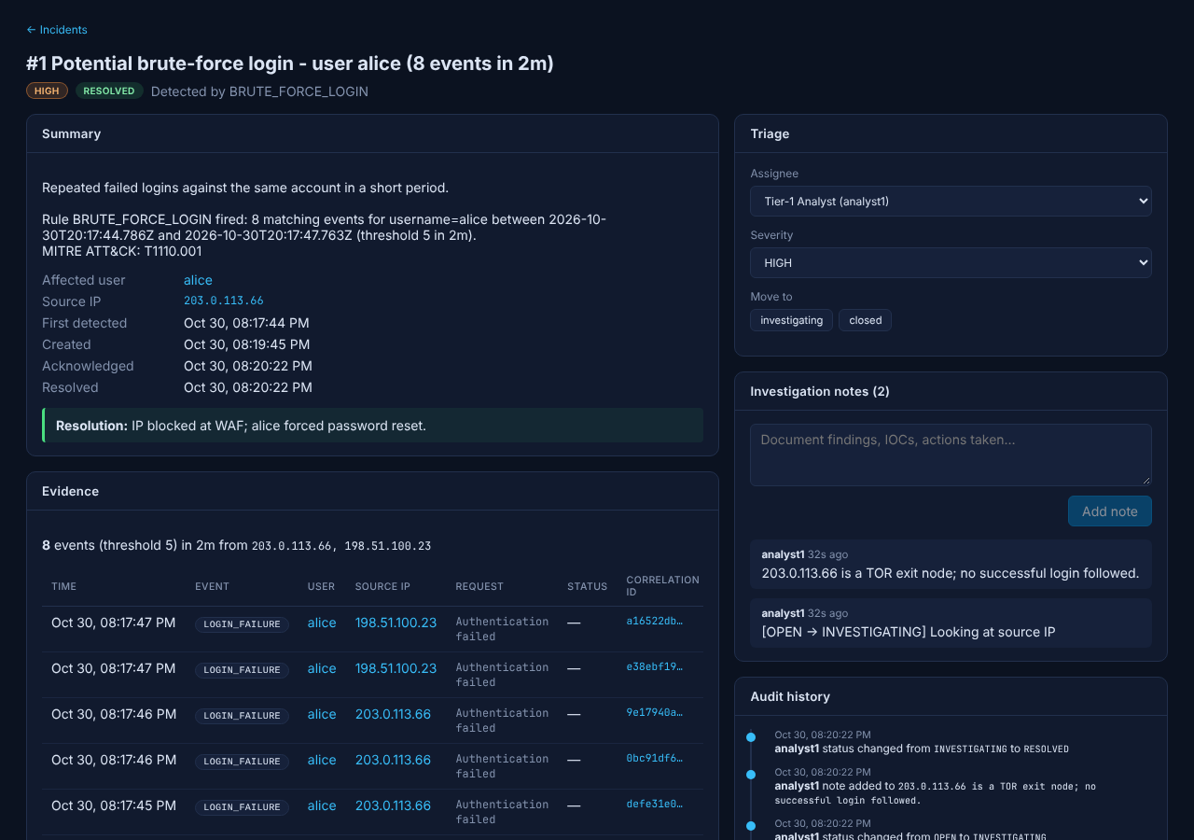
After detection: investigate and respond
Each alert becomes a case that one analyst owns from start to finish
Open
Evidence
events, IPs, timeline
Assign
Notes
findings as you go
Investigate
Resolution
summary required
Resolve
Audit trail
who, what, when
Close
Typical response
Block IP
Reset password
Revoke tokens
Notes:
[1:15] Detection is only half the job. Each alert becomes an incident - a case. The analyst assigns it to themselves, then investigates: the incident shows the evidence events, the attacker's IP and the victim's full timeline. They write notes as they go, contain the threat, and to resolve the case they must write a resolution summary - the system will not accept 'resolved' without one. Every change is kept in an audit history. In real life the actions are things like blocking the IP, resetting the password and revoking stolen tokens. Repeat attacks are added to the same open case instead of creating duplicates.

Slide 14
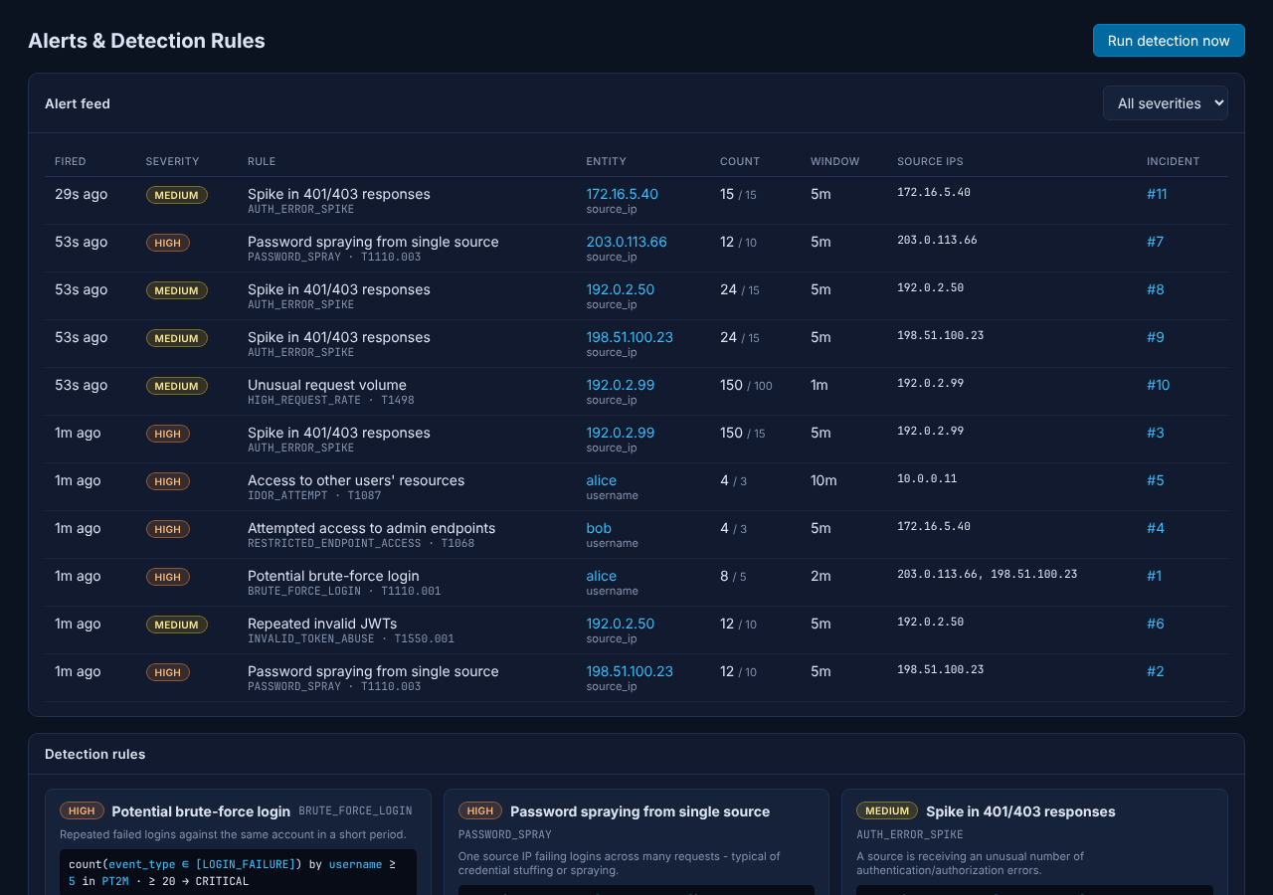
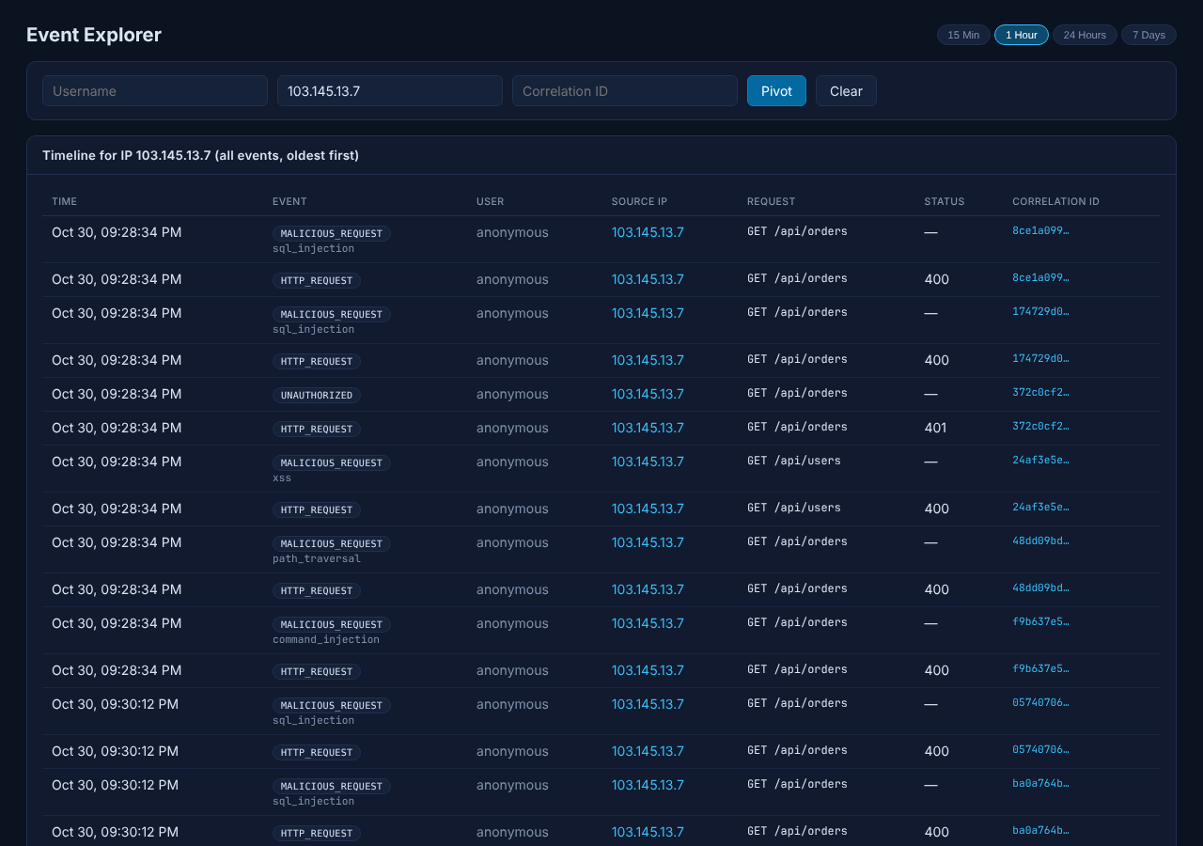
Digging deeper: alerts and events
From "something fired" to "exactly what happened" in two clicks
Alerts & Rules every alert, its rule and its incident
Event Explorer pivot on a user, IP or request ID
Notes:
[0:30] Two more screens for digging deeper. On the left, the alert feed: every alert, which rule fired, how many events, and a link to its incident. Below it, every rule with its live status. On the right, the event explorer: type in a user, an IP or a tracking ID and see every single event, here every blocked attack payload from one attacker, labelled by type.

Slide 15
Dockerised: one command runs everything
Eight containers on a private network - start, stop and reset in seconds
1
Create secrets once
8 containers
powershell -File scripts\generate-env.ps1
2
Build and start
Target app
Fluent Bit
docker compose up -d --build
OpenSearch
OpenSearch init
3
Open the dashboard
Detection service
Incident tracker
http://localhost:3000
PostgreSQL
Dashboard (nginx)
4
Stop (keep data)
docker compose down
Started in order by health checks. Only ports 8080 and 3000 are opened. Data survives restarts.
Notes:
[0:45] Everything runs in Docker, so it works the same on any laptop - Windows, Mac or Linux. You generate the secrets once (on Windows add -ExecutionPolicy Bypass if PowerShell blocks the script; on Mac or Linux use generate-env.sh), run docker compose up, and open the dashboard on localhost port 3000. Health checks start the containers in the right order - for example the tracker waits for the database. Data is kept between restarts; 'down' stops everything and 'down -v' wipes it for a fresh start.

Slide 16

Takeaways and what's next
A complete SOC loop
log, detect, investigate, resolve - end to end
What could come next
Automatic response: block IPs, revoke tokens
Alerts to Slack, Teams or email
Single sign-on and MFA for analysts
Cloud deployment with HTTPS
Anomaly detection with machine learning
Security built in
signed tokens, roles, attack filtering, audit trail
Reproducible
one command to run, six attacks to demo
Thank you - questions?
github.com/SaiPrakashBV/Mini-SOC-Project
Notes:
[0:45] To sum up: this is a complete SOC loop - logging, detection, investigation and resolution - with security built into the application itself, and it is fully reproducible with one command. Natural next steps would be automatic responses such as blocking an IP, sending alerts to Slack or email, single sign-on for analysts, a cloud deployment with HTTPS, and smarter anomaly detection. Thank you - I'm happy to take questions, or to run one of the simulators live.

