Slide 1
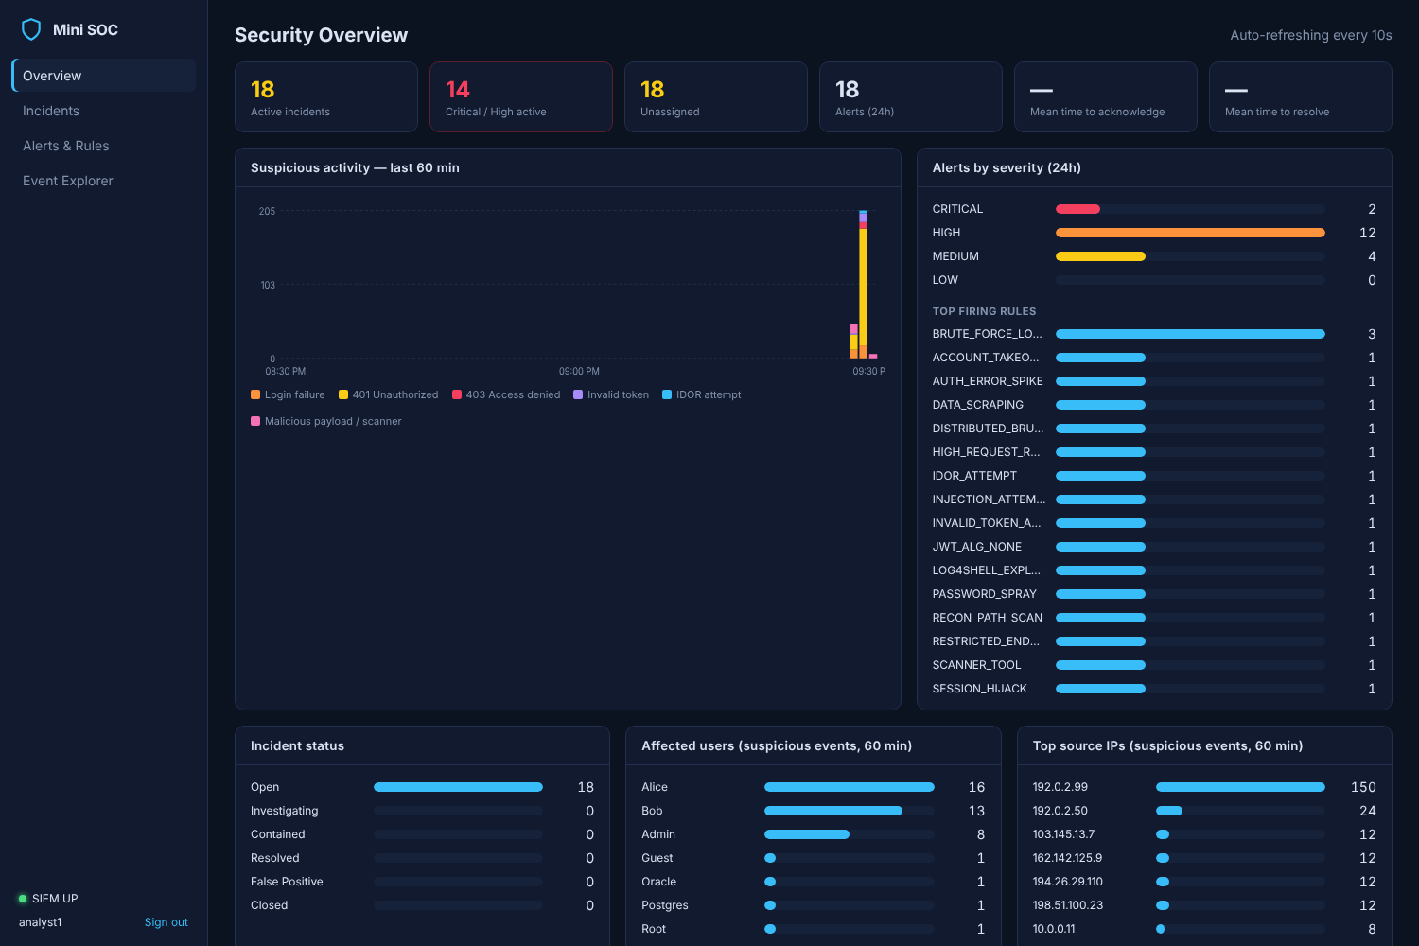
Mini Security Operations Center (SIEM)
Design and implementation of a log-driven threat detection and incident management platform
Spring Boot · Spring Security & JWT · Fluent Bit · OpenSearch · PostgreSQL · React · Docker Compose
SOC dashboard after an attack simulation
Sai Prakash
Notes:
[0:30] Good morning. This presentation covers the Mini Security Operations Center, a SIEM-style platform I designed and implemented. I will cover the problem it addresses, its architecture, the backend and security implementation, the detection pipeline, incident management, deployment, testing and a demonstration.

Slide 2




Project overview
1 · PROJECT INTRODUCTION
A complete detection-and-response loop, from an instrumented application to an incident workflow
Monitored application
Spring Boot API emitting structured security audit events
3
16
Spring Boot services
detection rules
SIEM pipeline
Fluent Bit collection, OpenSearch storage and search
10
8
Detection & response
Rule engine raises alerts; incident tracker manages cases
security event types
Docker containers
24
< 20 s
Analyst dashboard
React SPA with live metrics, triage and investigation
automated tests
attack-to-incident latency
Notes:
[1:15] The platform has four parts. A Spring Boot application is the monitored system and emits structured security events. Fluent Bit and OpenSearch form the SIEM layer for collection and search. A detection service evaluates sixteen rules and raises alerts, and an incident tracker manages the response. A React dashboard gives analysts real-time visibility. The figures on the right summarise the scope: three Spring Boot services, sixteen rules, ten event types, eight containers and twenty-four automated tests.

Slide 3


Problem statement and objectives
2 · PROBLEM STATEMENT AND OBJECTIVES
Attacks are only actionable if they are recorded, correlated, detected and tracked to resolution
Problem statement
Objectives
Attacks such as credential stuffing, token theft and injection are hidden in high-volume application traffic
Unstructured, local logs cannot be correlated across requests, users and source IPs
Detections without a managed workflow are not assigned, investigated or resolved
1
Instrument the application with structured security events
2
Centralise events in a searchable SIEM store
3
Detect attack patterns with configurable rules
4
Manage incidents through an auditable workflow
5
Deploy reproducibly with Docker Compose
Notes:
[1:15] The problem has three parts. Attacks such as credential stuffing, token theft and injection are hidden inside normal traffic. Without structured, centralised logs, related events cannot be correlated across requests and sources. And a detection that is not managed through a workflow is easily lost. The objectives map directly to those gaps: instrument the application, centralise its events, detect patterns with configurable rules, manage incidents with an auditable workflow, and make the whole system reproducible with Docker.

Slide 4
Technology stack
3 · TECHNOLOGY STACK
Open-source, industry-standard components, each selected for a single responsibility
Layer | Technologies | Purpose
Backend services | Java 21, Spring Boot 3.3.5, Spring Web, Spring Data JPA | REST services, business logic, persistence
Security | Spring Security 6, JWT (jjwt 0.12.6, HS256), BCrypt | Authentication, role-based access, token validation
Logging & SIEM | Logback + Logstash JSON encoder, Fluent Bit 3.1, OpenSearch 2.17 | Structured events, log shipping, search and aggregation
Data | PostgreSQL 16, Hibernate, Flyway | Incident persistence and versioned schema migrations
Frontend | React 18, Vite 5, React Router 6, nginx 1.27 | Analyst dashboard and reverse proxy
DevOps & testing | Docker Compose, multi-stage Dockerfiles, JUnit 5, MockMvc, H2, Python 3 | Deployment, automated tests, attack simulation
Notes:
[1:30] The stack is organised by layer. The three backend services use Java 21 and Spring Boot 3.3. Security is Spring Security with HS256-signed JWTs and BCrypt password hashing. Logging uses Logback with a JSON encoder, Fluent Bit for shipping and OpenSearch 2.17 for storage and aggregation queries. Incidents are stored in PostgreSQL 16 with Flyway migrations. The dashboard is React 18 built with Vite and served by nginx. Everything is deployed with Docker Compose, tested with JUnit 5 and MockMvc, and exercised with Python attack simulators.

Slide 5
High-level system architecture
4 · HIGH-LEVEL SYSTEM ARCHITECTURE
Seven services on a private Docker network; only the application (8080) and dashboard (3000) are published
Docker Compose network: mini-soc-net
Clients
target-app
JSON log
fluent-bit
_bulk
OpenSearch
users, attack simulators
Spring Boot :8080
JWT, RBAC, WAF filter
tail + filter + ship
security-events-*
soc-alerts
_search
SOC analyst
frontend
/tracker
incident-tracker
API key
detection-service
web browser
React SPA, nginx :3000
Spring Boot :8081
incident REST API
Spring Boot :8082
16 rules / 15 s
JDBC
PostgreSQL
incidents schema
/detection (HTTP Basic)
Notes:
[2:00] Requests reach the target application on port 8080. It writes JSON security events to a log file on a shared volume. Fluent Bit tails that file and bulk-indexes events into OpenSearch. The detection service runs aggregation queries every fifteen seconds; matches are stored as alerts and posted to the incident tracker using an API key. The tracker persists incidents in PostgreSQL over JDBC. Analysts use the dashboard on port 3000, where nginx proxies API calls to the tracker and the detection service with HTTP Basic authentication. Only ports 8080 and 3000 are exposed; OpenSearch is bound to localhost for debugging.

Slide 6
Components and responsibilities
5 · APPLICATION COMPONENTS
Each container has one responsibility and a single, well-defined interface
Component | Responsibility | Interface
target-app | Monitored API (auth, orders, admin); WAF filter; emits security events | REST :8080 (published)
fluent-bit | Tails app.json, filters audit events, ships to OpenSearch | file volume → HTTP _bulk
opensearch + init | Stores security-events-* and soc-alerts; templates, 14-day retention | REST :9200 (localhost only)
detection-service | Evaluates 16 rules every 15 s; stores alerts; opens incidents | REST :8082 (internal)
incident-tracker | Incident lifecycle, assignment, notes, audit history, statistics | REST :8081 (internal)
postgres | Durable incident storage (Flyway-managed schema) | JDBC :5432 (internal)
frontend | React dashboard; nginx proxy for /tracker and /detection | HTTP :3000 (published)
Notes:
[1:15] This table maps every component to its responsibility and interface. Note the separation: the target application only writes a file and never calls the SIEM directly, so it keeps running if the monitoring side is unavailable. OpenSearch holds events and alerts, PostgreSQL holds incidents, and only the application and the dashboard publish ports to the host.

Slide 7








End-to-end application workflow
6 · END-TO-END WORKFLOW
From an HTTP request to a resolved incident, typically within 20 seconds
1
2
3
4
HTTP request
Security filters
Audit event
Collection
client calls target-app
correlation ID, WAF, JWT, RBAC
one JSON line per event
Fluent Bit → OpenSearch
≈ 5 s
8
7
6
5
Response
Incident
Alert
Rule evaluation
triage, notes, resolution
created or de-duplicated
stored in soc-alerts
aggregations every 15 s
≤ 15 s detection cycle · < 20 s end to end
Notes:
[1:45] This is the complete workflow. A request passes through the security filters - correlation ID, WAF, JWT validation and authorisation - and is answered. One structured audit event is written for it, and Fluent Bit makes it searchable in OpenSearch within about five seconds. On the next detection cycle, at most fifteen seconds later, matching rules produce alerts, which are stored and posted to the tracker. The tracker either opens an incident or folds the detection into an open incident with the same fingerprint. Finally, the analyst triages and resolves it in the dashboard.

Slide 8
Spring Boot backend architecture
7 · SPRING BOOT BACKEND
Three independent services with the same layered structure and shared conventions
target-app
incident-tracker
detection-service
web Auth, User, Order, Admin controllers
web IncidentController, AnalystController
web DetectionController, EventQueryService
security JWT service & filter, WAF filter, 401/403 handlers
service IncidentService, IncidentStatsService
engine DetectionEngine, SuppressionCache, IncidentForwarder
logging correlation filter, SecurityEventLogger
repository Spring Data JPA + Specifications
rules RuleDefinition, ThresholdRuleQuery
service UserDirectory, OrderService
domain Incident, IncidentNote, IncidentHistory
opensearch OpenSearchClient (RestClient)
config SecurityConfig, typed properties
config Basic auth + API-key filter
config rule binding, HTTP clients, security
Java 21 records
Bean Validation
RFC 7807 errors
Actuator health
Env-based secrets
Notes:
[1:30] All three services follow the same layered design. Controllers in the web package handle HTTP, validation and paging. Services contain the business rules and transaction boundaries. The tracker adds Spring Data repositories and JPA entities; the detection service has a rules package and a thin OpenSearch client instead of a database. Shared conventions include Java records for DTOs and configuration, Bean Validation, RFC 7807 problem responses, Actuator health checks for Docker, and secrets supplied only through environment variables.

Slide 9
Implementation: structured security events
7 · SPRING BOOT BACKEND
Security decisions are emitted as typed events with consistent fields for detection
AuthController.java (lines 42-54)
var auth = authenticationManager.authenticate(
new UsernamePasswordAuthenticationToken(username, request.password()));
UserDetails user = (UserDetails) auth.getPrincipal();
var token = jwtService.issue(user);
var roles = user.getAuthorities().stream().map(GrantedAuthority::getAuthority).toList();
events.success(SecurityEventType.LOGIN_SUCCESS, "User authenticated",
Map.of("username", username, "roles", String.join(",", roles)));
return ResponseEntity.ok(new LoginResponse(token.token(), "Bearer", token.expiresAt(), username, roles));
} catch (AuthenticationException e) {
events.failure(SecurityEventType.LOGIN_FAILURE, "Authentication failed",
Map.of("username", username, "reason", e.getClass().getSimpleName()));
return ResponseEntity.status(HttpStatus.UNAUTHORIZED)
.body(Map.of("error", "Unauthorized", "message", "Invalid username or password"));
Resulting event (one JSON line, wrapped)
10 typed event categories
MDC adds correlation_id, source_ip, token_id
Generic error prevents user enumeration
{"event_type":"LOGIN_FAILURE", "outcome":"FAILURE",
"event_category":"authentication", "username":"alice",
"source_ip":"203.0.113.66", "reason":"BadCredentialsException",
"correlation_id":"8f0c2c1e-...", "@timestamp":"...42.318Z"}
Notes:
[1:15] Here is the implementation of the login endpoint, taken directly from AuthController. On success it issues a JWT and emits LOGIN_SUCCESS; on failure it emits LOGIN_FAILURE with the targeted username and the reason, and returns a generic message so usernames cannot be enumerated. The logger adds the event category and outcome, and the request filter adds the correlation ID and source IP through the MDC. The right-hand side shows the resulting JSON line, which is exactly what the detection rules query.

Slide 10
REST APIs
8 · REST APIS
Resource-oriented endpoints with validated request bodies and consistent error responses
Service | Endpoint | Access
target-app | POST /api/auth/login | public
target-app | GET /api/users/me · GET /api/users | authenticated · ADMIN
target-app | GET | POST /api/orders · GET /api/orders/{id} | authenticated (owner check)
target-app | GET /api/admin/stats · POST /api/admin/maintenance | ADMIN
Service | Endpoint | Access
tracker | POST /api/incidents | SERVICE, ANALYST
tracker | GET /api/incidents (filters, paging) · GET /{id} | SERVICE, ANALYST
tracker | PATCH /{id}/status · /assign · /severity | ANALYST
tracker | POST /{id}/notes · GET /api/incidents/stats | ANALYST
detection | GET /api/alerts · /api/rules · POST /api/rules/run | ANALYST
detection | GET /api/events/recent · /timeline · /activity | ANALYST
Errors: RFC 7807 problem details · 400 validation · 401/403 security · 404 not found · 409 invalid state transition or concurrent update
Notes:
[1:15] The target application exposes login, users, orders and admin endpoints. The incident tracker implements the seven required operations - create, list with filters, detail, status, assignment, notes and statistics - plus a severity update. The detection service exposes alerts, rules, a manual detection trigger and event queries for the dashboard. All request bodies use Bean Validation, list endpoints are paged with clamped sizes, and errors are returned as RFC 7807 problem details.

Slide 11
Security implementation
8 · SECURITY IMPLEMENTATION
Defence in depth: every request passes an ordered filter chain before reaching a controller
RequestLogging
AttackSignature
JwtAuthentication
Authorization
Controller
correlation ID, IP
WAF → 400
HS256, issuer, expiry
roles per path
ownership checks
SecurityConfig.java (lines 38-44)
Additional controls
.authorizeHttpRequests(auth -> auth
.requestMatchers(HttpMethod.POST, "/api/auth/login").permitAll()
.requestMatchers("/actuator/health", "/actuator/info").permitAll()
.requestMatchers("/api/admin/**").hasRole("ADMIN")
.requestMatchers(HttpMethod.GET, "/api/users").hasRole("ADMIN")
.requestMatchers("/api/**").authenticated()
.anyRequest().denyAll())
BCrypt password hashing
JWT: 30-min expiry, random jti
Ownership check prevents IDOR
Constant-time API-key comparison
SERVICE role: create and read only
No stack traces in error responses
Notes:
[1:45] Security is implemented as an ordered filter chain. The request logging filter runs first and assigns the correlation ID. The attack signature filter inspects paths, parameters and headers and blocks injection payloads with HTTP 400. The JWT filter validates the signature, issuer and expiry, and Spring Security then applies role-based rules - the snippet shows the actual configuration, with deny-by-default for unknown paths. Further controls include BCrypt hashing, object-level ownership checks against IDOR, constant-time API key comparison between services, and a service role that can create but never modify incidents.

Slide 12
Log collection pipeline
9 · LOG COLLECTION AND MONITORING
Structured logs flow from the application to a searchable index without coupling the two
Logback JSON
app.json
Fluent Bit
OpenSearch
LogstashEncoder, UTC,
async appender
shared volume
target-logs
tail + grep filter,
file-buffered
security-events-
YYYY.MM.DD
fluent-bit.conf (lines 42-54)
Pipeline properties
[OUTPUT]
Name opensearch
Match app.*
Host ${OPENSEARCH_HOST}
Port ${OPENSEARCH_PORT}
tls Off
Logstash_Format On
Logstash_Prefix security-events
Logstash_DateFormat %Y.%m.%d
Read offsets persisted (tail.db): no loss or duplicates on restart
Retries indefinitely while OpenSearch is unavailable
Index template: keyword fields for exact aggregation
Event time = application timestamp (UTC)
ISM policy: 14-day retention
Notes:
[1:15] Logback writes each event as one JSON line using the Logstash encoder, to stdout and to a rotating file on a shared volume. Fluent Bit tails the file, keeps its read position in a state database, filters to audit events and warnings, and bulk-indexes into a daily OpenSearch index. The output configuration is shown here. An index template defines explicit keyword and numeric mappings so the rules can aggregate efficiently, and an ISM policy deletes indices after fourteen days.

Slide 13
Threat detection engine
9 · THREAT DETECTION
Rules are declarative YAML, translated into OpenSearch aggregation queries every 15 seconds
application.yml (lines 50-61)
1
Build query range + terms filters, terms agg by group-by
- id: BRUTE_FORCE_LOGIN
name: Potential brute-force login
description: Repeated failed logins …
severity: HIGH
window: 2m
threshold: 5
escalate-at: 20
escalate-to: CRITICAL
group-by: username
match:
event_type: [LOGIN_FAILURE]
mitre: T1110.001
2
Aggregate OpenSearch returns one bucket per entity
3
Evaluate threshold · min-distinct · require
4
Suppress fingerprint RULE:field:entity
5
Persist alert soc-alerts index
6
Forward POST /api/incidents, retry queue
Notes:
[1:45] Each rule is declared in YAML. This is the brute-force rule exactly as configured: LOGIN_FAILURE events, grouped by username, at least five in a two-minute window, escalating to critical at twenty. The engine converts each rule into an aggregation query, then evaluates the buckets. Beyond simple thresholds, rules can require a minimum number of distinct values - for example five different IPs - or require a correlated event, such as a successful login after failures. A suppression cache prevents repeated alerts for the same rule and entity, alerts are persisted, and incidents are forwarded with a retry queue if the tracker is unavailable.

Slide 14




Detection rule catalogue
9 · THREAT DETECTION
16 rules across four categories, combining threshold, cardinality, correlation and signature detection
Authentication
Tokens & sessions
Access control & data
Web attacks & traffic
BRUTE_FORCE_LOGIN
INVALID_TOKEN_ABUSE
RESTRICTED_ENDPOINT_ACCESS
INJECTION_ATTEMPT
HIGH
MEDIUM
HIGH
HIGH
PASSWORD_SPRAY
JWT_ALG_NONE
IDOR_ATTEMPT
LOG4SHELL_EXPLOIT
HIGH
HIGH
HIGH
CRITICAL
DISTRIBUTED_BRUTE_FORCE
SESSION_HIJACK
DATA_SCRAPING
SCANNER_TOOL
HIGH
HIGH
HIGH
MEDIUM
ACCOUNT_TAKEOVER
RECON_PATH_SCAN
CRITICAL
MEDIUM
HIGH_REQUEST_RATE
MEDIUM
AUTH_ERROR_SPIKE
MEDIUM
Threshold: count ≥ N in window
Cardinality: ≥ N distinct IPs / paths
Correlation: failures + success
Signature: WAF attack_type
Notes:
[1:15] The sixteen rules fall into four categories. Authentication rules detect brute force, password spraying, distributed attacks and account takeover - the last one is a correlation rule. Token and session rules catch tampered or unsigned JWTs and a single token used from several IP addresses. Access-control rules detect privilege escalation attempts, IDOR enumeration and bulk data access. Web and traffic rules use the WAF signatures for injection, Log4Shell and scanners, plus volume-based rules for reconnaissance, request floods and 401/403 spikes. Severity colours are shown, with escalation where configured.

Slide 15
Security alerts and incident management
10 · ALERTS AND INCIDENT MANAGEMENT
Alerts become incidents with a controlled lifecycle, de-duplication and a complete audit trail
Incident handling
OPEN
INVESTIGATING
CONTAINED
RESOLVED
Fingerprint de-duplication: repeat detections re-trigger the open incident
Severity escalation on re-trigger
Resolution summary required to resolve
Append-only audit history
Optimistic locking (@Version)
MTTA / MTTR statistics
re-open → INVESTIGATING
FALSE POSITIVE
CLOSED
Also allowed: OPEN → CONTAINED / RESOLVED, CONTAINED → INVESTIGATING. Invalid transitions return HTTP 409.
Notes:
[1:30] An alert is a single rule match; an incident is the case an analyst manages. The lifecycle is enforced by the server: incidents move from open to investigating, contained, resolved and closed, false positives are handled explicitly, and closed cases can be re-opened. Invalid transitions return HTTP 409, and resolving requires a resolution summary. Repeat detections with the same fingerprint are added to the open incident rather than duplicated, with severity escalation. Every change is recorded in the history table, and optimistic locking prevents two analysts from overwriting each other.

Slide 16
Database design and data flow
11 · DATABASE DESIGN AND DATA FLOW
Relational storage for incident workflow, search storage for high-volume events
incidents
1 : N
incident_notes
Data flow
PK id
BIGINT identity
PK id
BIGINT
title, description
VARCHAR, TEXT
FK incident_id
CASCADE
PostgreSQL
written and read by incident-tracker (JDBC, Flyway, ddl-auto validate)
severity, status
CHECK enums
author, content
TEXT
rule_id
VARCHAR
created_at
TIMESTAMPTZ
fingerprint
indexed
affected_user
VARCHAR
incident_history
security-events-*
written by Fluent Bit; read by rules and event APIs
source_ip
VARCHAR
1 : N
assignee
indexed
PK id
BIGINT
evidence
JSON text
FK incident_id
CASCADE
detection_count
INTEGER
action
CREATED, …
resolution
TEXT
from / to_value
VARCHAR
soc-alerts
written by detection-service; read by the alert feed
*_at
TIMESTAMPTZ
actor, timestamp
audit
version
optimistic lock
Notes:
[1:15] Two stores are used for different purposes. PostgreSQL holds the incident workflow: the incidents table with severity, status, fingerprint, evidence and timestamps, plus one-to-many notes and history tables with cascading foreign keys. The schema is created by a Flyway migration and Hibernate only validates it; CHECK constraints mirror the Java enums and indexes support filtering and de-duplication. OpenSearch holds high-volume, append-only data - security events and alerts - which is written by Fluent Bit and the detection service and read through aggregation queries.

Slide 17
Docker Compose architecture and deployment
12 · DOCKER COMPOSE
One command builds and starts eight containers in dependency order, gated by health checks
frontend
docker-compose.yml (lines 166-170)
postgres
incident-tracker
depends_on:
opensearch-init:
condition: service_completed_successfully
incident-tracker:
condition: service_healthy
detection-service
opensearch
opensearch-init
fluent-bit
Run locally
target-app
./scripts/generate-env.sh
docker compose up -d --build
docker compose ps
# http://localhost:3000
docker compose down
target-app has no dependencies: logging is decoupled through the shared volume
Multi-stage builds, non-root JRE images
Volumes: postgres-data, opensearch-data, target-logs, fluent-bit-state
Required secrets (${VAR:?}) fail fast
Published ports: 8080, 3000 (+ 9200 on localhost)
Notes:
[1:30] The stack is defined in a single Compose file. Start-up order is enforced with depends_on conditions: the tracker waits for a healthy database, the detection service waits for the OpenSearch initialisation to complete and for a healthy tracker, as shown in the snippet. The Spring services use multi-stage Dockerfiles - Maven builds the jar, a slim JRE image runs it as a non-root user. Named volumes keep database, search and log-shipping state across restarts, and required secrets fail fast if the .env file is missing.

Slide 18
Testing and validation
13 · TESTING AND VALIDATION
Automated tests per service, plus end-to-end validation against the full Docker stack
Test suite | Type | Tests | Coverage
SecurityFlowTest | MockMvc | 6 | 401/403, admin access, IDOR, tampered JWT
AttackDetectionTest | MockMvc | 6 | SQLi, XSS, traversal, cmd injection, Log4Shell, alg=none
IncidentApiTest | H2 + Flyway | 5 | API key, de-duplication, workflow, filters, stats
ThresholdRuleQueryTest | Unit | 5 | query shape, buckets, escalation, distinct, require
ApplicationContextTest | Context | 2 | 16 YAML rules bind; API requires login
24 / 24
automated tests passing
16 / 16
rules fired end to end
6 / 6
mvn test (per service) · npm run build (frontend)
attack simulators verified
Notes:
[1:15] Testing has two levels. There are twenty-four automated tests: MockMvc security tests for authentication, authorisation, IDOR and the WAF filter; integration tests for the incident API on H2 with the real Flyway migration; and unit tests for rule query building and parsing, plus a context test that binds all sixteen YAML rules. End-to-end, the full stack was built and the six attack simulators were run: every expected rule fired, incidents carried the correct user and IP, and the dashboard was verified in a headless browser.

Slide 19
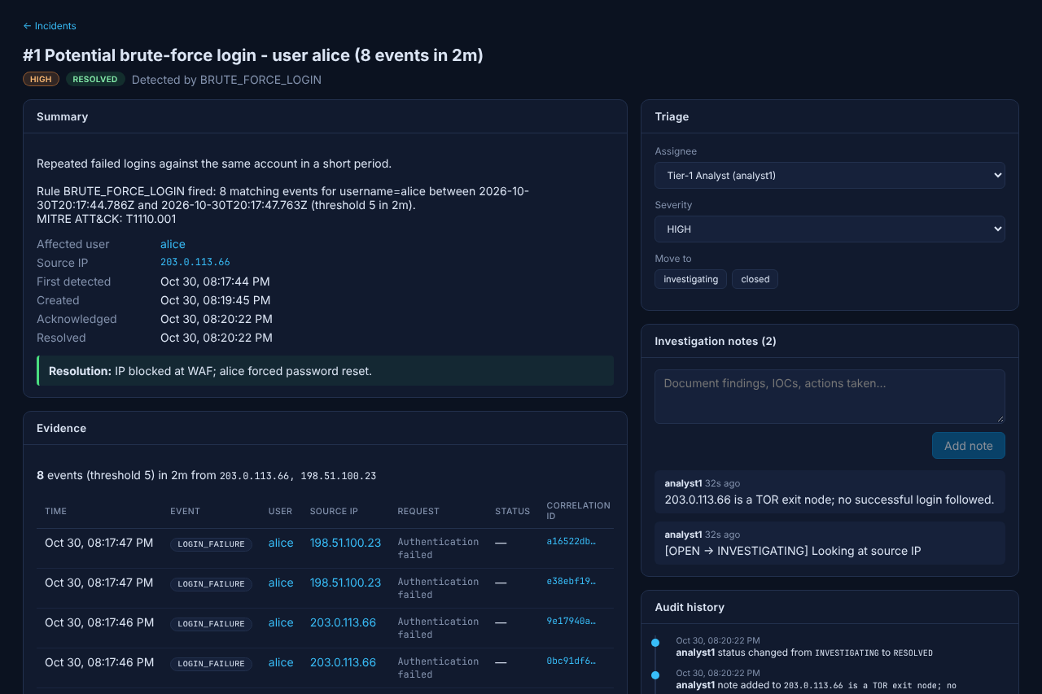
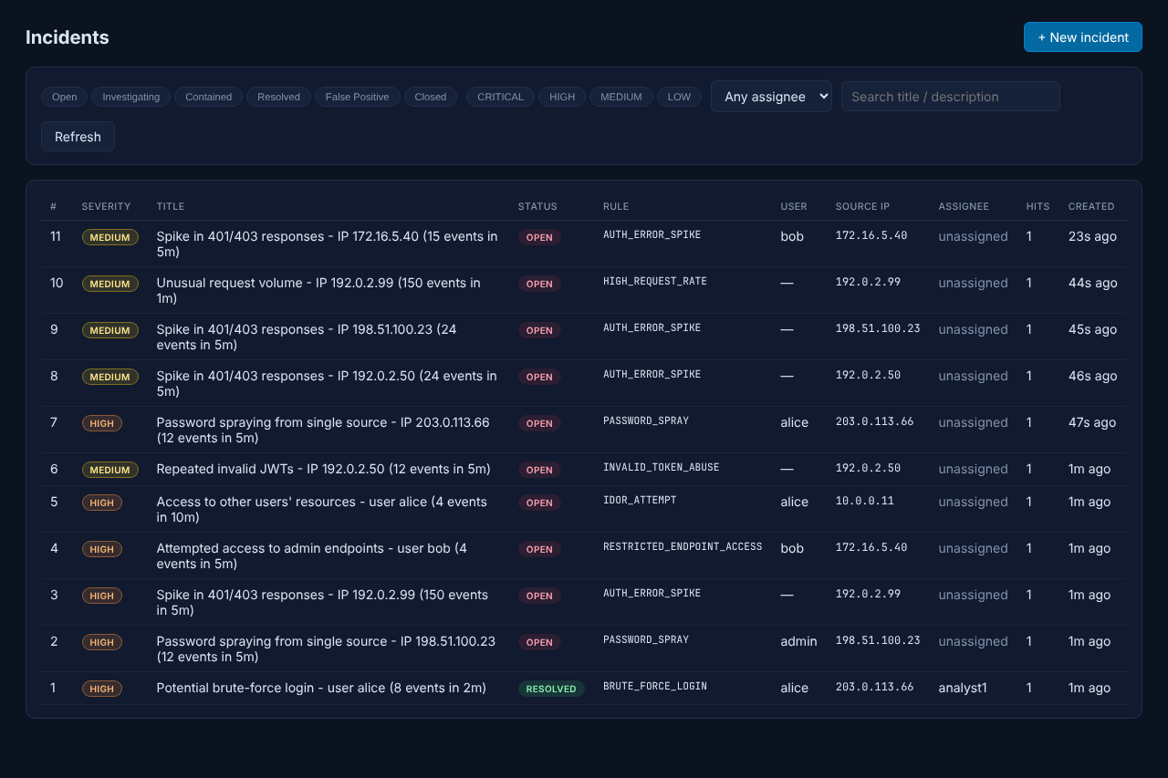
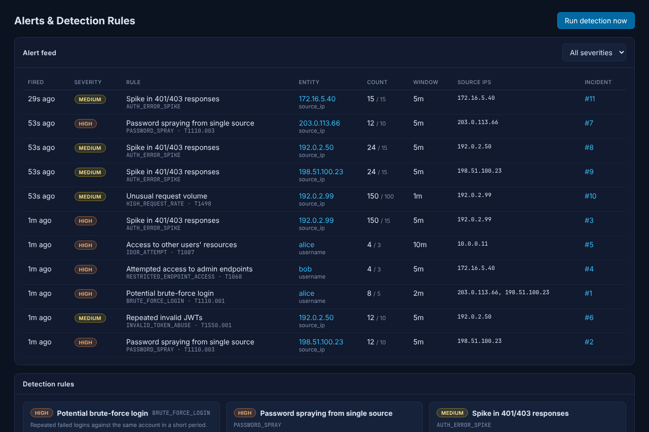
Application demonstration
14 · APPLICATION DEMONSTRATION
Credential-stuffing simulation: from attack traffic to an investigated, resolved incident
1
Start the stack: docker compose up -d
2
Run simulator 1 (credential stuffing)
3
Observe alerts and incidents (< 20 s)
4
Investigate evidence and timeline
Overview: KPIs, activity, severity
Incident: evidence, triage, notes
5
Assign, add notes, resolve with summary
Other simulators: vulnerability scanner, malicious insider, session hijack, Log4Shell campaign, DDoS flood
Incident list with filters
Alert feed and rule status
Notes:
[2:00] For the demonstration, the stack is started and the credential-stuffing simulator is run. It sends distributed login attempts against alice, replays a leaked password list until the admin's reused password succeeds, and then bulk-reads orders. Within twenty seconds, five incidents appear, including a critical account takeover, visible on the overview dashboard on the left. Opening an incident shows the evidence events, the affected user and source IP; the analyst assigns it, records notes and resolves it with a summary, as on the right. Five further simulators cover scanning, insider abuse, session hijacking, Log4Shell and request floods.

Slide 20
Technical challenges and solutions
15 · TECHNICAL CHALLENGES
Issues identified during development and end-to-end testing, and how they were resolved
Challenge | Root cause | Solution
No events reached OpenSearch | Extra spaces in a Fluent Bit grep pattern dropped all records | Diagnosed via Fluent Bit metrics; corrected pattern
Detection service failed to start | @Scheduled requires ISO-8601 durations (PT15S) | Fixed config; added context-load test
Build failed on a fresh clone | .gitignore 'target/' excluded package com.minisoc.target | Narrowed rule to /*/target/
Scripts failed from Windows | CRLF line endings inside Linux containers | .gitattributes (LF) and PowerShell scripts
Duplicate alerts and incidents | Ongoing attacks match on every poll | Suppression cache and fingerprint de-duplication
Correlation false positives | Successful logins counted toward the threshold | Separate matched / required counts per bucket
Notes:
[1:15] These are real issues found during development and testing. A Fluent Bit filter with extra spacing silently dropped every record; it was found through the Fluent Bit metrics and fixed. The scheduler rejected a '15s' duration and needed ISO-8601 format; a context test now catches configuration errors. A broad .gitignore rule excluded a Java package from the repository and was narrowed. Windows line endings broke shell scripts inside Linux containers, solved with .gitattributes. Repeated alerts were addressed with suppression and fingerprint de-duplication, and correlation rules were redesigned to count only the relevant events to avoid false positives.

Slide 21
Future enhancements and conclusion
Conclusion
Future enhancements
Complete loop implemented: instrument, collect, detect, respond
Security controls built into the application itself
16 configurable rules validated end to end
Reproducible deployment with Docker Compose
Automated response (SOAR): block IPs, revoke tokens
Notifications to Slack, Teams or email
OIDC single sign-on and MFA for analysts
TLS and OpenSearch security plugin enabled
Anomaly detection with machine learning
Thank you · Questions
github.com/SaiPrakashBV/Mini-SOC-Project
Notes:
[1:00] To conclude: the project implements the full SOC loop - instrumentation, collection, detection and response - with security controls built into the application and sixteen rules validated end to end, all reproducible with one command. Future work would add automated response actions, notifications, single sign-on for analysts, TLS and OpenSearch security for production, and anomaly detection. Thank you - I am happy to take questions.

