Slide 1
JAC: Just Another Chatbot An Implementation Of A Simple Chatbot
Mentor:
Dr. Deepa Gupta
Team Members:
N.N.V Sai Prakash – AIE19045
V. Sudharsan Reddy – AIE19067
N. Suneel – AIE19045

Slide 2
What Is A Chatbot?
A chatbot is an AI software application designed to carry out a conversation with another human being.
It tries to mimic a real conversation between two people and tries to maintain a natural flow of dialogue.
Chatbots are mainly used on-line on company websites to guide any newcomers and enhance customer experience.
Most chatbots are built with a certain theme in mind, pertaining to the company’s main business ideas.
Swiggy’s Delivery Chatbot, MedWhat and Insomnobot 3000 are just a few of the most popular chatbots designed
Chatbots are ultimately meant to be used in the place of humans, serving on one end of customer service line and provide the same/better quality of service.

Slide 3
Who is JAC?
JAC: Just Another Chatbot is a chatbot we have designed, serving as a conversational chatbot aimed at making simple small-talk with the user.
JAC includes, along with the programmed responses, two other features, namely:
Autocorrect
Autocomplete
JAC has been developed in Python, borrowing from different libraries and stitching together certain concepts.
JAC, as a whole, consists of three classes:
Autocorrect.py
Autocomplete.py
Chatbot.py

Slide 4
Autocorrect
The first class among the three, Autocorrect.py, implements the autocorrect functionality of JAC.
From a layman’s point of view, autocorrect refers to the action of correcting a misspelt word.
Many a times, we would’ve sent a text, riddled with spelling mistakes, with no intention of our own.
The autocorrect feature aims to overcome this simple, yet common problem.
The Autocorrect program we’ve implemented in JAC, is based off of Bayes’ Theorem, and includes three models that perfectly tie everything together.

Slide 5

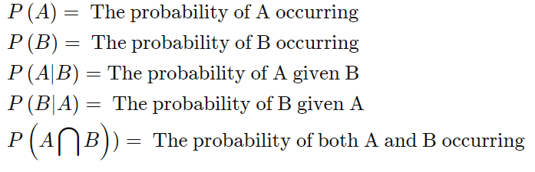
Bayes’ Theorem
Bayes’ Theorem, named after the 18th C mathematician, Thomas Bayes, is a mathematical formula useful for determining conditional probability.
Conditional Probability of an event B, can be described as the probability of B happening, given that another event A has already happened.
Conditional Probability is denoted as P(B|A), read as Probability of B given A.
Bayes’ Theorem is formulated as:
where,

Slide 6

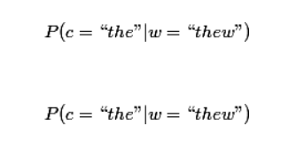
The Theory Behind The Autocorrect Implementation
Given that a user has typed out a word “w”, what could’ve been the correct word “c”?
In the case that the user typed out something differing from his intention, how do we determine what the actual word was?
If we typed out thew, c could be any of the following: {“the” , ”then” ,”thaw” , “thew” , “threw” …}
To clear the air, what we do is given a word, we generate a set of possible intended words C, choose a c from that set with the highest probability. Mathematically,
We basically calculate
and so on for each c in C and pick the maximum from it

Slide 7
The Three Models
The Autocorrect implementation is built upon three models:
The Language Model
The Error Model
The Candidate Model
We’ve already seen the Language Model in the previous slide, let’s move on to the other two.

Slide 8
The Error Model
There are two factors affecting the choice of the right candidate(intended word)
How probable is in the absence of any other information
How likely is it that someone would type w when they intended c (because of a fat finger, a mistake, confusion, etc.)
We need to consider the above two types of errors to have a better correction

Slide 9
Building The Error Model
We are given the word “w” and we need to compute the intended word “c”
Mathematically ,it’s the following :
Finding the right candidate ,by maximizing the above joint probability
the unigram probability(P(c)) multiplied
by the probability that “w” is a spelling error of “c”
Once we have our error model, spellchecking/correction is a matter of computing the conditional probability to have best candidate
But where did we get these candidates from to begin with?

Slide 10
The Candidate Model
A misspelled word looks similar to the intended word most of the time, except they have some errors that occur when some characters are missed
We model the different types of spelling errors people make using a measurement called Damerau-Levenshtein Distance and generate candidates based on that.
The Damerau-Levenshtein Distance calculates the number of operations required to transform one word into another. Typically, the operations included are:
Substitution: Substitute a single character by another (e.g, pwned →owned)
Deletion: Delete a single character (e.g., thew →the)
Addition: Add a single character (e.g., langage →language)
Transposition: Transpose or exchange a single pair of adjacent characters (e.g., recieve → receive)
So the candidate set when w=“thew” might be

Slide 11
The Candidate Model
A misspelled word looks similar to the intended word most of the time, except they have some errors that occur when some characters are missed.
This can become quite a large set. If the length of the word is n, there are n deletions, 26 X n, substitutions, 26 X (n + 1) insertions, and n-1 transpositions possible. That is 54n + 25 candidates
Limiting the Damerau-Levenshtein Distance to a maximum of 1 or 2 can help reduce the speed a bit.
Filtering out the possible words from the Candidate Model with the help of a Corpus, by eliminating non-existent words that could possibly exist in the Candidate set.

Slide 12
Code Explanation
The call correction(w) tries to choose the most likely spelling correction for “w” .We are trying to find the correction ”c” out of all possible candidate corrections
argmax_{c ∈ candidates} P(c|w)
From Bayes’ Theorem,
Since
argmax_{c ∈ candidates} P(c) P(w|c) / P(w)
P(w) is the same for every possible candidate c, we can factor it out, giving:
argmax_{c ∈ candidates} P(c) P(w|c)

Slide 13
Code Explanation
The Code is split into four parts:
Selection Mechanism: argmax We choose the candidate with the highest combined probability.
Candidate Model: c ∈ candidates This tells us which candidate corrections, c, to consider.
Language Model: P(c) The probability that c appears as a word of English text. For example, occurrences of "the" make up about 7% of English text, so we should have P(the) = 0.07.
Error Model: P(w|c) The probability that w would be typed in a text when the author meant c. For example, P(teh|the) is relatively high, but P(theeexyz|the) would be very low.

Slide 14


Code Explanation
Selection mechanism : In Python, ‘max’ with a ‘key’ argument does 'argmax’.
Candidate model : the function ‘editdiastance1’ returns a set of all edited strings
If we restrict ourselves to words that are known—that is, in the
dictionary— then the set is much smaller:
print(len(editDistance1("somthing")))
print(knownword(editDistance1("somthing))

Slide 15
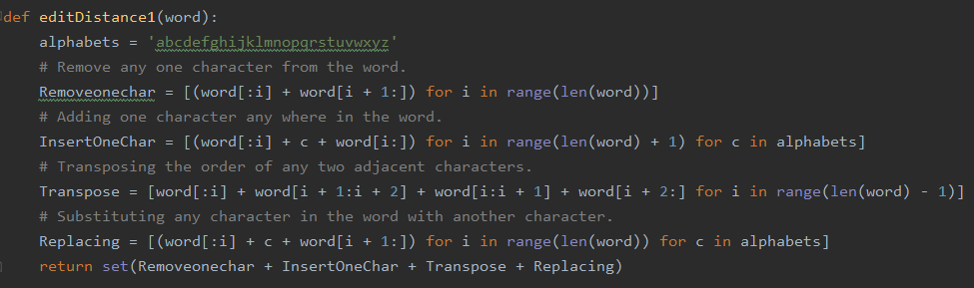


Candidate Model
This can be a big set .For a word of length n there will be n deletions, n-1 transpositions, 26n alterations, and 26(n+1) insertions, for a total of 54n+25 (of which a few are typically duplicates)

Slide 16


Candidate Model
If we restrict the words that are ‘knownword’-that is in the dictionary – then the set will be much smaller
For example :
We'll also consider corrections that require two simple edits. This generates a much bigger set of possibilities, but usually only a few of them are known words

Slide 17



Candidate Model
Therefore the result will have the words of edit distance two from the actual word

Slide 18
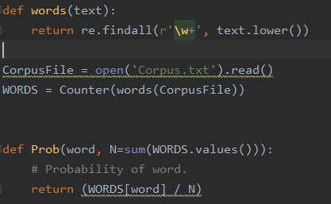


Language Model (P(c))
We can estimate the probability of a word, ‘prob(word)’ by counting the number of times each word appears in a text file of about a million words(corpus text).
The function ‘words’ breaks text into words , then the variable ‘WORDS’ holds a Counter of how often each word appears and ‘prob’ estimates the probability of each word, based on this Counter
We can see there are 30748 distinct words ,which together appear 311867 times

Slide 19
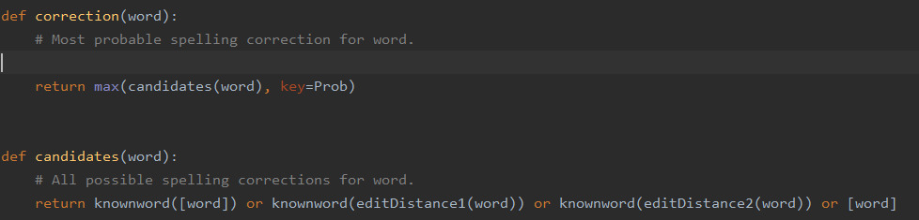
Error Model (P(w|c))
With out data we cannot build a error model
So we can make ’candidates(word)’ produce the first non-empty list of candidates in order of priority
1. The original word, if it is known
2. The list of known words at edit distance one away, if there are any
3. The list of known words at edit distance two away, if there are any
4. The original word, even though it is not known
Then we don't need to multiply by a P(w|c) factor, because every candidate at the chosen priority will have the same probability (according to our model)

Slide 20

Autocomplete
Autocomplete.py, implements the second feature of this chatbot.
Autocomplete suggest and types out the rest of a certain word before the user can complete it
First, we initialize our dataset, against which we’ll be checking for words to complete.
The, we sort all the options in an ascending order.

Slide 21
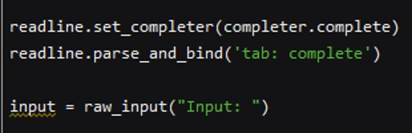
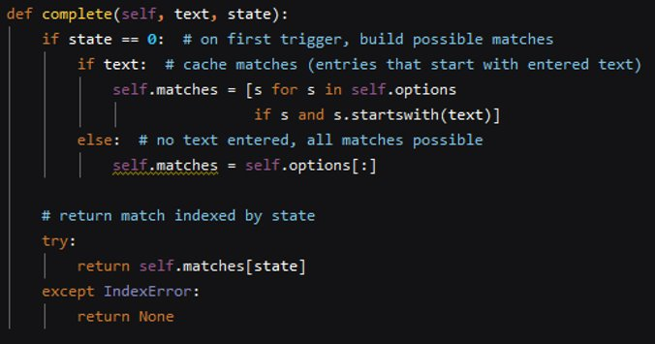
Autocomplete
We track the live input of the user and listen for words and
constantly check if the word being typed out can be completed.
If the starting of the typed out word matches with any of the
words in the dataset, we return that word and autocomplete it.

Slide 22
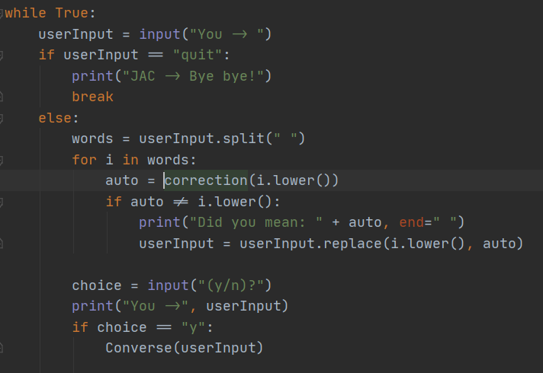
Chatbot
Chatbot.py, is the last component of JAC and brings the previous two classes together on a simple interface.
A block of code is thrown into a forever loop, and this
block takes input from the user, and the autocorrect and
autocomplete functions are run through the input before
sending the final sentence as an input to JAC, which prints
out an appropriate response.
The user can exit the program by simply typing “quit”
when prompted to say something

Slide 23
Thank You

