Slide 1
SMART TEMPERATURE AND SEIZURES MONITORING FOR PEDIATRICS

Slide 2
PROBLEM BEING ADDRESSED & SOLUTION
PROBLEM:
Sudden increase in body temperature of an infant has a very high chance of leading to febrile seizures which is a convulsion caused by abnormal electrical activity in the nerve cells of brain. The seizure could turn out to be fatal if not detected at the right time
SOLUTION:
Our solution to tackle this problem is a device that would monitor the temperature and vibrations of the body and if the measured values are beyond the threshold levels it would notify the person near by thus preventing the situation from turning fatal.

Slide 3
PRODUCT/SERVICE
Briefly describe the product :
This product consists of temperature and vibration sensor interfacing with Arduino nano. LM35 sensor which is used to obtain the temperature and SW420 sensor which is used to obtain the vibrations of the body. There is a buzzer that turns ON when its corresponding temperature range is reached i.e., 102 fahrenheit or when its corresponding vibration range is reached or both simultaneously. The sensors are properly interfaced to the Arduino ecosystem and the sensor values are recorded periodically based on which the buzzer sounds.

Slide 4
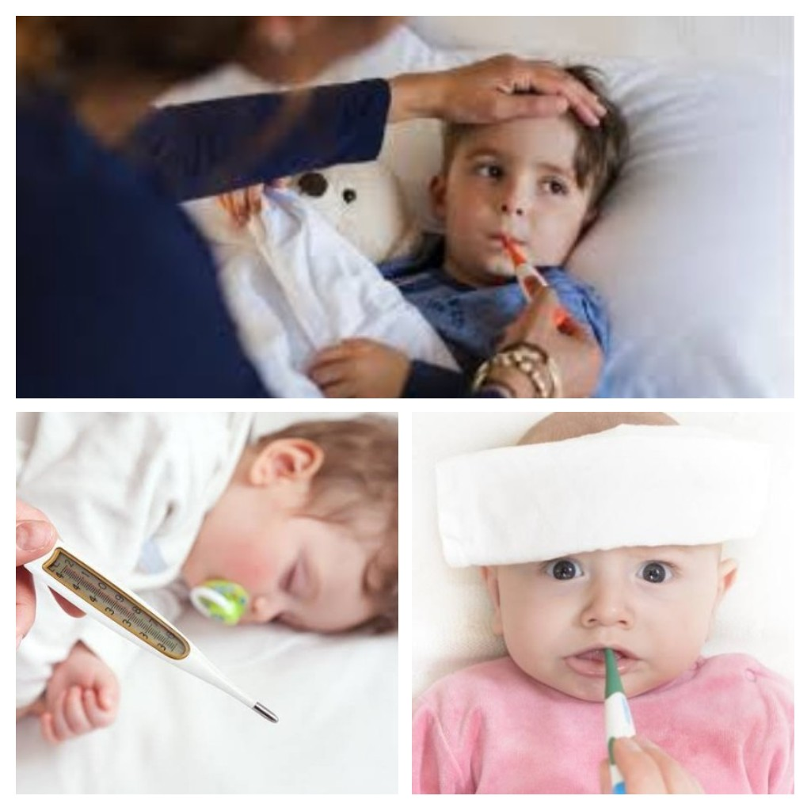
Images and visuals are helpful :

Slide 5
COMPETITION
Who are your competitors :
Bang good DS01 Intelligent Wearable Thermometer.
How have they succeeded:
It has a unique feature to avoid viral spread of fever.
How are different than your competitors:
Our competitor doesn’t have the feature for detection of seizures. So for detection of seizures we use SW-420 vibration sensor.

Slide 6
MARKET
Who are your customers :
Care takers of children.
How many prospective customers are there totally :
According to statistics birth rate of infants in India are 19 births per 1000 population. So our prospective customers are 70% of birth rate.
How many can you address now : ------

Slide 7
MARKETING STRATEGY
Where are your customers :
Everywhere
How will you reach out to them:
Through pharmacies and paediatricians.
What marketing channels/methods will you use:
Through Social Media, by publishing posters.

Slide 8
FINANCIALS
What is your cost of making the product:
Rs 550/-
What will be your month-wise revenue for at least one year:
Rs 7500/- per month

Slide 9
TEAM
List out the names of your team members and their roles:
P. Akhila – Marketing and Survey
M.Satya Sai Harshitha – Interfacing Sensors with Arduino
M.Sai Priyanka – Coding in Arduino IDE
V. V. Sai Pranathi – Designing of product
Give their qualifications/skills: 2nd BTech

Slide 10
ASK
Investment required:
Rs 10,000/-
How will you use the money :
To buy raw materials, To pay Government taxes, for upgradation.

Slide 11
REVENUE MODEL
What are your revenue sources:
Pharmacy stores, Service fee, Advertising Sales.
Price of your product:
Rs 700/- only.

Slide 12
Q&A

