Slide 1
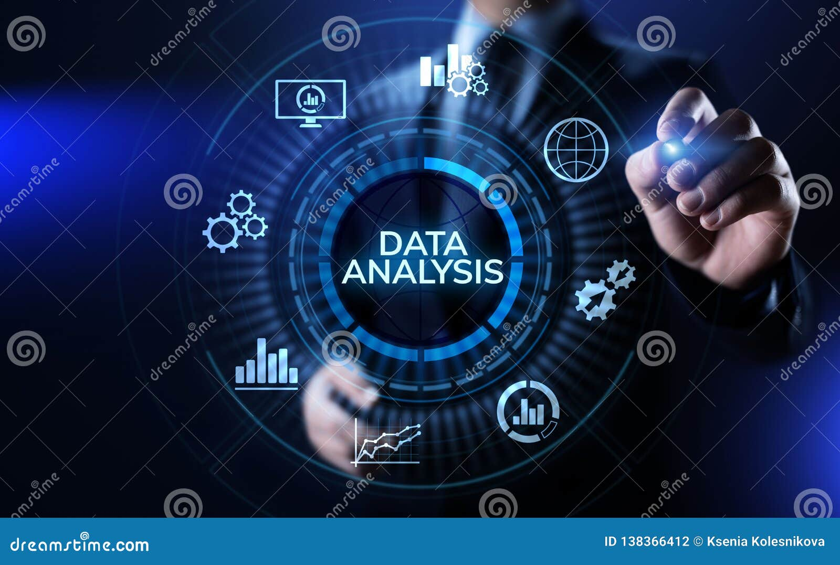
Data Analytics in Healthcare: Enhancing Patient Care and Operational Efficiency
Presented by: Group 5
Sandeep Anumula
Nikhil Bathini
Sai Prashanth Reddy Dyapa
Shirisha Teegala
Nikhith Vemula

Slide 2

Introduction to Data Analytics in Healthcare
Data analytics in healthcare involves collecting, analyzing, and interpreting health data to improve decision-making and patient care.
It plays a crucial role in identifying trends, optimizing resources, and enhancing efficiency in hospitals and clinics.
Unlike machine learning, which builds predictive models, data analytics focuses on insights derived from structured and unstructured data.

Slide 3

Why Data Analytics Matters in Healthcare?
Predicts disease outbreaks and prevents health crises.
Improves hospital resource management, including staff allocation, medical supplies, and facility optimization.
Data-driven insights help doctors and healthcare providers reduce errors, improving patient outcomes.

Slide 4
Applications of Data Analytics
Predictive Analytics
Forecasts disease outbreaks, patient admissions, and potential health risks.
Operational Efficiency
Optimizes hospital workflows, reducing costs and improving patient care delivery.
Patient Safety & Care
Monitors treatment effectiveness, identifies medication errors, and ensures safety protocols.

Slide 5
Applications of Data Analytics in Healthcare
Claims and Financial Data Analysis:
MedInsight helps in tracking insurance claims, identifying fraudulent activities, and managing costs by analyzing financial data and healthcare claims patterns.
Population Health Management:
Utilizes data analytics to identify at-risk populations, suggest preventive care strategies, and improve overall public health outcomes.

Slide 6

Predictive Analytics
Identifies at-risk patients through historical data.
Forecasts patient admissions and hospital capacity.
Example: Predicting COVID-19 surges to prepare for patient influx and allocate resources.

Slide 7
Operational Efficiency
Optimizes hospital resource allocation by tracking patient flow and staff schedules.
Reduces wait times by analyzing peak hours for patient admissions.
Streamlines operations through digital health records.

Slide 8
Enhancing Patient Care & Safety
Continuous treatment monitoring through real-time patient data.
Identifies medication errors by analyzing prescription trends.
Real-time monitoring with wearable tech for immediate response.

Slide 9
How Data is Collected in Healthcare
Electronic Health Records (EHRs):
EHRs store structured patient histories, lab results, medications, and prescriptions in a digital format, making it easy for healthcare providers to access and update patient data.
Medical Imaging Data:
Data collected from MRI, CT scans, and X-rays are stored in DICOM (Digital Imaging and Communications in Medicine) format, which standardizes the sharing of medical images across systems.
Wearable Devices & IoT:
Wearables such as smartwatches, heart monitors, and IoT devices collect real-time health data (e.g., heart rate, glucose levels) and transmit it in JSON/XML formats for easy integration into healthcare systems.

Slide 10
Data Formats in Healthcare Analytics
Structured Data: Stored in relational tables, typically in SQL databases, providing clear, organized formats such as patient demographics, medical histories, and clinical records.
Semi-Structured Data: Includes formats like JSON and XML, commonly used for data from IoT devices, wearables, and sensors (e.g., real-time heart rate data).
Unstructured Data: Consists of non-tabular data such as physician notes, medical imaging scans (X-rays, MRIs), and audio recordings (e.g., from patient interviews).

Slide 11

Case Study - Johns Hopkins Medicine
Uses big data analytics to personalize patient care.
AI-driven predictive models anticipate patient deterioration and provide timely interventions.

Slide 12

Case Study - Advanced Health
Integrates claims and clinical data to improve patient outcomes.
Enhances population health management by identifying high-risk patients.

Slide 13

Case Study - AI in Post-Operative Reporting
AI-driven analytics generate accurate post-operative reports.
Automates patient recovery monitoring, reducing discrepancies in documentation.

Slide 14

Case Study - MedInsight Data Analytics
Integrates Claims Data and Clinical Records:
MedInsight combines claims data with clinical records to assess patient risks, track healthcare utilization, and identify high-risk individuals.
Uses Machine Learning Algorithms:
Machine learning algorithms predict future hospital visits, enabling healthcare providers to allocate resources effectively and reduce patient wait times.
Enhances Population Health Management:
By identifying trends in disease outbreaks and patterns in population health, MedInsight helps healthcare organizations implement preventive care strategies to improve community health outcomes.

Slide 15
Data Collection Methods & Formats
Electronic Health Records (EHRs): Streamlined access to patient data.
Wearable Devices & Remote Monitoring: Collects real-time health metrics.
Patient Surveys & Administrative Data: Gathers insights into patient satisfaction.

Slide 16
Goals of Data Analytics in Healthcare
Improving Patient Outcomes: Best treatments based on analytics-driven insights.
Reducing Operational Costs: Efficient resource use reduces costs.
Facilitating Research & Innovation: Enables large-scale studies and robust data sets.

Slide 17
Challenges in Healthcare Data Analytics
Data Privacy & Security: Compliance with HIPAA.
Data Integration Issues: Unifying data from various systems.
Data Quality & Accuracy: Standardization of data collection.

Slide 18

Future of Data Analytics in Healthcare
AI & Machine Learning Advancements: Enhanced diagnostics and treatment accuracy.
1
Enhanced Patient Personalization: Genomic data and medical history-driven treatment plans.
2
Increased Real-Time Decision-Making: Instant access to critical patient data.
3

Slide 19
Conclusion & References
Data analytics is transforming healthcare by enabling data-driven decision-making and improving patient care quality.
Ongoing advancements in AI and data integration will further enhance healthcare efficiency and patient outcomes.
References:** - Health Data Management ([link](https://www.healthdatamanagement.com/articles/10-top-case-studies-big-data-analytics-in-healthcare)) -
MedInsight ([link](https://medinsight.com/healthcare-data-analytics-resources/case-studies/)) -

Slide 20
Thank You

