Slide 1
Olympic Data Engineering and Analysis
Sai Prathap

Slide 2
Overview:
Brief Description:
Our DE project offers data-driven Olympics insights by analyzing previous records.
Through efficient queries, we unlock valuable information for informed decision-making.
Business Problem:
The Data is in different sources like MySQL, Aws S3, Azure Blob. Ingest the data from the sources into Hive, HBase and snowflake and querying the data.
Extracting meaningful patterns from the data.
Solution Approach:
We address this challenge by using Sqoop, Snow Pipe and Copy Into ingestion services to ingest data into different sources and analyze data using Hive, HBase and Snowflake enabling us to uncover trends, correlations, and opportunities. Our optimized queries provide actionable insights.

Slide 3





Tools and Technologies Used:
Hive
HBase
Snowflake
Sqoop
Snowpipe

Slide 4
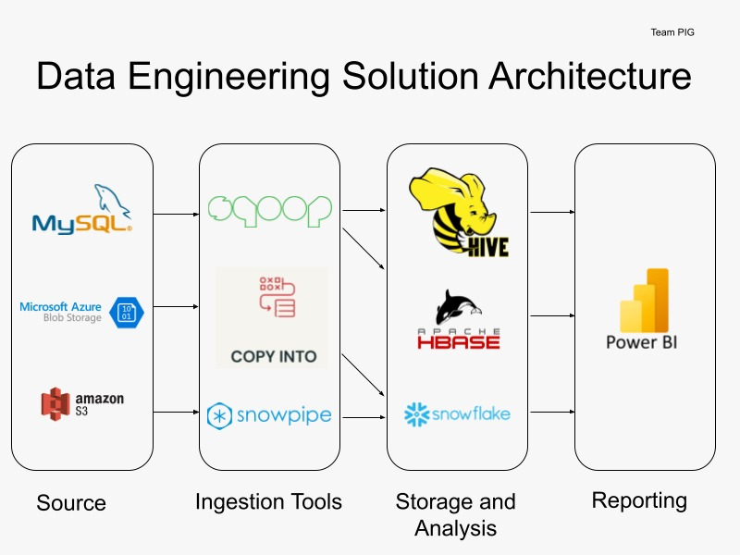
P1
P1
P1
P2
P3
P2
P2
P3
P3
P4
P4
P4

Slide 5
Roadblocks & Resolutions
1. Removed commas and replaced NA with NULL
2. Generated row number and used it as key.
- Cleaning the data and removing the duplicates.
- Loading CSV file to MySQL
- No unique identifier for the tables to integrate with HBase.

Slide 6
Pipeline 1 1.Create two tabes in mysql olympics_history and olympics _history_noc _regions. 2.Load data into table in mysql using load data infile. 3.Import the data into hive using sqoop import. 4.Created partitioning and bucketing on the columns in the olympics_history tables. 5.Finally performed analysis on user stories using hive.

Slide 7
Fetch the top 5 athletes who have won the most gold medals.

Slide 8
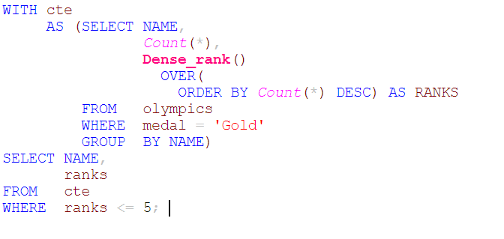
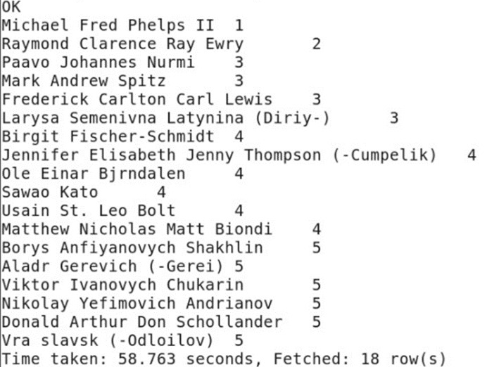
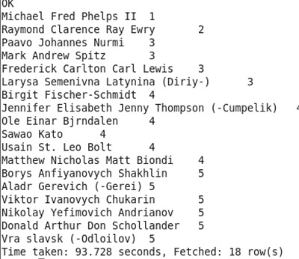
Partitioned

Slide 9
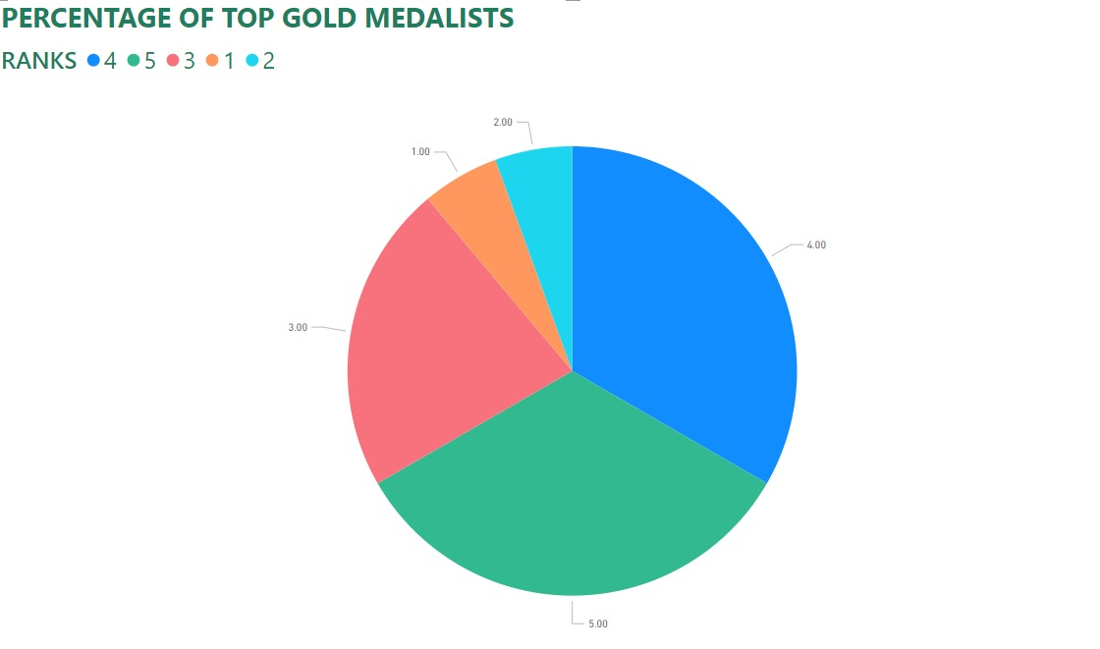

Slide 10
Pipeline 2
From the Hive shell, create a HBase table
From the HBase shell, access the hbase_hive_table
Insert the data into the HBase table through Hive
From the HBase shell, verify that the data got loaded
From Hive, query the HBase data to view the data that is inserted in the hbase_hive_table

Slide 11
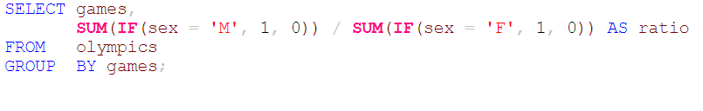
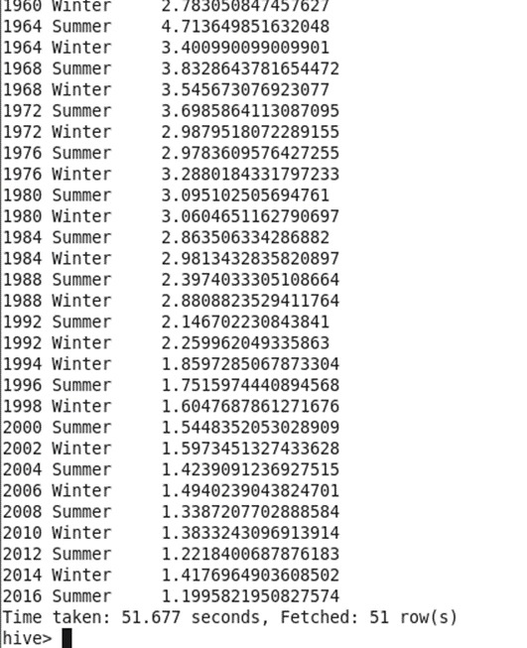
Output
Find the Ratio of male and female athletes participated in Olympic games.

Slide 12
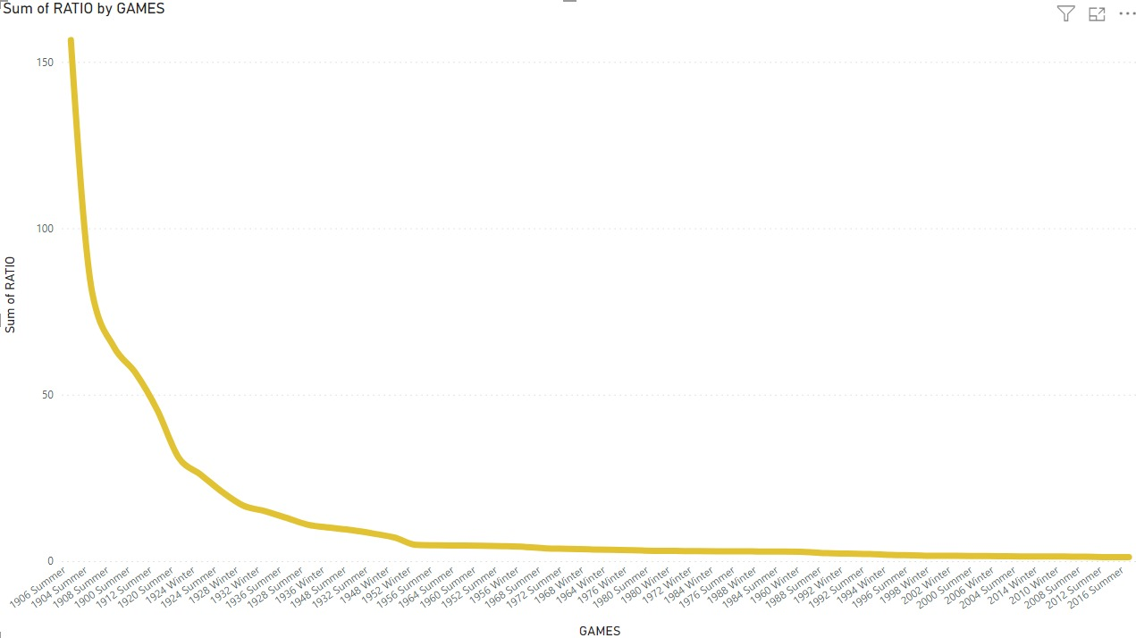

Slide 13
1) Create storage account and containers in Azure, and upload files into it. 2) Copy file URL and SAS token 3) Create file format and table in snowsql 4) Create stage in snowsql using the URL and SAS token 5) Copy into the table by using the data in the stage
Pipeline 3

Slide 14
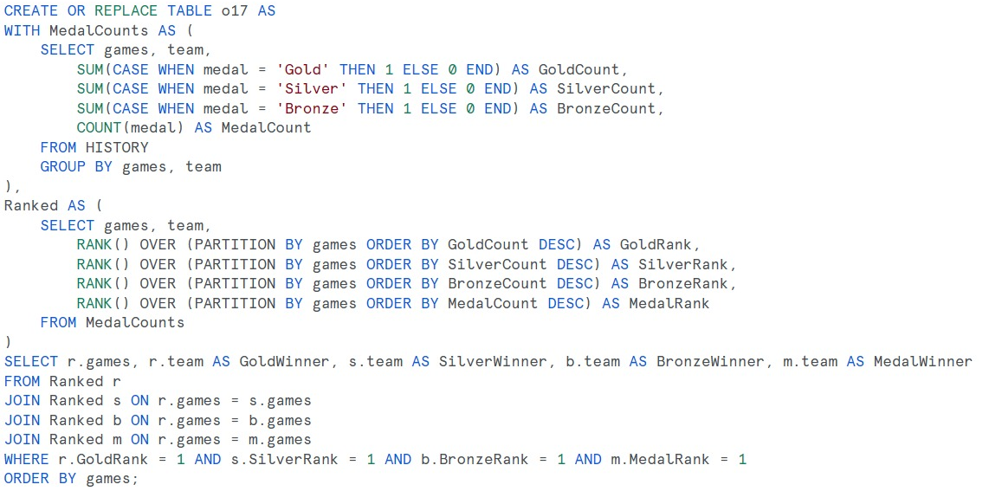
Identify which country won the most gold, most silver, most bronze medals and the most medals in each Olympics game.

Slide 15
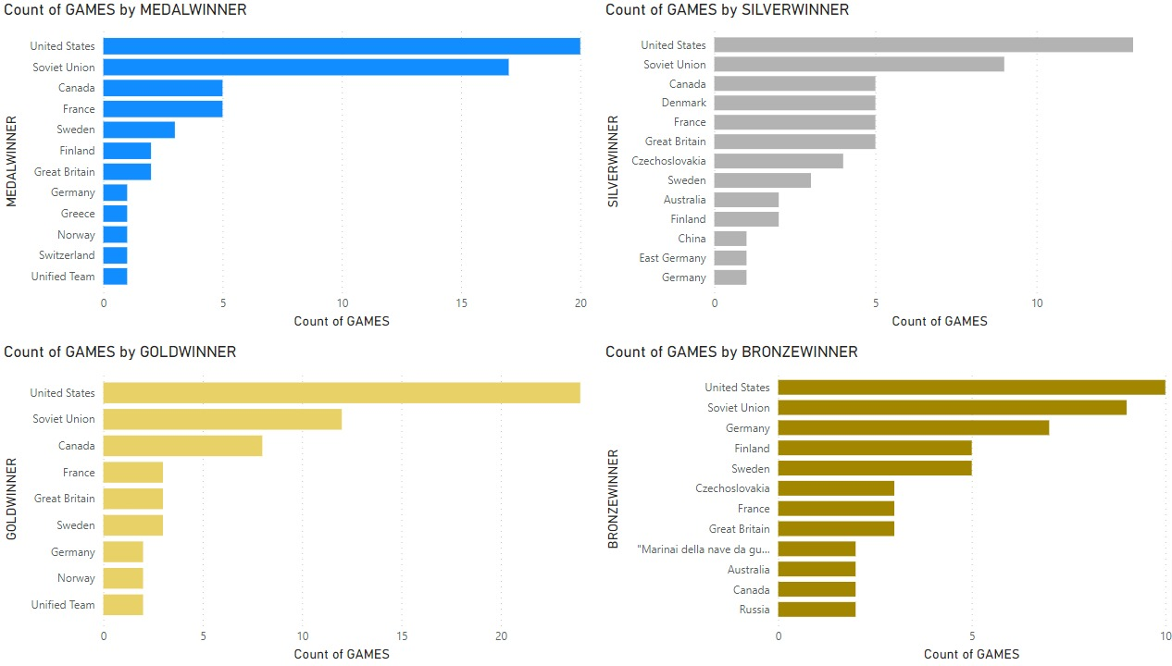

Slide 16
Pipeline 4
Create an Amazon S3 Bucket and Upload Data Files (e.g., CSV, JSON).
Configure Snowflake and Create Snowflake Database and Schema.
In AWS, go to IAM and create user groups, Users, and Roles.
Next go to Snowflake CLI, create integration, stage, and update Trust policy.
Load the data into that schema with the help of the external stage

Slide 17
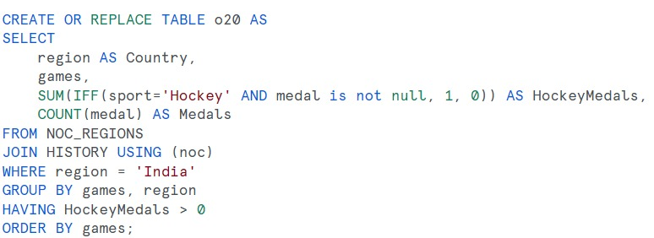
Break down all Olympic games where India won medal for Hockey and how many medals won in each Olympic games.

Slide 18
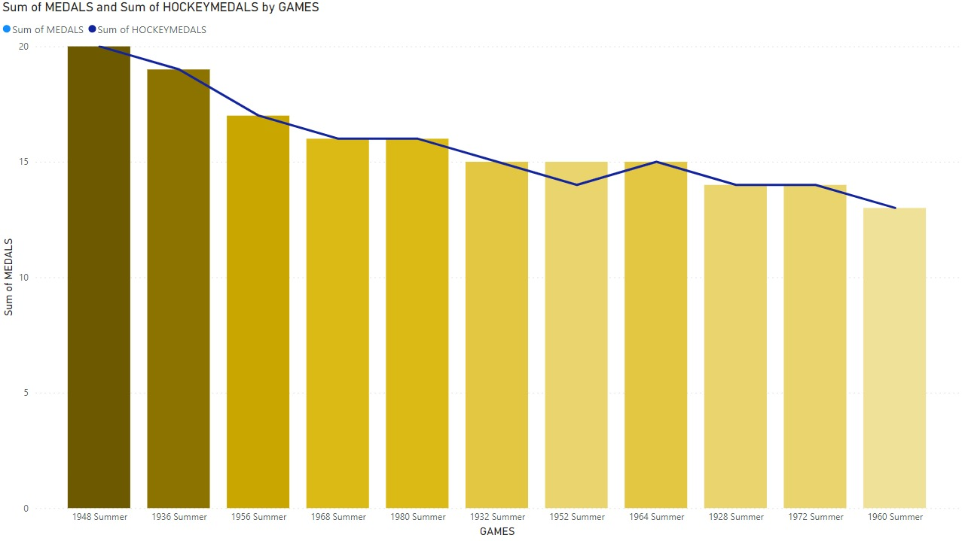

Slide 19
Thank You

