Slide 1

Denoising Autoencoders
TEAM 14 :
MANJULA -- 22071A3230
SAI PRIYA -- 23075A3203
SHIVANI –- 23075A3204
DEEPTHI – 23075A3205

Slide 2
Auto-encoders
Denoising autoencoder
Autoencoders are a type of neural network architecture that are designed to learn a compact, low-dimensional representation of the input data, called the encoded representation or bottleneck. The main idea behind autoencoders is to use the encoded representation to reconstruct the original input data through a process called decoding. Autoencoders are trained to minimize the difference between the original input and the reconstruction.
A denoising autoencoder (DAE) is a type of autoencoder neural network architecture that is trained to reconstruct the original input from a corrupted or noisy version of itAenean nec lorem. In porttitor. Donec laoreet nonummy augue.
Suspendisse dui purus, scelerisque at, vulputate vitae, pretium mattis, nunc. Mauris eget neque at sem venenatis eleifend. Ut nonummy.

Slide 3
Training Process
Input data is corrupted by adding noise to it. The noise can be added in different ways, such as masking out a certain percentage of the input’s pixels, or adding Gaussian noise.
The corrupted input is passed through the encoder network, which maps the input data to a lower-dimensional encoded representation.
The encoded representation is passed through the decoder network, which generates a reconstruction of the original, noise-free input.
The reconstruction is compared to the original input, and the difference is used to calculate the reconstruction error. The reconstruction error is used as the loss function to update the weights of the encoder and decoder networks.
The process is repeated for multiple iterations, and the weights of the encoder and decoder networks are updated in order to minimize the reconstruction error.

Slide 4
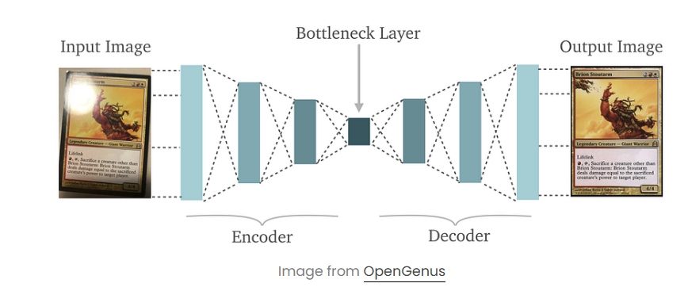

Removes noise and restores clean, meaningful data representations for robust learning.
Hyperparameters of DAE’s
Activation function
Batch size
Noise level
Learning rate:
Number of neurons

Slide 5


Architecture of DAE
Encoder Network
The encoder network in a denoising autoencoder (DAE) maps the input data to a lower-dimensional encoded representation. The architecture of the encoder network can vary depending on the specific application and the type of input data.
Decoder Network
The decoder network in a denoising autoencoder (DAE) maps the encoded representation back to the original input space, in order to reconstruct the original input from the noisy version of it. The architecture of the decoder network is typically the mirror of the encoder network, with the layers arranged in reverse order.

Slide 6

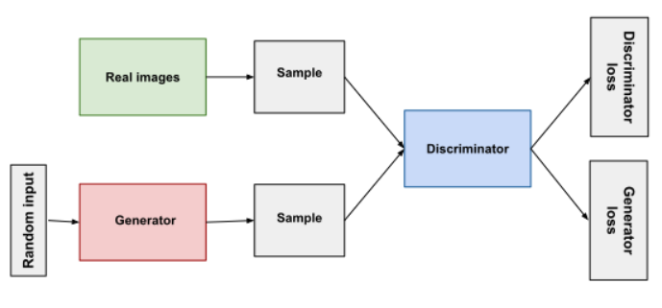
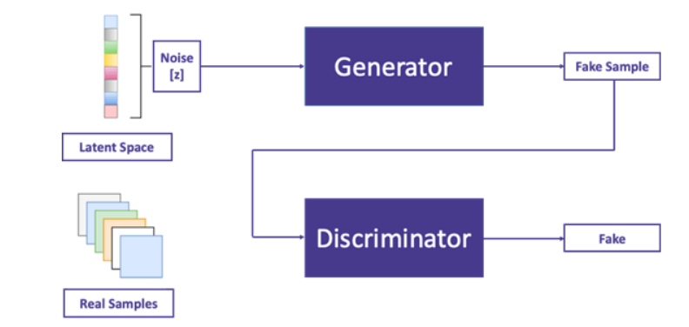
Generative Adversarial Networks
a component of deep learning models used for generative tasks, create virtually anything phony, from deepfake films to look-alike photos to fake datasets of anything.
GANs are made up of two major neural networks:
THE GENERATOR
The Generator network takes random noise as input, considers random as completely random fake data, and then attempts to transform it into data that resembles the original data, or its target distribution
THE DISCRIMINATOR
The Discriminator network, on the other hand, functions as a classifier, attempting to differentiate between real data from the original dataset and bogus data generated by the Generator. It learns to give true data with high probability and false data with low probabilities.

Slide 7
TRAINING PHASE:
COMPETITION PHASE:
The Generator produces fresh fictitious data.
The Discriminator compares fresh phony data to actual data.
The Discriminator’s increased classification capacity may now allow it to better distinguish the new phony data.
The Generator modifies its parameters in order to create more compelling results.
The Generator generates fake data from random noise.
The Discriminator assesses and assigns probability to both actual and bogus data.
The Discriminator’s purpose is to enhance its classification accuracy by learning to discriminate between true and bogus data.
The Generator’s purpose is to generate data that is compelling enough to “fool” the Discriminator. It modifies its settings to provide data that the Discriminator is more likely to recognize as real.

