Slide 1
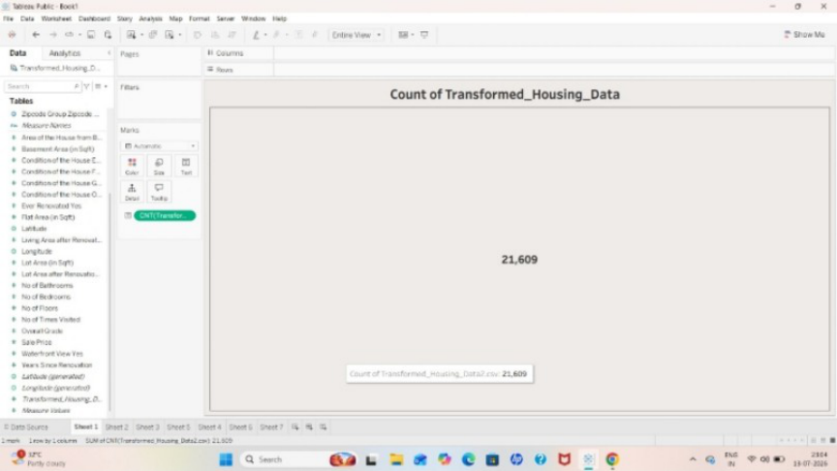
Performance Testing
Date | 15 July 2026
Team ID
Project Name | Visualizing Housing Market Trends: An Analysis of Sale Prices and Features using Tableau
Maximum Marks | 2 Marks
Model Performance Testing:
1. Data Rendered:
The housing dataset was successfully imported into Tableau Public. The dataset contains
21,609 housing records with 31 attributes, including sale price, bedrooms, bathrooms,
floors, basement area, renovation year, and other housing features. The data was loaded
without errors, confirming that it is being rendered accurately and is suitable for analysis
and dashboard creation.
Figure 1. Housing Dataset Successfully Loaded into Tableau
2. Data Preprocessing:

Slide 2
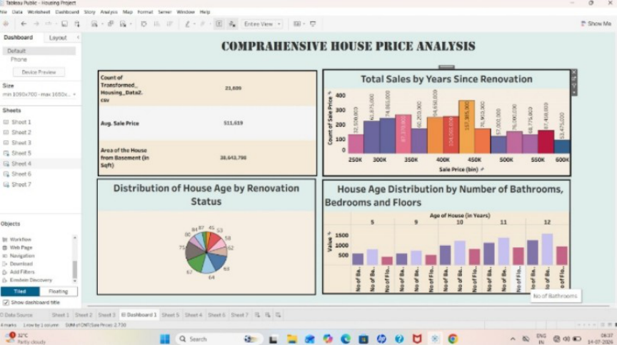
Before creating visualizations, the dataset was prepared by verifying data types, renaming fields where necessary, and creating calculated fields such as Years Since Renovation and House Age. The data was checked for missing values and formatted appropriately to ensure accurate analysis and consistent categorization, supporting reliable dashboard execution. 3. Utilization of Filters: Interactive filters were implemented in the Tableau dashboard to improve user interaction. The filters allow users to analyze housing data dynamically by selecting different housing characteristics such as bedrooms, bathrooms, floors, and renovation status. When filter values change, all visualizations update automatically, making data exploration easier and more effective. Figure 2. Interactive Dashboard with Filters 4. No. of Visualizations / Graphs: The Tableau dashboard included a total of 6 visual elements summarizing the housing market dataset: Count of Housing Data Records, Average Sale Prices, Area of House from Basement (Sqft), Total Sales by Years Since Renovation, Distribution of House Age by Renovation Status, and House Age Distribution by Bedrooms, Bathrooms, and Floors. These visualizations help users quickly identify pricing patterns and housing trends.

Slide 3
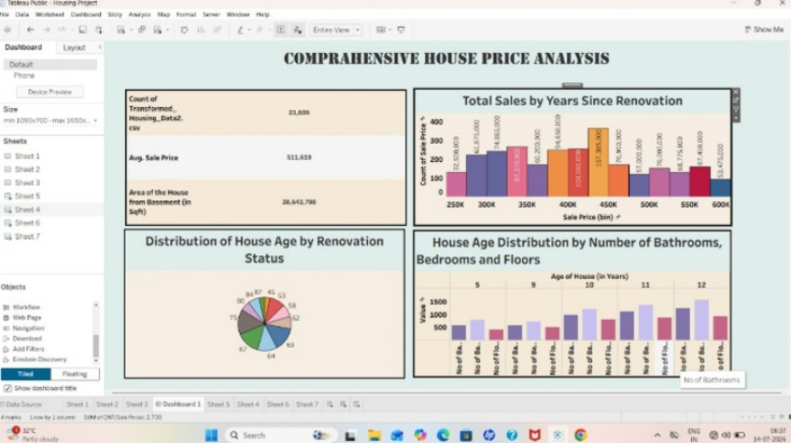
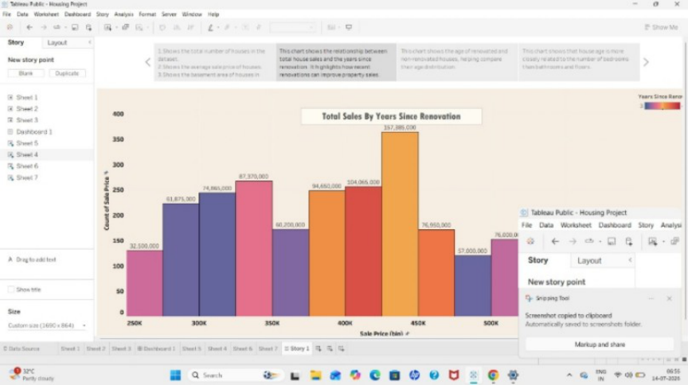
Figure 3. Tableau Dashboard Showing Housing Market Visualizations 6. Story Design: A Tableau Story was created to present the dashboard analysis in a logical sequence. Each story point explains a different aspect of the housing market, including overall housing statistics, renovation trends, basement area analysis, and house feature distributions. The story was tested and successfully guided viewers through the insights, improving data storytelling and helping users understand the analysis more effectively. Figure 4. Tableau Story Explaining Housing Market Trends

Slide 4
Results: - Interactive Tableau dashboard and storyboard developed successfully for housing market analysis - Dataset of 21,609 records processed accurately with no data errors - All required visualizations generated correctly and update dynamically with filters - Dashboard enables efficient comparison of housing sale prices, features, and renovation trends - Dashboard accessible to end users through Tableau Public and Flask web integration Figure 5. Final Dashboard Output

