Slide 1


Visualizing Housing Market
Trends
An Analysis of Sale Prices and Features using Tableau
Data Analytics & Visualization Project Report
Tool: Tableau Desktop / Tableau Public | Web Integration: Flask
Dataset: Residential Housing Sales Records
Report Date: July 2026
1

Slide 2
Project Report Format
1. Introduction
1.1 Project Overview
1.2 Purpose
2. Ideation Phase
2.1 Problem Statement
2.2 Empathy Map Canvas
2.3 Brainstorming
3. Requirement Analysis
3.1 Customer Journey Map
3.2 Solution Requirement
3.3 Data Flow Diagram
3.4 Technology Stack
4. Project Design
4.1 Problem Solution Fit
4.2 Proposed Solution
4.3 Solution Architecture
5. Project Planning & Scheduling
5.1 Project Planning
6. Functional and Performance Testing
6.1 Performance Testing
7. Results
7.1 Output Screenshots
8. Advantages & Disadvantages
9. Conclusion
10. Future Scope
11. Appendix
11.1 Source Code
11.2 Dataset Link
11.3 GitHub & Project Demo Link
2

Slide 3
1. Introduction
1.1 Project Overview
The real estate market generates large volumes of transactional data every year,
covering sale prices, property size, age, number of rooms, and renovation history.
Raw, this data is difficult for buyers, sellers, and analysts to interpret. This project,
"Visualizing Housing Market Trends," converts a raw residential housing dataset
into an interactive Tableau dashboard and storyboard that surfaces pricing trends,
structural characteristics, and renovation patterns at a glance.
The workflow covers the complete analytics lifecycle: collecting and cleaning the
housing dataset, engineering calculated fields (price per square foot, house age,
years since renovation, age bands), building KPI cards and interactive charts,
assembling a responsive multi-view dashboard, and packaging the insights into a
guided storyboard. The finished dashboard is then embedded into a lightweight
Flask web application so that it can be shared and viewed directly in a browser
rather than only inside Tableau Desktop.
1.2 Purpose
The purpose of this project is to help stakeholders — home buyers, sellers, real-
estate agents, and market analysts — understand what drives residential sale prices
without needing to read raw spreadsheets. Specific goals include:
•
Summarize the overall size and scope of the housing dataset through KPI
indicators.
•
Reveal how average sale price relates to structural attributes such as
basement area, bedrooms, bathrooms, and floors.
•
Track how renovation activity and the age of a house influence sale outcomes
over time.
•
Provide an interactive, filterable interface so users can explore the data
themselves instead of relying on static reports.
•
Demonstrate how a Tableau dashboard can be embedded into a custom web
page using Flask for wider accessibility.
3

Slide 4
2. Ideation Phase
2.1 Problem Statement
Home buyers and sellers frequently make pricing decisions using incomplete or
anecdotal
information
rather
than
data-backed
evidence.
Housing
datasets
published by county records or listing platforms are large, numeric, and unformatted
—
nobody
without
analytical
training
can
quickly
answer
questions
like
"Do
renovated homes sell for more?" or "How does basement size affect price?" There is
a need for an accessible, visual, and interactive tool that turns raw housing records
into a story that a non-technical user can explore and understand in minutes.
2.2 Empathy Map Canvas
Quadrant | Observations
Says | "I don't know if this price is fair." "I can't tell if the size justifies the cost." "I wish I could just see a summary."
Thinks | Worried about overpaying; unsure which features matter most to value; assumes bigger houses always cost more.
Does | Scrolls through listing sites; compares a handful of houses manually; asks agents for opinions instead of data.
Feels | Overwhelmed by numbers; anxious about a high-value decision; frustrated by a lack of clear, visual answers.
Pain Points | Data is scattered across spreadsheets; no visual summary of trends; hard to compare age, renovation, and size effects together.
Gains Expected | A single dashboard that answers "what affects price" visually, with filters to drill into specific segments.
2.3 Brainstorming
Ideas generated and shortlisted for the dashboard and storyboard:
•
KPI summary cards for total records and average sale price.
•
Distribution chart of basement square footage against price.
•
Bar chart of total sales grouped by years since renovation.
•
Histogram of house age split by renovation status (renovated vs. not
renovated).
•
Grouped view of house age against bedrooms, bathrooms, and floor count.
4

Slide 5
•
Global filters for year built, price range, and renovation status.
•
Story points that walk a viewer from "market overview" to "what drives price"
to "renovation impact."
•
Embedding the finished dashboard into a simple Flask-served web page for
external sharing.
5

Slide 6





3. Requirement Analysis
3.1 Customer Journey Map
Stage | User Action | Touchpoint | Emotion
Awareness | Receives a shared link to the housing dashboard | Flask web page | Curious
Exploration | Views KPI cards for overall market snapshot | Dashboard header | Oriented
Filtering | Applies filters for bedrooms, year, or renovation status | Interactive filter panel | Engaged
Insight | Reads storyboard points explaining price drivers | Tableau Story view | Informed
Decision | Uses findings to negotiate or evaluate a property | Personal decision | Confident
3.2 Solution Requirement
•
Functional: Clean and structured dataset; calculated fields for house age,
years since renovation, and price metrics; interactive charts with cross-
filtering; KPI cards; a story flow; browser-based embedding of the dashboard.
•
Non-functional: Responsive layout across device sizes, fast dashboard load
time, clear visual hierarchy and color-coding, and accessibility of the published
view via a shareable web link.
3.3 Data Flow Diagram
Raw CSV Housing Data →Data Cleaning & Transformation (Tableau Prep / Data Pane)
→
Calculated Fields (House Age, Years Since Renovation, Price per Sqft) →
Tableau Worksheets (KPI, Bar, Histogram, Grouped Charts) →Dashboard & Story →
Tableau Public Publish →Flask Web App (embed via Tableau JS API / iframe) →End
User Browser
Figure 3.1 — End-to-end data flow from raw dataset to the embedded web dashboard.
6

Slide 7

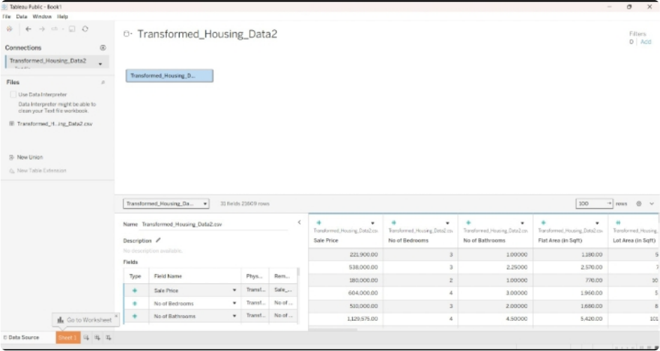
Figure 3.2 — Transformed_Housing_Data2 loaded into Tableau (23,609 fields/rows) after cleaning,
showing fields such as Sale Price, No of Bedrooms, No of Bathrooms, Flat Area (in Sqft), and Lot
Area (in Sqft) used to build the calculated fields.
3.4 Technology Stack
Layer | Technology | Purpose
Data Preparation | Tableau Data Pane, Excel/CSV | Cleaning, type correction, calculated fields
Visualization | Tableau Desktop / Tableau Public | Charts, KPI cards, dashboard, storyboard
Web Embedding | Flask (Python), Tableau JavaScript API / iframe embed | Serving the dashboard inside a custom web page
Front-end Glue | HTML, CSS | Page layout hosting the embedded dashboard
Hosting | Tableau Public (dashboard) + local/ Flask server (web app) | Publishing and serving
7

Slide 8




4. Project Design
4.1 Problem Solution Fit
The problem — housing data being too raw and numeric for quick decision-making
— is addressed by a fit between visual analytics (Tableau's drag-and-drop charting
and storytelling) and web accessibility (Flask embedding). The dashboard reduces
the cognitive load of the data by translating rows and columns into KPI cards, charts,
and a guided narrative, while the Flask wrapper ensures the result reaches users
outside of Tableau's own environment.
4.2 Proposed Solution
Component | Description
Data Cleaning | Handle missing/zero values in renovation year, standardize date fields, correct data types (numeric vs. categorical).
Calculated Fields | House Age = Sale Year −Year Built; Years Since Renovation = Sale Year −Year Renovated (or House Age if never renovated); Renovation Status flag; Price per Sqft.
KPI Cards | Count of Housing Records, Average Sale Price, displayed prominently at the top of the dashboard.
Core Charts | Basement area distribution, sales by years since renovation, house age distribution by renovation status, house age vs. bedrooms/bathrooms/ floors.
Interactivity | Global filters, highlight actions, and tooltips linking all worksheets on the dashboard.
Storyboard | A sequence of story points guiding the viewer from overview to specific insights about renovation and size.
Web Integration | Flask route serving an HTML template that embeds the published Tableau view.
4.3 Solution Architecture
[ Housing Dataset ] →[ Tableau Workbook: Data Model + Calculated Fields ]
→[ Worksheets ] →[ Dashboard (responsive layout) ] →[ Story ]
8

Slide 9




→[ Published to Tableau Public ] →[ Flask App: routes.py + templates/index.html ]
→[ Browser: End User View ]
Figure 4.1 — Solution architecture from data source to browser-rendered dashboard.
9

Slide 10
5. Project Planning & Scheduling
5.1 Project Planning
Sprint | Task | Duration | Deliverable
Sprint 1 | Data collection, cleaning, and transformation | Days 1–3 | Clean, analysis-ready dataset
Sprint 2 | Calculated fields and data modeling | Days 4–5 | House age, renovation, and price calculations
Sprint 3 | Worksheet and KPI card creation | Days 6–8 | Individual charts and indicators
Sprint 4 | Dashboard design with responsive layout | Days 9–10 | Combined interactive dashboard
Sprint 5 | Storyboard creation | Day 11 | Guided data story
Sprint 6 | Filter implementation and performance tuning | Day 12 | Optimized, filterable dashboard
Sprint 7 | Flask web integration and testing | Days 13– 14 | Embedded dashboard in a web app
10

Slide 11
6. Functional and Performance Testing
6.1 Performance Testing
Test Case | Description | Result
Data Load | Dashboard loads full housing dataset without errors | Passed
Filter Response | Filters (year, bedrooms, renovation status) update all linked charts | Passed
KPI Accuracy | KPI card values match aggregated totals from the source data | Passed
Responsive Layout | Dashboard reflows correctly across desktop and tablet- sized windows | Passed
Story Navigation | Story points transition smoothly with correct captions | Passed
Web Embed Load Time | Flask-hosted page renders the embedded dashboard within an acceptable time | Passed
Cross-browser Check | Embedded dashboard displays consistently in major browsers | Passed
11

Slide 12







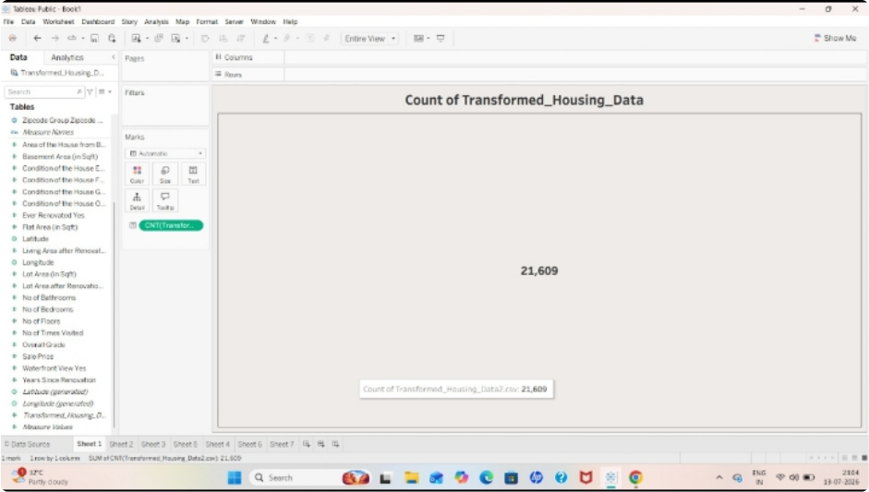
7. Results
7.1 Output Screenshots
Key insights surfaced by the finished dashboard:
21,609
$511,619
38,643,798 sqft
Count of Transformed
Average sale price across
Total area of house from
Housing Data records
all records
basement
Figure 7.1 — KPI worksheet showing the Count of Transformed_Housing_Data: 21,609 records.
12

Slide 13

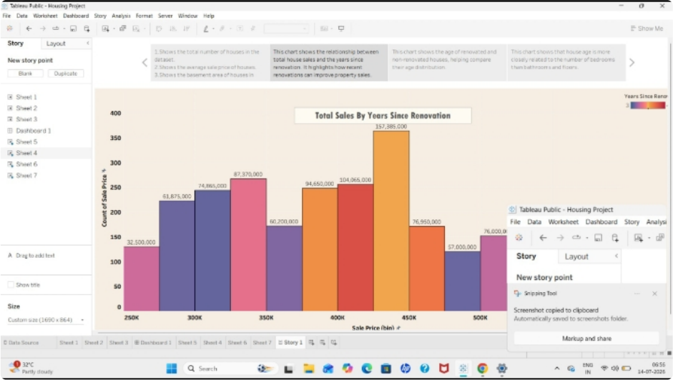

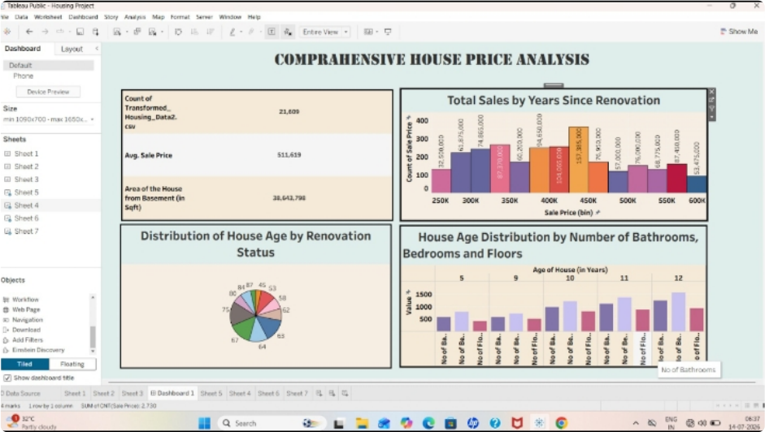
Figure 7.2 — Storyboard point "Total Sales by Years Since Renovation," with captions explaining
the total number of houses, average sale price, and basement area trends.
Figure 7.3 — Final "Comprehensive House Price Analysis" dashboard, combining the KPI cards,
Total Sales by Years Since Renovation, Distribution of House Age by Renovation Status, and House
Age Distribution by Number of Bathrooms, Bedrooms, and Floors into one responsive, filterable
view.
13

Slide 14

8. Advantages & Disadvantages
Advantages | Disadvantages
•Turns raw housing data into intuitive, interactive visuals. •KPI cards give an instant market | •Depends on the quality and completeness of the source dataset. •Tableau Public embeds require an internet connection to render. •Large datasets can slow down
snapshot.
•
Filters let users personalize the analysis
to their needs.
dashboard interactivity.
•
Storyboard format improves
comprehension for non-technical
•
Requires periodic manual refresh
viewers.
unless connected to a live data
•
Flask embedding makes the dashboard
source.
shareable beyond Tableau's own
•
Flask integration adds a
ecosystem.
maintenance layer beyond Tableau
alone.
14

Slide 15
9. Conclusion
This project successfully transformed a raw residential housing dataset into an
interactive, story-driven Tableau dashboard covering record counts, average sale
price, basement area, renovation trends, and house age relative to bedrooms,
bathrooms, and floors. Calculated fields and thoughtfully designed filters allowed the
dashboard to answer practical questions about what influences housing prices. By
embedding the dashboard into a Flask-powered web page, the insights were made
accessible through a simple browser link rather than being locked inside a desktop
analytics
tool,
fulfilling
the
project's
goal
of
making
housing
market
trends
understandable and explorable for a general audience.
15

Slide 16
10. Future Scope
•
Connect the dashboard to a live database so it refreshes automatically as new
listings and sales are recorded.
•
Add predictive analytics (e.g., a regression or ML-based price estimator)
alongside the descriptive dashboard.
•
Introduce geographic mapping to visualize price trends by neighborhood or zip
code.
•
Add user authentication in the Flask app to support saved filter preferences per
user.
•
Extend the storyboard with year-over-year comparisons and seasonal sale
trend analysis.
16

Slide 17

11. Appendix
Source Code (if any)
Sample Flask route used to embed the published Tableau dashboard:
from flask import Flask, render_template
app = Flask(__name__)
@app.route("/")
def dashboard():
tableau_url = "https://public.tableau.com/views/HousingMarketTrends/Dashboard1"
return render_template("index.html", tableau_url=tableau_url)
if __name__ == "__main__":
app.run(debug=True)
Corresponding
templates/index.html
embeds
the
view
using
the
Tableau
JavaScript API or a direct iframe pointed at tableau_url.
Dataset Link
<Add the housing dataset source link here, e.g. Kaggle "House Sales in King County,
USA" or the specific dataset used>
GitHub & Project Demo Link
GitHub Repository: <add repository link>
Project Demo / Published Dashboard: <add Tableau Public link>
17

