Slide 1
DEEP LEARNING PROJECT
Crack Segmentation for
Structural Monitoring
A U-Net that finds cracks pixel by pixel, and converts the result into a physical measurement a conservator can act on.
Team NeuraCoders
Tarrun B · Shyam M · Sriman A · Shyam Sundar K

Slide 2
MOTIVATION
Finding a crack is easy. Measuring one is not.
A structural engineer does not need to know that a wall has a crack — they can see that. They need to know whether it is wider than it was six months ago, and by how much. That is a measurement problem wearing a computer vision problem’s clothes.
01
Segment
02
Measure
03
Scale
04
Compare
A network marks every pixel belonging to a crack. This is the deep learning part.
Skeletonise the mask, apply a distance transform, and recover width in pixels.
A surveyed reference in the photograph converts pixels to millimetres.
Two aligned captures months apart give the change that actually matters.
›
›
›
Segmentation alone is not measurement. A mask says which pixels. It does not say how wide, and it cannot say how much has changed. Steps 02 to 04 are what turn a vision model into an instrument.
Crack Segmentation for Structural Monitoring
2

Slide 3
THE CENTRAL DIFFICULTY
Cracks are 2 to 3% of the image
A model that predicts “no crack” everywhere scores roughly 97% pixel accuracy. The loss looks excellent and the model is useless. Almost every design decision in this project follows from that one fact.
LOSS ON A DO-NOTHING MODEL
WHY IT MATTERS
Measured, not asserted — run python src/losses.py
Cross-entropy barely penalises predicting nothing — 0.31 is a mediocre score, not a failing one.
Overlap-based losses score the same model at 0.99, because an empty prediction has zero intersection.
Tversky lets false negatives be punished harder than false positives, which is the right trade: a missed crack is a missed structural signal.
Comparing all six on real data is the core experiment of this project.
Binary cross-entropy
0.31
Focal
0.23
BCE + Dice
0.65
Tversky
0.99
Dice
0.99
Focal Tversky
0.99
Crack Segmentation for Structural Monitoring
3

Slide 4
METHOD
U-Net, written from scratch
An encoder compresses the image, a decoder expands it back to full resolution, and skip connections carry fine detail across. Thin structures need those skips — without them a one-pixel crack does not survive the bottleneck.
DESIGN DECISIONS
in
3
›
32
›
64
›
128
›
256
Returns logits, never probabilities. Each loss applies its own sigmoid; a double sigmoid trains without error and quietly halves the learning signal.
Trains on a free Colab GPU at base 32, so capacity is an ablation rather than a hardware constraint.
Both upsampling modes implemented, so bilinear versus transposed convolution can be measured, not assumed.
out
256
‹
128
‹
64
‹
32
‹
1
Vertical ties are skip connections. Channel widths at base 32, depth 4 — 7.8M parameters.
Augmentation is constrained by the subject: flips and rotations are safe, but a scale change can erase a one-pixel crack while leaving its mask intact, teaching the model that blank wall means crack. Masks use nearest-neighbour interpolation. Measured: 1 px cracks still fade in about 90% of draws. That does not matter on DeepCrack (median crack 5.9 px) but would for hairline cracks.
Crack Segmentation for Structural Monitoring
4

Slide 5
EVALUATION
Measuring it honestly
With 2 to 3% positive pixels, the choice of metric and the choice of protocol decide whether the numbers mean anything. Three decisions were made deliberately.
Metrics
Threshold
Splits
IoU, Dice, precision and recall — reported per image and averaged, so a few heavily cracked images cannot dominate the score.
The default 0.5 is rarely optimal on imbalanced data. A sweep selects it on the validation split, then it is applied once to test.
Train, validation and test are assigned by hashing the filename, not by shuffling with a seed.
Pixel accuracy is reported only to show how misleading it is: the do-nothing model scores 0.966 on the test set.
Tuning on test and reporting test is leakage, and it is an easy mistake to make by accident.
An image lands in the same split every run, even after files are added. A re-shuffle that leaks test into train is very hard to spot from metrics alone.
Crack Segmentation for Structural Monitoring
5

Slide 6
THE DIFFERENTIATOR
From a mask to a millimetre
A segmentation network cannot measure crack width. Recovering a physical number takes three further steps, and each introduces error that has to be stated.
Skeletonise
Distance transform
Width
Scale
Reduce the mask to a one-pixel centreline running along the crack.
At every crack pixel, the distance to the nearest background pixel.
On the centreline, width = 2d − 1 pixels.
Multiply by mm-per-pixel from the surveyed reference.
CALIBRATION, MEASURED
WHAT THAT MEANS IN PRACTICE
true width 1 2 3 4 5 6 7
estimate 1 1 3 3 5 5 7
Odd widths are exact; even widths read one pixel short. Absolute widths therefore carry ±1 px of quantisation error.
At 0.5 mm per pixel, a reported “+2.0 mm” is really +2.0 ± 0.5 mm. Alert thresholds must sit above that floor. Stating the limit is worth more than hiding it — an engineer acting on these numbers needs to know when not to trust them.
Crack Segmentation for Structural Monitoring
6

Slide 7
RESULTS
Loss comparison on DeepCrack
The identical U-Net trained six times, changing only the loss function. Scores are on 85 held-out test images, with the threshold chosen on validation only. Each loss was trained once.
Loss
IoU
Dice
Precision
Recall
Binary cross-entropy
0.601
0.717
0.704
0.781
Dice
0.644
0.764
0.731
0.837
BCE + Dice
0.636
0.755
0.718
0.836
Focal
0.632
0.749
0.724
0.806
Tversky (β > α)
0.648
0.770
0.730
0.846
Focal Tversky
0.651
0.771
0.737
0.851
Finding. Cross-entropy was worst on every metric. The top three, focal Tversky (0.651), Tversky (0.648) and Dice (0.644), sit within 0.007 IoU and, with one run each, are effectively tied. Tversky's expected precision cost did not appear.
Crack Segmentation for Structural Monitoring
7

Slide 8
BEYOND THE TABLE
Width accuracy and the brick-wall test
Two checks that decide whether the numbers can be trusted on a real wall: width against hand-drawn ground truth, and a different surface.
Width vs ground truth
Thin cracks
Brick walls
Against hand-drawn widths on the 85 test images, mean width lands within 1 px on 51% of images (median error 0.98 px). The widest point is within 1 px on only 27%.
On the 17 cracks under 3 px wide, width reads about 0.97 px too wide, length 58 px short, and the crack count is off by about 3.
On 240 masonry images (Dais et al.) with no retuning: IoU 0.455, Dice 0.588, precision 0.545, recall 0.770.
A perfect model at this input size would reach 99%, so most of the gap comes from the model, not the measurement.
Cracks 1 px wide also fade out of training images in about 90% of draws. Harmless on DeepCrack, a risk for hairline cracks.
Mortar joints are marked as cracks, so precision falls. The set has no crack-free images, so the false-alarm rate on clean walls is not measured.
Crack Segmentation for Structural Monitoring
8

Slide 9
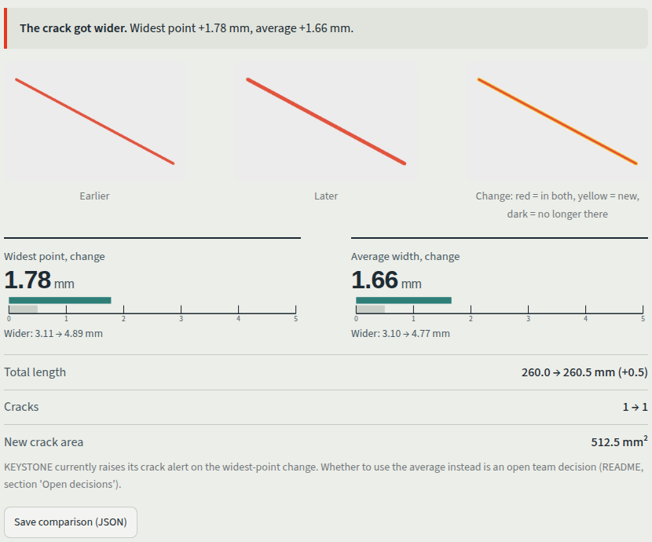
FRONT END
A browser app for the measurement
Upload a wall photo to get crack length and width in millimetres, or two captures to see whether a crack has widened.
Measure one photo
Cracks are outlined and measured: length, average width and widest point, each drawn on a millimetre ruler with the 1 px error band marked.
Compare two photos
Reports whether the crack got wider, narrower, or changed by less than the 1 px step, and shows new crack pixels in a change image.
Honest by default
Results, limits and the scale assumption are in the app. It does not align photos, and the scale comes from the user.
Crack Segmentation for Structural Monitoring
9

Slide 10
LIMITATIONS
What this does not do
Four limits, stated rather than discovered by a reviewer. The first is the one that matters most.
Domain gap
Quantisation
Every public crack dataset is road and concrete. The target is stone masonry, where mortar joints look exactly like cracks and the model marks them. Measured: IoU falls from 0.651 on DeepCrack to 0.455 on 240 masonry images (precision 0.545).
Width carries ±1 px of error from the distance transform. Against ground truth, mean width is within 1 px on 51% of images, and cracks under 3 px read about 1 px too wide. Sub-pixel fitting is out of scope.
Scale dependency
Alignment assumption
Without a surveyed reference in the photograph, every output is in pixels and is not comparable between captures. The model cannot supply this; the capture protocol must.
Comparing two captures assumes they are spatially registered. Two hand-held photographs from different positions produce meaningless deltas.
Crack Segmentation for Structural Monitoring
10

Slide 11
ENGINEERING
Three workstreams, one contract
The project is split along two interfaces that are written down and machine-checked, so three people can build in parallel without an integration day spent on shape mismatches.
A
Data
B
Model
C
Measure
dataset, augmentation, class balance
›
U-Net, losses, training loop
›
metrics, evaluation, measurement
batches: float32 (N,3,H,W) + binary (N,1,H,W)
logits: raw (N,1,H,W), never probabilities
masks: uint8 (H,W) in {0,1}, plus statistics
22 CONTRACT CHECKS, RUN BEFORE EVERY PUSH
Each workstream tests against stand-in implementations of the other two, so all three pass independently from day one — nobody waits. The checks catch the mistakes that actually break three-way splits: a mask that lost its channel dimension, a mask that stopped being binary after interpolation, a model returning probabilities instead of logits. If every section passes alone, the pipeline runs end to end.
Crack Segmentation for Structural Monitoring
11

Slide 12
CONCLUSION
Where this goes next
The segmentation model is a complete project in its own right. It was also built to be one component of a larger monitoring system.
DELIVERED
INTEGRATION TARGET
U-Net implemented from scratch, both upsampling modes verified
Six losses compared on 85 test images: best IoU 0.651, top three effectively tied
Width measurement checked against ground truth, within ±1 px
Brick-wall test run: IoU 0.455, so the domain gap is quantified
Browser app for measuring and comparing captures; 22 contract checks pass
The wider system supplies the two things this model cannot: a scale reference, and two captures registered to the same control points.
seg = CrackSegmenter(ckpt)
m1 = seg.segment(march)
m2 = seg.segment(september)
delta = compare_captures(m1, m2,
mm_per_px=0.8)
A mask says which pixels. A measurement says whether to send an engineer.
Crack Segmentation for Structural Monitoring
12

