Slide 1
Neural Network Classification on Fashion-MNIST
Name : Sai Ram Gaddam
Student ID: P2904427
Course name: M.Sc. Artificial Intelligence
University name: De Montfort University

Slide 2
Problem Overview
Image classification is central to modern AI.
Traditional ANNs struggle with spatial dependencies.
CNNs are specifically designed to exploit spatial hierarchies.
Fashion-MNIST offers a real-world benchmark beyond MNIST digits.
Aim:
Compare the effectiveness of ANN and CNN models on Fashion-MNIST classification.
Objectives:
Build and train both architectures in PyTorch.
Analyze training and validation dynamics.
Evaluate class-wise metrics (precision, recall, F1).
Examine confusion matrices for interpretability.
Provide design recommendations.

Slide 3
Dataset Description and Preprocessing
Dataset: Fashion-MNIST
70,000 grayscale images, 28×28 pixels.
10 classes: T-shirt, Trouser, Pullover, Dress, Coat, Sandal, Shirt, Sneaker, Bag, Ankle Boot.
Preprocessing Pipeline:
Normalized pixel values to [0, 1] range for stable gradients.
Converted images to tensors using torchvision.transforms.
Train/validation/test split: 80/10/10
Framework: PyTorch
Hardware: GPU-enabled training environment
Loss Function: CrossEntropyLoss

Slide 4
Artificial Neural Network (ANN) Architecture
Architecture Details:
Input layer: 784 neurons (flattened 28×28 image)
Hidden layer 1: 256 neurons with ReLU
Hidden layer 2: 128 neurons with ReLU
Output layer: 10 neurons (softmax classification)
Regularization: Dropout(0.2)
Limitation: Ignores spatial structure of images

Slide 5
Convolutional Neural Network (CNN) Architecture
Architecture Design:
Conv Layer 1: 32 filters (3×3), ReLU , MaxPool(2×2)
Conv Layer 2: 64 filters (3×3), ReLU , MaxPool(2×2)
Fully Connected Layers: 128 → 10 neurons
Dropout(0.25) used to reduce overfitting
CNN uses convolutional filters to automatically detect visual features such as edges, textures, and shapes.
Training Setup:
Optimizer: Adam (lr = 0.001)
Loss: Cross-Entropy
Epochs: 10

Slide 6
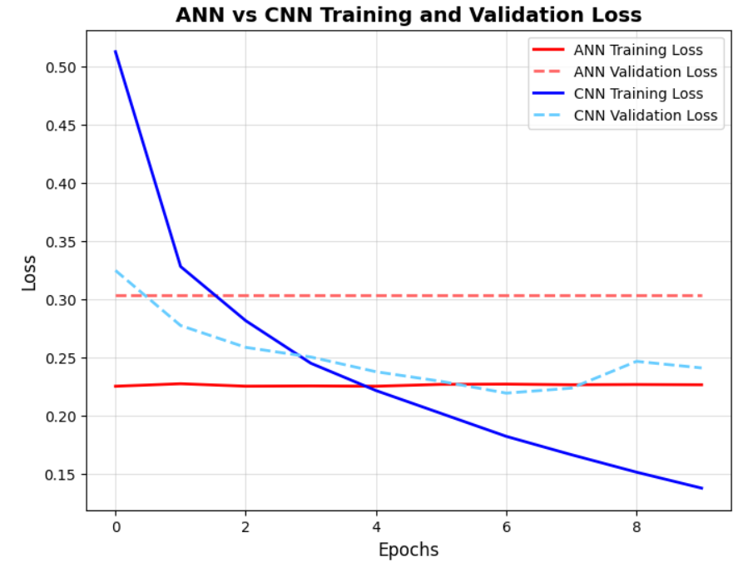
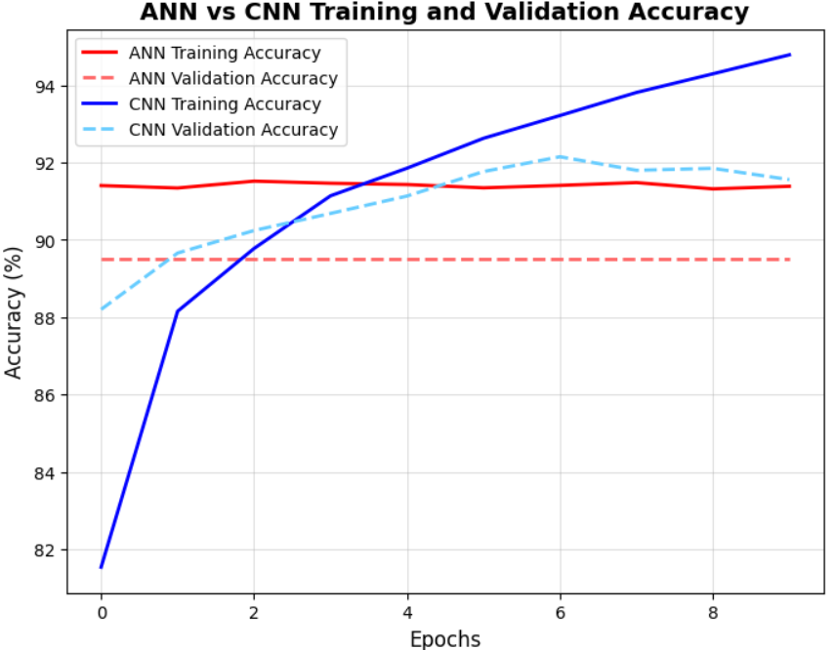
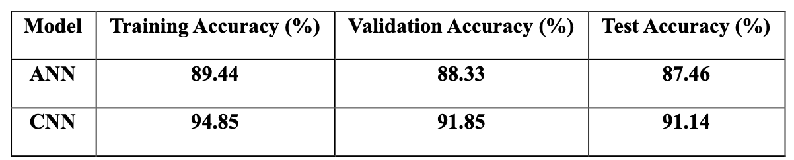
Training and Validation
Both models converged steadily with minimal overfitting
CNN achieved smoother and faster convergence.
ANN showed slightly fluctuating validation accuracy
Model Performance:

Slide 7
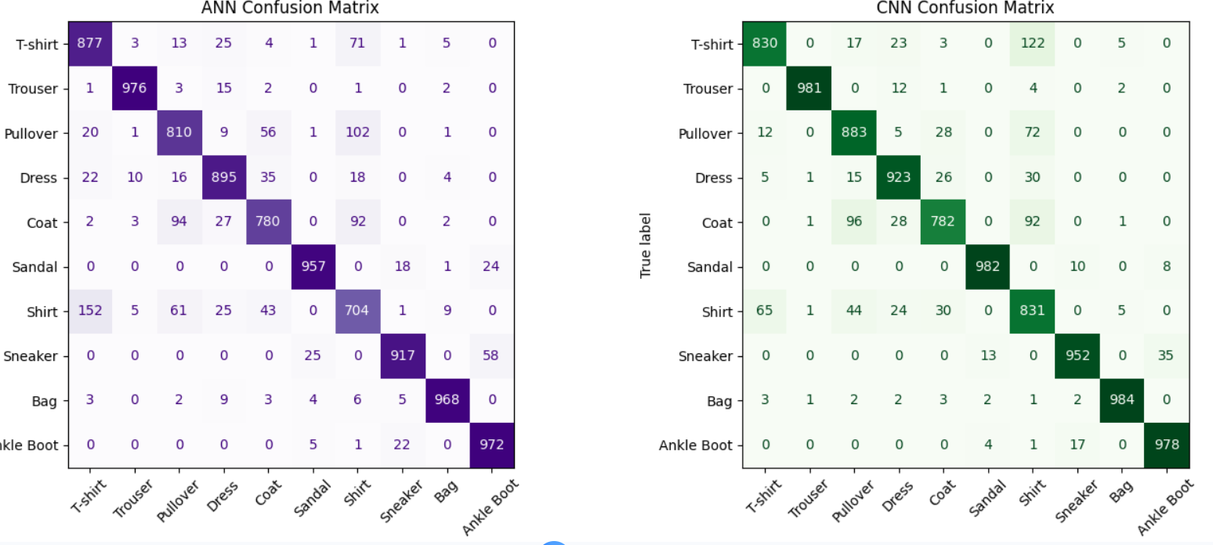
Confusion Matrix Analysis
Confusion Matrices for ANN and CNN
CNN shows clearer separations and fewer misclassifications.
ANN shows confusion among shirt, coat, pullover.
Best performing categories: Sneaker and Bag.

Slide 8
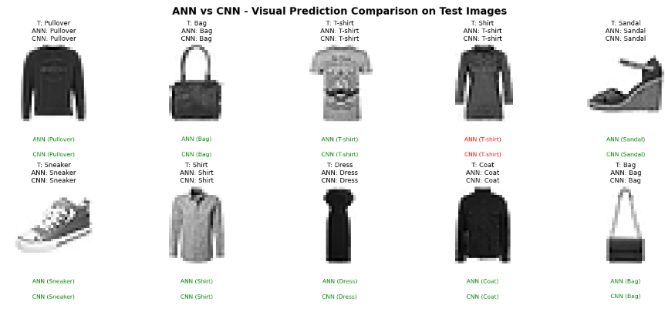
Visual Prediction Comparison
This figure compares ANN and CNN predictions for the same test samples.
CNN consistently produces correct classifications (green text), while ANN exhibits occasional misclassifications (red text).
The CNN model demonstrates stronger spatial feature understanding, resulting in fewer label errors across similar clothing types.
Confirms CNN’s robustness and higher generalization on visual data.

Slide 9
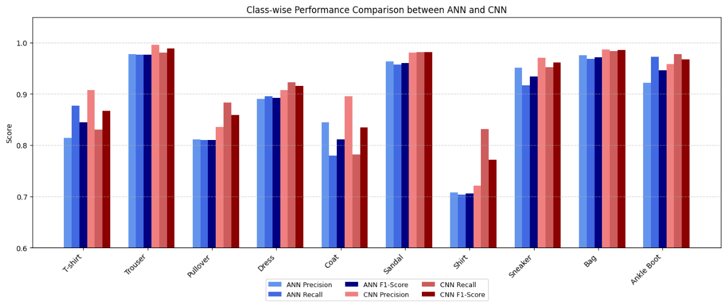
Evaluation Metrics
Both models work very well on easily identifiable items like Trouser, Sandal, and Bag.
Lower scores appear for confusing classes such as T-shirt, Coat, and Shirt due to their visual similarity.
Overall, CNN gives more accurate and consistent results than ANN across all classes.

Slide 10
Technical Contributions and Innovations
Implemented complete ANN and CNN architectures from scratch in PyTorch.
Integrated dropout and adaptive learning optimization.
Visualized learning metrics and confusion matrices.
Delivered analytical comparison using accuracy, recall, and F1-scores.
Provided practical recommendations for architectural improvement.

Slide 11
Conclusions and Future Work
Conclusions:
CNN outperformed ANN by leveraging spatial inductive bias and local feature learning.
ANN’s performance was solid but limited by flattened input representation.
CNN learning dynamics were more stable and consistent.
Recommendations:
Data Augmentation : Apply flips, rotations, and translations to improve generalization.
Learning Rate Scheduling : Dynamically reduce LR for smoother convergence.
Deeper Architectures : Adding extra convolutional blocks could further boost accuracy.

Slide 12
Thank you

