Slide 1

Camp OAC - B
Michael Boulanger | Client Liaison
Sai Rohith Enumala | Scrum Manager
Paul Ranger | QA Leader
Baillie Stang | Tech Leader
Notes:
Say our names and roles

Slide 2
About our Software:
Mobile friendly React based website
UX
User selects a location from a list
Number of bags of firewood desired
User selects payment option
Generate either receipt or invoice based on option selected
User is then tasked with going to location to receive firewood via receipt or payment on request via invoice.
Notes:
Stang
To meet the clients needs our team will be developing a:
Mobile friendly react based website that delivers the following user experience:
User selects a location based on an up-to-date list maintained by our database
User selects amount of bags of firewood desired assuming the amount is available (also kept up to date via our database)
User is prompted to either pay now, or pay later.
Pay now is done through squares payment api as per clients request and also ensuring a seamless and modern experience

Slide 3
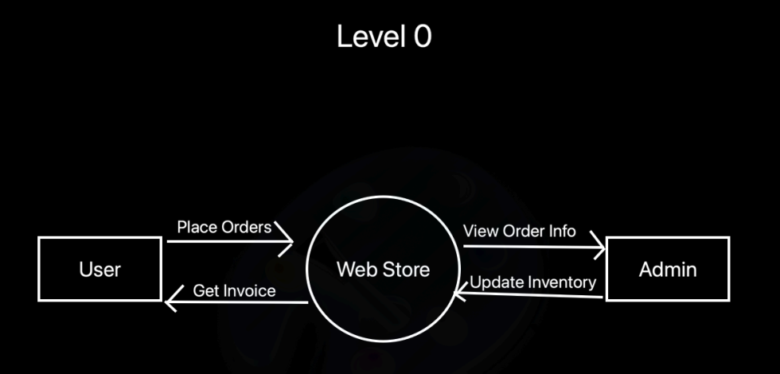
System Requirements : Data Flow Diagram (Level 0)
Notes:
Michael

Slide 4
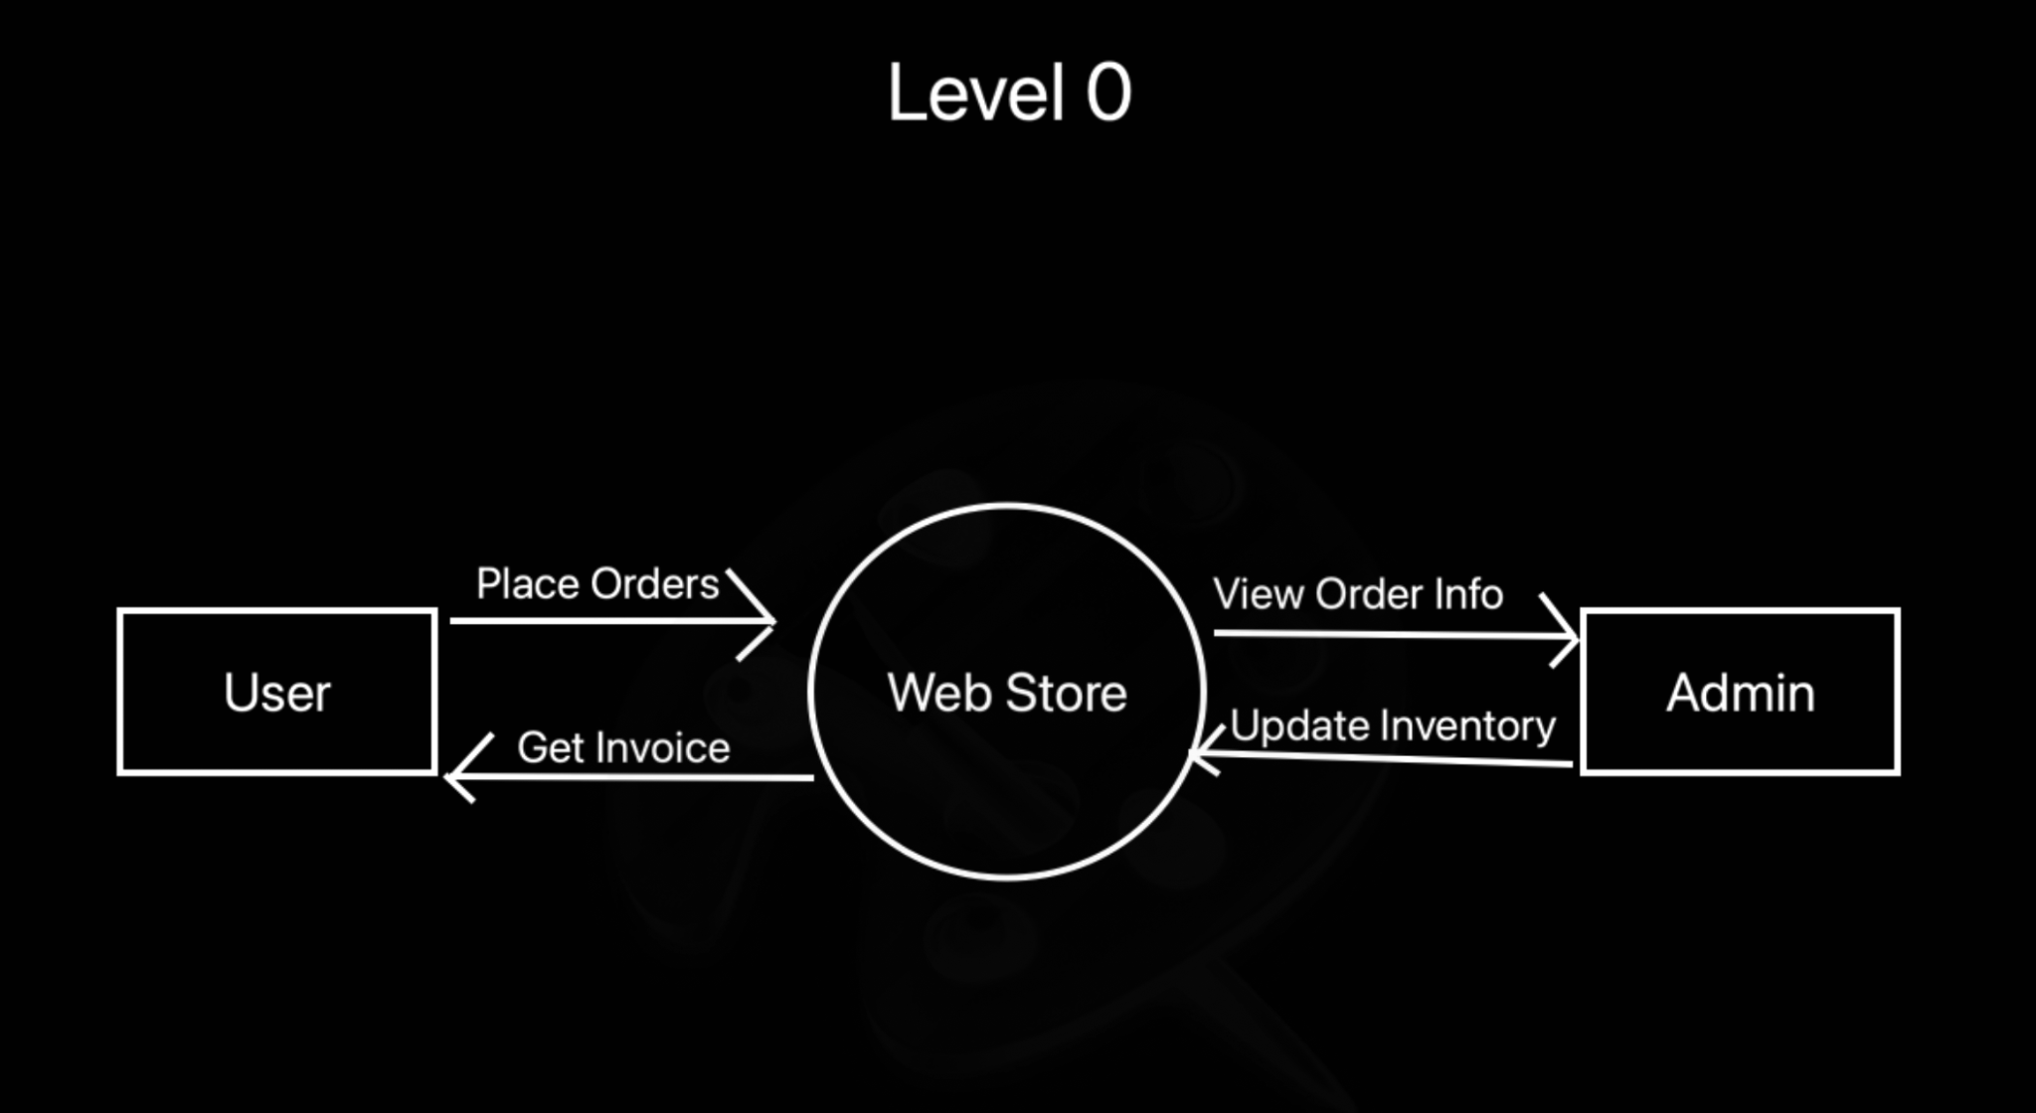
System Requirements : Data Flow Diagram (Level 0)
Very simplified view
Users can place orders through the store page
Will receive an invoice once order is placed
Admin can view and update store inventory as well as view info about previous orders
Notes:
Michael

Slide 5
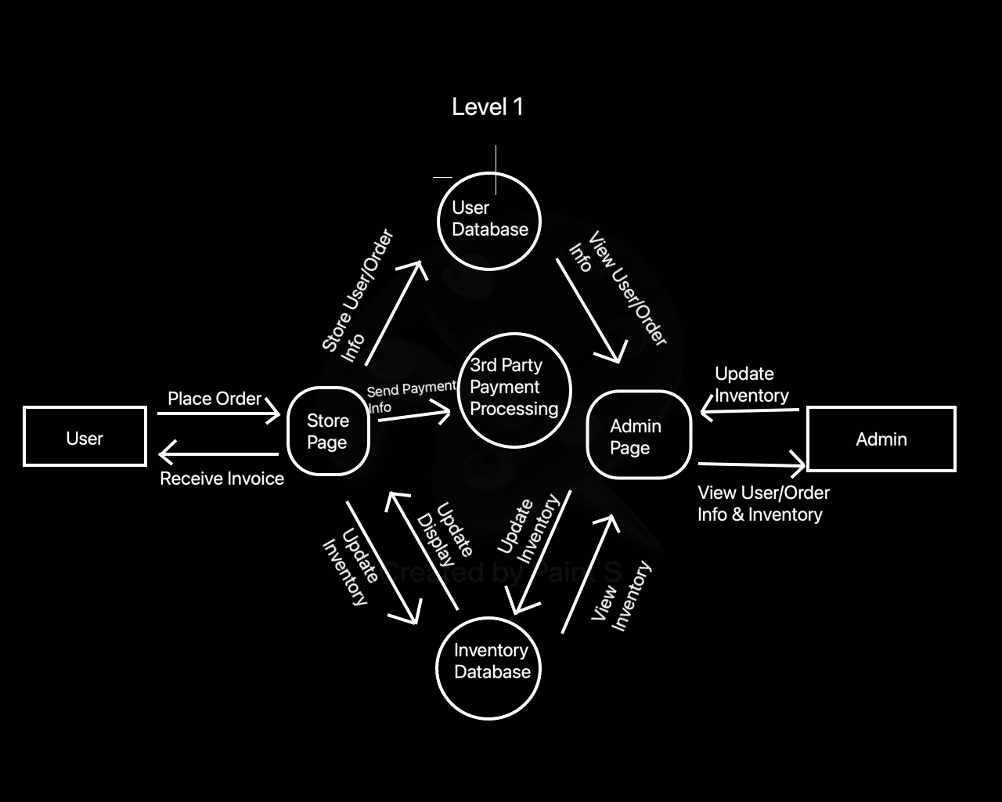
System Requirements : Data Flow Diagram (Level 1)
Notes:
Michael

Slide 6
System Requirements : Data Flow Diagram (Level 1)
More complex view
Frontend consists of user-focused store page and admin-only admin page
Backend consists of database of user info/order history, database of inventory, and third party payment processing
Notes:
Michael

Slide 7
Peer testing 1 Milestone
Has minimal backend interaction
A mobile-friendly storefront
Notes:
Sai
By milestone 1
we aim to have our hosting solution (web server) sorted and
our website will be up and running with proof of functional backend

Slide 8
Peer testing 2 Milestone
Storefront is good-looking & mobile-friendly
Has complete back-end integration
Has a fully functional database structure
Completed purchase form (no actual payment or order fulfillment)
Notes:
Sai
By the second milestone
our team aims to have a completely working storefront,
(click)
With full back-end integration
(click)
This includes functional database
(click)
and functional purchasing form, however we do not intend to fully integrate Square or order fulfilment at this stage.

Slide 9
Final deliverable
All prior milestone objectives
Fully functional invoice creation
Proper payment processing
Notes:
Sai
our final deliverable will be what is outlined in our first presentation.
(click)
At this point, in addition to the previous milestones, we will have invoicing and receipts fully integrated.
(click)
And we have proper payment processing

Slide 10
Functional Requirements:
The user will choose:
Location (from a list of available locations)
Number of bags of firewood desired
User automatically receives an invoice
Website makes payment (using square)
Or invoice for cash payment upon pick up
Receipt is generated automatically
Notes:
Paul
For our functional requirements:
The user must be able to choose a location from a list of locations, and the number of bags of firewood they want, limited by the number available at that location.
The website must be able to automatically generate an invoice for that user.
The website must also be able to accept payment using Square, the credit card processor we will be using.
Lastly, the website needs to be able to automatically generate a receipt.

Slide 11
Non-Functional Requirements:
Easy to use interface
Stock is automatically updated on sale
Out of stock locations hidden from pickup location list
Admin can login to confirm location restocks
Pickup address hidden until after purchase confirmation
Store customer purchase information
Notes:
Paul
For our non-functional requirements:
The user interface must be easy to use, even for those that do not use computers regularly.
The stock listed on the website should be automatically updated after a sale.
Website administrators must be able to update stock on the website when a restock occurs.
The pickup address should be hidden from the customer until after purchase confirmation.
As well, the website needs to be able to store customer purchase information.

Slide 12




MERN tech stack
Notes:
Stang
MongoDB for our database needs
Express.js to host our
React website
All tied in with NodeJS in the backend

Slide 13
Why?
All Technology is open source
Extensive documentation
MongoDB is a great option for our relatively small dataset.
Express suits our serving needs.
React is a good fit for look and feel
Node.js ensures javascript is our language of choice
Notes:
Stang
All the technology is open source, free, and used by a large community.
Extensive documentation means we can reduce time it takes to become proficient in certain development aspects.
MongoDB is a great option for our relatively small dataset in terms of human readability and functionality with our other javascript tech components. (JSON)
Express can serve our React app good enough with low performance overhead, a perfect fit for a low-cost hosting solution
React is perfect for the kind of look and feel we are going for, very easy to add intractability and scaling can be achieved with very little effort.
Node.js ties everything together with javascript which is simple to read and write, and has powerful package support which we can leverage to make development simpler. Great for prototyping new features quickly

Slide 14


Alternative stacks (and why they won’t work)
MEAN stack? (Angular vs React)
React is strictly faster
Smaller bundle size
JS library vs front end framework
LAMP stack
Archaic
Overkill for our needs
Relational database not necessary
Notes:
Stang
Mean Stack
Mongo, express, angular, nodejs
React has a smaller bundle size all together and is faster to run our relatively low footprint page as opposed to angular which is a whole frontend framework
As we’re going to see with the next stack this is rather overkill
Lamp stack [LINUX, APACHE, MYSQL, Php and it’s derivatives (WAMP etc)
Not to say there’s anything wrong with it, personally I like this stack for it’s simplicity at scale but for our purposes a lot of it is not necessary
but they’re not as commonly known today and work better for creating very robust scalable solutions
SQL in particular is very extreme for our use case

Slide 15
Testing:
Our stack gives us lots of flexibility for testing based on the availability of testing libraries for JS
Back end:
Unit tests to ensure certain aspects of our API work
Front end:
Chrome's developer tools
Regression tests with different browsers
If something breaks, we can isolate the incident
Postman, a REST client, will ensure our API is secure and can’t be spoofed by hackers who would steal information
Notes:
Paul
Our tech stack gives us lots of flexibility for testing based on the availability of testing libraries for Javascript.
On the back end, we can use unit tests to ensure certain aspects of our API function properly.
And on the front end, we can use Chrome's developer tools and regression tests with different browsers. This way, if something breaks, we can isolate the incident.
We will also use Postman, a REST client. This will ensure our API is secure and can’t be spoofed by hackers who may steal information for nefarious purposes.

Slide 16
Thank you

