Slide 1
MiniProjectIII_Dashboard_golla2s
File created on: 8/10/22 4:52:10 PM MDT

Slide 2
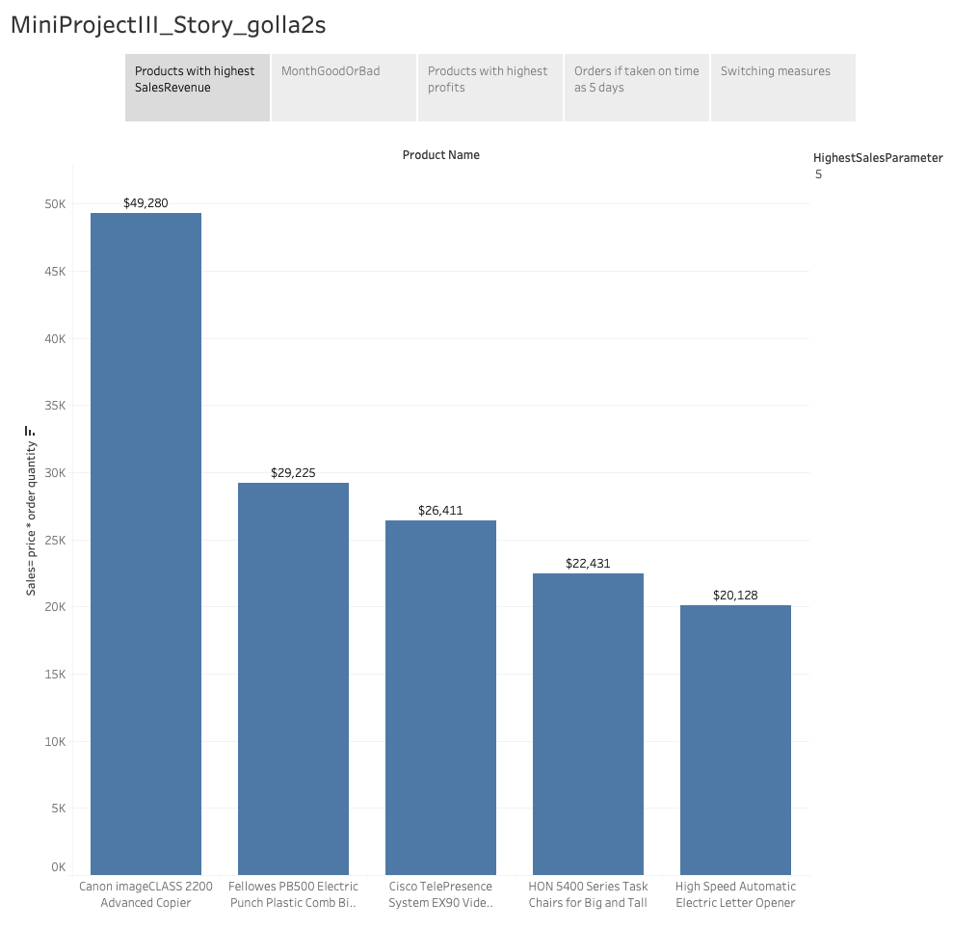

Slide 3
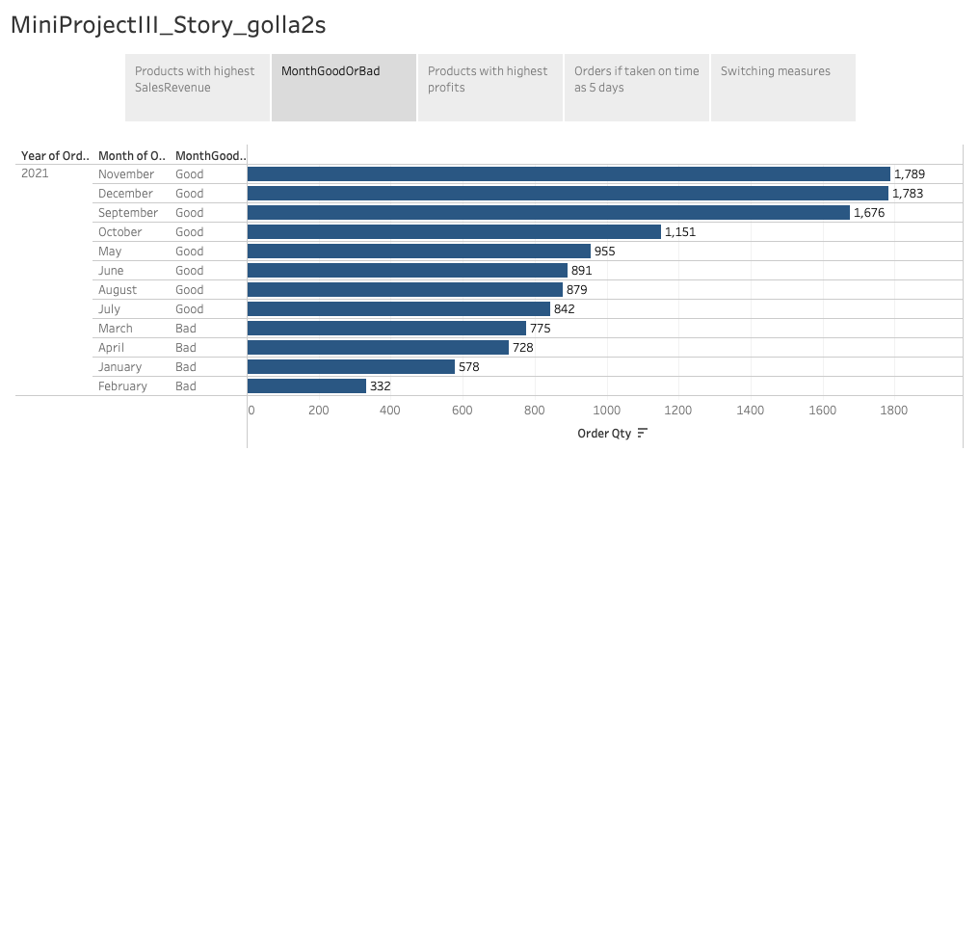

Slide 4
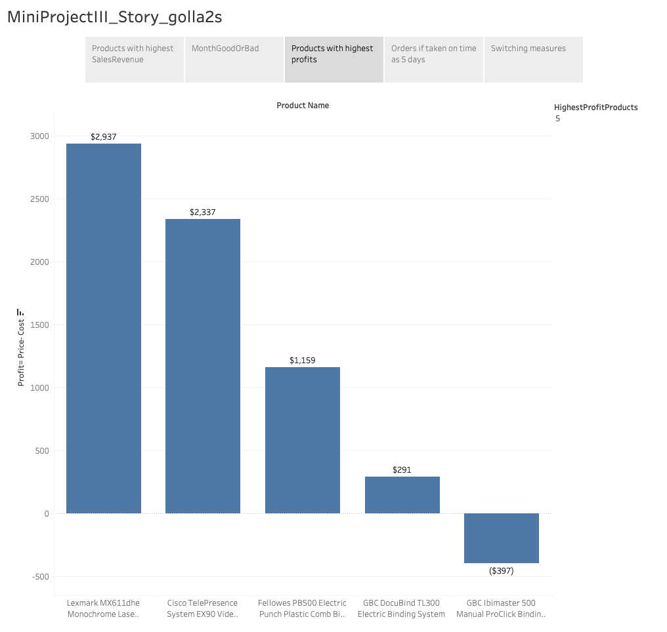

Slide 5
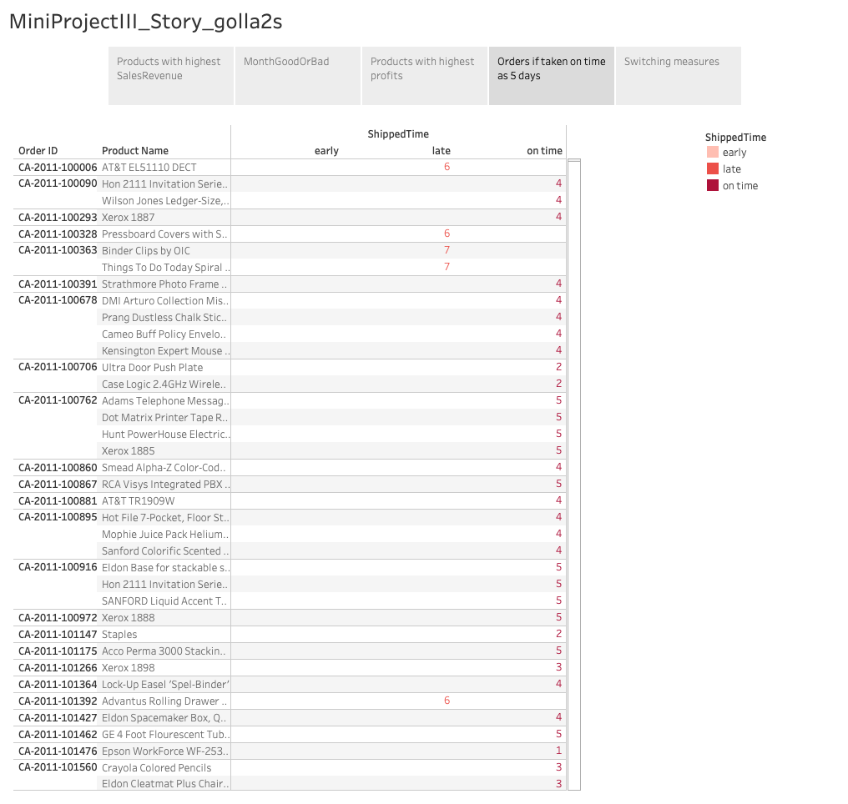

Slide 6
