Slide 1

Smart Traffic Prediction and Caching Using Machine Learning Techniques in Fog Radio Access Networks Mini Project Title
Presented By:
Raguru Sai Sandeep(121003216)
Veeravalli Satya Manasa(121003303)
Vegulla Naga Sai Sowmitri(121003304)
CSE
School of Computing
SASTRA Deemed University
Guided By:
Meena V
AP-III
CSE
School of Computing
SASTRA Deemed University

Slide 2
Agenda
Problem Statement
Literature Survey
Architecture
Proposed Methods
Data Set
Flow Chart
Implementation
Experimental Results
Conclusion
References

Slide 3
Base Paper Details
IF-RANs: Intelligent Traffic Prediction and Cognitive Caching Toward Fog-Computing-Based Radio Access Networks, IEEE Wireless Communications ( Volume: 27 , Issue: 2 , April 2020 )
DOI: 10.1109/MWC.001.1900368
Scopus / SCIE
AUTHORS:
Long Hu Yiming Miao Mubarak Alrashoud
School of Computer Science B.S. degree from the College of Department of Software Engineering
and Technology at Huazhong Computer Science and Technolog, and Information Sciences, University,
University of Science and Qinghai Univerisity, Xining, China, King Saud Riyadh, Saudi Arabia
Technology (HUST) in 2016

Slide 4

Problem Statement
The rapid development of wireless communication and smart devices, the traditional architecture of cloud is unable to meet the increase in the requirements day to day.
To meet the requirements efficiently and to provide good quality of service(QoS) to the end users F-RAN has become a solution.
But there are some challenges to be resolved regarding infrastructure, network traffic and caching mechanism of F-RANs.

Slide 5

Problem Statement
Challenges:
Communication Latency
Conflict of Bandwidth Resources
Increasing Computing Pressure of the Base Station and the Cloud

Slide 6

Literature Survey

Slide 7
Year | Proposed Strategy | Description
2015 | Throughput Maximization in C-RAN System | Maximizing the total throughput of cloud radio access networks (CRANs) in which multiple radio remote heads (RRHs) are connected to a central computing unit known as the cloud. ... Hence, the paper maximizes the throughput which is defined as the number of correctly received bits.
2017 | Content Delivery in D2D Networks (Device to Device Communication) | The use of smartphones and data-hungry applications in radio access networks are increasing dramatically worldwide. This growth impacts the ability of traditional wireless networks to meet the required QoS for its user devices (UDs). D2D communication technique is exploited to distribute the popular content as such to offload the CBS and reduce network congestion in the cellular networks.
2018 | CBS Offloading in F-RAN System (Cloud based Service) | F-RAN has been introduced to exploit both EC and C-RAN for carrying out file delivery effectively. In order to further improve the performance of F-RANs, implementing D2D communications in F-RAN is shown to be a potential technology in 5G and beyond. This integrated system is referred as D2D-aided F-RAN.
2018 | Cooperative F-RAN and D2D Communications(Device to Device Commmunication) | F-RAN has been introduced to exploit both EC and C-RAN for carrying out file delivery effectively. In order to further improve the performance of F-RANs, implementing D2D communications in F-RAN is shown to be a potential technology in 5G and beyond. This integrated system is referred as D2D-aided F-RAN.

Slide 8
Literature Survey
1.Throughput Maximization in C-RAN System (Cloud Random Access Network System)-2015
Maximizing the total throughput of cloud radio access networks (CRANs) in which multiple radio remote heads (RRHs) are connected to a central computing unit known as the cloud.
Hence, the paper maximizes the throughput which is defined as the number of correctly received bits.

Slide 9
Literature Survey
2. Content Delivery in D2D Networks-2017
Evaluating the throughput performance of a mobile network cell where device to device (D2D) communication, using part of the resource blocks of the considered cell, is used to offload the base station (BS) of part of its content delivery traffic.
A multi-class processor sharing model is developed to determine the optimal resource partition between D2D and BS subsystems and evaluate the resulting throughput performance.

Slide 10
Literature Survey
3. CBS Offloading in F-RAN System (Cloud based Service)-2018
Maximizing cloud offloading by finding an efficient schedule of coded file transmissions from the eRRHs and the cloud base station (CBS).

Slide 11
Literature Survey
4. Cooperative F-RAN and D2D Communications(Device to Device Commmunication)-2018
Device-to-Device (D2D) communication can support the operation of cellular systems by reducing the traffic in the network infrastructure.
Offline caching, out-of-band D2D communication, and an F-RAN with two edge nodes and two user equipments, an information-theoretically optimal caching and delivery strategy is presented that minimizes the delivery time in the high signal- to- noise ratio regime.
The delivery time accounts for the latency caused by fronthaul, downlink, and D2D transmissions.

Slide 12

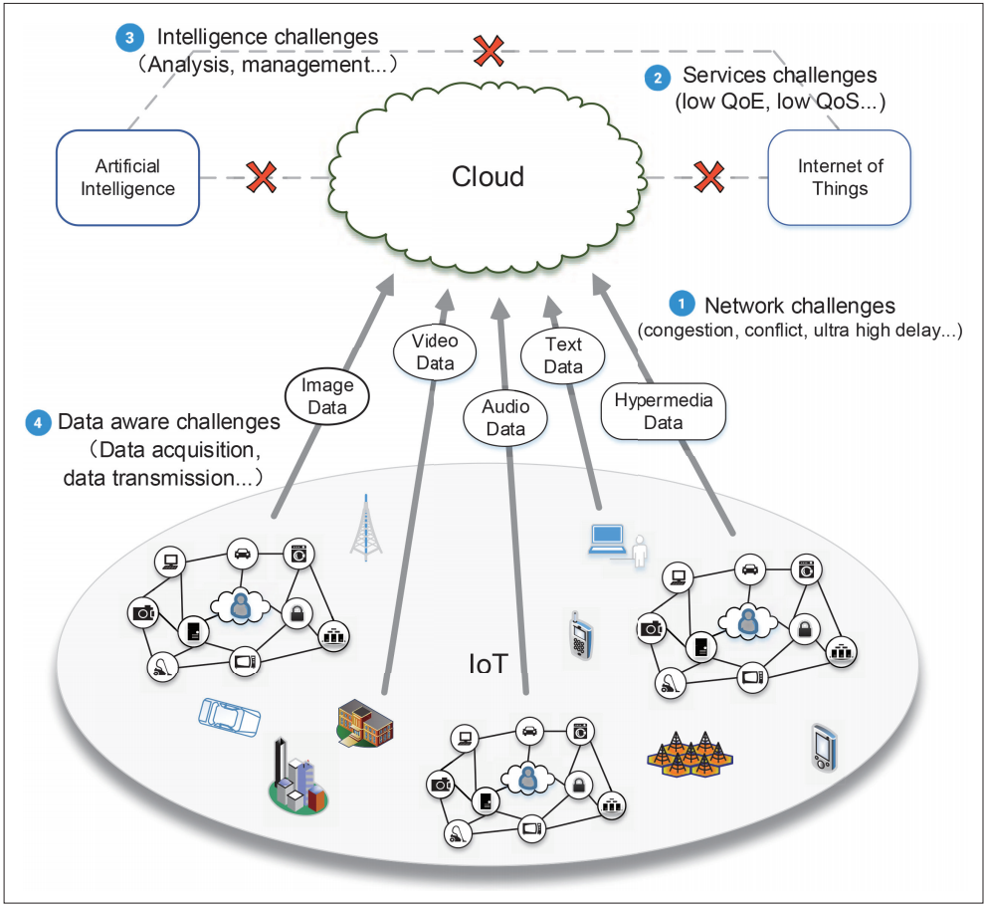
Architecture
Traditional cloud computing based IoT architecture and challenges.
Challenges Faced:
Network challenges
Services challenges
Intelligence challenges
Data aware challenges

Slide 13

Proposed Methods
Traffic prediction based on LSTM(Long short term memory).
Cognitive Caching based on LRU(Least Recently Used) and LFU(Least Frequently Used).

Slide 14

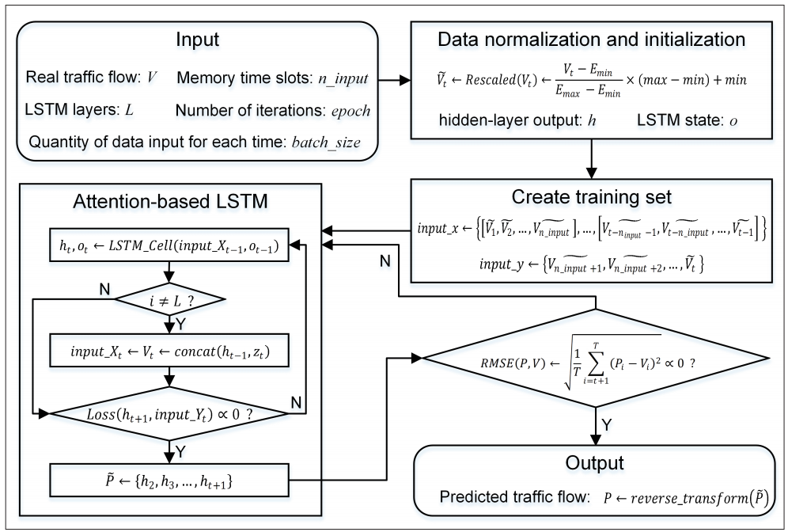
Traffic prediction based on LSTM(Algorithm)

Slide 15

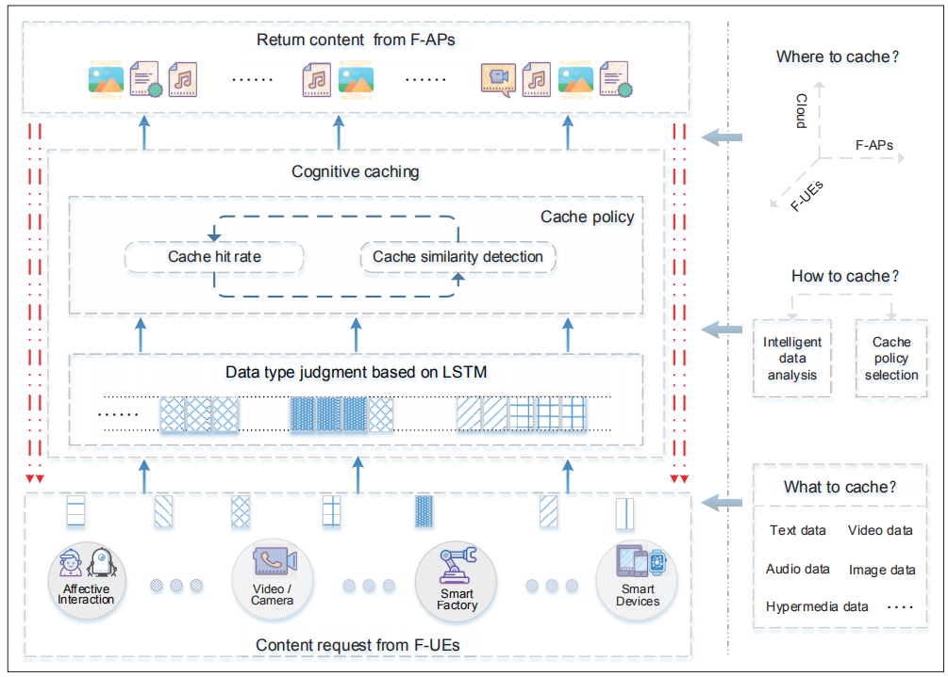
Cognitive Caching based on LSTM and Collaborative Filtering

Slide 16

Data Set
Request frequency to a cloud from four nodes in a network over two months.

Slide 17
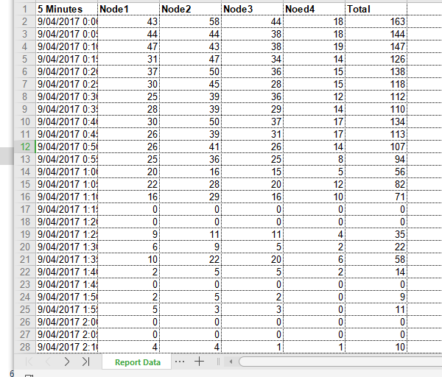
Data Set Sample

Slide 18
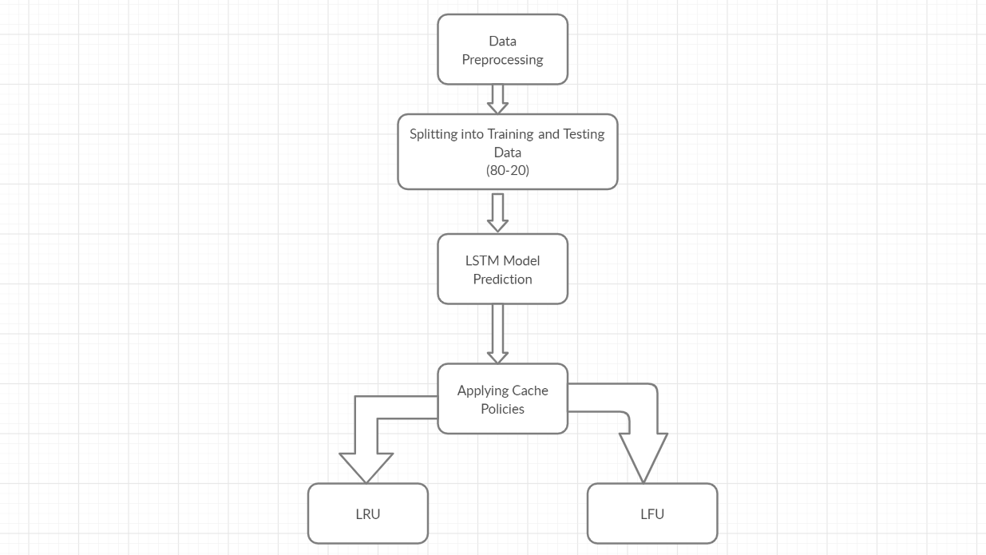
Flow Chart

Slide 19
Modules
1. Combining different excel data sheets into one single module(merge.ipynb)
2. Preprocessing the Data(read.ipynb)
3. Prediction using LSTM(lstm_prediction.ipynb)
4. Applying Cache Policies:
i. LRU Algorithm(lru.ipynb)
ii. LFU Algorithm(lfu.ipynb)
5. Graph Depiction of Cache Algorithm Results(compare.ipynb)

Slide 20
Implementation
Data collected contains 4 node request rates to a cloud over two months period.
Each 15 days data is collected seperatly.
Files are merged and preprocessing is done.
Preprocessing includes removal of non-variant columns, removing invalid tuples and normalisation.
Implementation of LSTM algorithm for traffic prediction.
Applying LRU(least recently used) and LFU(least frequently used) cache policies on dataset.
Comparing the results.

Slide 21
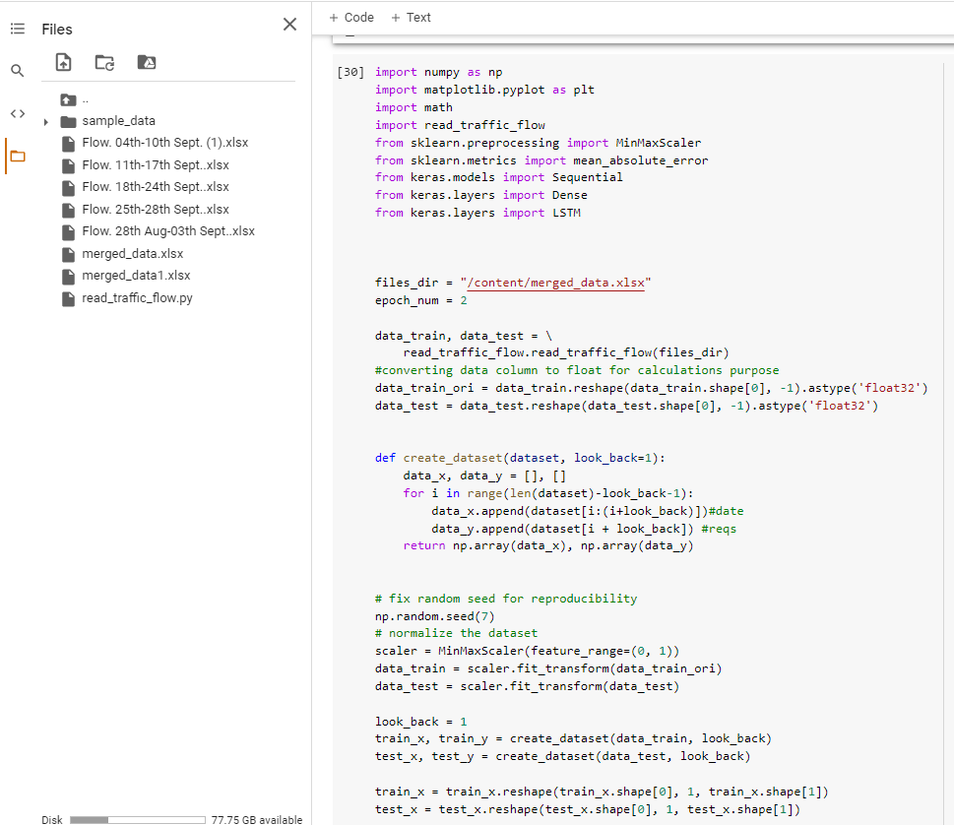
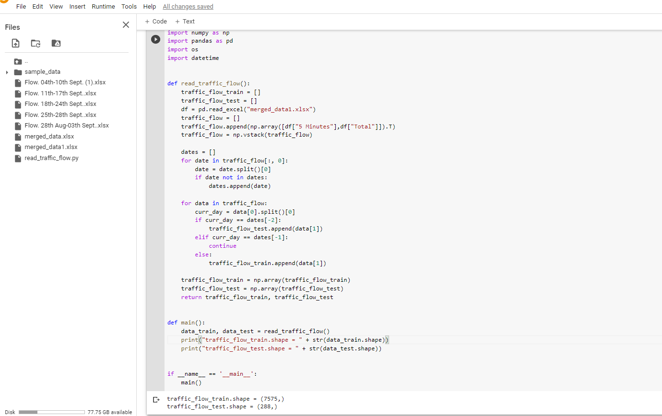
Implementation
Main code of LSTM implementation
Splitting into train and test data

Slide 22
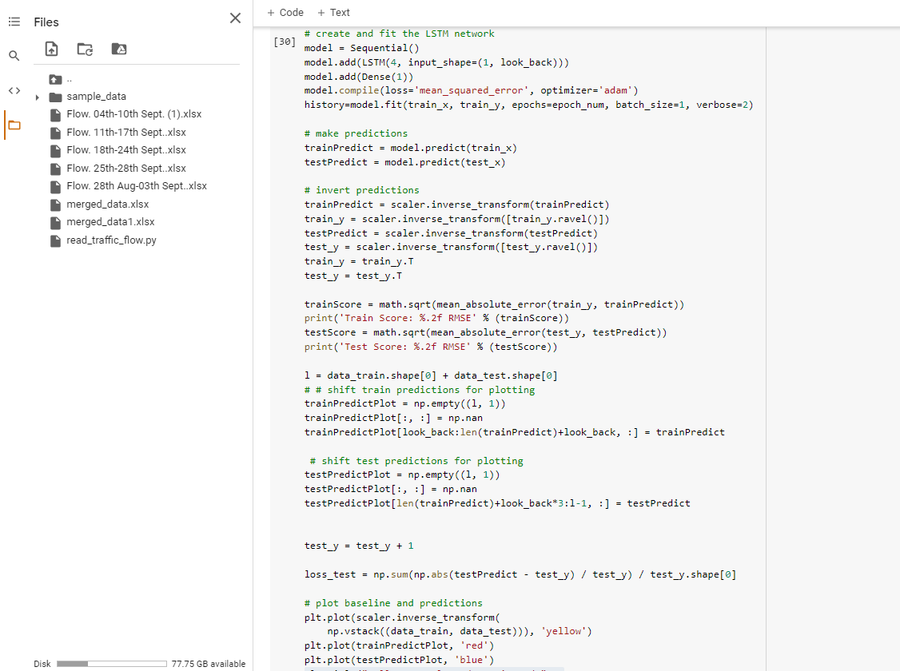
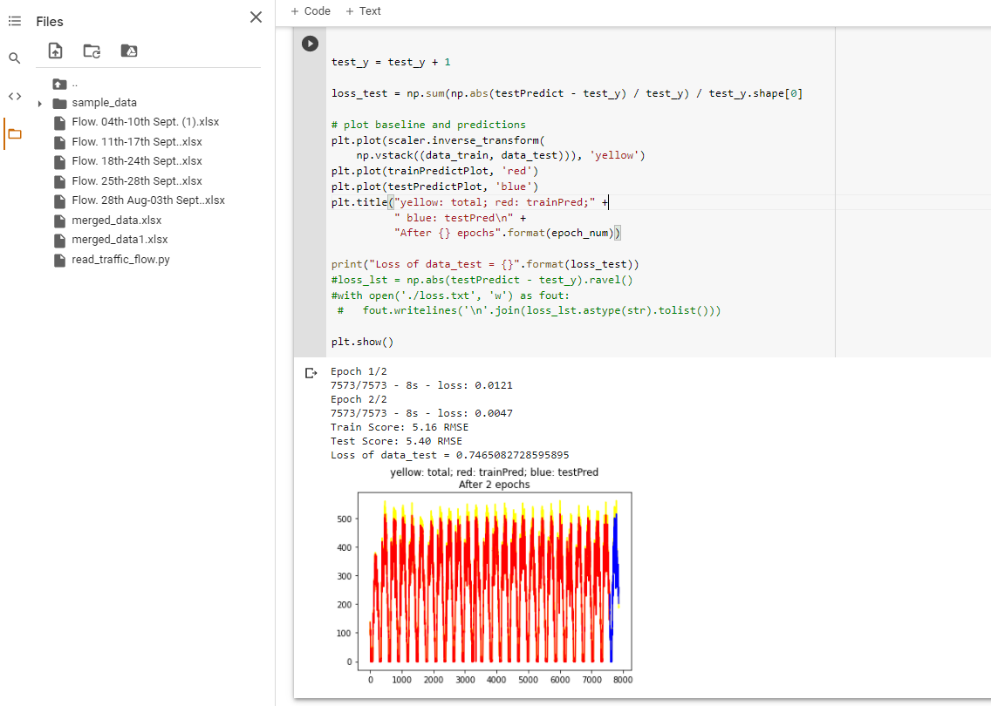
Implementation
LSTM layers
LSTM prediction output

Slide 23
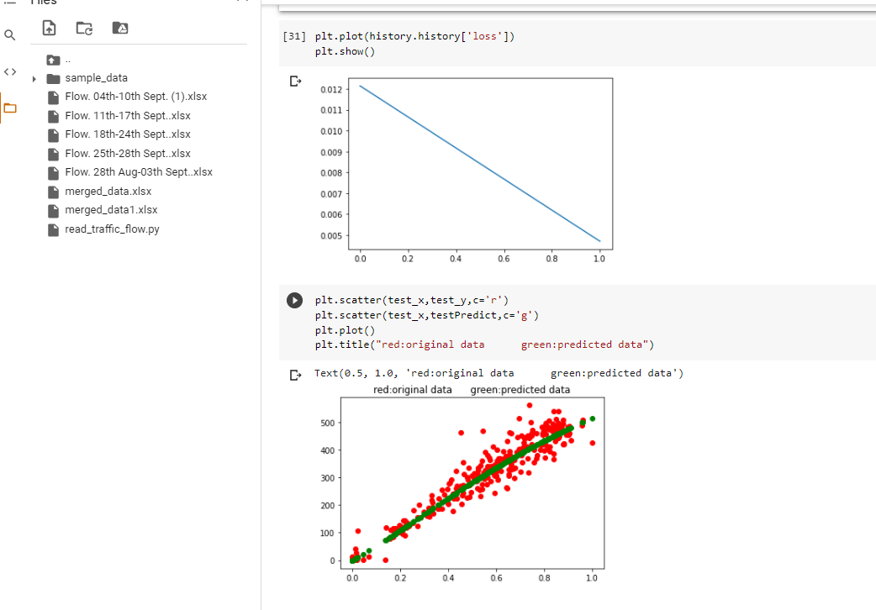
Implementation
Plot of test data vs epochs and train vs test data(LSTM)

Slide 24
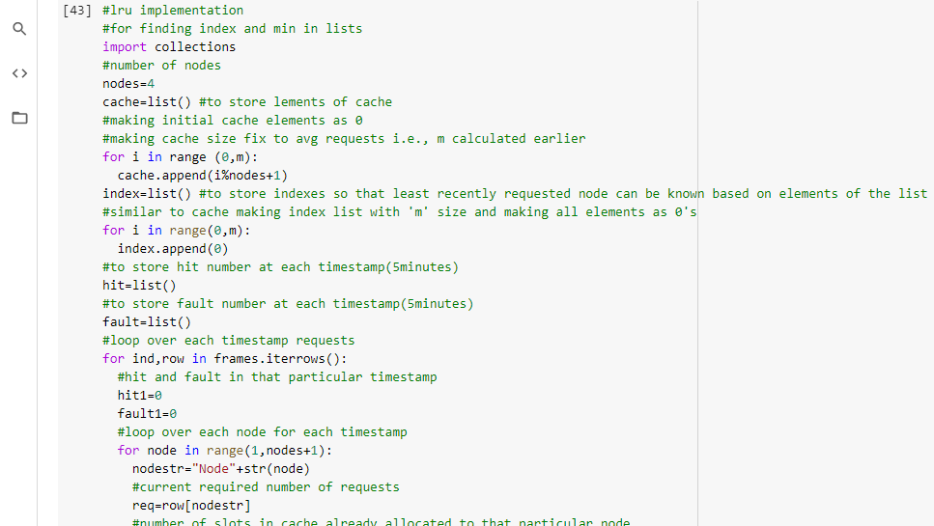
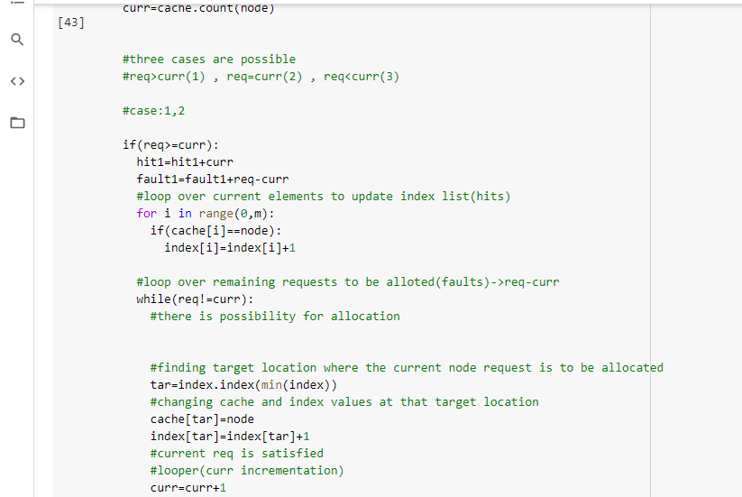
Implementation
LRU cache main code

Slide 25
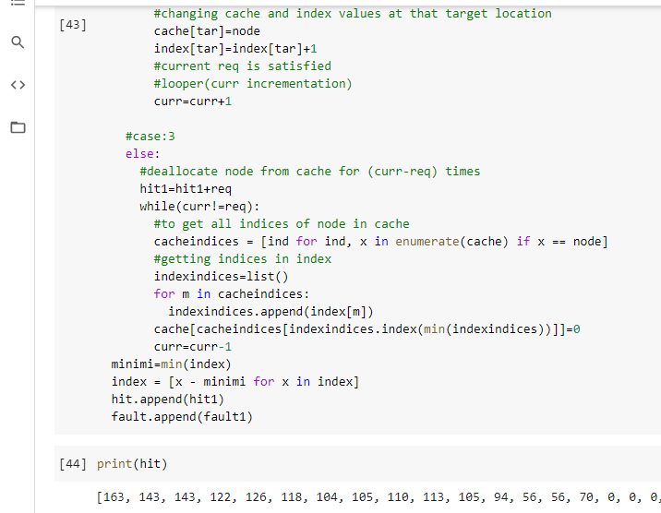
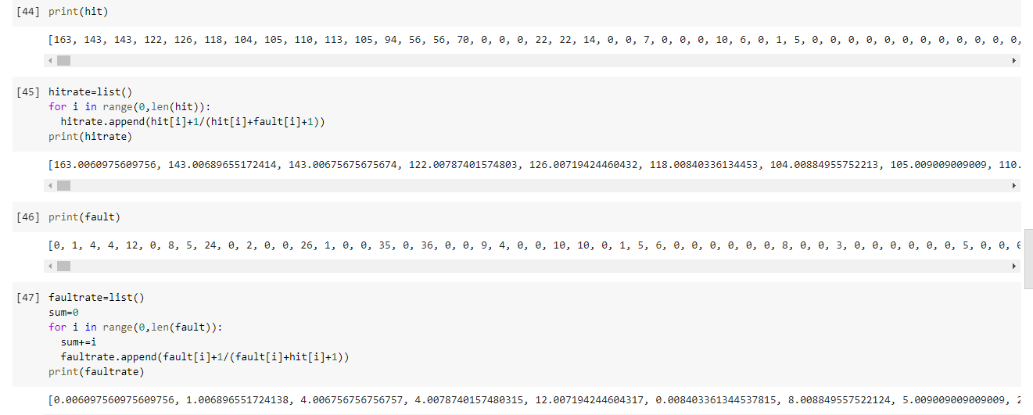
Implementation
LRU cache hit and fault rate calculation

Slide 26
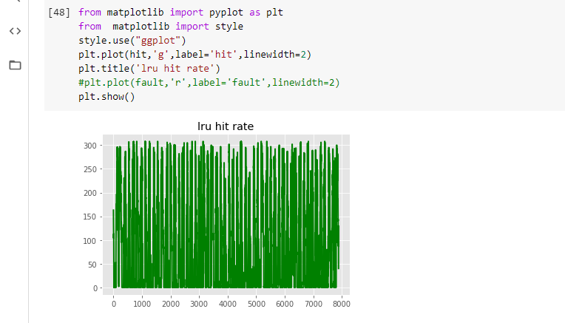
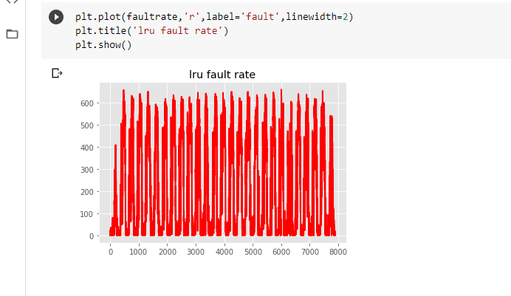
Implementation
LRU cache variation of hit and fault rates
Hits
Faults

Slide 27
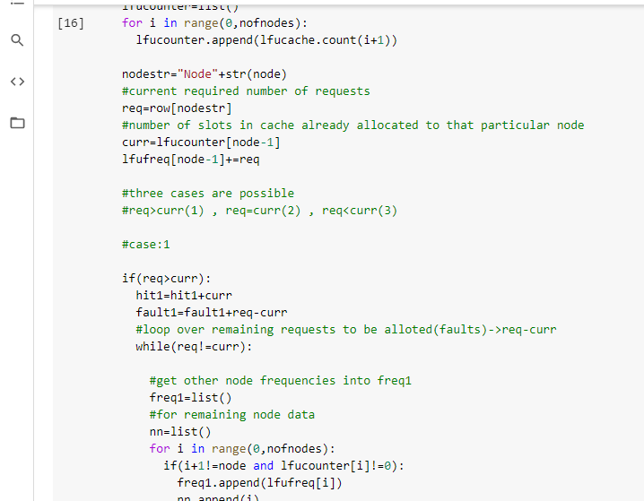
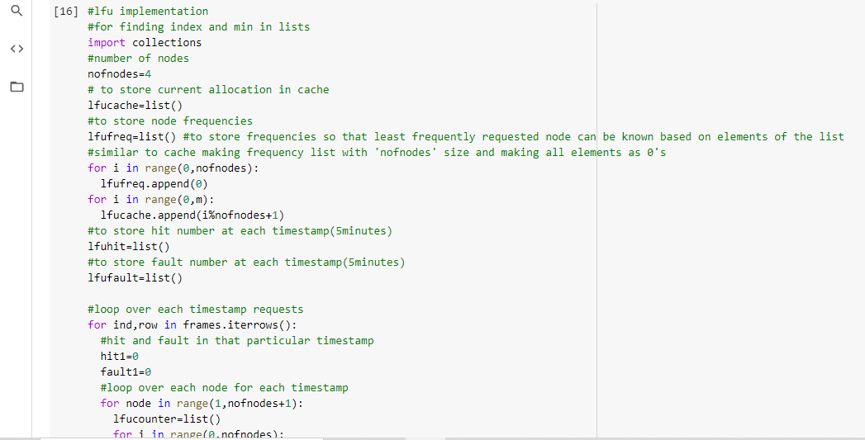
Implementation
LFU main code

Slide 28
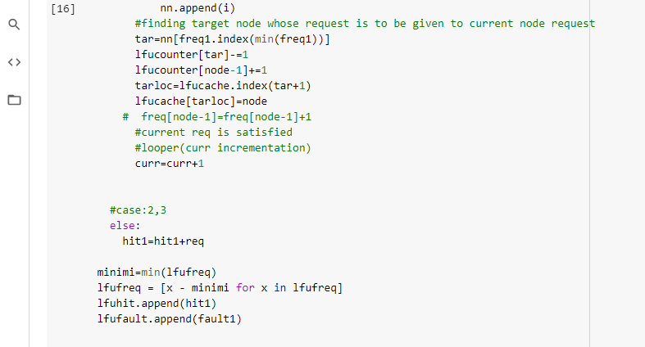
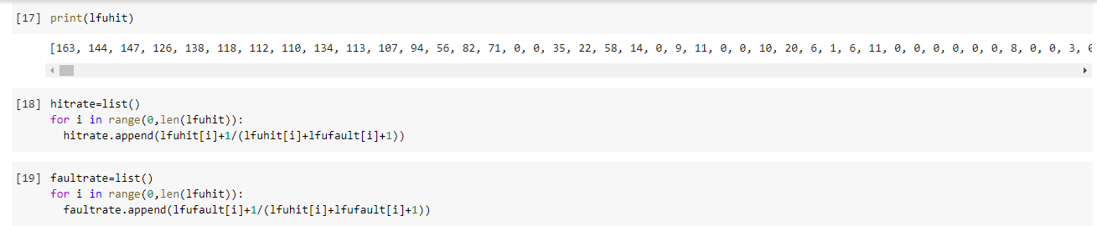
Implementation
LFU hit and fault rate calculation

Slide 29
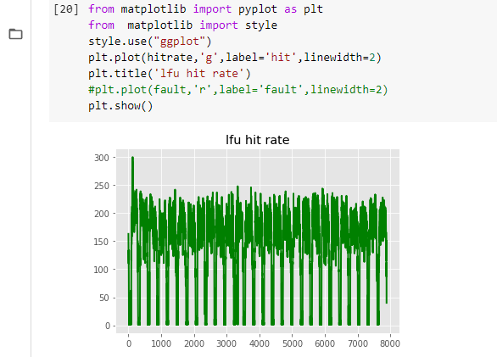
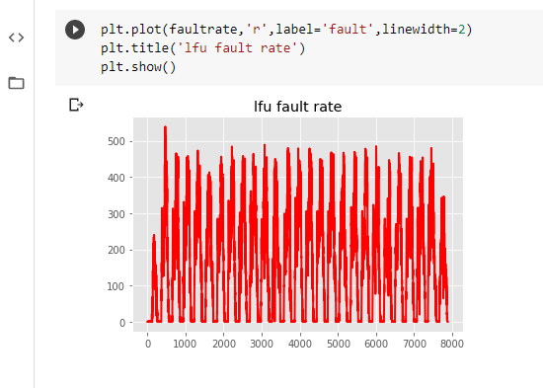
Implementation
LFU cache variation of hit and fault rates
Faults
Hits

Slide 30
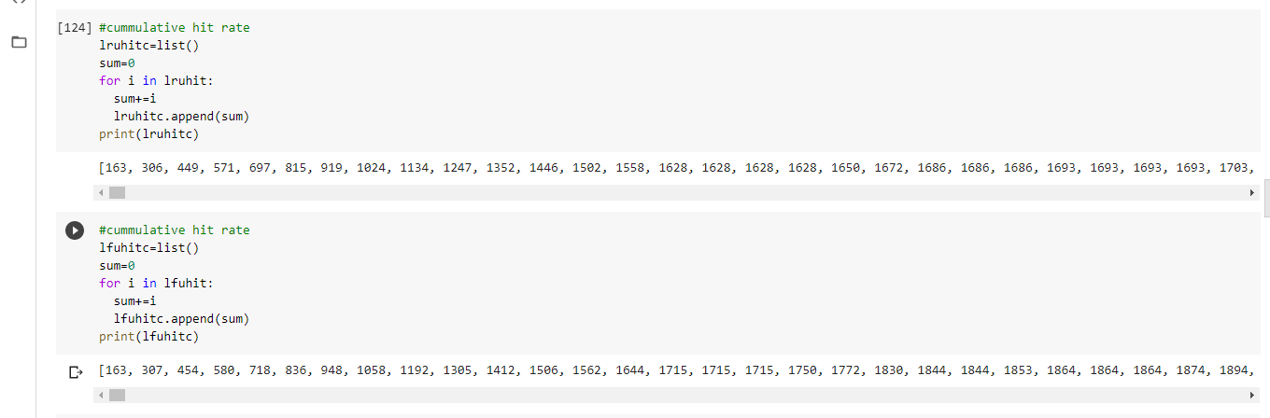
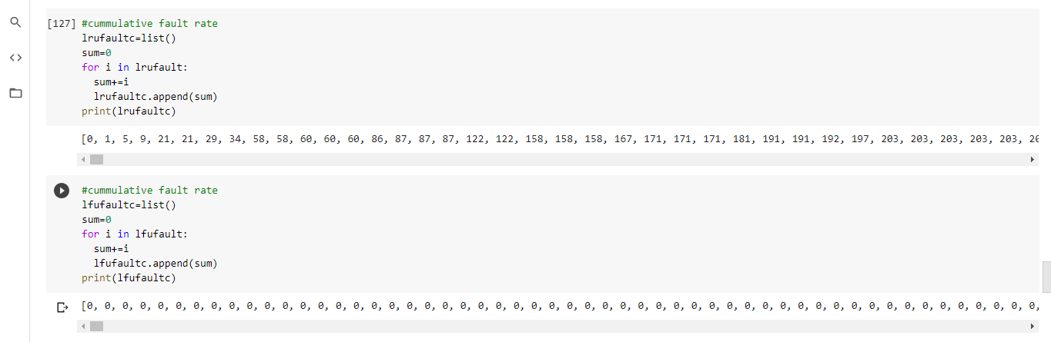
Implementation
Calculation of cumulative hit and fault rates for comparision of caching policies

Slide 31
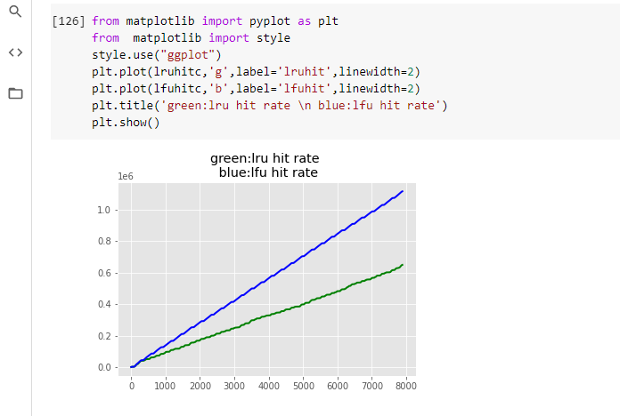
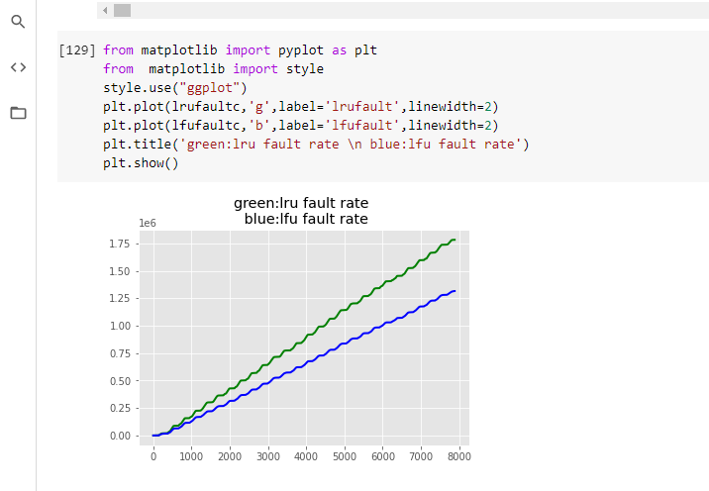
Implementation
LRU vs LFU comparision
Hit rate comparision(cumulative)
Fault rate comparision(cumulative)

Slide 32
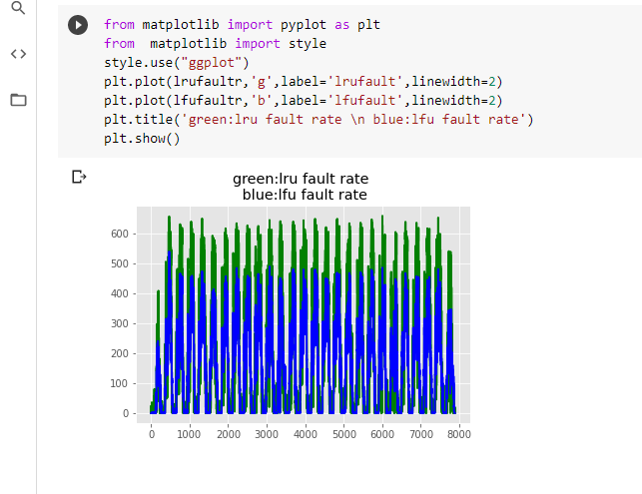
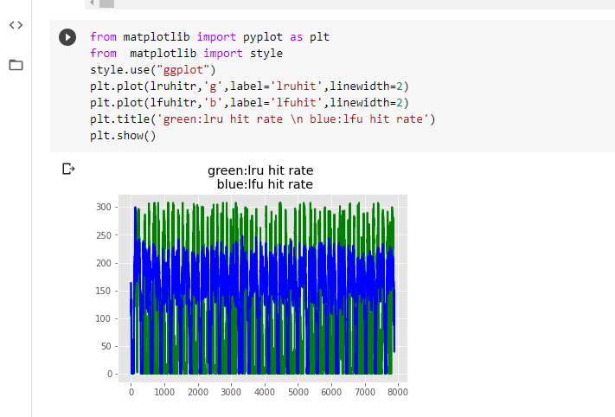
Implementation
LRU vs LFU comparision
variation of hit rate
Variation of fault rate

Slide 33
Experimental Results
In the experimental environment, F-UEs request three types of content (text data, image data, and video data) from F-APs.
A total of 7500 historical logs were collected from F-APs and divided into training dataset (6500 pieces of data) and test dataset (1000 pieces of data).
The datasets were used for training and testing the traffic prediction model and the cognitive caching model.
The proposed algorithm can accurately predict the trend of real-time traffic. Therefore, it can provide traffic information for IF-RANs

Slide 34
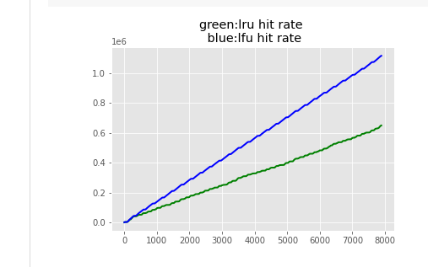
Experimental Results
LSTM network traffic prediction
LRU vs LFU hit rates

Slide 35
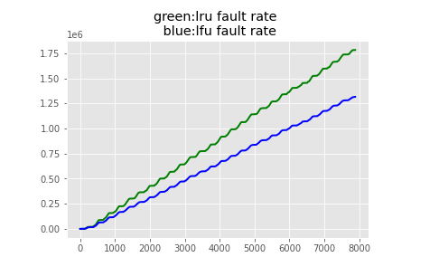
Experimental Results
Inference:
Comparision of hit and fault rate plots of LRU and LFU , LFU is efficient than LRU .
LRU vs LFU fault rates

Slide 36
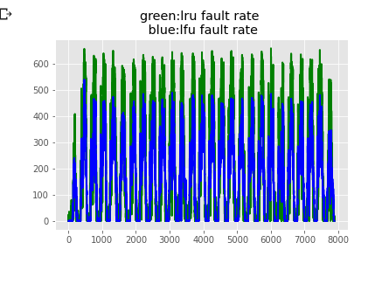
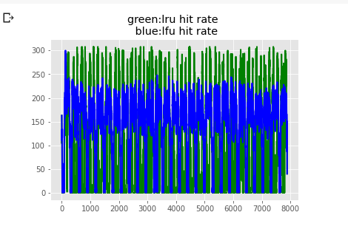
Experimental Results
LRU vs LFU hit rate variation
LRU vs LFU fault rate variation
Inference:
LFU hit rate is stable compared to LFU. LFU hit rate has lot of fluctuations.
LFU fault rate peaks are lower than LRU fault rate peaks. Both LRU and LFU have fluctuations in the graph.

Slide 37
Conclusion
First, the traditional cloud-based IoT architecture is discussed, and the development history of F-RANs in view of its shortcomings is summarized.
To meet the requirements efficiently and to provide good quality of service to the end users F-RAN has become a solution. But there are some challenges to be resolved regarding infrastructure, network traffic and caching mechanism of F-RANs.
So an attention-based LSTM algorithm is used to predict the service traffic flow with different requested data types.
Then a cognitive caching strategy based on LSTM and collaborative filtering is designed. The performance of the proposed LSTM-based traffic prediction algorithm and cognitive caching strategyis evaluated using simulation of IF-RAN architecture in a real environment.

Slide 38
References
https://ieeexplore.ieee.org/document/7508408
https://ieeexplore.ieee.org/document/7513863
https://ieeexplore.ieee.org/document/8726072
https://ieeexplore.ieee.org/document/6779679
https://ieeexplore.ieee.org/document/7498684
https://ieeexplore.ieee.org/document/8283747
https://ieeexplore.ieee.org/document/8675173

Slide 39


Slide 40
Thank You

