Slide 1

Nature Nurture
Team Members
Sai Sanjana Nedunuri (20MID0046)
Damini N (20MID0119)
T.Chandana Sree (20MID0158)
Kotha Kartikeya (21MIC0059)
Kotturu Keerthana (21MID0034)

Slide 2
Problem Statement
Farmers encounter weather unpredictability and market fluctuations, leading to suboptimal yields and financial losses.
Nature Nurture Company utilizes machine learning to offer precise crop recommendations, along with expert consultancy and an integrated e-commerce platform.

Slide 3
Market Study
We have analyzed three companies to understand the market.
Crop prophet
Agri marketplace
National Agricultural Market
CropProphet models the effect of weather conditions on crops using 40 years' worth of daily, county/sub-district level weather data.
Agri market place acts as a connecting bridge between farmers and purchasers by providing e-commerce services
The National Agricultural Market (NAM) is an agri-marketplace launched by the Government of India in 2016 with the initiative to create a unified market for agricultural products across the country.

Slide 4
Need Analysis
There are many companies that offer e-commerce services but have no support for farming, just as there are companies that provide support for farming but no e-commerce service. Nature Nurture offers both services to support farmers.
Companies like CropProphet take into consideration only climatic conditions for determining yield. There are other factors, like the contents of the soil, that have a major impact on determining the yield. Nature Nurture takes into consideration both climatic as well as soil contents to suggest the best farming practices.
With awareness about organic products, people are more inclined to buy organic fruits and vegetables. But very few companies promote organic farming, which is not sufficient to fulfil the increasing demand.

Slide 5
Factors motivating for starting the business
Market fragmentation and demand
Technological Developments
Efficiency and profitability
Sustainability and organic farming
Expertise and support
Initiatives and support the from the government.

Slide 6
Business Tagline
Our tagline is "Empower, Educate, Elevate.”
It implies empowering agriculture, Educating Farmers, and Elevating Harvests

Slide 7
Licenses , permits and NOC
Business Registration and Licenses
- Business Registration
- Agricultural Advisory license
Environmental clearances and NOC’s
- Environmental Impact Assessment
- No objection certificate from the local agricultural departments or authorities to carry out advisory and data collection activities.
Marketplace and Trading Licenses:
- Marketplace Registration
Transportation permits

Slide 8
Data Protection and Privacy Compliance:
- Data Protection Compliance : Nature Nurture collects and uses soil data. It should comply with data protection and privacy laws, ensuring data security for farmers.
Technology and Innovation Licensing:
- Software and Technology Licensing
Taxation and Regulatory Compliance:
- Goods and Services Tax (GST) Registration
- Income Tax and Corporate Tax Compliance
Labor and Employment Compliance:
- Employee Provident Fund (EPF) and Employee State Insurance (ESI)
Food Safety and Quality Standards:
- Compliance with Food Safety Standards

Slide 9
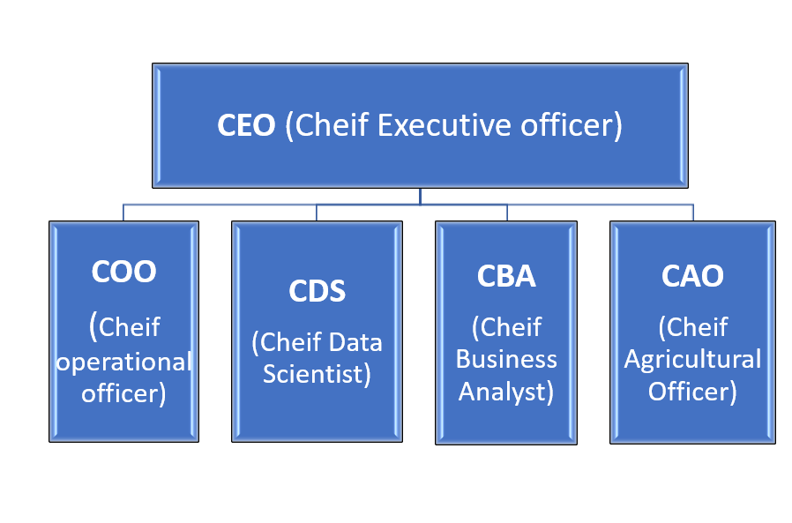
Management and employees

Slide 10
Sales Plan
Step 1: Recruiting and Engaging Farmers
Direct Outreach
Online Visibility
Collaborations
Step 2: Promoting the E-commerce Platform
Platform optimization
Marketing Techniques
Customer Feedback and Trust Development
Step 3: Customer Service and Sales
Sales Team
Client assistance
Loyalty Initiatives
Gathering of comments
Expansion Methodology

Slide 11
Business Marketing Plan
Content Marketing:
Social Media Marketing
Email Promotions
Search Engine Optimization (SEO)
Marketing Through Influencers
Workshops & Webinars
Ad Revenue (Secondary Revenue Stream)
Tracking and analytics

Slide 12
Financial Plan
Startup Costs
Operational Expenses (Monthly)
Revenue Streams
Ad Revenue
Scaling and Expansion
Contingency Fund
Profit Projections
Investment in Technology
Marketing and Growth Strategies

Slide 13
Management Plan
1. Before product launch:
Market investigation and analysis
Development of a business model
Compliance with laws and regulations
Development of Products or Services
.Financial planning
Team recruitment and Training
Marketing and branding
Technology and Infrastructure

Slide 14
Management Plan
2. During launch:
Product/Service launch
Customer Onboarding
Sales and Distribution
Operations management
Monitoring and Reporting

Slide 15
Management Plan
3. After launch:
Feedback and Improvement
Scaling and Expansion
Community building and Engagement
Financial management
Compliance with regulations

Slide 16
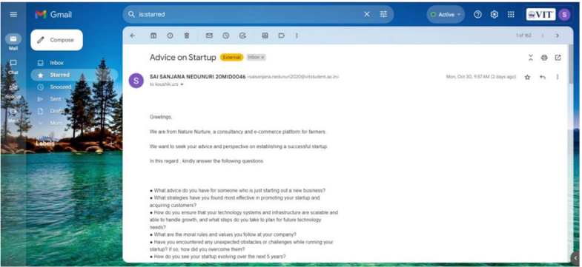
On experience of meeting start-up proprietor or any business person
Email sent Proof

Slide 17
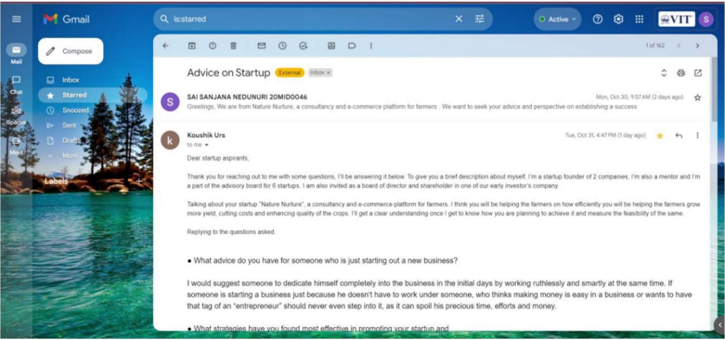
On experience of meeting start-up proprietor or any business person
Reply Proof

Slide 18
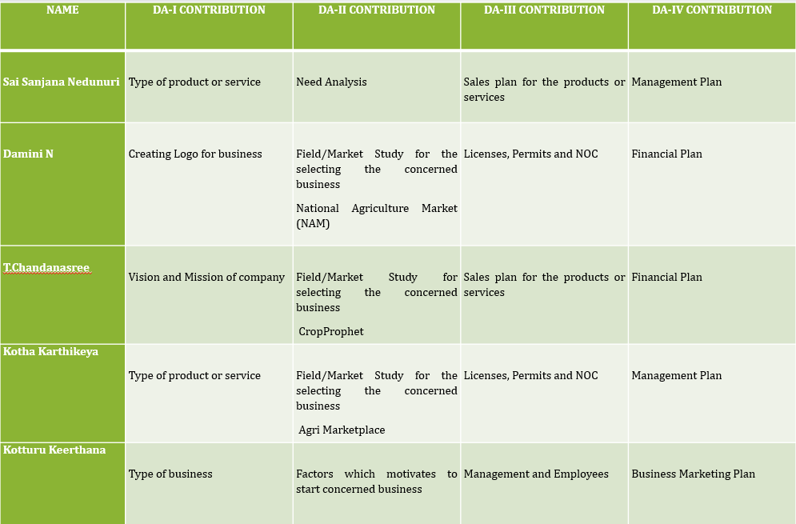
DA5- Contributed by all (Participated in the questioning)

Slide 19
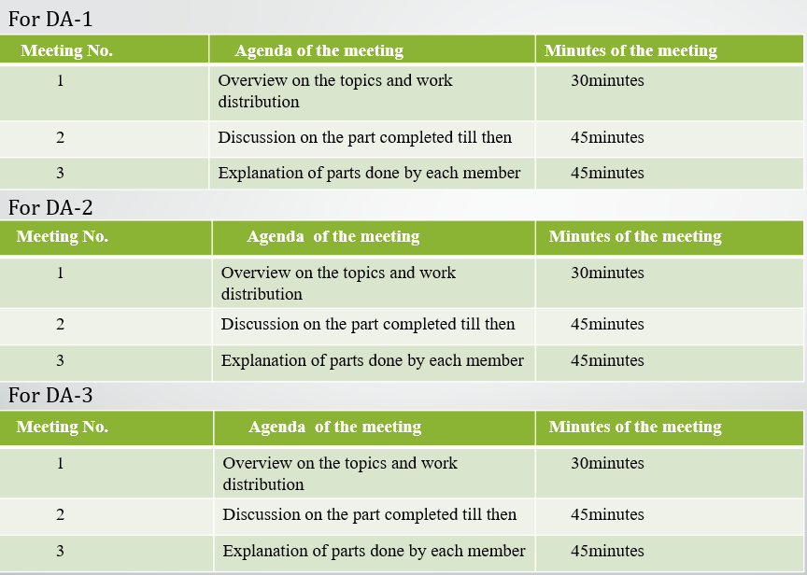

Slide 20
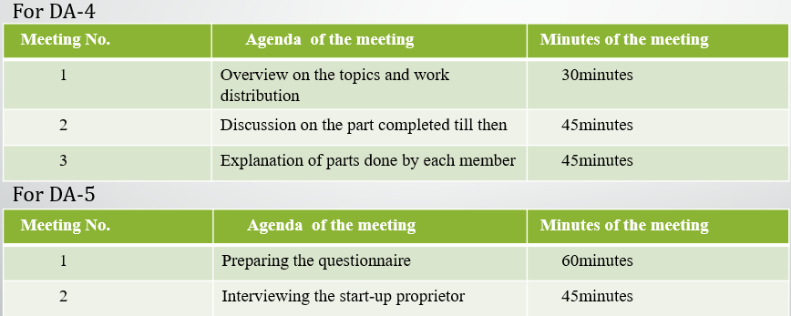

Slide 21
THANK YOU !!

