Slide 1
Buying/RENTING Property (LONDON)
Data Science Coursera Capstone
Sai Sasaank Srivatsa Pallerla

Slide 2
INTRODUCTION
House hunting is a difficult job and in this project we take London as an example. Where you live in London will have a huge impact on the land value. For instance, if you want to buy a properties close to business/ daily convenience, such as central London, Kensington, Chelsea or the Docklands it will cost you a six digit figure. However, if you move to sub urban areas of London, property become much more affordable.
To search for the house according to your preferences about the neighborhood, you'll need to browse the internet and find information by yourself. It is a consuming and tiring. To help with this process of searching for a new house and narrow down the search for the house according to user preferred neighborhood we designed this project. This project focuses on providing relevant and quality information to be used for a decision when choosing the best residence to live in.

Slide 3
Data
1. The data that contains all postcodes present in the Lewisham council in London is downloaded from doogal.co.uk. In this dataset, the mainly focus is the Lee Green ward to minimize the calls to Four square API. This dataset can als be accessed from the url "https://www.doogal.co.uk/AdministrativeAreasCSV.ashx?district=E09000023“
2. The Foursquare API enables developers to build applications that interact with the Foursquare platform. Venues data will be used in collaboration with the above dataset. Foursquare City Guide, commonly known as Foursquare, is a local search-and-discovery mobile app which provides search results for its users.

Slide 4
Methodologies
Data Wrangling/Cleansing
Exploratory Analysis
Machine Learning – K-means clustering

Slide 5
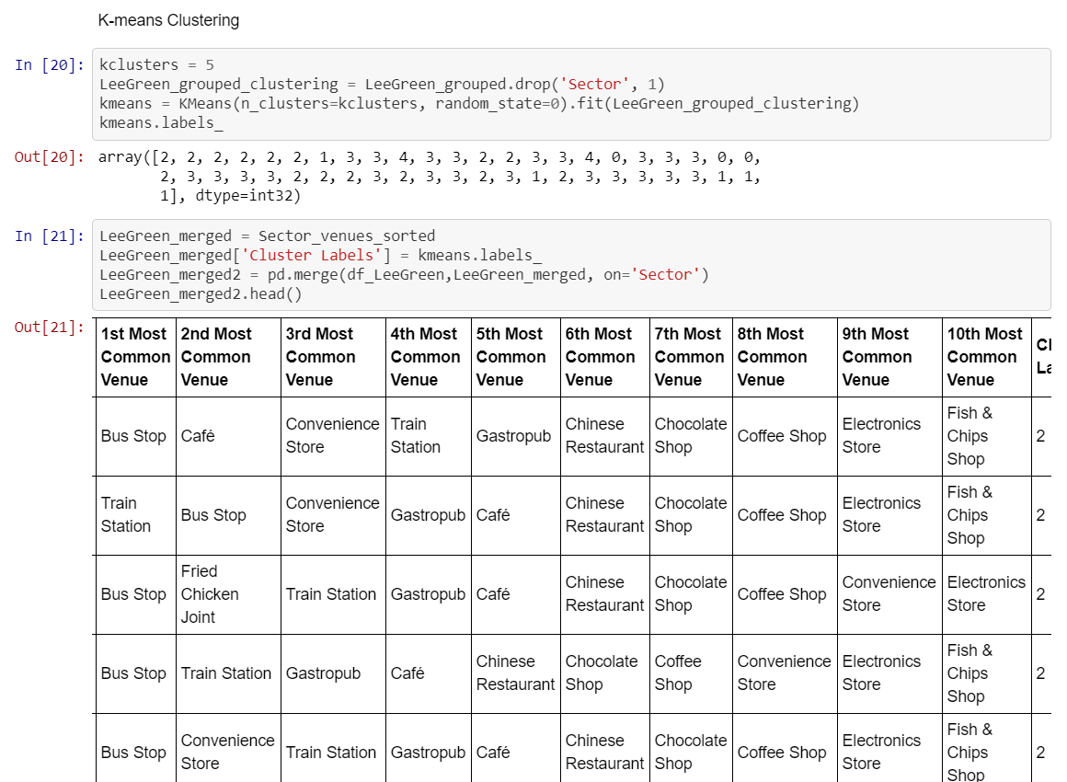
Results

Slide 6
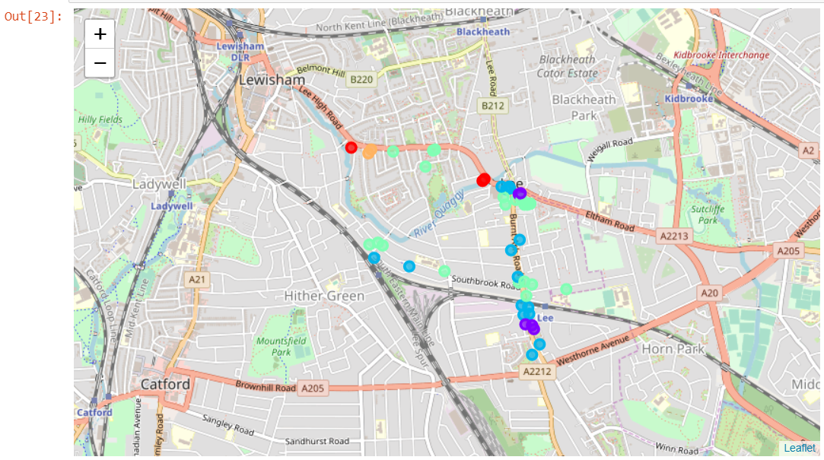
Results

Slide 7
Conclusion
As demonstrated in the Result and Discussion section, by clustering the area based on the venue categories and filtering the cluster to narrow down the search area can help a lot to simplify the house hunting process. Customers can then prefer to focus their house search by analysing various trade offs. Those who are confused can efficiently compare various areas and choose a house that's most suitable for them.

