Slide 1
Password Security System using FPGAs
EEE F348 FPGA Design Lab
Project
Team:
Anantha Sai Satwik Vysyaraju 2019A3PS1323H
Akhilesh Gowrishetty, 2019AAPS0241H

Slide 2
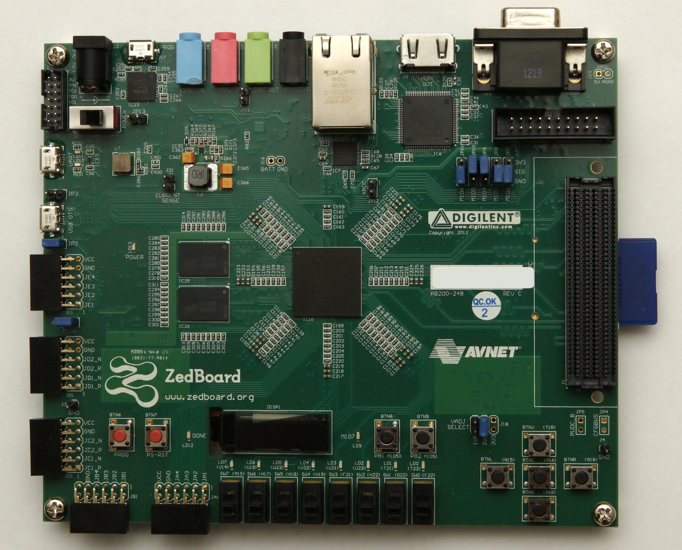
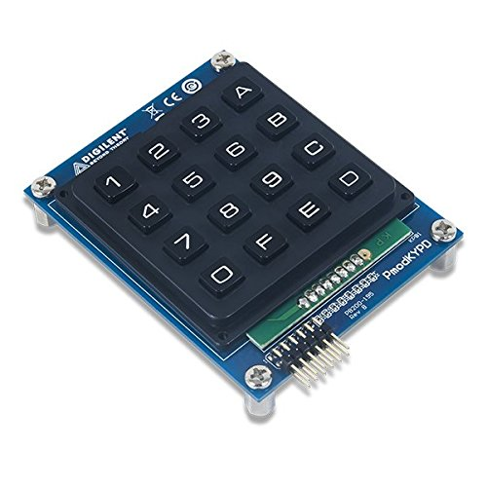
Hardware
Source: https://m.media-amazon.com/images/I/51YcH25XYFL.jpg
Source: billauer.co.il/blog/wp-content/uploads/2012/09/zedboard-front.jpg

Slide 3
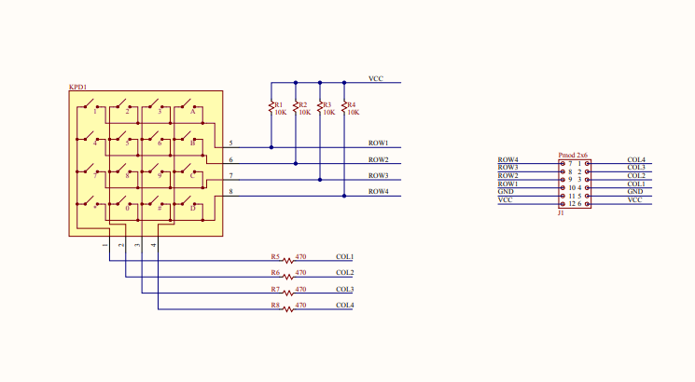
PMOD KYPD
0
1
1
1
ROWS – INPUTS
COLUMNS – OUTPUT
0
1
1
1
Source: https://digilent.com/reference/_media/reference/pmod/pmodkypd/pmodkypd_sch.pdf

Slide 4
Flowchart
Start
Locked
Grant Access
Yes
fails = 0
digits = 0
Reset using Physical Key
Yes
No
Wait for user input
Yes
fails < 3
fails = fails + 1
No
PIN matches
digits = digits + 1
digits < 8
No
digits = 0
Yes

Slide 5
OLED Initialization
Apply power to VDD.
Send Display Off command.
Initialize display to desired operating mode.
Clear screen.
Apply power to VBAT.
Delay 100ms.
Send Display On command.

Slide 6
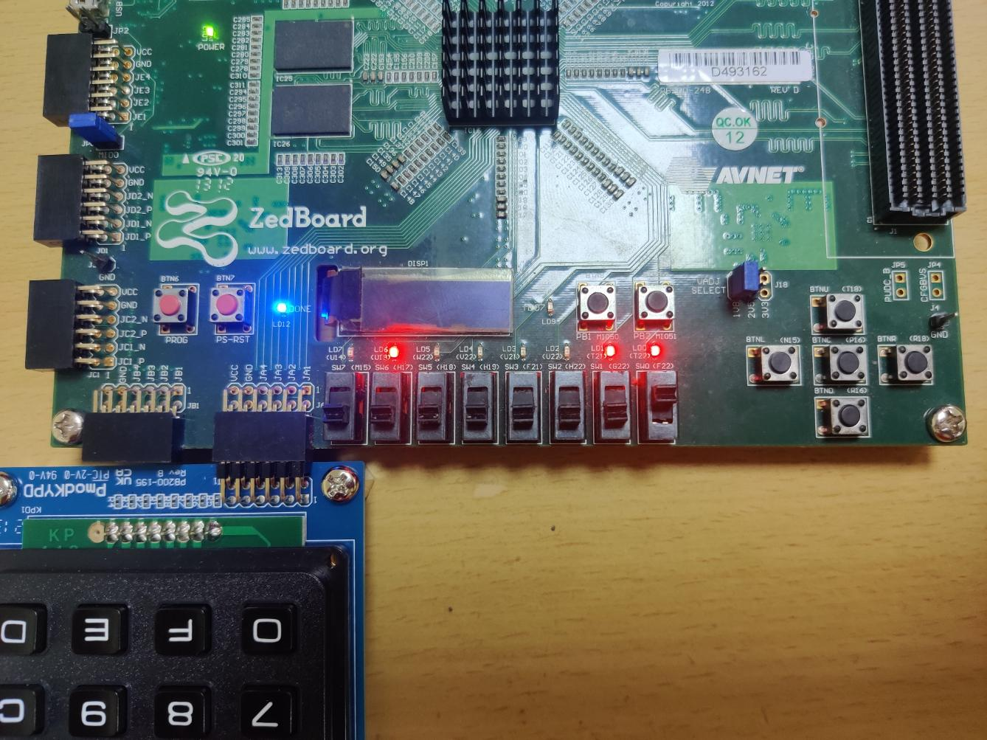
States
UNLOCKED
LOCKED
PERMANENT LOCK
CHANGE PASSCODE
RESET
LOCK

Slide 7
Thank you

