Slide 1
EMU 8086: Installation & Example Code
Dr. Subhradeep Pal
Department of EEE

Slide 2
Download and License Key
Download Link:
https://docs.google.com/uc?export=download&id=0B5esS330z1pNc0FiWG9OSElMdHc
License: Initially 14 days trial license will be there.
Installation Process (works only in Windows platform):
Unzip the downloaded file.
Double click on the setup file and follow the onscreen process to complete it.
An icon should be generated on the desktop on successful installation.

Slide 3
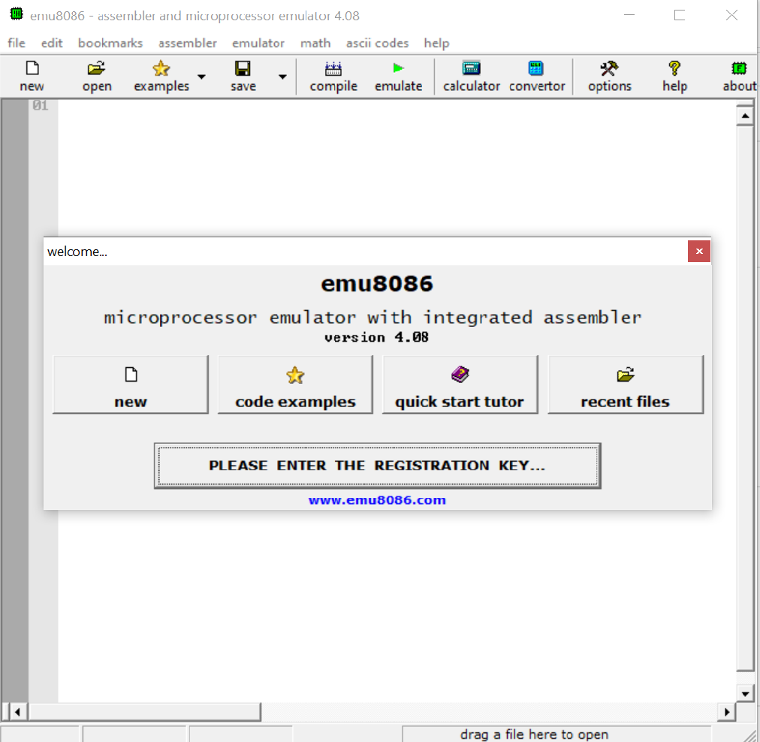

Licensing EMU 8086
Double-click on the icon in the desktop.
A window should be opened.
First register your product.
Use the given registration key.
Note licensee name can be arbitrary and press ok.
A “thank you” message should be flashed and it is good to go.

Slide 4
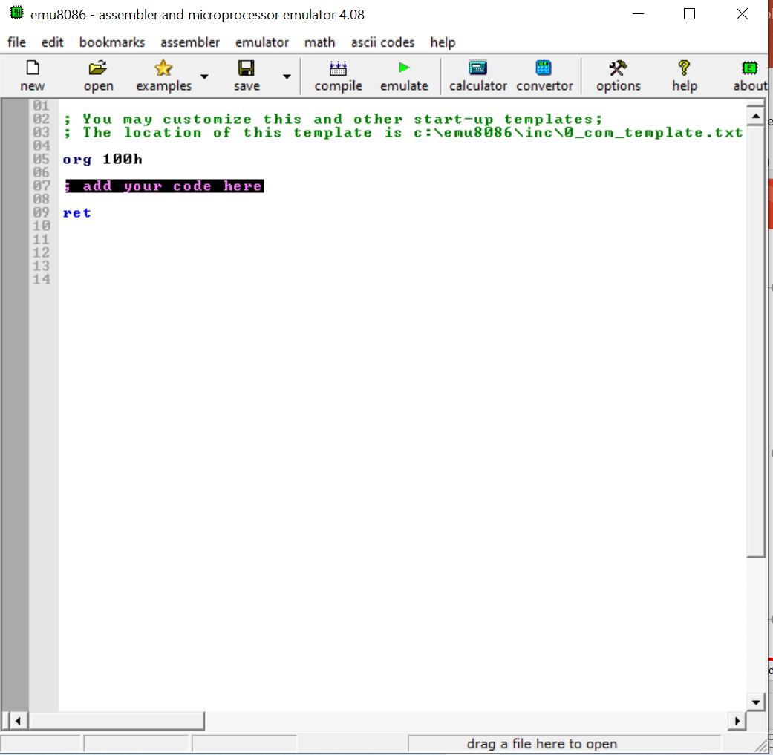
Executing the first program
Click on “new” in the tab.
Choose the code template to be “COM template” and press “OK”.
A programming screen editor with default messages should be opened.
Write the code in specified area.
Add “HLT” instruction just before “ret” instruction.
Then emulate the code to see the results.

Slide 5
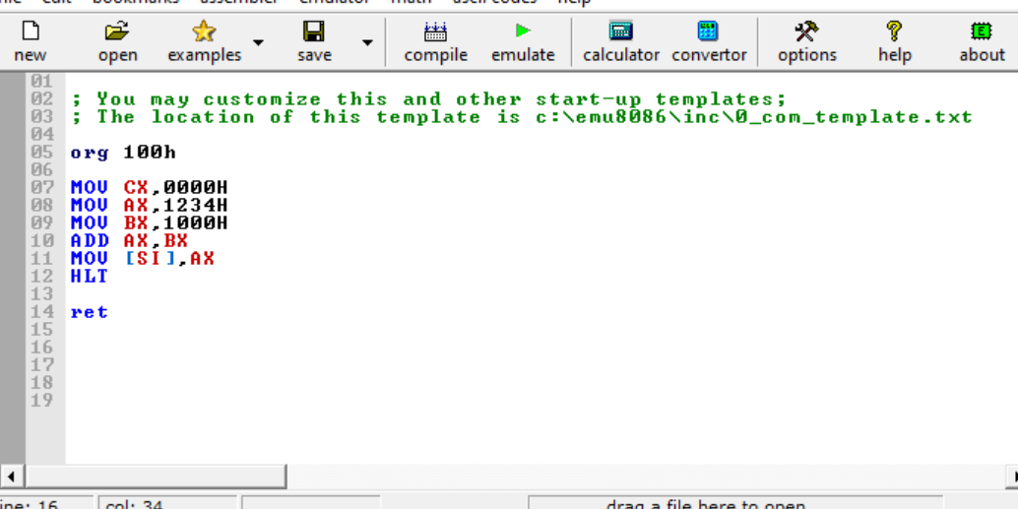
Example 1: Addition of 16 bit numbers
2. After completing the instructions, click on “emulate”.
1. Provide the instructions, as shown.

Slide 6
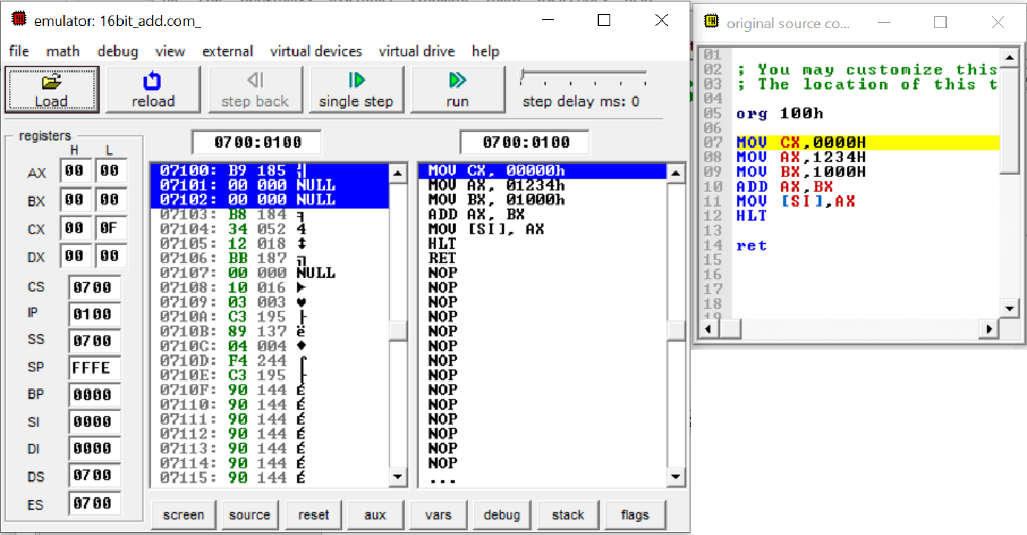
Interpreting the results
1. For each step press here.
2. Note the changes in the register content here. It will be highlighted in blue

Slide 7
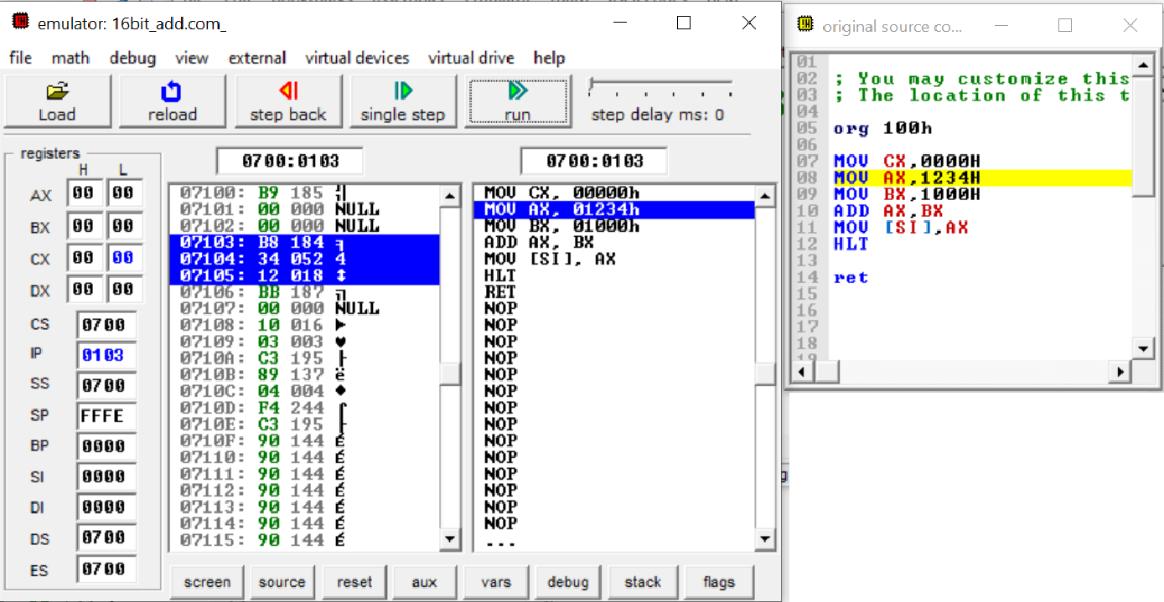
Interpreting the results
Next instruction will be highlighted too.
Disassembled Machine Code
Physical Address
HEX DECIMAL ASCII

Slide 8
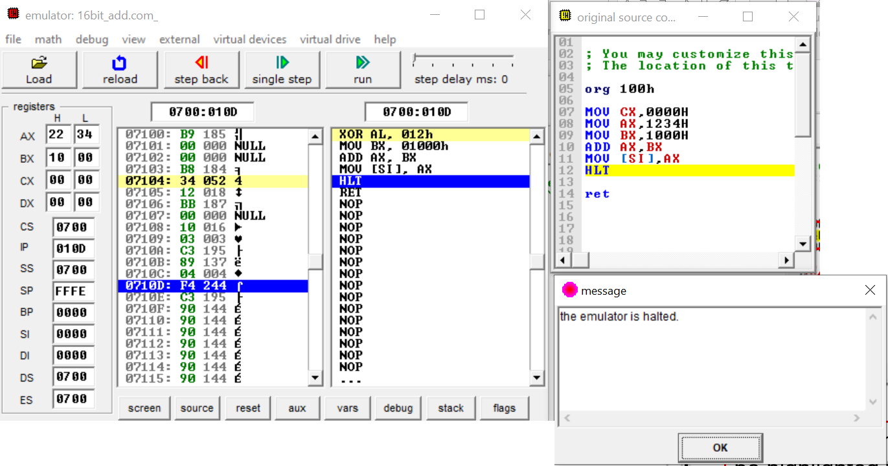
Interpreting the results
2. Final result indicated here.
3. Note register indirect addressing mode is used i.e. content of AX will be stored in the memory location of SI.
4. Note the address of CS.
5. Note the address of SI.
6. Final memory location is CS:SI i.e. 0700:0000. We can cross check the data stored in RAM too !!
1. Press here to gain control over the emulator.

Slide 9
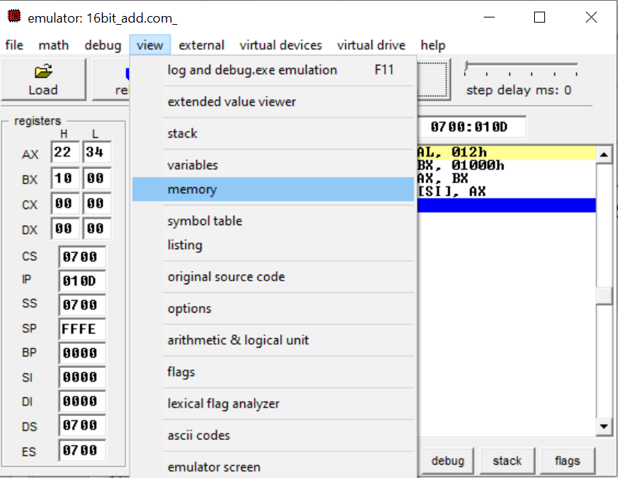
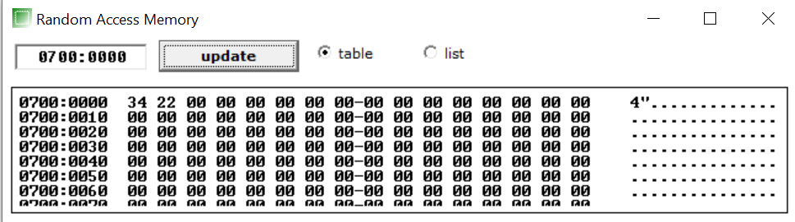
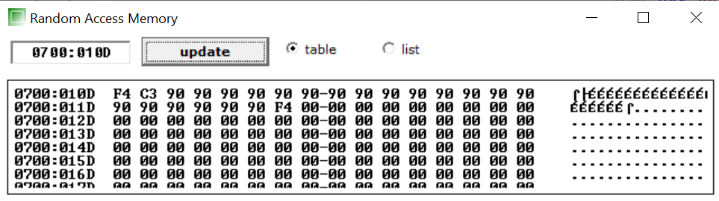
Interpreting the results
1. Click here.
3. Note down the result. In RAM the data are stored in LSB-MSB format
2. Change the address to 0700:0000 and click update.

