Slide 1
Experiment 2: Verification of Arithmetic Operations in 8086
Dr. Subhradeep Pal
Department of EEE

Slide 2
ALPs to be completed
Operation | Registers to be used
 | 8-bit | 16-bit
Addition | CL, DL | AX, BX
Subtraction | CL, DL | BX, CX
Multiplication | AL, BL | AX, BX
Division | AL, BL | AX, BX

Slide 3
2.1 Addition of two numbers
Instruction to be used: ADD
Effect on Flags
Instruction | Operands | Usage Description
ADD | REG, memory | Operand 1 = Operand 1 + Operand 2 Example: ADD AL,BL ADD AL,-5 Operates on both 8-bit or 16-bit numbers.
 | memory, REG
 | REG, REG
 | memory, immediate
 | REG, immediate
C | Z | S | O | P | A
r | r | r | r | r | r
r: flag value depends on result of the instruction

Slide 4
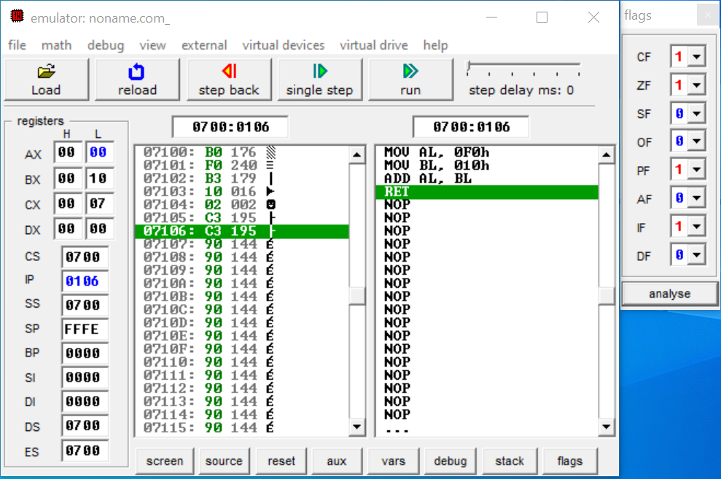
2.1 Addition of two 8-bit numbers
Example Code
org 100h
MOV AL,0F0H
MOV BL,010H
ADD AL,BL
ret
1. Click here and check the changes in the registers.
3. Interpret the results of the flags of the μp.
CF: Carry is generated when performing n bit operations and the result is more than n bits, then it is 1, otherwise 0.
2. Click here to check the conditions of flags of the μp.
ZF: After any arithmetical or logical operation results 0 (00)H, the zero flag is 1, otherwise 0.
PF: 1 accumulator has even number of 1 bits 0 accumulator has odd parity

Slide 5
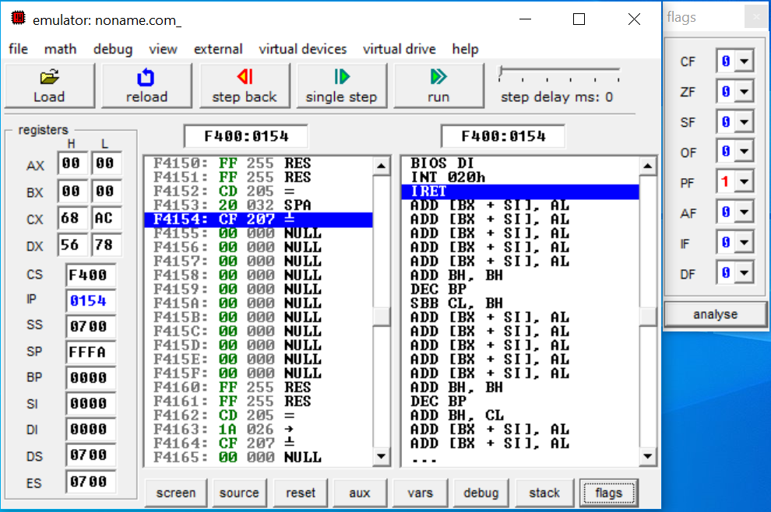
2.2 Addition of two 16-bit numbers
Example Code
org 100h
MOV CX,1234H
MOV DX,5678H
ADD CX,DX
ret
1. Click here and check the changes in the registers.
3. Interpret the results of the flags of the μp.
2. Click here to check the conditions of flags of the μp.

Slide 6
2.3 Subtraction of two numbers
Instruction to be used: SUB
Effect on Flags
Instruction | Operands | Usage Description
SUB | REG, memory | Operand 1 = Operand 1 - Operand 2 Example: SUB AL,BL SUB AL,1 Operates on both 8-bit or 16-bit numbers.
 | memory, REG
 | REG, REG
 | memory, immediate
 | REG, immediate
C | Z | S | O | P | A
r | r | r | r | r | r
r: flag value depends on result of the instruction

Slide 7
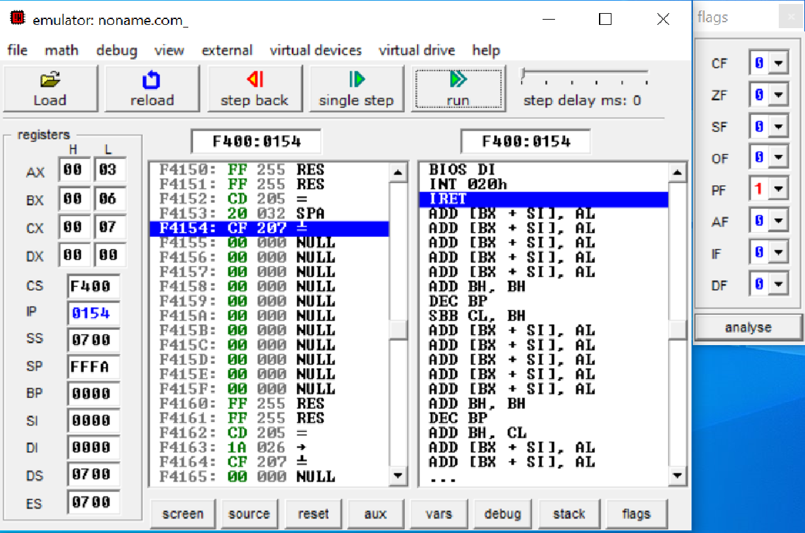
2.3 Subtraction of two 8-bit numbers
Example Code
org 100h
MOV AL,009H
MOV BL,006H
SUB AL,BL
ret
1. Click here and check the changes in the registers.
3. Interpret the results of the flags of the μp.
2. Click here to check the conditions of flags of the μp.

Slide 8
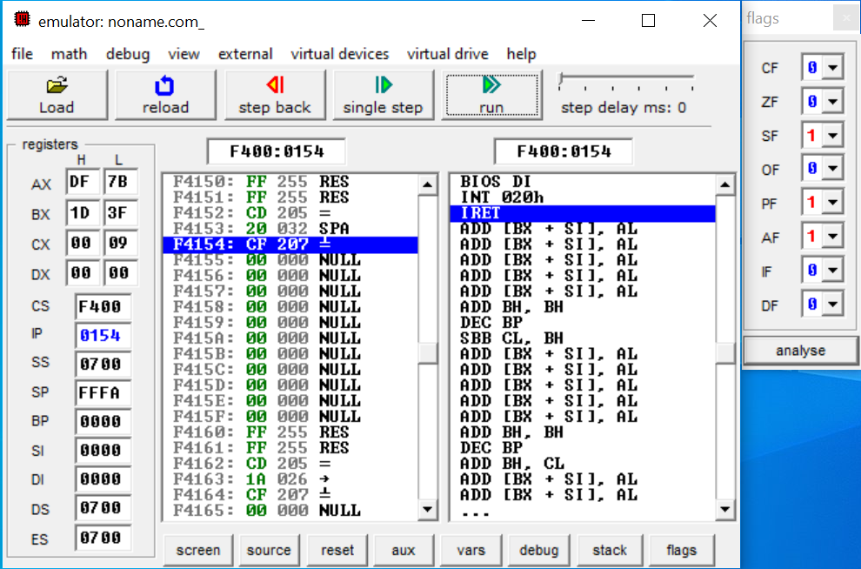
2.4 Subtraction of two 16-bit numbers
Example Code
org 100h
MOV AX,0FCBAH
MOV BX,01D3FH
SUB AX,BX
ret
1. Click here and check the changes in the registers.
3. Interpret the results of the flags of the μp.
2. Click here to check the conditions of flags of the μp.
SF: 1- MSB is 1 (negative)
0- MSB is 0 (positive)
AF: 1-carry out from bit 3 on addition or borrow into bit 3 on subtraction
0-otherwise

Slide 9
2.5 Multiplication of two numbers
Instruction to be used: MUL
Effect on Flags
CF = OF = 0 when high section of the result is zero.
Instruction | Operands | Usage Description
MUL | REG | When operand is a byte: AX = AL × operand. When operand is a word: (DX AX) = AX × operand.
 | memory
C | Z | S | O | P | A
r | ? | ? | r | ? | ?
r: flag value depends on result of the instruction.
?: flag value is undefined (maybe 1 or 0).

Slide 10
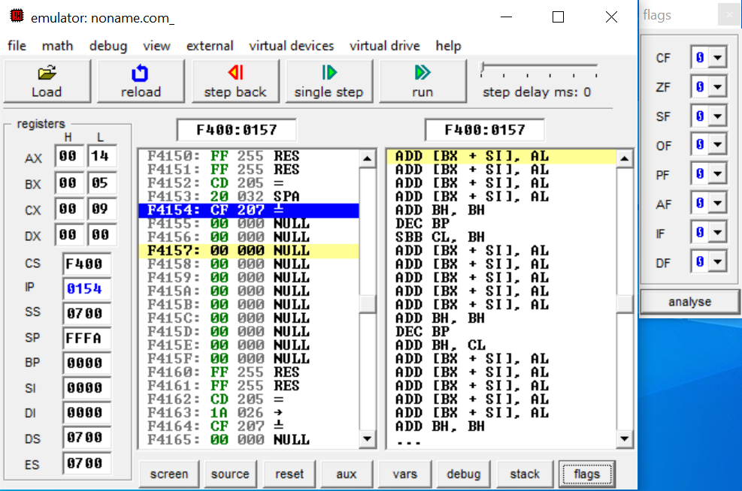
2.5 Multiplication of two 8-bit numbers
Example Code
org 100h
MOV AX,04H
MOV BX,05H
MUL BX
ret

Slide 11

2.6 Multiplication of two 16-bit numbers
Example Code
org 100h
MOV AX, 0111H
MOV BX, 1212H
MUL BX
ret
Check the content of both AX and DX registers.

Slide 12
2.7 Division of two numbers
Instruction to be used: DIV
Effect on Flags
Instruction | Operands | Usage Description
DIV | REG | When operand is a byte: AL = AX / operand AH = remainder (modulus) When operand is a word: AX = (DX AX) / operand DX = remainder (modulus)
 | memory
C | Z | S | O | P | A
? | ? | ? | ? | ? | ?
?: flag value is undefined (maybe 1 or 0).

Slide 13

2.7 Division of two 8-bit numbers
Example Code
org 100h
MOV AX,20H
MOV BX,10H
DIV BX
ret
Check the content of both AL and DL registers.

Slide 14
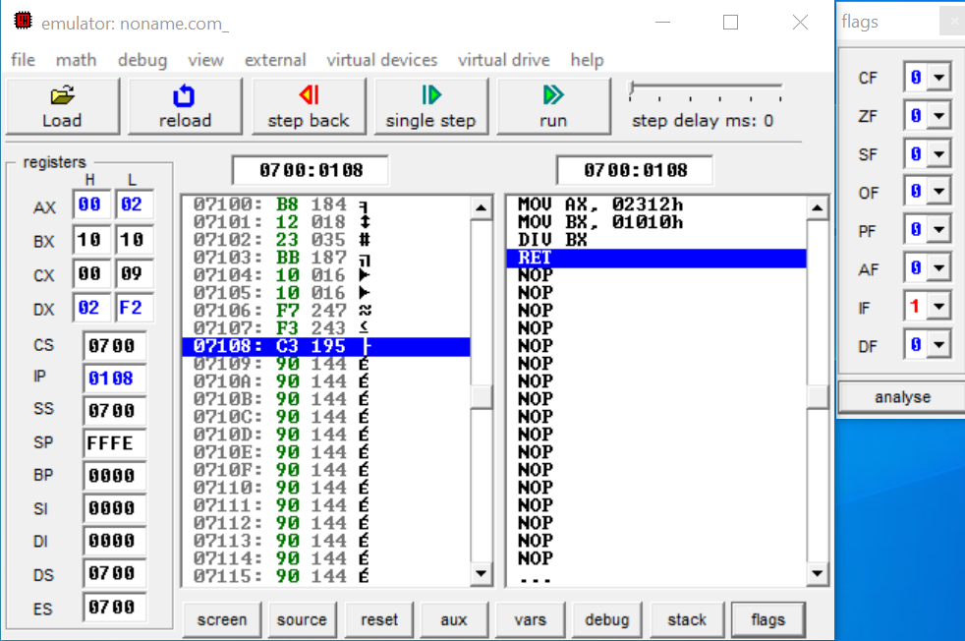
2.8 Division of two 16-bit numbers
Example Code
org 100h
MOV AX,2312H
MOV BX,1010H
DIV BX
ret
Check the content of both AX and DX registers.

Slide 15
Exercise
Write ALP codes for the following arithmetic operations:
In each case interpret the results of different flags. Crosscheck your results by converting them into decimal numbers.
Problem No. | Arithmetic Instructions | Which registers are to be used?
1 | 12H + CAH | CL, DL
2 | 1A4CH + B1DEH | AX, BX
3 | 7AH – 4CH | CL, DL
4 | 3B7AH – C142H | BX, CX
5 | 1DH × 77H | AL, BL
6 | EF1AH × CD50H | AX, BX
7 | 19H ÷ 03H | AL, BL
8 | 1927H ÷ 1201H | AX, BX

