Slide 1
Experiment 8: Usage of Interrupts for input from keyboard & output to display.
Dr. Subhradeep Pal
Department of EEE

Slide 2
ALPs to be completed
Write a program using interrupt to read from standard input, with echo, and store the result in AL.
Write a program using interrupt to write to standard output, copy the result in DL.
Write a program using interrupt to print a string in the standard output.

Slide 3
8.1 Read from standard input
Objective: 1. Read from standard input.
2. Store the result in AL.
Condition: Use interrupt command.
Solution: INT 21h/ AH=1
Function: Read character from standard input, with echo, result is stored in AL. If there is no character in the keyboard buffer, the function waits until an key is pressed.
Code: MOV AH,01h
INT 21h

Slide 4
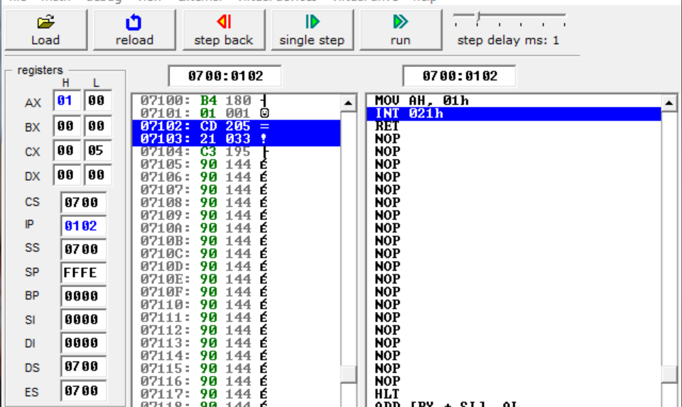
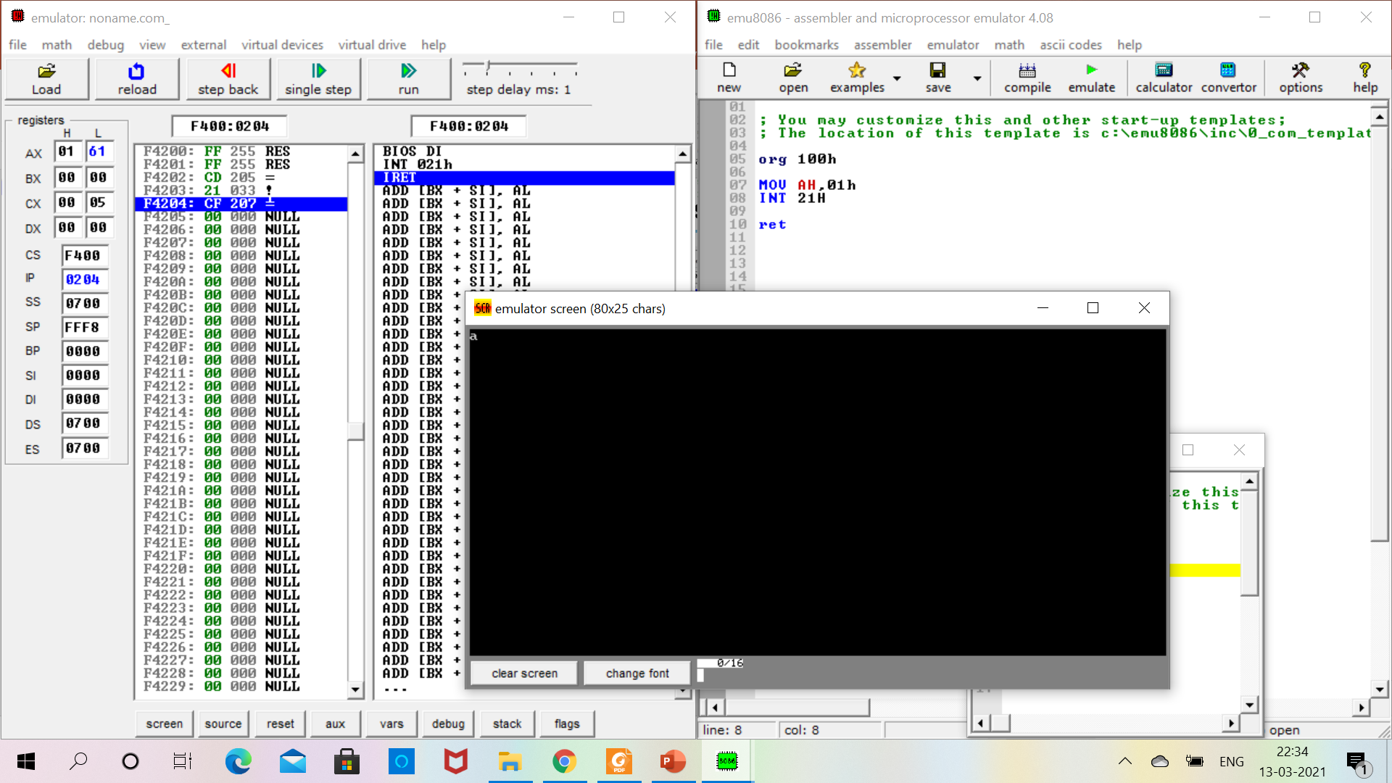
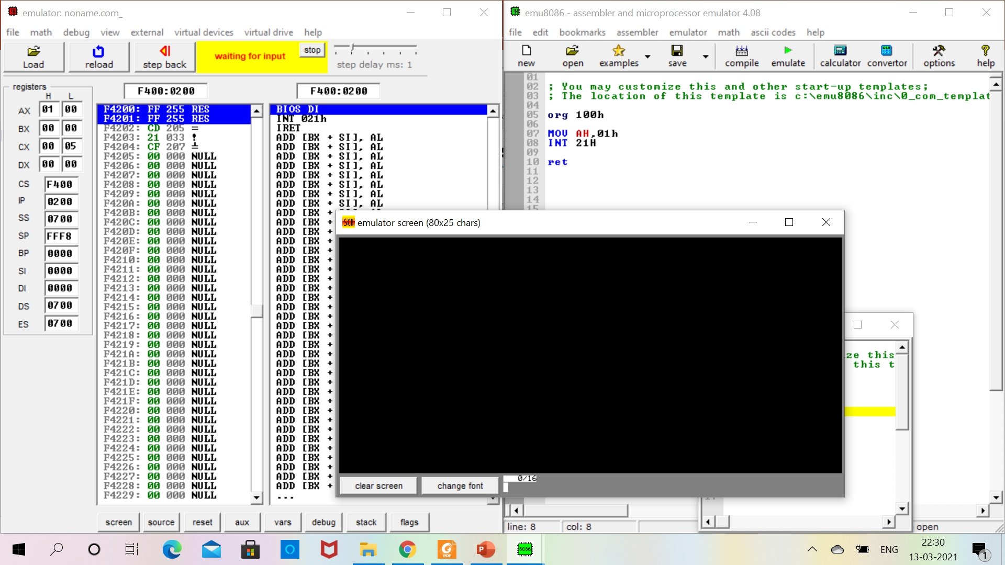
8.1 Read from standard input
1. Note the value of AL.
2. Type a character through your keyboard. It will be shown here. Corresponding ASCII value will be updated in AL. Consider example ‘a’. Its ASCII value is 61.

Slide 5
8.1 Review Question
Write a program using interrupt to read from standard input, store the result in the memory offset 0501h. In which format the data will be stored?
What will be effect of the same code if AH becomes 07h?
Explain the output of the following code:
org 100h
MOV AH,2Ah
INT 21h
ret

Slide 6
8.2 Write to standard output
Objective: 1. Read from standard input.
2. Copy the result in DL.
Condition: Use interrupt command.
Solution: INT 21h/ AH=2
Function: Write a character to standard output, with result is stored in DL.
Code: MOV AH,02h
MOV DL,’a’
INT 21h

Slide 7
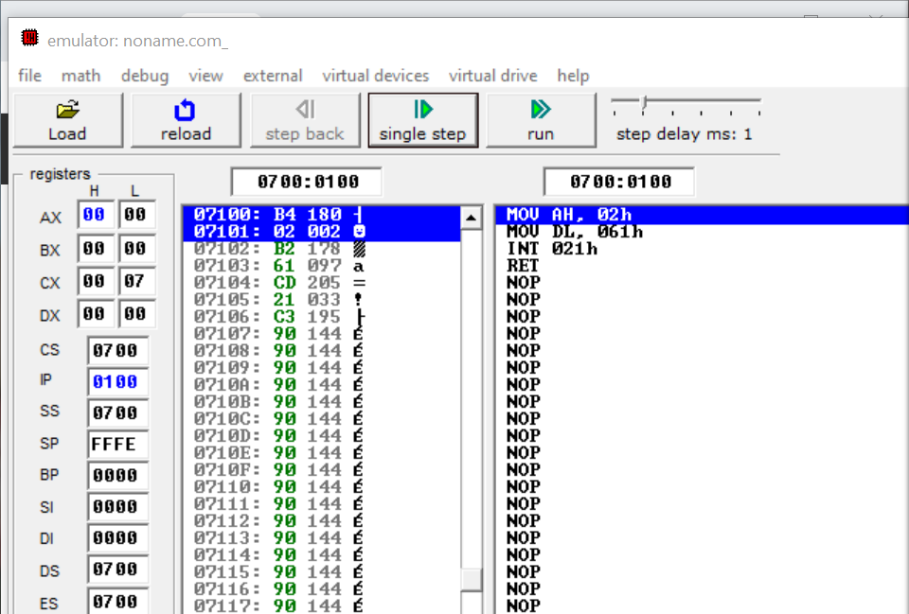
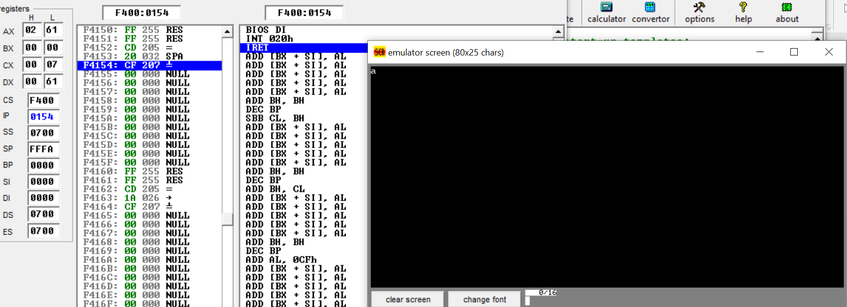
8.2 Write to standard output
2. Continue single step execution.
1. Note the values of AL, AH, DL.
4. Printed Character
3. Note the value of AL, DL.

Slide 8
8.2 Review Question
Repeat the problem with some arbitrary character/number.
Using only interrupt write an ALP which will accept a character from keyboard and print the next two characters in the screen.

Slide 9
8.3 Printing of String
Objective: To print string to standard output.
Condition: Use interrupt command.
Solution: INT 21h/ AH=9
Function: Output of a string at DS:DX. String must be terminated by $.

Slide 10
8.3 Printing of String
org 100h
.data
msg db ‘XXXXXXX'
.code
mov ax,@data
mov ds,XX
mov dx,offset msg
mov ah,XXh
int 21h
hlt
Test String: BITS-PILANI
Pseudocode

