Slide 1
Experiment 10: Write a program to control the traffic light system.
Dr. Subhradeep Pal
Department of EEE

Slide 2
ALPs to be completed
Write a program to control the traffic light system using 8086.

Slide 3
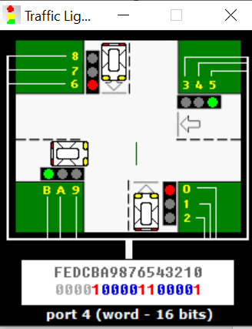
Traffic Light in Emulator
A virtual traffic light system is available in EMU8086 with port address 4.
It consists of 12 LEDs with an animation of car moving in direction where green LED is activated.
Control word can be provided using 8086 to change the signal color.
State of each LED
1: LED is turned on
0: LED is turned off
Control Word Format
Current Control Word

Slide 4
Traffic Light in Emulator
Port Address: 04H
Instruction to include stepper motor in emulator:
#start=traffic_lights.exe#
How to load the control word in traffic light?
Use OUT instruction. For out instruction select port 4. Use AX
register to store control word intermediately.
How to maintain time gap between two control words?
Use CX-DX registers for wait time. Note: Unit of time for 8086 is μs.

Slide 5
Control Words
F | E | D | C | B | A | 9 | 8 | 7 | 6 | 5 | 4 | 3 | 2 | 1 | 0
× | × | × | × | 1 | 0 | 0 | 0 | 0 | 1 | 1 | 0 | 0 | 0 | 0 | 1
× | × | × | × | 0 | 0 | 1 | 0 | 0 | 1 | 0 | 0 | 1 | 0 | 0 | 1
× | × | × | × | 0 | 0 | 1 | 1 | 0 | 0 | 0 | 0 | 1 | 1 | 0 | 0
× | × | × | × | 0 | 1 | 1 | 0 | 1 | 0 | 0 | 1 | 1 | 0 | 1 | 0
× | × | × | × | 1 | 0 | 0 | 0 | 0 | 1 | 1 | 0 | 0 | 0 | 0 | 1
× | × | × | × | 1 | 0 | 0 | 0 | 0 | 1 | 1 | 0 | 0 | 0 | 0 | 1
× | × | × | × | 0 | 1 | 0 | 0 | 1 | 1 | 0 | 1 | 0 | 0 | 1 | 1
Default
All red
×: Not used bits (should be replaced by 0).

Slide 6
ALP for Traffic Signal
#start=Traffic_Lights.exe#
name "traffic"
mov ax, all_red
out 4, ax
mov si, offset situation
next:
mov ax, [si]
out 4, ax
mov cx, xxxxh
mov dx, xxxxh
mov ah, 86h
int 15h
add si, 2
cmp si, sit_end
jb next
mov si, offset situation
jmp next
situation dw xxxx_xxxx_xxxx_xxxxb
s1 dw xxxx_xxxx_xxxx_xxxxb
s2 dw xxxx_xxxx_xxxx_xxxxb
s3 dw xxxx_xxxx_xxxx_xxxxb
s4 dw xxxx_xxxx_xxxx_xxxxb
sit_end = $
all_red equ 0000_0010_0100_1001b
Initializes the virtual traffic signal
Closes all traffic
Offset calculation of CW and load in SI.
Loads the first data in AX and send it IO
Use CX-DX register to provide wait instruction for 5s.
BIOS Delay Function. Unit in µs. Content Format: CX-DX
Increase SI for next data
Check all situational data are emulated or not. If yes, then restart else complete all the situational control words.
Control world (16-bit format)

Slide 7
Review Questions
What should be the value of CX-DX register for wait time of 2s between two control instructions?

