Slide 1
Experiment 3: Factorial of a number and temperature conversion from ºC to ºF
Dr. Subhradeep Pal
Department of EEE

Slide 2
ALPs to be completed
Problem 1: Conversion of temperature from ºC to ºF.
Problem 2: Factorial of a given number.

Slide 3
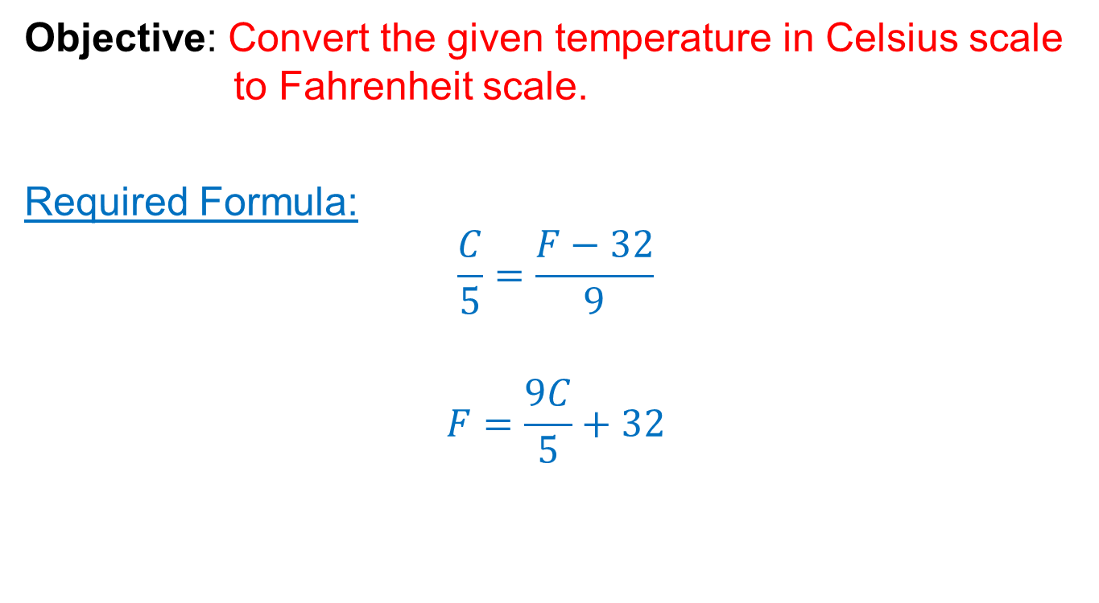
3.1 Conversion of temperature

Slide 4
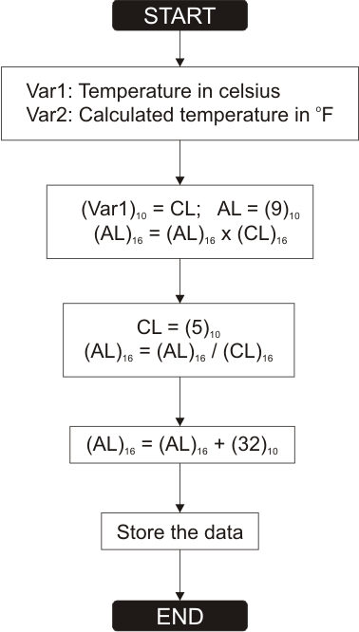
3.1 Conversion of temperature
Variable Initialization
Syntax
name DB value
name DW value
db or DB: Define Byte
dw or DW: Define Word
Example:
var1 db 10
If it is replaced by ‘?’ then the variable is not initialized.
Name of the variable
Value of the variable

Slide 5
3.1 Conversion of temperature
Pseudocode
jmp start
var1 db xx
var2 db yy
var3 db ?
start:
mov cl,zz
mov al,ww
imul cl
mov cl,tt
idiv cl
add al,pp
…
Values highlighted in yellow color are needed to altered as per the flowchart.
Complete the code for tempr. conversion.

Slide 6
3.1 Review Questions
What will be the effect if we consider ‘mul’ instruction instead of ‘imul’ instruction in the code? Explain with an example.
“mul” is used for the unsigned numbers while “imul” is used for the signed numbers since the temperature has signed numbers “imul” is used.
Does your code take signed numbers as input?
Yes
Write a similar kind of code for converting temperature from ºF to ºC.

Slide 7
3.2 Factorial of a given number
Factorial of the number: n!
Example: 7! = 7 × 6 × 5 × 4 × 3 × 2 × 1 = 5040
1! = 1
Calculation of factorial from previous number: n! = n × (n-1)!
n | n!
1 | 1 | 1 | 1
2 | 2 × 1 | = 2 × 1! | 2
3 | 3 × 2 × 1 | = 3 × 2! | 6
4 | 4 × 3 × 2 × 1 | = 4 × 3! | 24
5 | 5 × 4 × 3 × 2 × 1 | = 5 × 4! | 120

Slide 8
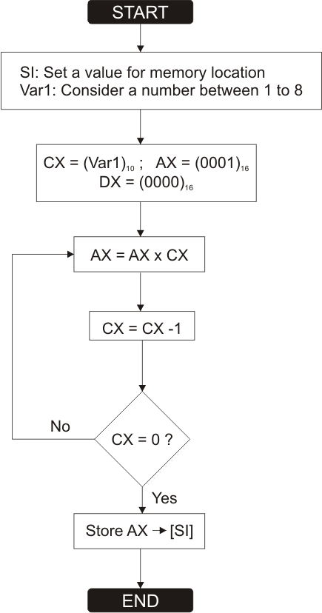
3.2 Factorial of a given number
Flowchart
For this problem consider SI = 0200 H
Loop operation

Slide 9
3.2 Factorial of a given number
Implementation
To implement the flowchart we shall use a new instruction of 8086 which is listed below.
Instruction | Operands | Algorithm with usage
LOOP | Label | Decrease CX, jump to label if CX not zero. Algorithm: CX = CX - 1 if CX ≠ 0 then jump else no jump, continue Example MOV CX, 5 label1: PRINTN 'loop!' LOOP label1

Slide 10
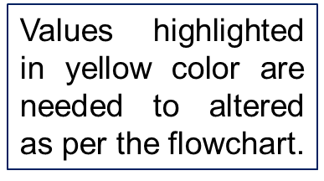
3.2 Factorial of a given number
Pseudocode
org 100h
MOV SI, XXXX
MOV CX, YYYY
MOV AX, ZZZZ
MOV DX, WWWW
L1: MUL AA
LOOP PP
MOV [SI],KK
HLT
ret
Format for defining label
Complete the code for determination of factorial of a number.

Slide 11
3.2 Review Questions
What will be the effect if we consider the number to be 0 in the given pseudocode?
Since it decrements before checking 0 zero it becomes -1 and so it turns into a inf loop
Why the input number range is selected between 1 to 8? Can we extend the range by altering the ALP suitable for 8086?
Since till 8! The number of bits req is 16 bits but for 9! 20bits are req so it is not possible to store in one register
Repeat the same problem without using the instructions “LOOP”. You can use the instructions like JZ or JNZ or any other registers as per your requirement. Evaluate the value of 7! using your new code.

