Slide 1
Experiment 04: Addressing Modes in 8086
Dr. Subhradeep Pal
Department of EEE

Slide 2
Objective
To understand different addressing modes supported by the microprocessor 8086.
To determine physical and logical address of different operands in a instruction used in 8086.

Slide 3
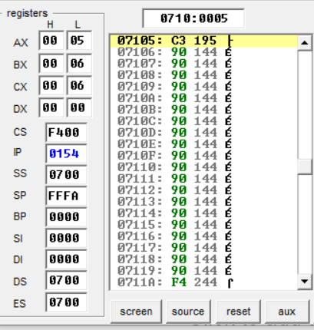
1.1 Immediate Addressing Mode
In this, immediate data is part of instruction, and
appears in the form of successive byte or bytes
org 100h
MOV AX,0005H
MOV BL,06H
ret
Here, 0005H and 06H are the immediate data to be loaded in AX and BL registers, respectively.

Slide 4
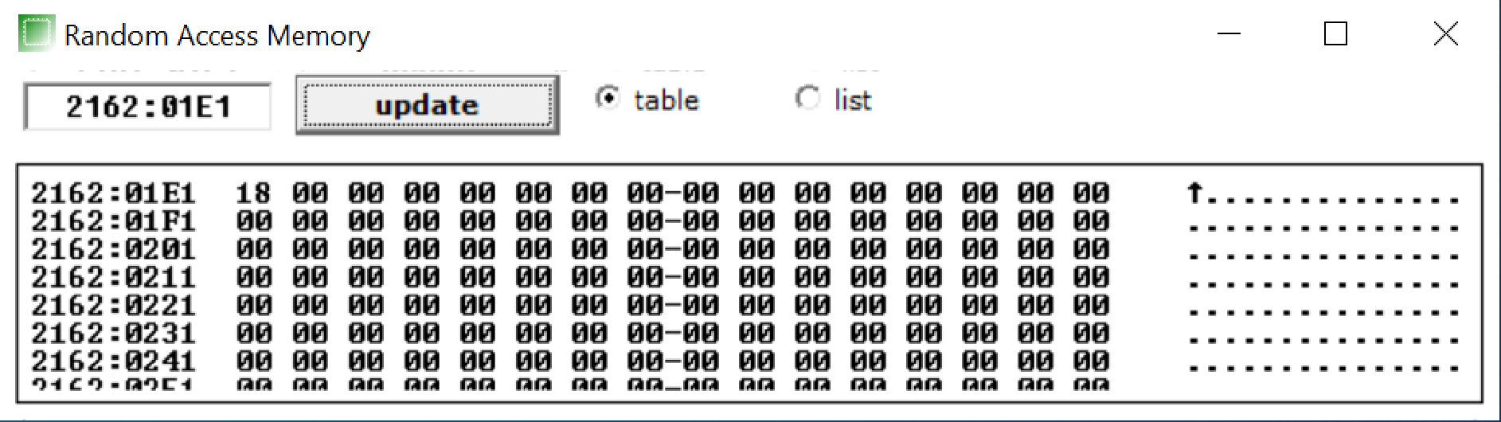
1.2 Direct Addressing Mode
In this, a 16 bit memory address or an IO address is directly specified in the instruction
Address Location Determination
(481)₁₀ → (1E1)₁₆
DS: 2162₁₆
Offset: 481₁₀
Logical Address: 2162:01E1
Physical Address: DS × 10₁₆ + offset = (21801)₁₆
Example
ORG 100h
MOV AX, 2162H
MOV DS, AX
MOV CX, 24
MOV [481], CX
MOV BX, [481]
ret

Slide 5
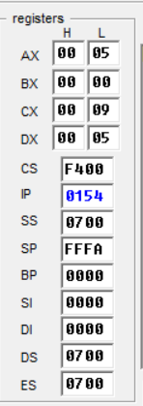
1.3 Register Addressing Mode
Operands are stored in registers. Transfer of operands are extremely fast since no memory access is required.
All except IP register can be used in this mode.
org 100h
MOV AX,0005H
MOV CX,0004H
MOV DX, AX
ADD CX, DX
ret
Content of Register A copied to D
Result
Move data content of Register A to Register D

Slide 6
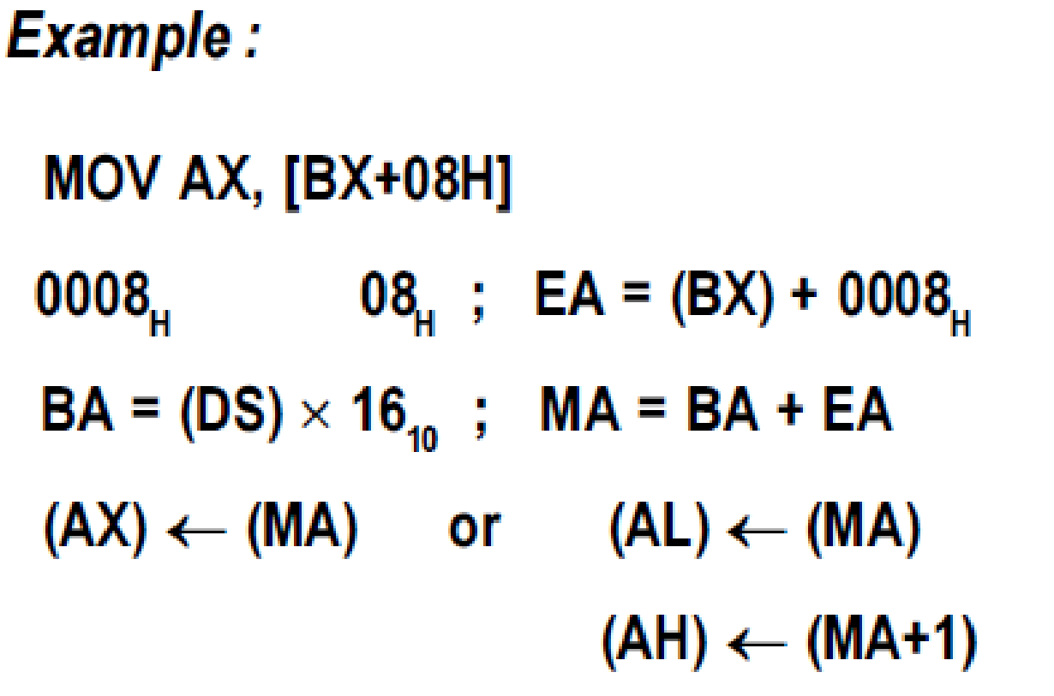
1.4 Base Addressing Mode
The BX or BP-register is used to hold a base value for effective address (EA).
A signed 8-bit or unsigned 16-bit displacement will be specified in the instruction.
The displacement is added to base value in BX or BP to obtain the EA.
When BX is used to hold base value for EA, the 20-bit physical address of memory is calculated by multiplying the content of DS by 16₁₀ adding to EA.
When BP is used to hold base value for EA, the 20-bit physical address of memory is calculated by multiplying the content of SS by 16₁₀ and adding to EA.

Slide 7
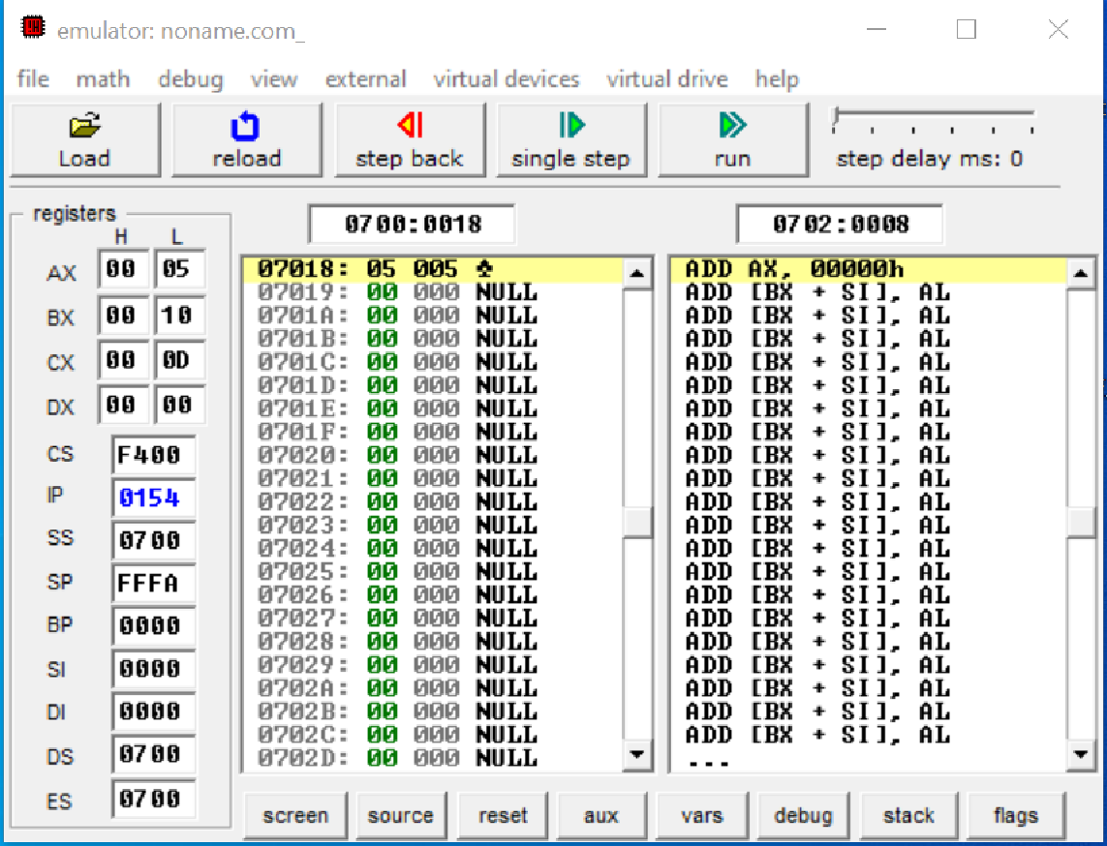
1.4 Base Addressing Mode
org 100h
MOV BX,0010H
MOV [0018H],0005H
MOV AX, [BX+08H]
ret
DS: 0700h
BX: 0010h
EA: (BX)+08h = 0018h
Logical Address: 0700:0018
Physical Address: 7018h

Slide 8
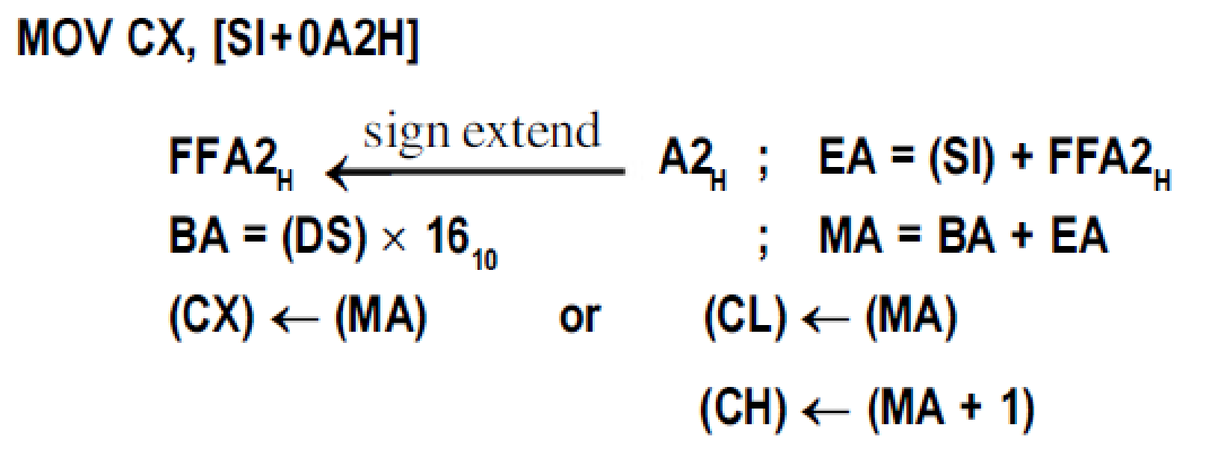
1.5 Indexed Addressing Mode
SI or DI-register is used to hold an index value for memory data.
A signed 8-bit or unsigned 16-bit displacement will be specified in the instruction.
The displacement is added to index value in SI or DI-register to obtain the Effective Address (EA)

Slide 9
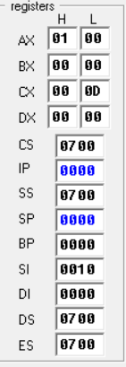
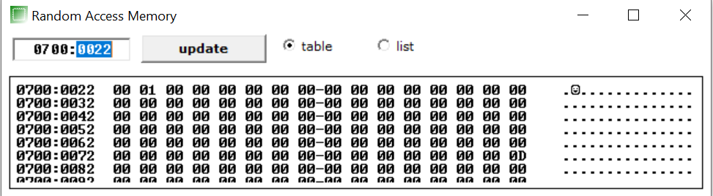
1.5 Indexed Addressing Mode
org 100h
MOV [0022H], 0100H
MOV SI, 0010H
MOV AX, [SI+012H]
ret
DS = 0700h; SI = 0010h
EA = (SI)+012h; BA = DS × 16₁₀
MA = BA + EA; AX ← MA; AL ← MA; AH ← MA + 1; Logical Address: 0700:0022;

Slide 10
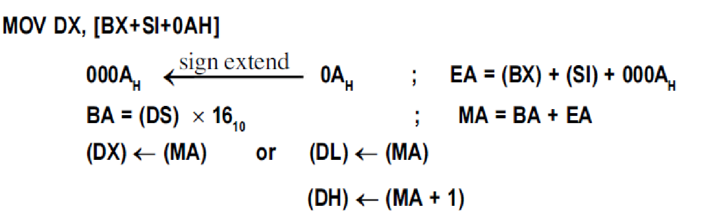
1.6 Base Indexed Addressing Mode
EA is given by sum of base value, index value and an 8-bit or 16-bit displacement specified in the instruction.
The base value is stored in BX or BP-register.
The index value is stored in SI or DI-register.
CORRECT SYNTAX FORMAT
ILLEGAL SYNTAX FORMAT
MOV AX, [BX+SI+20]
MOV AX, [SI+BX+20]
MOV AX, [SI][BX]+20
MOV AX, [BX][BP]+20
MOV AX, [SI][DI]+20

Slide 11
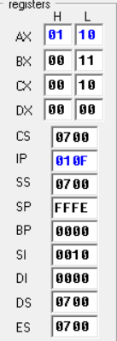
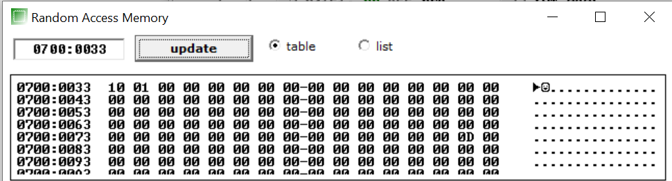
1.6 Base Indexed Addressing Mode
org 100h
MOV [0033H], 0110H
MOV SI, 0010H
MOV BX, 0011H
MOV AX, [BX+SI+012H]
ret
Contents of memory location 0018H moved to AX
DS = 0700h; SI = 0010h; BX = 0011h
EA = (BX)+(SI)+012h;
BA = DS × 16₁₀
Logical Address: 0700:0033;
Phycsial Address: 7033h and 7034h

Slide 12
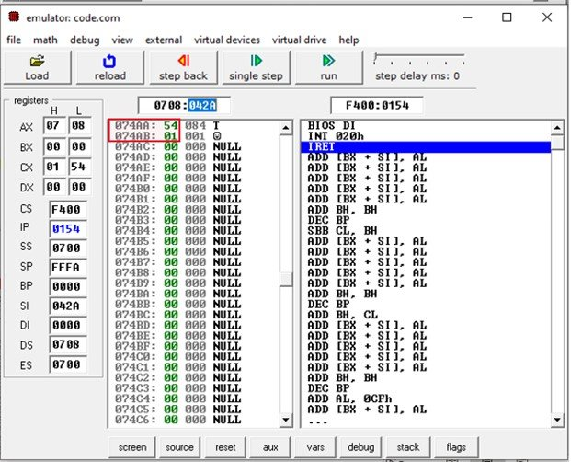
1.7 Register Indirect Addressing Mode
The offset address resides in one of these three registers i.e., BX, SI, DI.
The sum of offset address and the DS value shifted by one position generates a physical address.
ORG 100h
MOV AX, 0708h
MOV DS, AX
MOV CX, 0154h
MOV SI, 42Ah
MOV [SI], CX
RET
Physical Address: 0708:042Ah

Slide 13
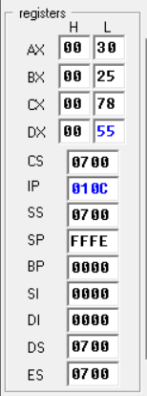
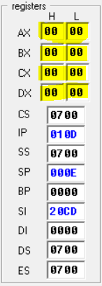
1.8 Implied Addressing Mode
The instruction itself will specify the data to be operated by the instruction.
org 100h
MOV BX , 25h
MOV AX,30h
MOV CX,78h
MOV DX,55h
POPA
RET
POPA command will pop all the general purpose registers.
Before POPA
After POPA

Slide 14
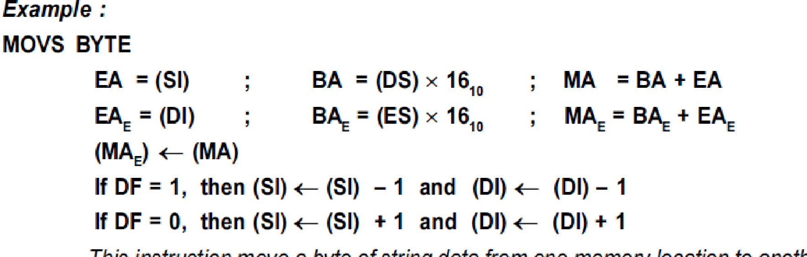
1.9 String Addressing Mode
This addressing mode is related to string instructions.
In this the value of SI and DI are auto incremented and decremented depending upon the value of directional flag.
In string addressing mode, the EA of source data is stored in SI-register and the EA of destination data is stored in DI-register

Slide 15
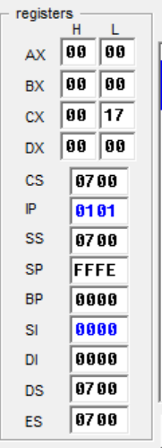
1.9 String Addressing Mode
ORG 100h
CLD
LEA SI, a1
LEA DI, a2
MOV CX, 5
REP MOVSB
RET
a1 DB 1,2,3,4,5
a2 DB 5 DUP(0)
Check the content of SI and DI after each step.

Slide 16
2.0 IO Port Addressing
It can be either direct or indirect.
In direct IO port addressing, the IO address is specified in the instruction.
In indirect IO port addressing, the instruction will specify the name of the register which holds the port address
Direct IO Port Addressing
Indirect IO Port Addressing
IN AL,80H;
IN AX,80H;
OUT 80H,AL;
OUT 80H,AX;
MOV DX,2080H
IN AL,DX;
IN AX,DX;
OUT DX,AL;
OUT DX,AX;

Slide 17
Problems
Load the operand (16AC)₁₆ into register BX using immediate, register addressing mode.
Using direct addressing mode load the data (4ECB)₁₆ in the memory location 3000:171E.
Let DS = 0300h; SI = 3126h and CX = 4A3Ch. What will be the physical address of the memory location?
MOV [SI], CX
Justify your answer with an ALP.
In the example of string addressing mode, replace the command ‘MOVSB’ by ‘MOVSW’. Show the change in SI and DI after each step of execution. Does it still support string addressing mode?
Assume DS = 3000h; BX = 1234h, ALPHA = 0012h, SI = 1233h. Determine the addressing mode and calculate and verify the physical addressing of the memory location for the following instructions:
MOV [BX] + ALPHA, AH
MOV [SI] + ALPHA, AH

Slide 18
Problems
Assume: DS = 3000h, BX = 1000h, SI = 1234h and ALPHA = 0012h. Find the physical address for the following instruction:
MOV AL, [BX] [SI] + ALPHA
Verify your result with an ALP.
50 dup(0) INITIALIZE 50 LOCATIONS EARMARK THEM AND CHANGE THEIR VALUE TO 0.

