Slide 1
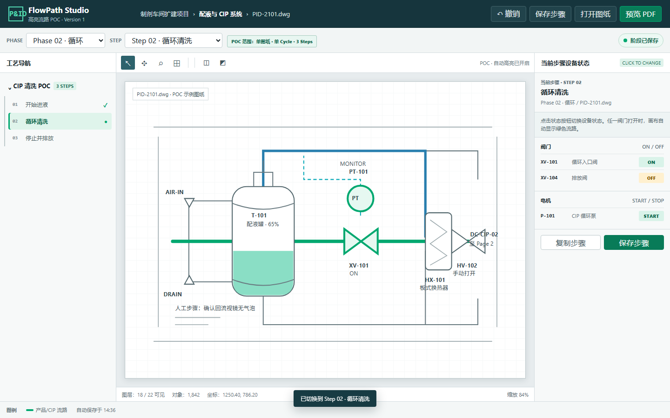
FLOWPATH
Highlighted Flow Path Software
Digital P&ID flow analysis and simulation for pharmaceutical process design
DESIGN · DIGITAL FLOW · STATE SIMULATION
BEYOND A STATIC P&ID
Make every phase route and equipment state visible
Notes:
The focus today is not a PDF utility. It is a design-stage platform for digital P&ID flow analysis and simulation, supporting pharmaceutical, bioreactor, solution preparation, and CIP/SIP systems. It helps engineering teams confirm flow paths and equipment states for each process phase.

Slide 2
BUSINESS CHALLENGE
02
Complex P&IDs make flow analysis heavily manual
Large numbers of pipes, valves, pumps, vessels and instruments
Each phase may require a different route and equipment state
Branches, returns and off-page connections are easily overlooked
Design reviews depend heavily on individual experience
TURN COMPLEX DRAWINGS INTO CLEAR SCENARIOS
HIGHLIGHTED FLOW PATH SOFTWARE · CUSTOMER PRESENTATION
Notes:
In CIP and SIP projects, the challenge is not opening the drawing. It is understanding where the medium actually flows in each phase. As system complexity grows, manual tracing can miss valves, branches, and off-page connections, and the result is difficult to communicate consistently across disciplines.

Slide 3
BUSINESS CHALLENGE
03
More phases create more repetitive work and risk
A single CIP process may contain dozens of phases
Every phase requires repeated route and valve-state checks
Manual copying and annotation consume engineering time
Hundreds of report pages amplify omissions and version errors
TURN COMPLEX DRAWINGS INTO CLEAR SCENARIOS
HIGHLIGHTED FLOW PATH SOFTWARE · CUSTOMER PRESENTATION
Notes:
The same P&ID is reused across phases, but the highlighted path and equipment states change. Manual copying and annotation scale poorly and introduce missing pages, incorrect sequence, and version inconsistencies. The report is only the final part of this broader workflow problem.

Slide 4
SOLUTION
04
From static drawings to a simulated process view
01
02
03
04
05
Digital P&ID
Flow analysis
Phase simulation
Design review
Deliverables
The core work happens in flow analysis and phase simulation; reporting delivers the approved result.
HIGHLIGHTED FLOW PATH SOFTWARE · CUSTOMER PRESENTATION
Notes:
The solution first turns the P&ID into an interactive engineering object. Flow analysis and phase-state simulation then support design work. Once reviewed, those results can be shared across disciplines and organized into project deliverables.

Slide 5
CORE CAPABILITY
05
Automatic highlighted flow path simulation
Select a process route or phase scenario
Highlight pipes, valves, pumps and key equipment together
Visualize valve positions and operating equipment states
Let engineers review, adjust and save the confirmed result
AUTOMATION SUPPORTS ENGINEERING JUDGMENT
HIGHLIGHTED FLOW PATH SOFTWARE · CUSTOMER PRESENTATION
Notes:
This is the central capability. The software uses P&ID connectivity to assist in generating a candidate path and presents the related pipes and equipment states clearly. Automation improves efficiency and reduces omission risk, while final engineering approval remains with the engineer.

Slide 6
CORE CAPABILITY
06
One P&ID, multiple phases, instant context
Organize work as Process → Sequence → Phase
Save flow highlights and equipment states for every phase
Restore the complete design scenario when switching phases
Manage and reuse large numbers of phases in order
TURN COMPLEX DRAWINGS INTO CLEAR SCENARIOS
HIGHLIGHTED FLOW PATH SOFTWARE · CUSTOMER PRESENTATION
Notes:
Results are organized according to the actual business process. A process can contain multiple cleaning sequences, and each sequence contains phases. Every phase stores its own path and equipment state, allowing engineers to compare pre-rinse, circulation, discharge, and other scenarios on the same drawing.

Slide 7
APPLICATIONS
07
Applicable across pharmaceutical process systems
01
02
03
04
05
CIP
SIP
Solution prep
Bioreactors
Utilities
A reusable industry capability built around material paths and equipment states on the P&ID.
HIGHLIGHTED FLOW PATH SOFTWARE · CUSTOMER PRESENTATION
Notes:
CIP and SIP are the strongest entry points, but the capability is not limited to cleaning. Any workflow that needs to analyze material paths and equipment states on a P&ID can extend to solution preparation, transfers, bioreactors, WFI, PW, clean steam, and other utilities.

Slide 8
BUSINESS VALUE
08
A shared visual basis for design review
Confirm that the medium reaches the intended destination
Identify missed branches, valves and off-page connections
Compare routes and equipment states across phases
Align process, mechanical, automation and validation teams
TURN COMPLEX DRAWINGS INTO CLEAR SCENARIOS
HIGHLIGHTED FLOW PATH SOFTWARE · CUSTOMER PRESENTATION
Notes:
Highlighted paths turn complex design reasoning into a visible scenario for all stakeholders. Process engineers can confirm routes, mechanical and automation teams can verify equipment and valve states, and validation teams can understand design intent earlier, reducing repeated explanation and late rework.

Slide 9
DELIVERABLES
09
Turn approved design states into consistent reports
Arrange pages automatically by sequence and phase
Exclude, restore or replace a page in its original position
Generate one complete PDF or a packaged set by sequence
Use pre-checks, progress, cancellation and failed-page retry
TURN COMPLEX DRAWINGS INTO CLEAR SCENARIOS
HIGHLIGHTED FLOW PATH SOFTWARE · CUSTOMER PRESENTATION
Notes:
PDF reporting is one delivery format for approved flow-analysis results. The software follows the business sequence automatically while retaining controlled page adjustments. This reduces manual preparation and lowers the risk of missing pages, incorrect ordering, and inconsistent versions.

Slide 10
PROJECT STATUS
10
Demo today, customer validation next
AVAILABLE IN THE DEMO
CUSTOMER DATA VALIDATION
FUTURE EXTENSIONS
Phase management and switching
Complex connectivity coverage
Extended automatic pathfinding
Saved paths and equipment states
Off-page links and business rules
Version and audit controls
Report editing and both outputs
Scale, performance and accuracy
E-signatures and validation
HIGHLIGHTED FLOW PATH SOFTWARE · CUSTOMER PRESENTATION
Notes:
The current demo covers phase management, state saving and switching, report editing, and output. The priority next step is validation with customer P&IDs, especially complex branches, off-page connections, and customer-specific rules. Audit trails, electronic signatures, and full regulatory compliance remain future scope and are not presented as current capabilities.

Slide 11
SUMMARY
11
A digital workflow across design, simulation, review and delivery
01
DIGITAL P&ID
02
SIMULATE & REVIEW
Connect CIP processes, P&ID states and report output in one complete digital workflow.
LESS REPETITION · LOWER OMISSION RISK · CONSISTENT DELIVERY
HIGHLIGHTED FLOW PATH SOFTWARE · CUSTOMER PRESENTATION
Notes:
In summary, the platform upgrades static P&IDs into digital engineering objects that can be analyzed, simulated, reviewed, and delivered. It reduces repetitive work and omission risk, improves cross-discipline communication and delivery consistency, and establishes a foundation for future version, audit, and compliance capabilities.

