Slide 1
CSEE 5590-0001: Python/Deep Learning Programming
Project Presentation
Team Name : Fantastic Four
Sai Shantan Goli
Vinith Kumar Chelupati
Prudhvidhar Reddy Katta
Girish Naga Vardhan Chirumamilla

Slide 2

Data Set Exploration
Total Number of rows : 14,000
Number of columns/Features : 24

Slide 3
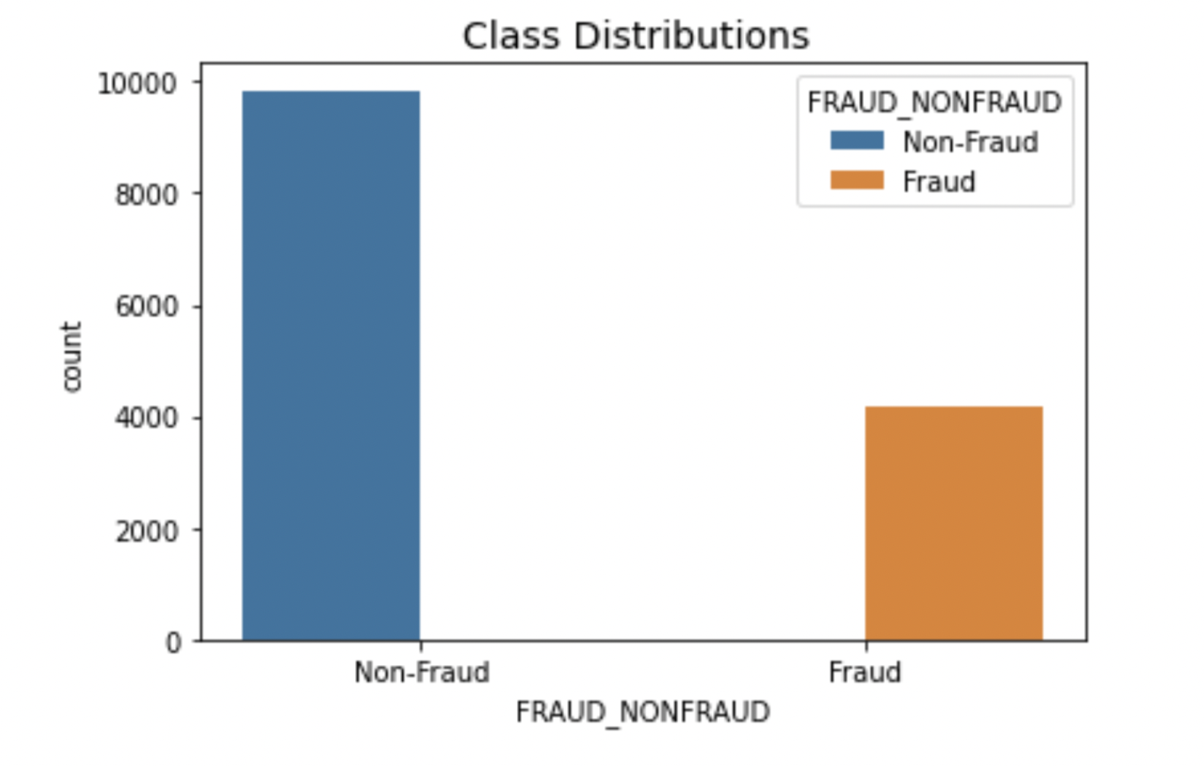
Contd
Highly Imbalanced Data
Almost Non-Fraud cases are double more than the Fraud Cases.
Creates many problems while training the model.

Slide 4
Data Pre-Processing
Handling Null Values
As there were many null values we did not have chance to remove all of them because this would reduce the Dataset size.
We replace all the null values with the NONE.
This can be done by using df.fillna(“none”).

Slide 5

Contd.
2.Converting String to Integer type
In this we convert the string datatype to int by finding all the string columns .
Then we apply labelencoder on all these columns to fit the data.
Next we have the numbers for each kind of value in all the string columns

Slide 6

Contd.
3.Converting all values to similar range.
In this we convert all the different range columns values to similar range so that model will not be biased towards the higher values.
This can be done standard scaling all the values using Sklearn standardscaler() function.

Slide 7

Modelling
We applied Different Algorithms like the below to check the accuracy for different grid search values
LogisticRegression
KNeighborsClassifier
SVC
DecisionTreeClassifier
GradientBoostingClassifier

Slide 8
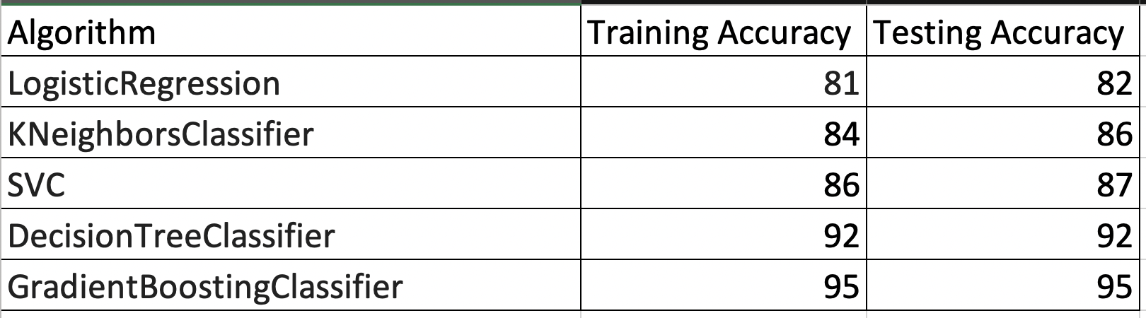
Contd.
The Accuracy of different algorithms is as in the picture.
For GradientBoostingClassifier we can see that accuracy is more compared to other algorithms.

Slide 9
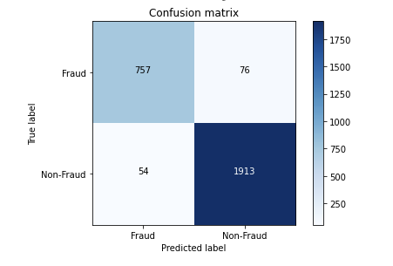
Contd.
This is the confusion matrix for the Xgboost Classifier.As we can see that the classification is very good.

Slide 10

Under-Sampling
Under sampling is a technique to balance uneven datasets by keeping all of the data in the minority class and decreasing the size of the majority class. It is one of several techniques data scientists can use to extract more accurate information from originally imbalanced datasets. Though it has disadvantages, such as the loss of potentially important information, it remains a common and important skill for data scientists.

Slide 11
Neural Networks
We used basic neural network model to train on the data. As the data is very imbalanced the accuracy was not that good. We had 4 Dense layers and dropout after each layer. We did use softmax as the activation function because we need to classify it into 2 categories.
clas = Sequential()
clas.add(Dense(units=16,kernel_initializer='uniform',activation='relu',input_dim=12))
clas.add(Dropout(rate=0.1))
clas.add(Dense(units=32,kernel_initializer='uniform',activation='relu',input_dim=12))
clas.add(Dropout(rate=0.1))
clas.add(Dense(units=64,kernel_initializer='uniform',activation='relu',input_dim=12))
clas.add(Dropout(rate=0.1))
clas.add(Dense(units=2,kernel_initializer='uniform',activation='softmax'))
clas.compile(optimizer = 'adam', loss = 'sparse_categorical_crossentropy', metrics = ['accuracy'])

Slide 12
Conclusion
Xgboost Classifier is much better than the all other models and under sampling did not work that much better as the more data is of im balanced data.

