Slide 1

GITHUB
Presented by
SaiSmita Rath

Slide 2
Agenda
Why use Version Control ?
What is version control ?
Types of version control system
Subversion vs Git
What are Git and GitHub
git vs GitHub
Setting up Git & Creating our first repository
Git working structure
Use of some git commands
Best practices for code collaboration
Important concept for GitHub users
Understanding GitHub workflow
Advantages of git and GitHub

Slide 3
Why version control ?
Scenario 1 :
Your program is working ->You change “just one thing” ->Your program breaks ->You change it back ->Your program is still broken -- why ?
Scenario 2 :
You change one part of a program--it works ->Your co worker changes another part--it works ->Your put them together -- it does not work ->Some change in one part must have broken the otherpart ->What were all the changes ?
Scenario 3 :
You make a number of improvement to a class ->Your co worker makes a number of improvements to the same class
How can you merge these changes ?
Has this ever happened to you ?

Slide 4
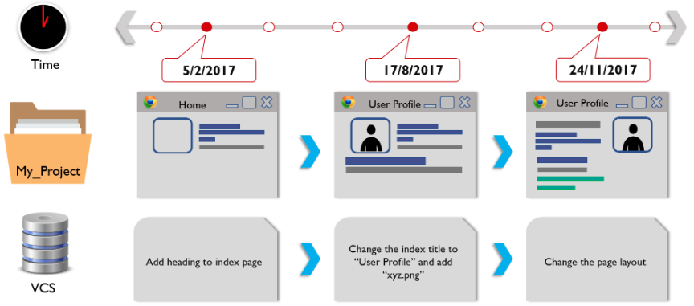
What is version control ?
Version Control System (short: "VCS") as a kind of "database"
A version control system (often called a source code control system) does these things:
Keeps multiple (older and newer) versions of everything (not just source code)
Requests comments regarding every change
Allows “check in” and “check out” of files so you know which files someone else is working on
Displays differences between versions

Slide 5
What is version control ? (contd..)
Version Control System also popularly know as:
Revision Control System (RCS)
Configuration Management System (CMS)
Source Control Management System (SCMS)
There are three types of Version Control System
Local Version Control System
Central Version Control System
Distributed Version Control System

Slide 6
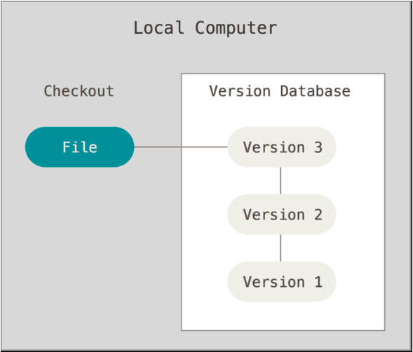
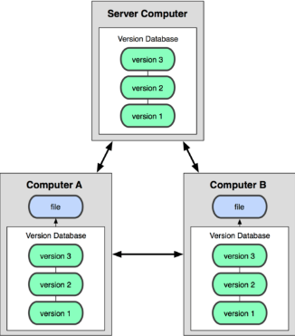
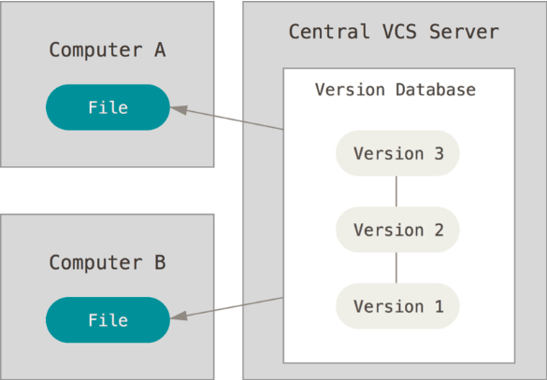
Types of Version control system

Slide 7
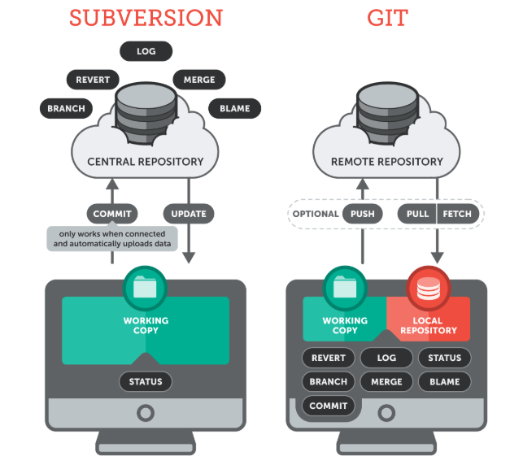
Subversion vs Git

Slide 8
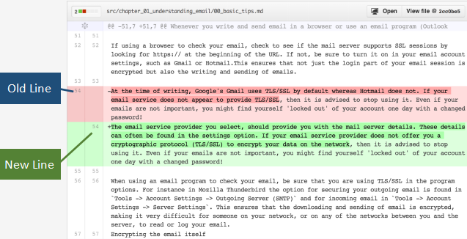
What are Git and GitHub
Git
Git started in 2005 and was created by Linus Torvald to aid in Linux kernel development .It is a free and open source, distributed version control system that records changes to a file or set of files and helps recall specific versions later if needed. It allows us to :
Revert files or the whole project to an earlier state.
Compare changes over time
See who modified what ?
Control modifications by collaborators with
the permission of admin/owners.
GitHub
GitHub is a web-based repository hosting service for Git .It was founed in 2008 and it also has an Enterprise edition for businesses.
While Git is a commandline tool,GitHub provides a web-based graphical interface that works on top of GIT.

Slide 9
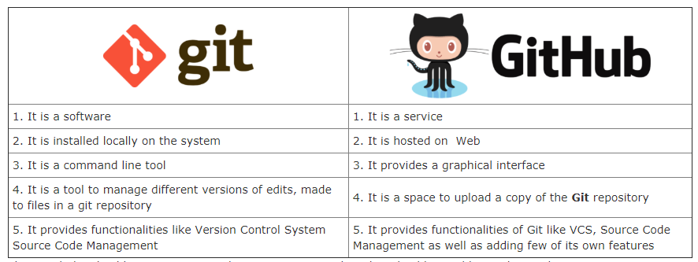
git vs GitHub

Slide 10
Let's Get Started
Setting up Git & Creating our first repository
Install git for your platform of choice (git-scm.org)
Graphical installer for Windows
DMGs for Mac
Your favorite Linux package manager
Or compile from source!
Configure Git through GitBash
git config --global user.name "Smita"
git config --global user.email “saismita.rath@gmail.com”
Establish our first repository:
mkdir git-test
cd git-test
git init -->This creates the repository (a directory named .git)
What do we have here?
git status
Let's take a quick look around .git directory
Add a file, make some changes, and run git status

Slide 11
Using our first repository
Let's commit a file into the repo:
git add test.py
git commit -m "My very first commit"
git status
Let's add a file we don't want to actually save
git add test.pyc
git commit -m "Something I didn't want to commit"
(You can use a different commit message, if you like)
git rm test.pyc
git commit -m "Removing derivable data"
What did we just do (at a glance)?
git hist
And what about in detail?
git log
git diff test.py

Slide 12
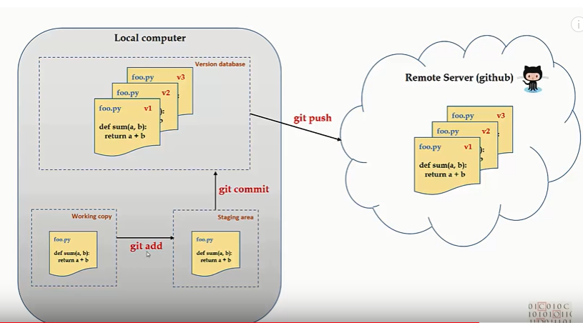
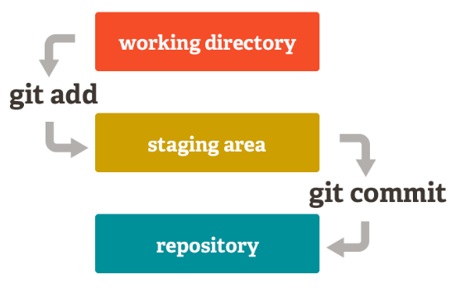
Git working structure
But why add and then commit ?
Staging area -- Where we set up a commit between file changes on the system and the commit to the repo
git add ---> will add the file to staging area.Later on staging area will be used to commit files when you run git commit
git commit---> adds your changes to local version control database.You have still not pushed these changes to remote server (github) .
git push---> will now push committed changes to remote server (github)

Slide 13
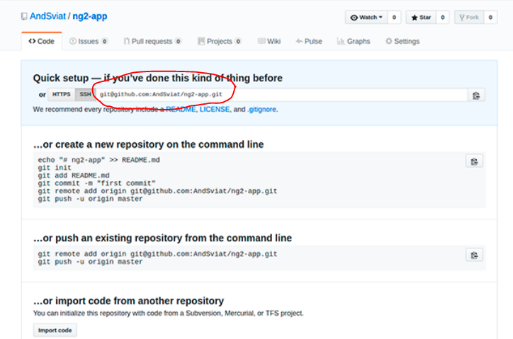
Git commands
We can also tell an active repo where the remote origin is:
git add remote origin nugent5@yt:~/davesdots.git
git status
Type in git add .
git status
Let's say our friend has set up a repository somewhere:
git clone git@github.com:Dylnuge/davesdots.git
(coping repository from GitHub to local computer.)
Make changes and commit like normal, then:
git push
If they make any changes, we can get them:
git pull
(Get changes from a remote repository and merge them into your own repository)

Slide 14
Best practices for code collaboration
When to commit ?
Source of major arguments (big changes vs small change)
Never put broken code on the master branch (test first!)
Try not to break things (dont do two weeks worth of work in one commit)
Always use a clear and concise message.
Put more details in lines below ,but always make the first line short
Describe the why ; the what is clear in the change log
When making giant changes consider branches.
Make sure your name and email are right.

Slide 15
Important concept for GitHub users
Creating a repo
Creating a repositiry for multiple people to work together
Master in a repository
This is the final version that is considered ready to use by anybody in the team or outside if repository is public.
Creating a Branch
Create a branch in your project for an environment where you can try out new ideas.
Changes you make on a branch dont affect the master unless pull request is accepted.
Changes committed to branch reflects for you to keep track of different versions.
Simple usage of branches:
git checkout -b testing
# Make a new branch "testing”, make some changes and commit them
git checkout master
# Switch to "master" branch
git merge testing
# Merge the "testing" branch

Slide 16
Important concept for GitHub users (contd...)
Adding Commits
Keep tracks of your progress as you work on a branch or master.
Creates a transparent history that others can follow to understand what you have done and why
Forking a repository
It creates a copy for you to work on independently without any changes to theirs.
Submit a pull request to owner so that the owner can in corporate changes
Pull requests
Pull requests initiates discussion about your commits or changes made to a code.
See exactly what changes would be merged if pill request is accepted.
Issues
Highlights bugs or issues with codes that need rectification
Issues remain open unless resolved.

Slide 17
Important concept for GitHub users (contd...)
git checkout
Used to checkout a specific version/branch of the tree
git checkout -f
git reset
Moves the tree back to a certain specified version
Use the --force to ignore working changes
git revert
Reverts a commit
Does not delete the commit object, just applies a patch
Reverts can themselves be reverted!
oh, we already commited it:
git revert HEAD
# Revert last commit (HEAD)
Git never deletes a commit object

Slide 18
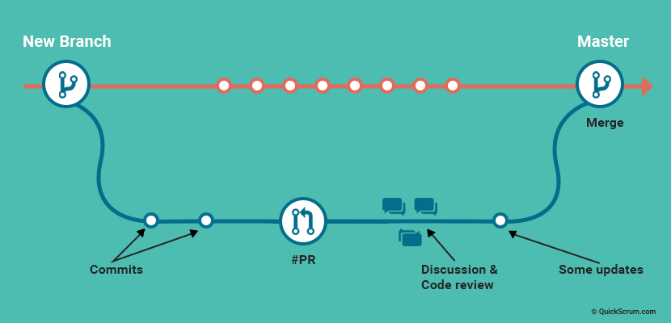
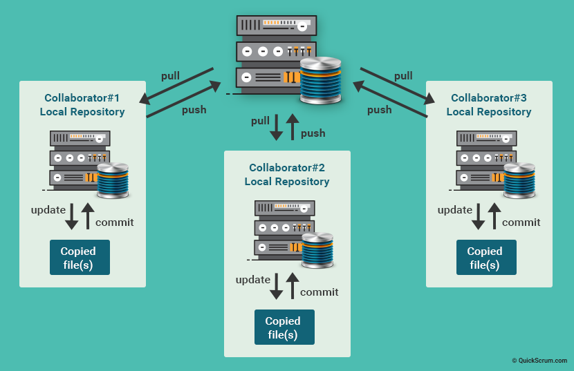

Slide 19
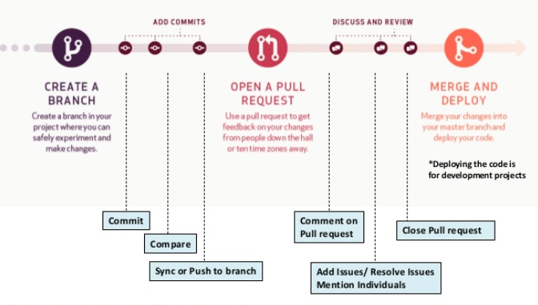
Understanding GitHub workflow

Slide 20
What are the advantages of Git?
Local Repository (commit changes prior to submitting)
View changes in code prior to committing
Track Changes (via log and commit messages)
Create Branches for specific tickets/tasks
Widely used and supported by multiple systems
Integrated with Jira, Bitbucket and Github

Slide 21
What are the advantages of GitHub?
Easy management of the central repository
Easy management and manipulation of code
Quickly perform Pull Requests
Quickly share code with others
Built in Bug tracking system
Code Security
Flexibility
Widely known and supported
Free (or paid for private repos)

Slide 22


Slide 23


