Slide 1
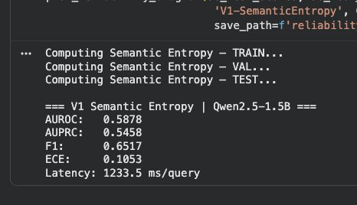
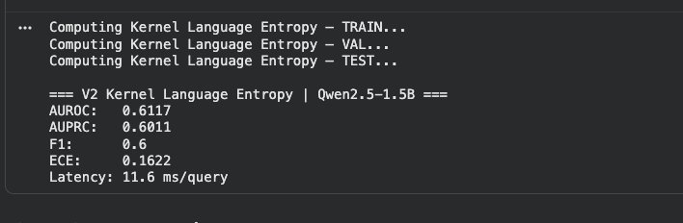
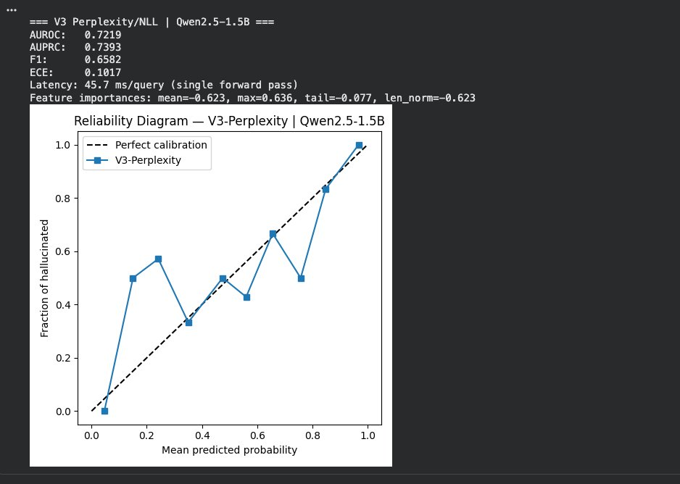
Qwen2.5-1.5B | V1 Semantic Entropy · V2 Kernel Language Entropy · V3 Perplexity/NLL | HalluEval QA, 500 samples
V1 - Semantic Entropy
V2 - Kernel Language Entropy
V3 - Perplexity / NLL ★ Best
Method
AUROC
AUPRC
F1
ECE
Latency
Fwd Passes
Note
V1 - Semantic Entropy
0.5878
0.5458
0.6517
0.1053
1,233 ms
5
Near random
V2 - Kernel Lang. Entropy
0.6117
0.6011
0.6000
0.1622
11.6 ms
5
Reuses K=5
V3 - Perplexity / NLL ★
0.7219
0.7393
0.6582
0.1017
45.7 ms
1
★ Winner
Key insight: V3 wins with AUROC 0.7219 - 22% above random (0.50), 27× faster than V1 (45.7ms vs 1,233ms), needs only 1 forward pass. V1 & V2 near-random on 1.5B - confirms SE/KLE methods designed for 7B+ fail at this scale. Novel finding.
Random baseline AUROC = 0.50 | Feature importances (V3): max_NLL=+0.636, mean_NLL=−0.623 | ECE: lower = better calibrated

Slide 2
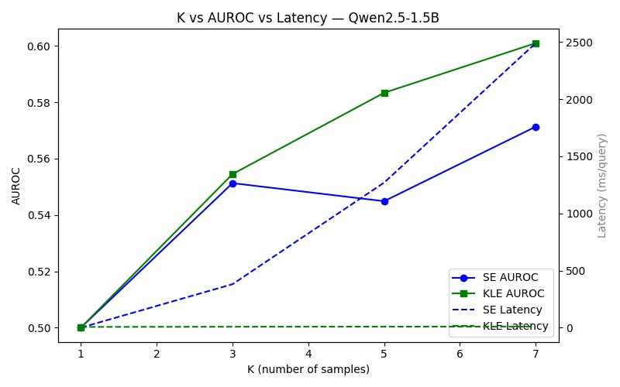
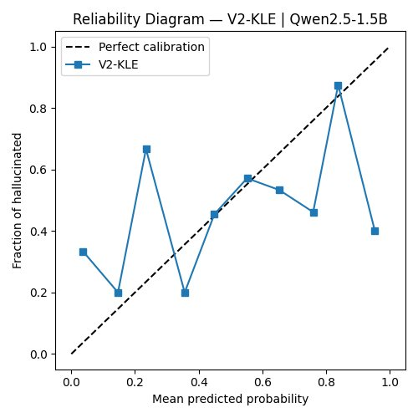
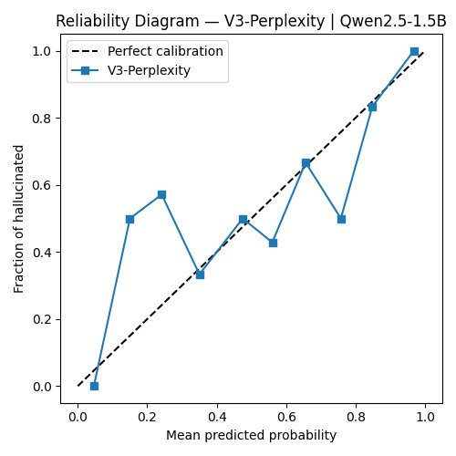
Qwen2.5-1.5B | K vs AUROC vs Latency · Reliability Diagrams V2 & V3 | Visual Analysis
K vs AUROC vs Latency (V1 & V2)
Reliability Diagram - V2 KLE (ECE = 0.1622)
Reliability Diagram - V3 PPL (ECE = 0.1017 ★)
K
SE AUROC
KLE AUROC
SE lat(ms)
KLE lat(ms)
1
0.50
0.50
0.3
6.7
3
0.55
0.55
380.7
8.2
V2 KLE - ECE 0.1622 Blue line zigzags badly. At x=0.23 model says 23% but actual = 67% hallucinated. Poorly calibrated - scores not trustworthy.
V3 PPL - ECE 0.1017 ★ Line follows diagonal closely, especially right half. At x=0.8 → actual 83% ✓ At x=1.0 → actual 100% ✓ Better calibrated - scores more trustworthy.
5
0.54
0.58
1,270
9.2
7
0.57
0.60
2,491
10.0
K=1 - random · K=3 = 95% accuracy at 40% cost · KLE flat latency (best)
Reliability diagram: dashed = perfect calibration · closer to diagonal = better · ECE lower = better · KLE latency flat because no NLI calls needed

Slide 3
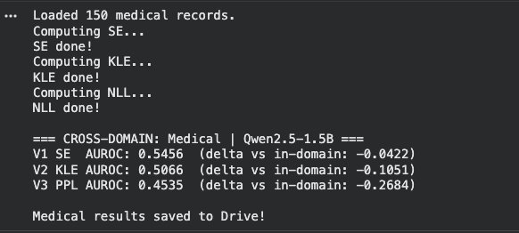
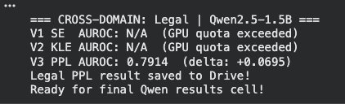
Qwen2.5-1.5B | Cross-Domain Zero-Shot Transfer · Progress & Remaining Work
Medical Domain - Actual Output
Legal Domain - Actual Output
✓ Completed — Qwen2.5-1.5B
✓ V1 SE · AUROC 0.5878 · ECE 0.1053
✓ V2 KLE · AUROC 0.6117 · ECE 0.1622
✓ V3 PPL ★ · AUROC 0.7219 · ECE 0.1017
Cross-Domain AUROC Summary
✓ K-curve (K=1,3,5,7)
Domain
V1 SE
V2 KLE
V3 PPL
Best Δ
✓ Reliability diagrams (V2 & V3)
In-Domain
0.5878
0.6117
0.7219
—
✓ Medical cross-domain (all 3)
Medical
0.5456
(−0.04)
0.5066
(−0.11)
0.4535
(−0.27)
SE (−0.04)
✓ Legal V3 PPL = 0.7914 (+0.07)
⏳ Still Remaining
Legal
N/A
N/A
0.7914
(+0.07)
PPL +0.07 ✓
Medical: All degrade. V3 PPL drops most (−0.27) — logistic regression trained on HaluEval, not medical text. V1 SE most robust (−0.04) since clustering is domain-agnostic. Legal: V3 PPL improves to 0.7914 (+0.07) — legal proxy uses same HaluEval-style questions, so NLL features transfer well. V1/V2 legal scores blocked by GPU quota.
⏳ Legal SE+KLE
~2 hrs GPU
⏳ Llama-3.2-1B pipeline
~8–10 hrs GPU
⏳ Llama-3.2-3B pipeline
~10–12 hrs GPU
⏳ Final table + chart
<1 hr (no GPU)
All Qwen results saved to Google Drive · GPU hours used: ~45–50 hrs · Remaining: ~22–25 hrs T4 GPU

