Slide 1
Baltimore Crime Analysis
Insights and Visualizations Sai Sri Harsha Kumbam EF41093

Slide 2
Introduction
Initially the data provided was quite messy with various null values, missing values and duplicates.
So this was minimized initially using the various data cleaning activities.
The Initial output before cleaning vs after cleaning is attached in the next slides
One Thing that surprised me was the dataset was having certain identical and missing values which were essential but certain instances were missing so for that I took into consideration the other instances available and stopped them from dropping and saved the important piece of information for further investigation activities

Slide 3
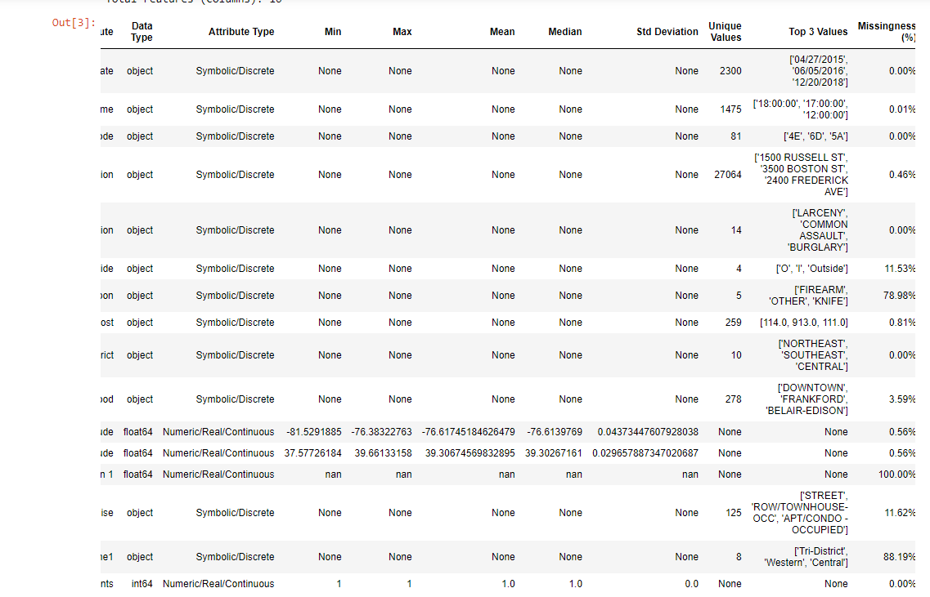
Before Cleaning

Slide 4
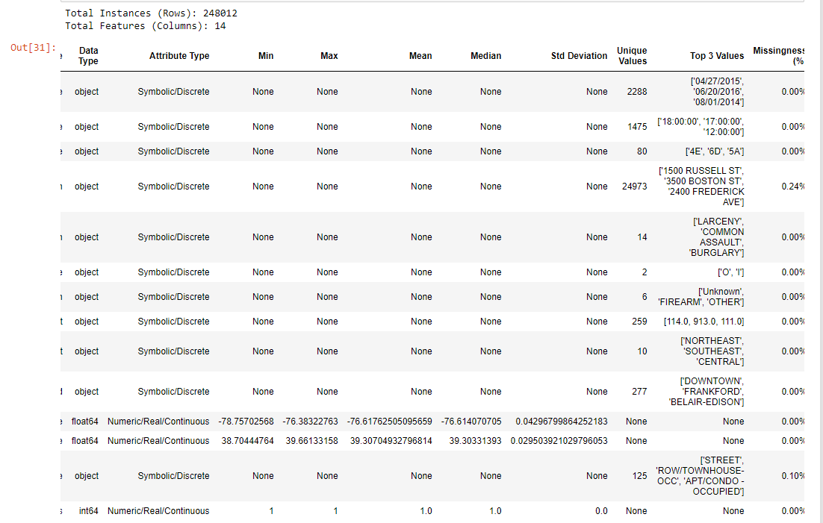
After Cleaning

Slide 5
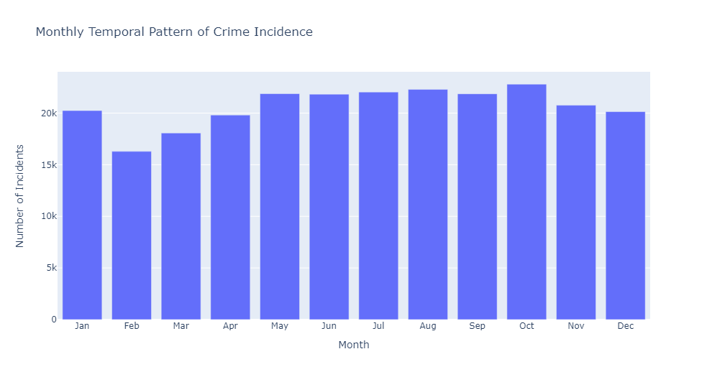
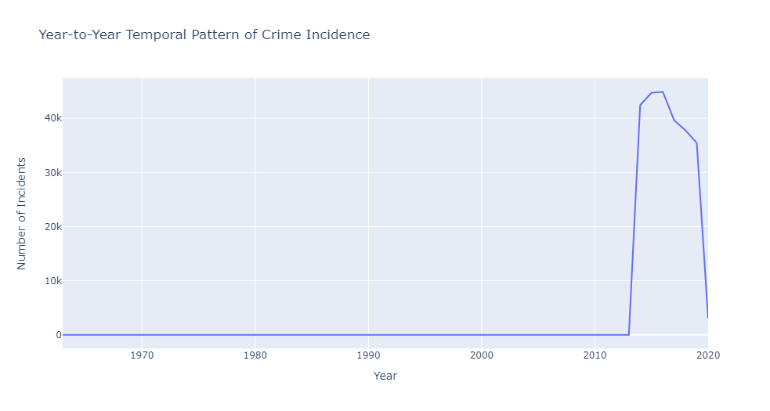
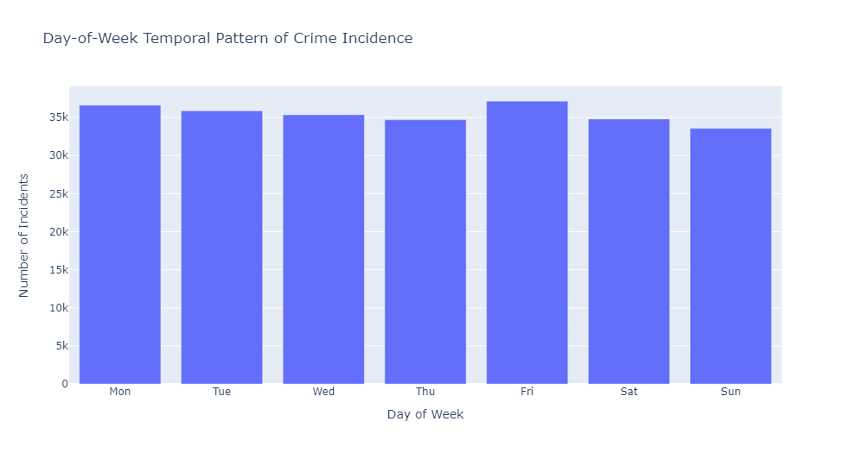
The Attached images shows us with the Temporal Pattern of Crime incidence in a particular Year, Month and Day of the week

Slide 6
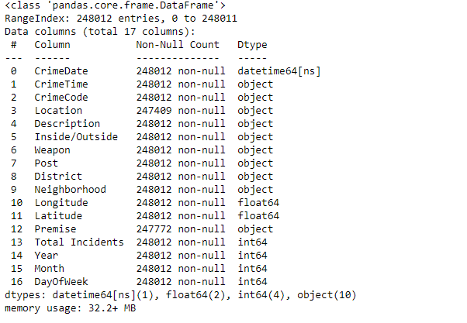
After Plotting the plots the dataset was modified as follows with new columns named Year, Month, Day of the Week as seen in the image

Slide 7
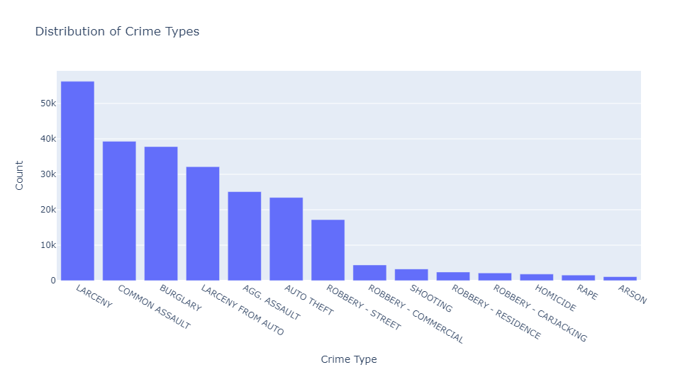
This is how the Distribution of crimetype look for each crime and their respective count values

Slide 8
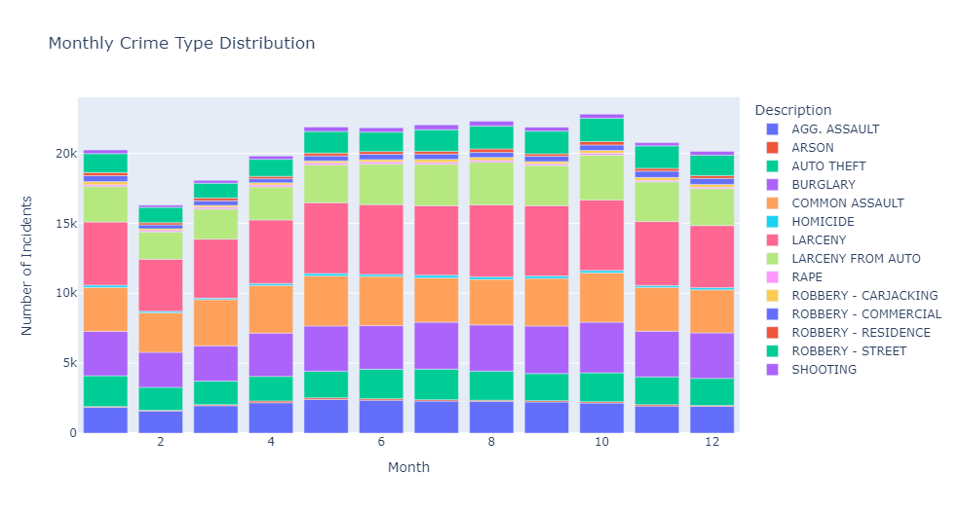
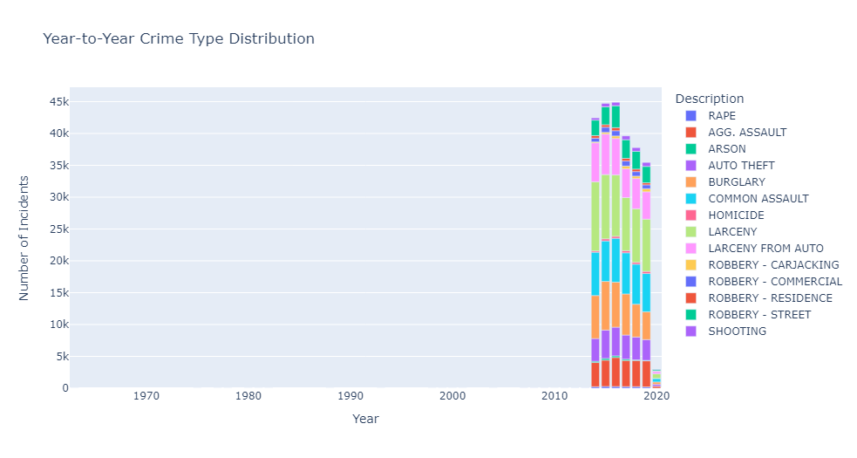
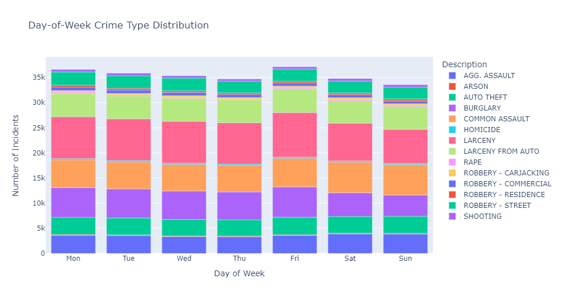
Through these images we can analyze how crime type distributions might vary from year-to-year, month-to-month, or by day-of-week aggregating across all locations.

Slide 9
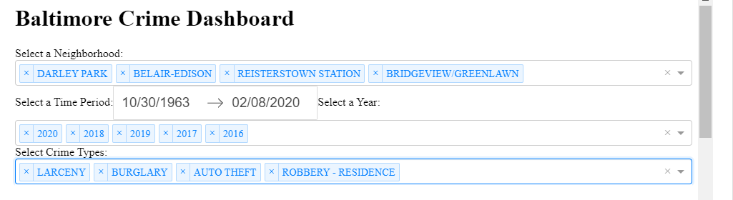
This is how the dashboard looks the officers have to provide the details from the dropdown as above to get the plots and explore the spatial and temporal patterns of crime.

Slide 10
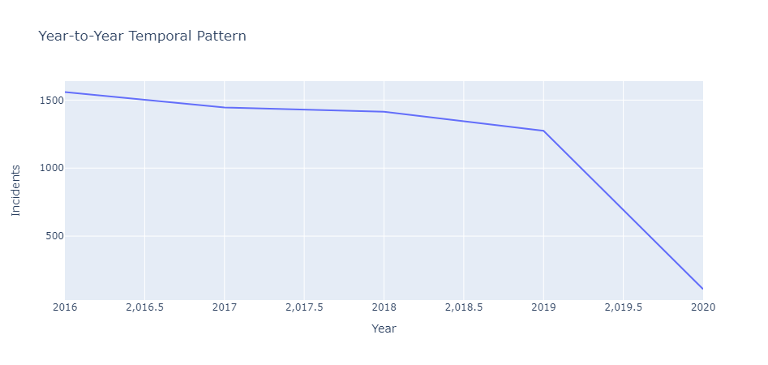
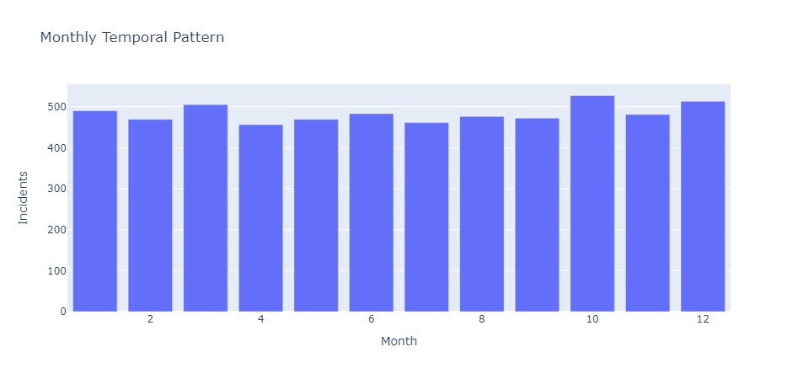
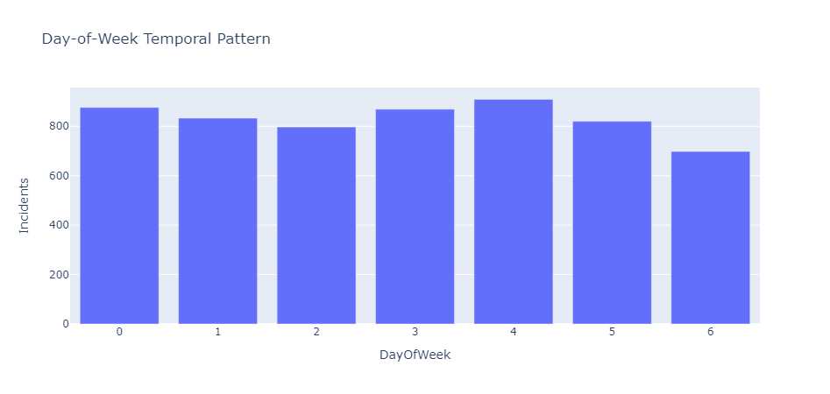
This how the officers view appears in thor respective dashboard to explore the temporal patterns of crime

Slide 11
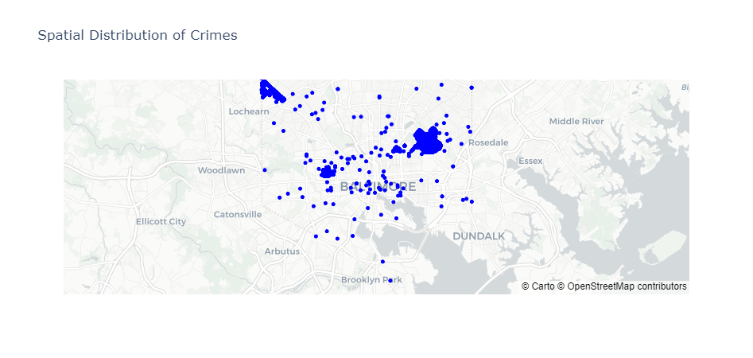
Finally for the selected items from dropdown the officers will see the spatial data in the following format which makes thor tasks easy and saves their time

Slide 12
GPT Prompts Used during the project analysis and visualization are as follows: https://chat.openai.com/share/adcd531f-9af2-48a4-b7e8-f758b3c531d6 I have attached a copy of my Code from jupyternotebook in the blackboard submission section.

