Slide 1

Better quality Education App
By-
Sai Sri Narne, Vijaya Yeruva

Slide 2
Problem
Kansas City Metro are facing challenges in K12 education resources. Studies found that student’s academic performance is associated with poverty level in Kansas City, and the association between poverty levels and ACT scores is negative 0.95. Suburban districts have consistently higher composite ACT scores than urban districts. The inequality of education in KC Metro is evident.

Slide 3
Solution
We developed an application to overcome this problem, this application helps you find the schools around you considering your salary, age, gender and disabilities. You can find the schools based on the location.
We made it easy by incorporating google maps API. The major hurdle was to find the data.

Slide 4
Data
We scrapped the data from “National Center for education statistics(https://nces.ed.gov/datatools/ )”. It has all the state public & private school data. We choose kansas state school data just to make the data accesibile in short time.
For the time being we considered this data and created an application on top of it, though the data had not described about the course it offers or many others the use case required.

Slide 5
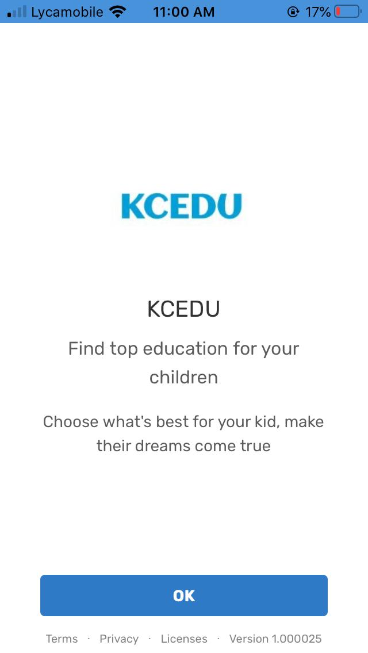
About Application
Here is the first screen of how the application looks like, we developed it in such way it can be accessible in IOS and Google play as well as the in the browser.

Slide 6
Features
We included three frames in the application, i.e
Personal Info (which takes in the user data like gender, age, disabilities, address, grade, health conditions)
Map( This shows us a map of the schools around the locality)
Schools( This includes name, location, phone number, messaging option for schools also includes number of teachers-student ratio, daily lunch option, disability special needs etc)

Slide 7
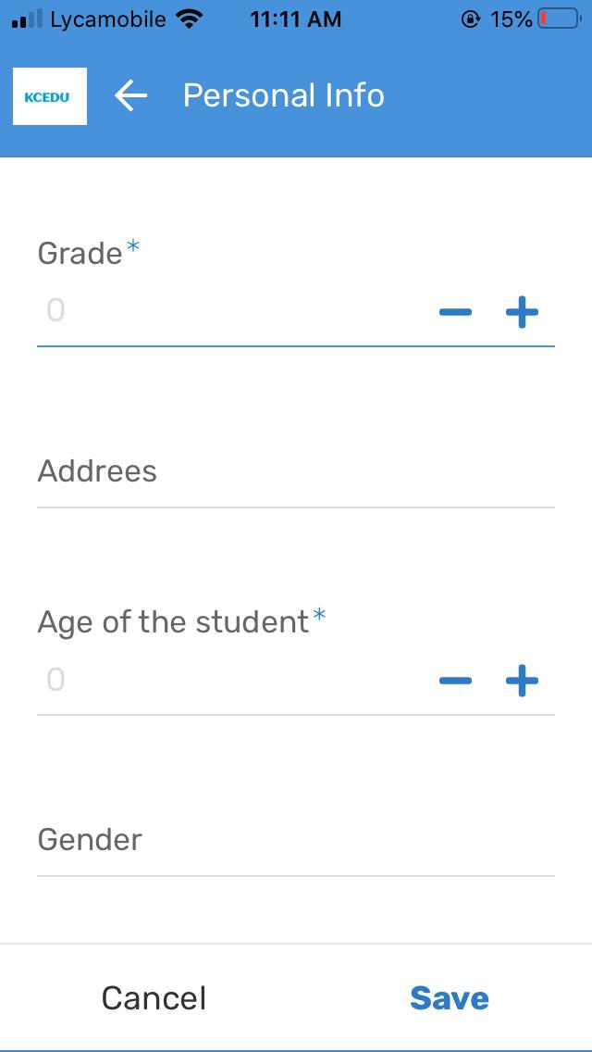
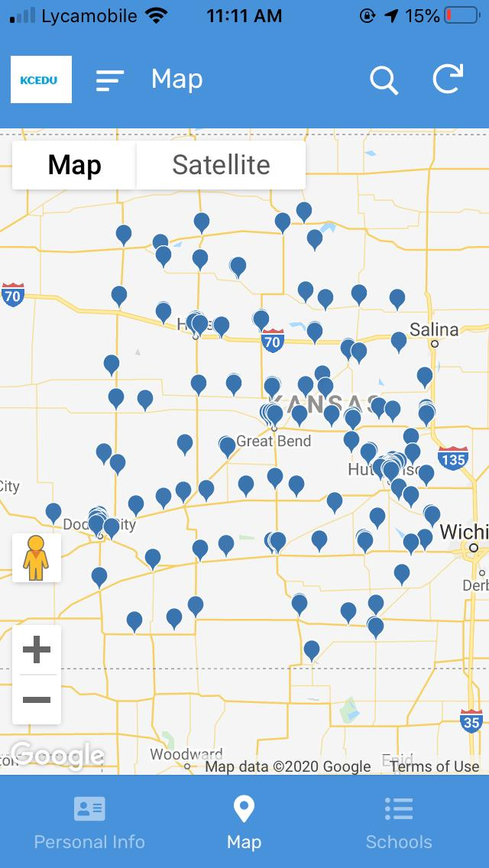
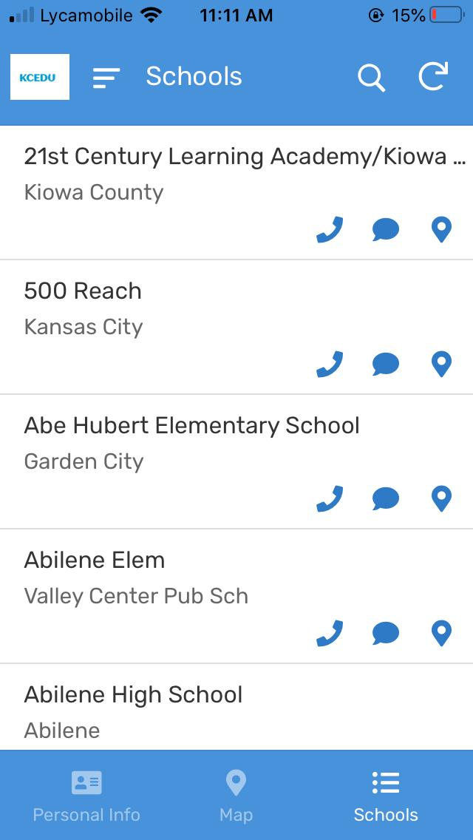
Frames

Slide 8
Security & Accessibility
We confined the access only to umsystem users for security purposes. We show more regarding this in the video.
Entire app is deployed in the cloud using the creation of REST API’s. Therefore, everyone with the link should be accessing the application.
Browser link- https://www.appsheet.com/start/132054f6-c2fc-4faa-9490-b17f748059a5
Mobile link- https://www.appsheet.com/newshortcut/132054f6-c2fc-4faa-9490-b17f748059a5

Slide 9
Conclusion & Future work
It is fun working for this, we did the best we can in the meantime for hackthon. We would love to collaborate for future work.
Thanks

