Slide 1
Healthcare Revenue Cycle Management
Presented by :-
Sai Sriram Inavolu

Slide 2
Introduction
The Healthcare Revenue Cycle Management (RCM) project simulates a real-world healthcare analytics pipeline built to unify and process large-scale patient, claims, and transaction data from multiple hospitals. This system ensures clean, structured, and insightful data delivery using modern cloud-first architectures and best practices in data engineering.
The core aim was to transform fragmented raw data into reliable analytics-ready datasets to support executive decision-making, improve patient outcomes, and optimize healthcare operations.

Slide 3
Problem Statement
Hospitals generate vast volumes of data across systems, including patient visits,
clinical procedures, insurance claims, and payments. However, this data is often
siloed, inconsistently formatted, and lacks standardized tracking for historical
changes.
Without a scalable and unified data pipeline, hospitals face challenges such as:
Inconsistent reporting across systems
Inability to trace patient history changes
Lack of real-time metrics for revenue and operations
Manual and error-prone analysis workflows
This fragmentation prevents leadership from making timely, informed decisions based on
reliable KPIs

Slide 4
Objective
To address these challenges, this project aimed to build a complete, automated ETL pipeline that:
Extracts data from MySQL and CSV sources representing different hospitals and claims
Cleans, merges, and enriches raw records into a consistent structure
Implements Slowly Changing Dimensions (SCD Type 2) for historical patient tracking
Builds a dimensional model optimized for analytical workloads
Loads curated data into Google BigQuery using a clean Medallion architecture
Supports healthcare-specific KPIs and executive dashboards

Slide 5
Technical Requirements
Tech Stack:
Languages: Python, SQL
Data Sources: MySQL (hospital_a, hospital_b), CSV (claims)
Data Lakehouse: Google BigQuery
Libraries: pandas, SQLAlchemy, google-cloud-bigquery
Architecture: Medallion (Bronze → Silver → Gold)
Data Modeling: Dimensional star schema, SCD Type 2
DevOps: Git, GitHub
Logging: Custom ETL logging via Python logger
Secrets Management: dotenv (.env)

Slide 6
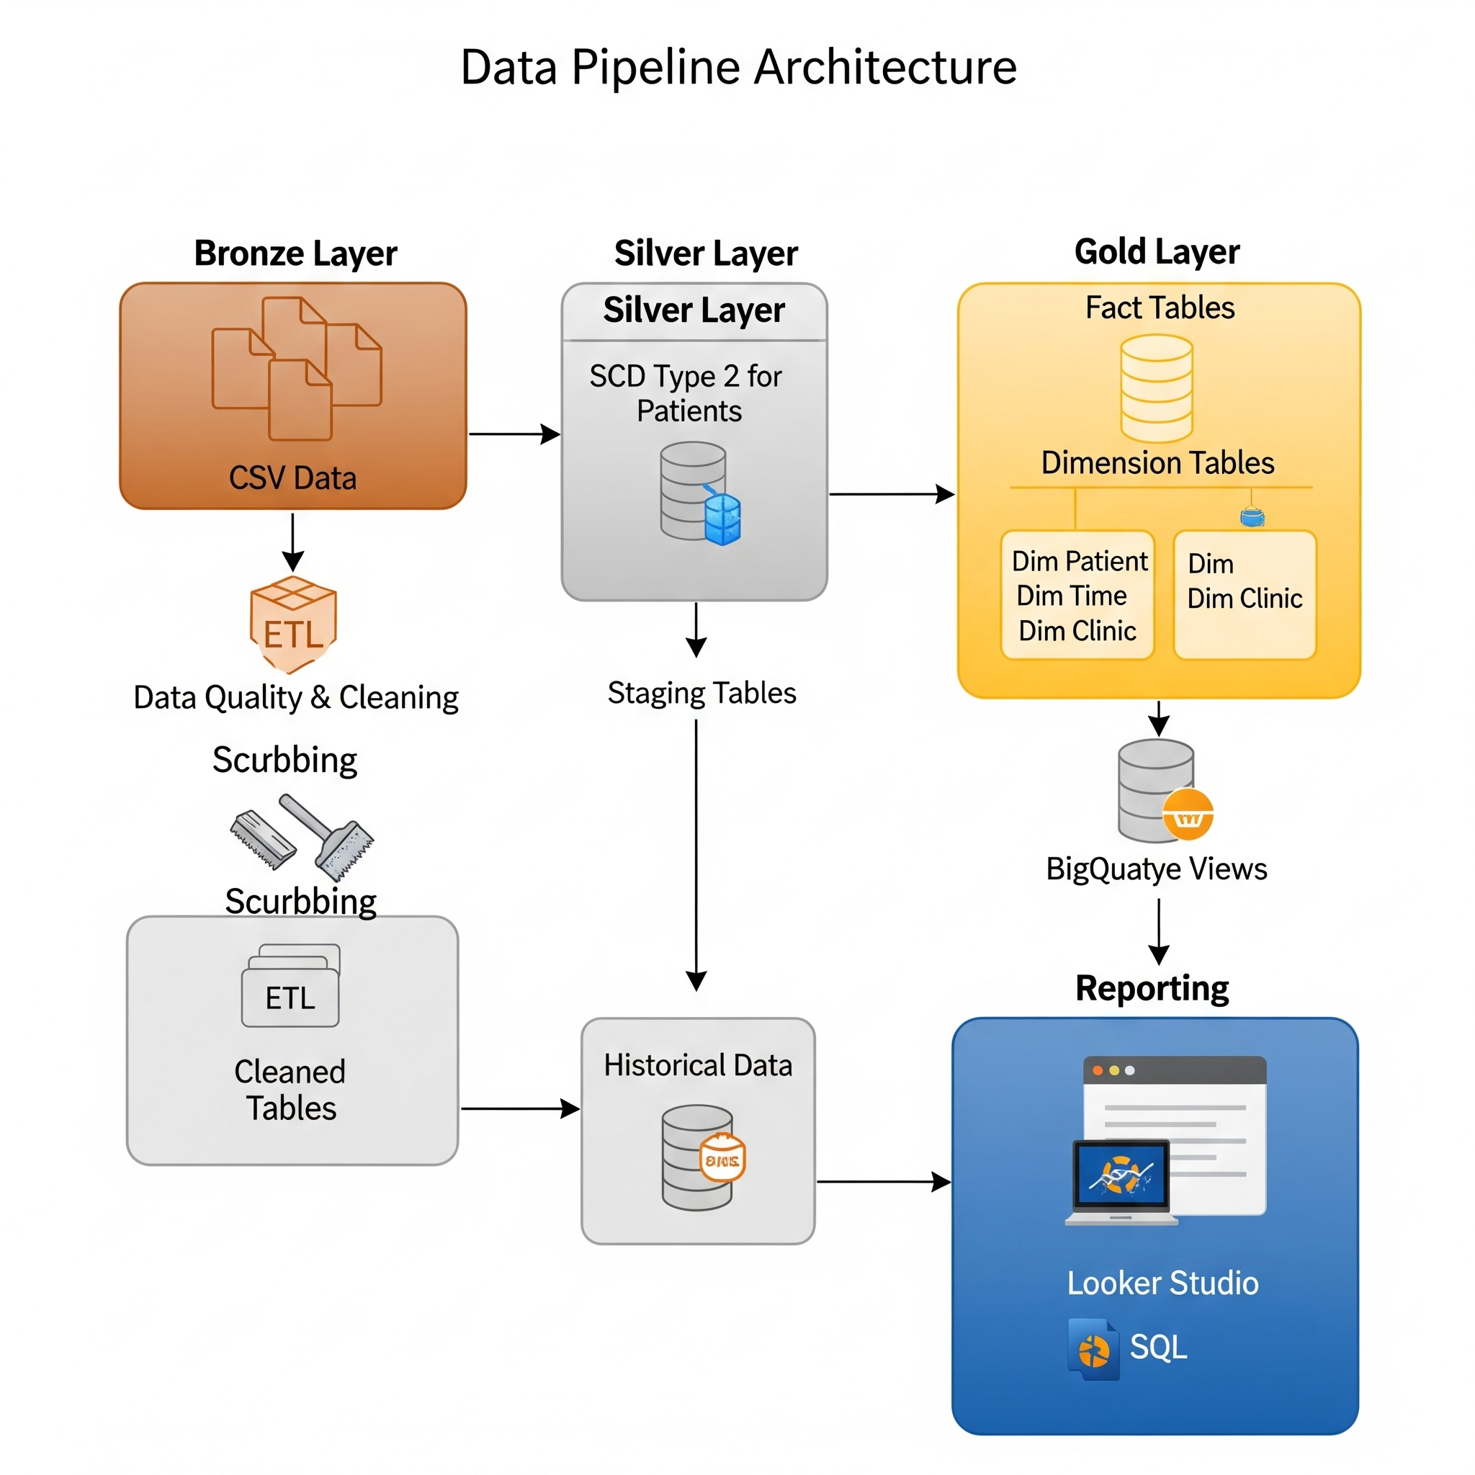

Slide 7
Architecture Overview
The project follows a Medallion Architecture with three distinct layers:
Bronze Layer (Raw): Captures unmodified extracts from databases and CSVs. Stored locally as-is
for traceability and optional reprocessing.
Silver Layer (Cleaned): Transforms and cleanses raw data. Deduplicates patients, merges codes,
validates fields, and ensures completeness across all records.
Gold Layer (Analytics-Ready): Converts cleaned data into a star schema model. Introduces
surrogate keys, historical tracking (SCD2), and fact-dimension separation to enable fast, accurate
BI analysis.
These layers are persisted as CSVs and also loaded into BigQuery under bronze, silver, and gold
datasets.

Slide 8
Silver Layer – Data Standardization
Patient Cleaning:
Gender normalized (M/F → Male/Female);
email validated via regex
unified patient ID created
duplicates removed
False Missing Data Handling:
Source fallbacks applied if email, procedurecode, transaction_date, or claim_date missing.
CPT Codes Enrichment:
Joined cptcodes.csv metadata (description, category) to both claims and transactions
Data Types & Formatting:
Dates parsed, numeric fields cast, amounts cleaned & defaults applied if needed

Slide 9
Gold Layer – Business Ready Data
Final output of the Medallion architecture; designed for analytics, dashboards, and KPIs.
Combines cleaned and modeled data into a star schema: facts and dimensions.
Implements SCD Type 2 for patient history tracking and dim_date for time-based reporting.
Tables are partitioned and clustered in BigQuery for performance optimization.
Delivers actionable insights: revenue trends, claim performance, patient demographics.
Powers Looker Studio dashboards for executive decision-making.
Stored as CSVs in /data/gold/ and loaded into bigquery.gold dataset.

Slide 10
BigQuery Architecture
In BigQuery, the pipeline loads only Silver and Gold layers to maintain storage efficiency and semantic clarity:
Silver datasets represent deduplicated, cleaned, and standardized records, optimized for enrichment or further modeling.
Gold datasets consist of dimensional star schema components, with fact tables partitioned by time and clustered on patient identifiers to improve query performance.
The pipeline supports:
Automatic schema summary generation for every load
Dynamic partitioning and clustering based on business fields
Ready-to-query tables powering downstream dashboards or analytics

Slide 11
Key Learning Outcomes
Through this project, the following data engineering principles and practices were applied and reinforced:
Real-world implementation of SCD Type 2 logic using surrogate keys and effective date tracking
Design and implementation of a multi-layered Medallion architecture for data reliability and modularity
Development of robust transformation logic to handle messy healthcare datasets
Leveraging BigQuery’s capabilities for optimized large-scale analytics using partitioning, clustering, and cost-effective storage
Deployment of a structured and testable ETL framework with error handling and detailed logging
Understanding how to shape data pipelines around domain-specific business logic (e.g., healthcare revenue, procedures, and claims)

Slide 12
Conclusion
This Healthcare RCM project delivered a scalable, production-ready data pipeline capable of ingesting, transforming, and modeling critical healthcare data for advanced analytics. By employing a layered architecture, type-safe modeling, and cloud-native warehousing, the pipeline ensures reliable and performant data delivery for revenue cycle management analysis.
With the Gold layer fully loaded into BigQuery, the organization can now easily calculate KPIs such as revenue trends, patient LTV, claim denial rates, and AR aging—all backed by historically accurate, deduplicated, and structured data.
This project is ready for real-world deployment and can be extended with orchestration (Airflow), streaming, or dashboarding (Looker Studio) layers.

Slide 13
Thank You

