Slide 1

Visvesvaraya National Institute of Technology, Nagpur
Electronics and Communication Engineering Department
Executive M.Tech. in Applied AI and Communications
Cohort 3B sem. 3, Summer 2026
Final Evaluation(24/05/2026)
Hybrid AI Framework
Predictive and Explainable Customer Communication Optimization in E-Commerce
Presented by
Sai Sudha Vadisina (MT24AAC019)
DevOPs Engineer III in Amazon
Under the supervision of
Dr.Pradnya H Ghare
VNIT Nagpur

Slide 2
Table of Contents:
Introduction
Objective for the project and architecture
Why research is needed
Project Progress
Proposed Solution
Timeline of the project
Conclusion
References

Slide 3
Introduction
E-commerce platforms manage high-volume customer communications
Existing systems are reactive and rule-based, where sentiment detection alone is insufficient
Need for predictive and proactive AI-driven communication optimization
Our system acts as frontline defense for the customers and advertisers.

Slide 4
Objective of the Project
Design hybrid AI framework for e-commerce communication
Predict escalation, dissatisfaction, and churn
Optimize routing and response strategies
Integrate structured + unstructured data
Enable explainable AI-based decision support
Customer satisfaction improves.
Manual effort from support reduces as they can focus on the actual issues.

Slide 5
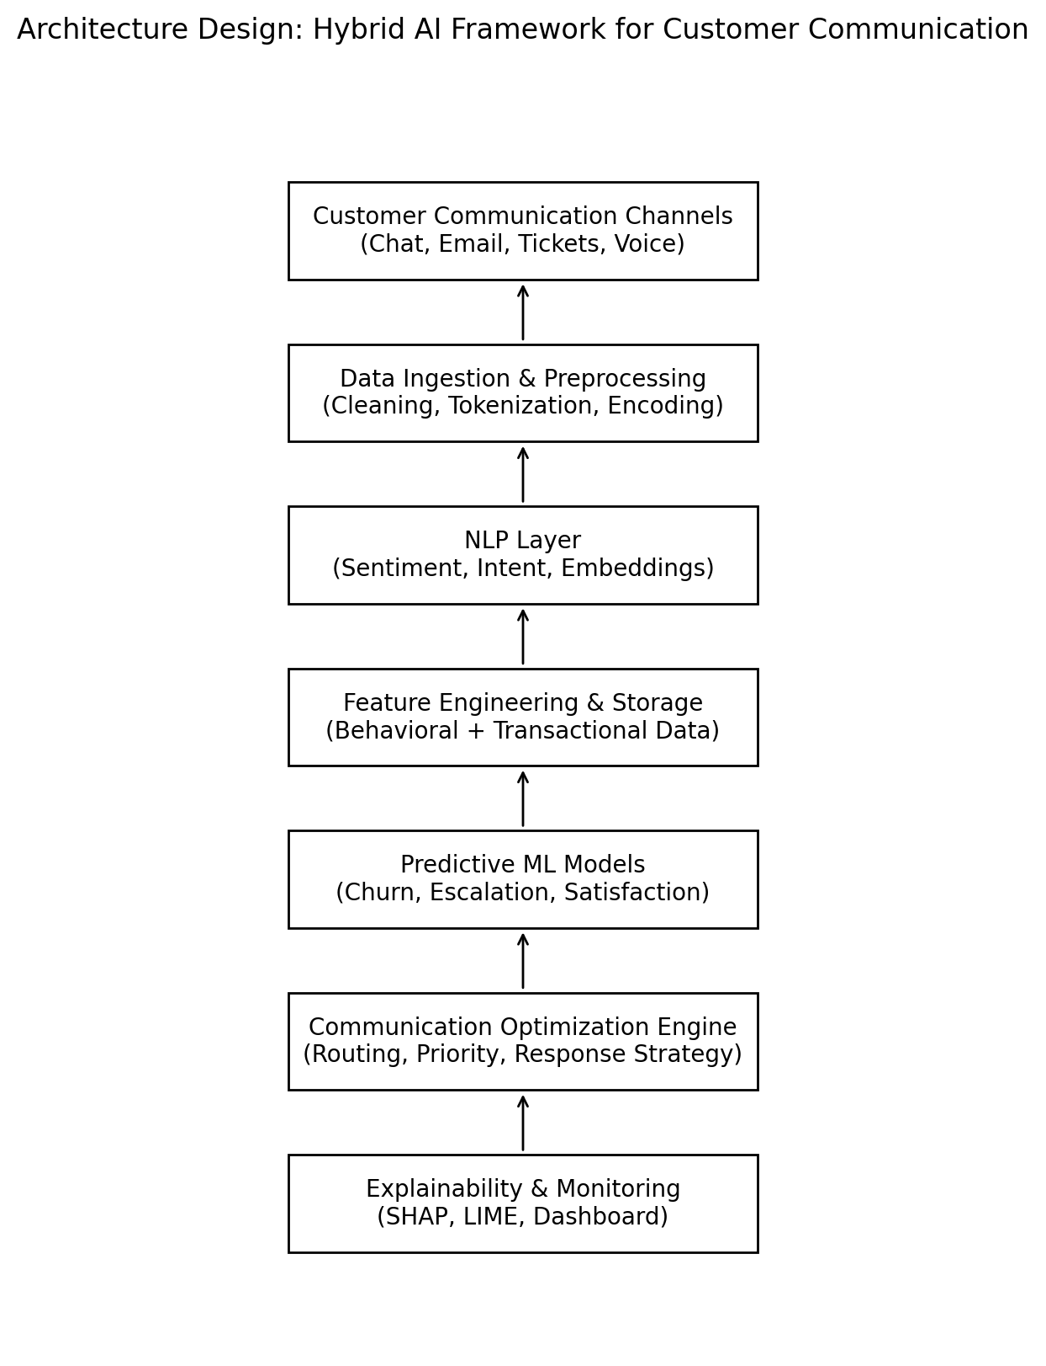
Architecture

Slide 6
Need for Research
Rapid growth in e-commerce customer interactions
High operational cost of customer support
Existing systems are reactive and rule-based
Sentiment detection alone is insufficient
No integrated predictive + optimization framework
Need for proactive, explainable AI-driven communication system

Slide 7
Identified Gaps
Reactive Communication Systems
Limited Explainability
Absence of Optimization Layer
No Structured + Unstructured Data Fusion
Lack of Predictive Modeling

Slide 8
Project Status
Dataset collection
Dataset Validation
Data preprocessing
Data readiness for NLP
Feature engineering
NLP preparation

Slide 9
Dataset Description
Key Features Identified:
Text features → sentiment, intent
Behavioral features → frequency, response delay
Transactional features → order value, returns
Target Variables (Planned):
Churn probability
Escalation likelihood
Customer dissatisfaction

Slide 10
Dataset Description
Dataset Component | Description
Customer Messages | Chats, reviews, complaints, feedback
Transactional Data | Order value, purchase history, returns
Behavioral Data | Interaction frequency, response delay
NLP Features | Sentiment, intent, keyword patterns

Slide 11
Dataset targets
Enable proactive customer support
Improve customer retention
Reduce operational costs
Optimize communication workflows
Support AI-driven decision making

Slide 12
Data Preprocessing
Multi-source Data Integration
Combined customer chats, transactional data, and behavioral logs
Data Cleaning
Removed duplicates and irrelevant records
Handled missing values and inconsistent formats
Text Preprocessing (NLP)
Tokenization and lowercasing
Stop word removal and basic text normalization
Feature Engineering
Extracted sentiment-related indicators (planned)
Derived behavioral features (interaction frequency, response time)
Categorical Encoding
Converted categorical variables into numerical format
Data Transformation
Prepared structured + unstructured data for unified analysis

Slide 13
NLP techniques used
Lowercase conversion
Punctuation removal
Stop word removal - Removed common non-informative words like the ,is, and & of for improvising model efficiency.
Tokenization - Split sentences into words/tokens.
Lemmatization - Reduced words to root form.

Slide 14
NLP techniques Advantages
Faster customer interaction analysis
Improved communication automation
Reduced manual customer support effort
Scalable AI-based workflow

Slide 15
Feature Engineering techniques
TF-IDF Vectorization - Converted text into weighted numerical vectors.
N-gram analysis - Helps capture contextual meaning.
Word frequency patterns

Slide 16
Feature Engineering Impact
Better sentiment classification
Enhanced intent detection
Reduced noisy text data
Improved NLP model performance

Slide 17
Timeline of the project
Phase | Task | Status
Phase 1 | Literature review & objective abstraction | ✅ Completed
Phase 1 | Architecture design& dataset identification | ✅ Completed
Phase 2 | Data preprocessing | ✅ Completed
Phase 2 | NLP model development(sentiment and intent) | ✅ Completed
Phase 2 | Feature engineering | ✅ Completed
Phase 3 | Predictive ML models | 🔜 Planned
Phase 3 | Optimization engine design | 🔜 Planned
Phase 3 | Benchmarking | 🔜 Planned
Phase 4 | Explainability integration | 🔜 Planned
Phase 4 | System evaluation & dashboard creation | 🔜 Planned
Phase 4 | Paper, Document preparation & final evaluation | 🔜 Planned

Slide 18
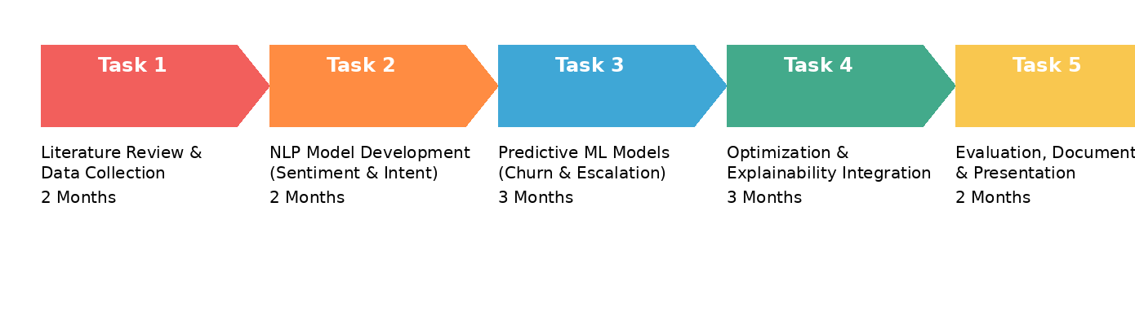
Timeline of the project

Slide 19
Next Plan of Action – (Immediate)
Fine-tune Logistic Regression & SVM
Build confusion matrix evaluation
Add precision / recall / F1-score metrics
Implement intent classification labels

Slide 20
Next Plan of Action - (advanced)
Transformer models (BERT)
Explainable AI (SHAP/LIME)
Reinforcement learning optimization
Hybrid predictive communication engine

Slide 21
Conclusion
The proposed solution transforms customer support from reactive response handling to proactive, intelligent communication management.

Slide 22
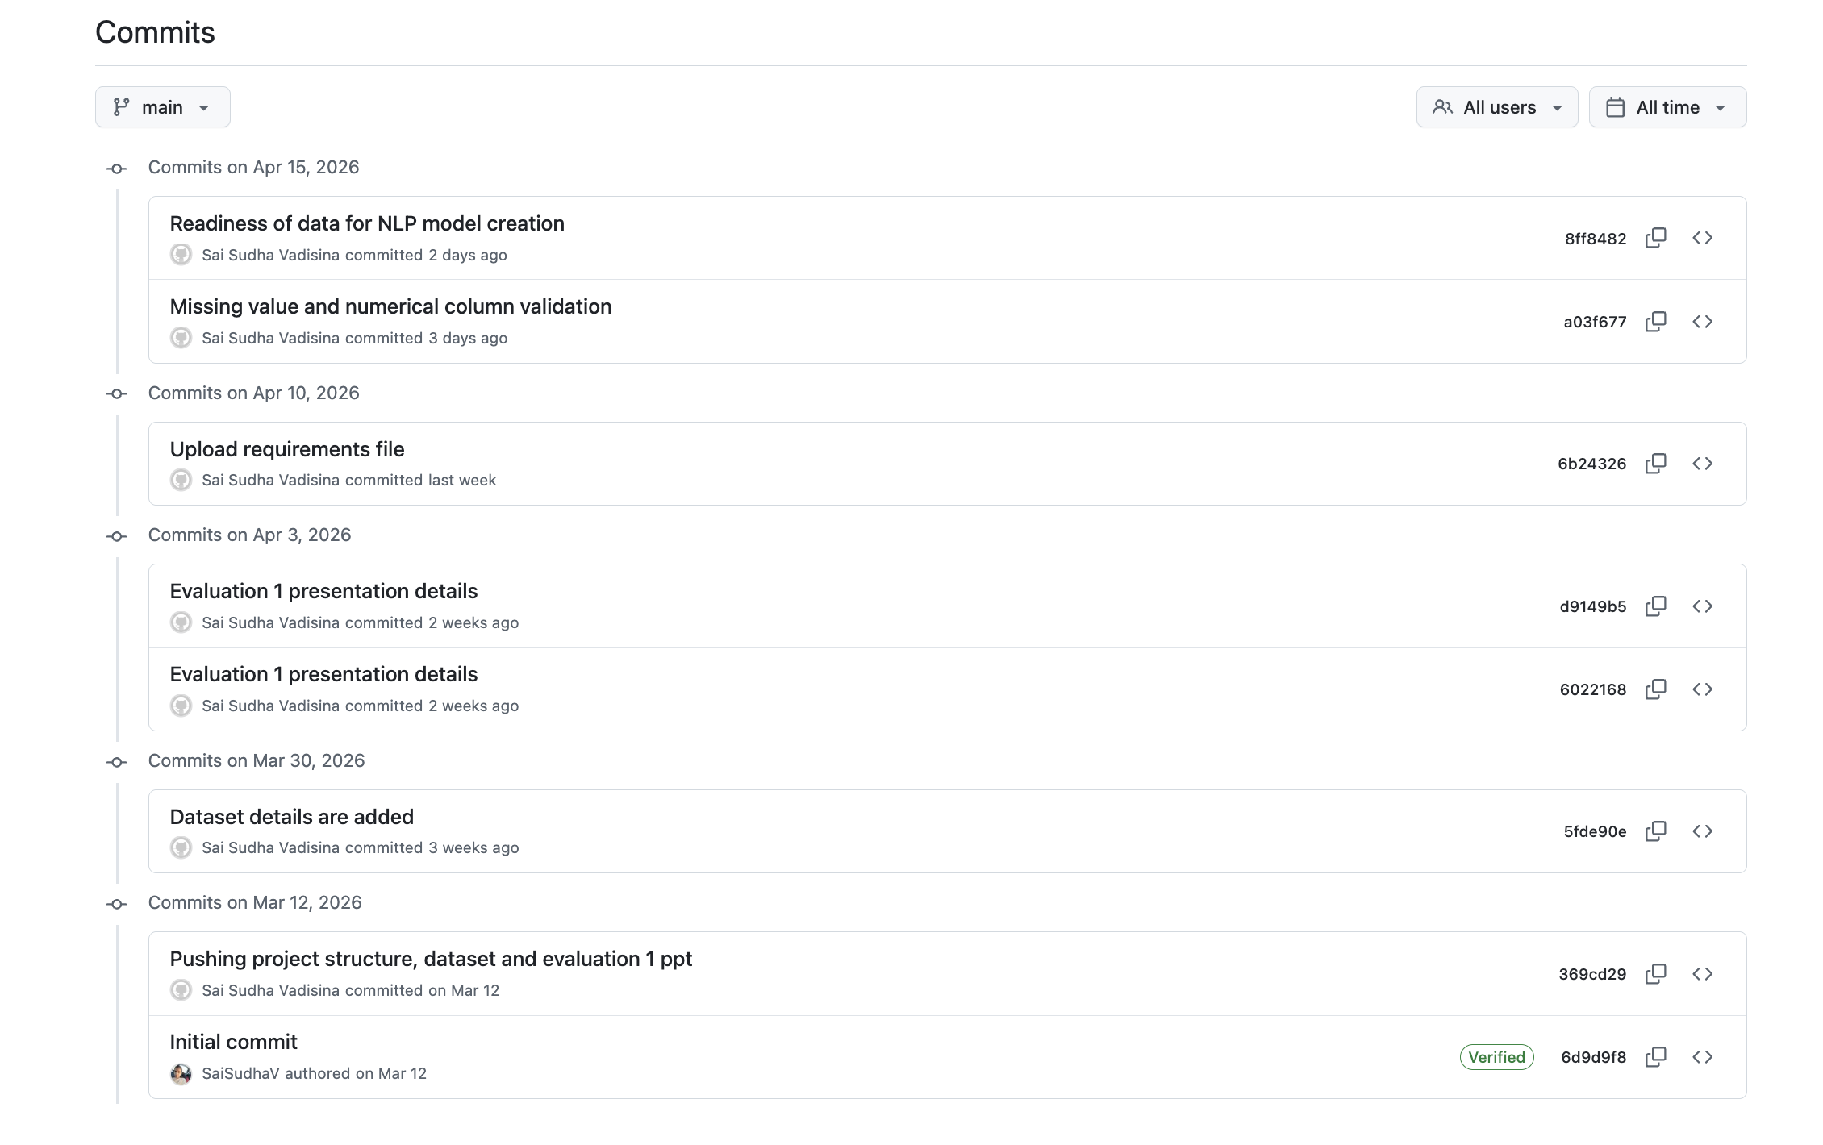
Project link
https://github.com/SaiSudhaV/Ecommerce-AI-Communication-Framework

Slide 23
References
Guidotti, R., Monreale, A., Ruggieri, S., Turini, F., Pedreschi, D., & Giannotti, F. (2018). A Survey Of Methods For Explaining Black Box Models. ACM Computing Surveys / arXiv.
Graßl / Survey on Reinforcement Learning for Dialogue Systems (2019). A Survey on Reinforcement Learning for Dialogue Systems.
Nirala, K. K., et al. (2022). A survey on providing customer and public administration services using chatbots. (PubMed Central).
Oliveira, J. M., et al. (2024). Evaluating the Effectiveness of Time Series Transformers for Demand Forecasting in Retail. (Research preprint / conference).
Recent works on churn prediction in e-commerce — e.g., E-commerce Customers Churn Prediction Using Machine Learning (2025).
Hengst, F., et al. (2019). Reinforcement Learning for Personalized Dialogue. (arXiv / ACM).
Caetano, R., et al. (2025). Transformer-Based Models for Probabilistic Time Series Forecasting. MDPI / Mathematics.

Slide 24
Thank you

