Slide 1

Visvesvaraya National Institute of Technology, Nagpur
Electronics and Communication Engineering Department
Executive M.Tech. in Applied AI and Communications
Cohort 3B sem. 3, Summer 2026
Eval. 1 (24/03/2026)
Hybrid AI Framework
Predictive and Explainable Customer Communication Optimization in E-Commerce
Presented by
Sai Sudha Vadisina (MT24AAC019)
DevOPs Engineer III in Amazon
Under the supervision of
Dr.Pradnya H Ghare
VNIT Nagpur

Slide 2
Table of Contents:
Introduction
Objective for the project and architecture
Why research is needed
Literature survey
Proposed Solution
Timeline of the project
Conclusion
References

Slide 3
Introduction
E-commerce platforms manage high-volume customer communications
Existing systems are reactive and rule-based, where sentiment detection alone is insufficient
Need for predictive and proactive AI-driven communication optimization
Our system acts as frontline defense for the customers and advertisers.

Slide 4
Sample Scenario
If there are 100 customers facing issues and 20 are the genuine issues where support team has to pitch in and investigate.
Support team can’t address all of them at a stretch, they might take 2 or more days to address all of them.
Enabling the automation will filter out the issues where human intervention is not required.
This improves the efficiency by addressing the issue in minutes and customer feels more satisfied.
Here the customers can be the advertisers or the consumers.

Slide 5
Objective of the Project
Design hybrid AI framework for e-commerce communication
Predict escalation, dissatisfaction, and churn
Optimize routing and response strategies
Integrate structured + unstructured data
Enable explainable AI-based decision support
Customer satisfaction improves.
Manual effort from support reduces as they can focus on the actual issues.

Slide 6
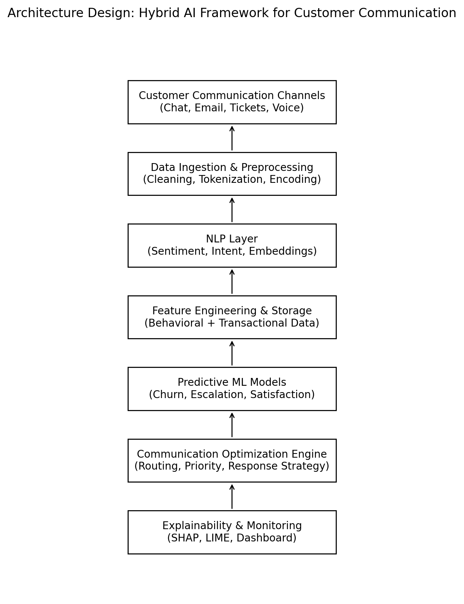
Architecture

Slide 7
Need for Research
Rapid growth in e-commerce customer interactions
High operational cost of customer support
Existing systems are reactive and rule-based
Sentiment detection alone is insufficient
No integrated predictive + optimization framework
Need for proactive, explainable AI-driven communication system

Slide 8
Identified Gaps
Reactive Communication Systems
Limited Explainability
Absence of Optimization Layer
No Structured + Unstructured Data Fusion
Lack of Predictive Modeling

Slide 9
Literature Survey
Existing research addresses isolated problems, but lacks an integrated, predictive, and explainable communication optimization framework for e-commerce systems:
Conversational AI in Customer Service
Deep learning improves intent detection and automation
Transformer models widely adopted
Focus mainly on classification tasks
Limited predictive outcome modeling
Sentiment Analysis in E-Commerce
Sentiment strongly correlates with satisfaction
Context-aware models improve accuracy
Primarily text-based analysis
No integration with behavioral features

Slide 10
Literature Survey - (contd.)
Churn Prediction Using Machine Learning
Structured transactional features used
Supervised ML models show good performance
Does not incorporate conversational text context
Explainable AI in Decision Systems
SHAP/LIME improve model transparency
Important for trust and accountability
Rarely integrated into customer communication systems

Slide 11
Proposed Solution
We are developing a Hybrid AI Framework that:
Understands customer communication (NLP)
Predicts future outcomes (churn, escalation, dissatisfaction)
Suggests the best response strategy
Explains why the decision was made
The goal is to move from reactive automation to proactive decision support.

Slide 12
How are we achieving?
The goal is to move from reactive automation to proactive decision support.
Gaps identified | Our Proposed Solution
Focus only on sentiment/intent detection | Add predictive models for churn & escalation
Text-only analysis | Combine text + behavioral & transactional data
No optimization of response strategy | Introduce risk-based prioritization & routing
Black-box AI systems | Integrate SHAP/LIME for explainability
Isolated models | Build unified end-to-end framework

Slide 13
Timeline of the project
Phase | Task | Status
Phase 1 | Literature review & objective abstraction | ✅ Completed
Phase 1 | Architecture design& dataset identification | 🟡 In Progress
Phase 2 | Data preprocessing | 🔜 Planned
Phase 2 | NLP model development(sentiment and intent) | 🔜 Planned
Phase 2 | Feature engineering & Paper 1 | 🔜 Planned
Phase 3 | Predictive ML models | 🔜 Planned
Phase 3 | Optimization engine design | 🔜 Planned
Phase 3 | Benchmarking | 🔜 Planned
Phase 4 | Explainability integration | 🔜 Planned
Phase 4 | System evaluation & dashboard creation | 🔜 Planned
Phase 4 | Paper2, Document preparation & final evaluation | 🔜 Planned

Slide 14
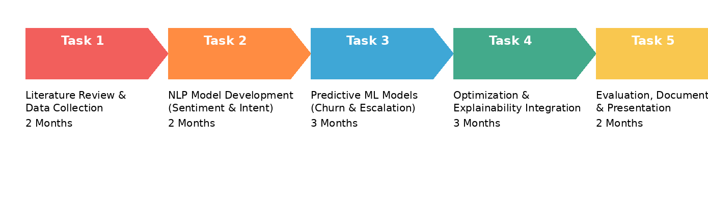
Timeline of the project

Slide 15
Conclusion
The proposed solution transforms customer support from reactive response handling to proactive, intelligent communication management.

Slide 16
Project link
https://github.com/SaiSudhaV/Ecommerce-AI-Communication-Framework

Slide 17
References
Guidotti, R., Monreale, A., Ruggieri, S., Turini, F., Pedreschi, D., & Giannotti, F. (2018). A Survey Of Methods For Explaining Black Box Models. ACM Computing Surveys / arXiv.
Graßl / Survey on Reinforcement Learning for Dialogue Systems (2019). A Survey on Reinforcement Learning for Dialogue Systems.
Nirala, K. K., et al. (2022). A survey on providing customer and public administration services using chatbots. (PubMed Central).
Oliveira, J. M., et al. (2024). Evaluating the Effectiveness of Time Series Transformers for Demand Forecasting in Retail. (Research preprint / conference).
Recent works on churn prediction in e-commerce — e.g., E-commerce Customers Churn Prediction Using Machine Learning (2025).
Hengst, F., et al. (2019). Reinforcement Learning for Personalized Dialogue. (arXiv / ACM).
Caetano, R., et al. (2025). Transformer-Based Models for Probabilistic Time Series Forecasting. MDPI / Mathematics.

Slide 18
Thank you

