Slide 1

Visvesvaraya National Institute of Technology, Nagpur
Electronics and Communication Engineering Department
Executive M.Tech. in Applied AI and Communications
Cohort 3B sem. 2, Winter 2025
Final Eval. (06/12/2025)
Virtual Yoga Trainer
Pose Detection & Correction using Deep Learning
Presented by
Sai Sudha Vadisina (MT24AAC019)
DevOPs Engineer III in Amazon
Under the supervision of
Dr.Pradnya H Ghare
VNIT Nagpur

Slide 2
Table of Contents:
Introduction
Objective for the project
Deep Learning Components
Timeline of the project
Drawbacks and Advantages
Next Plan of Action
Conclusion
References

Slide 3
Introduction
This project is to launch a virtual yoga studio front-end by integrating deep learning for real-time pose detection and correction.
Goal: Leverage AI to analyze user poses, provide instant feedback, and guide users to correct postures for safer and more effective at-home yoga practice.

Slide 4
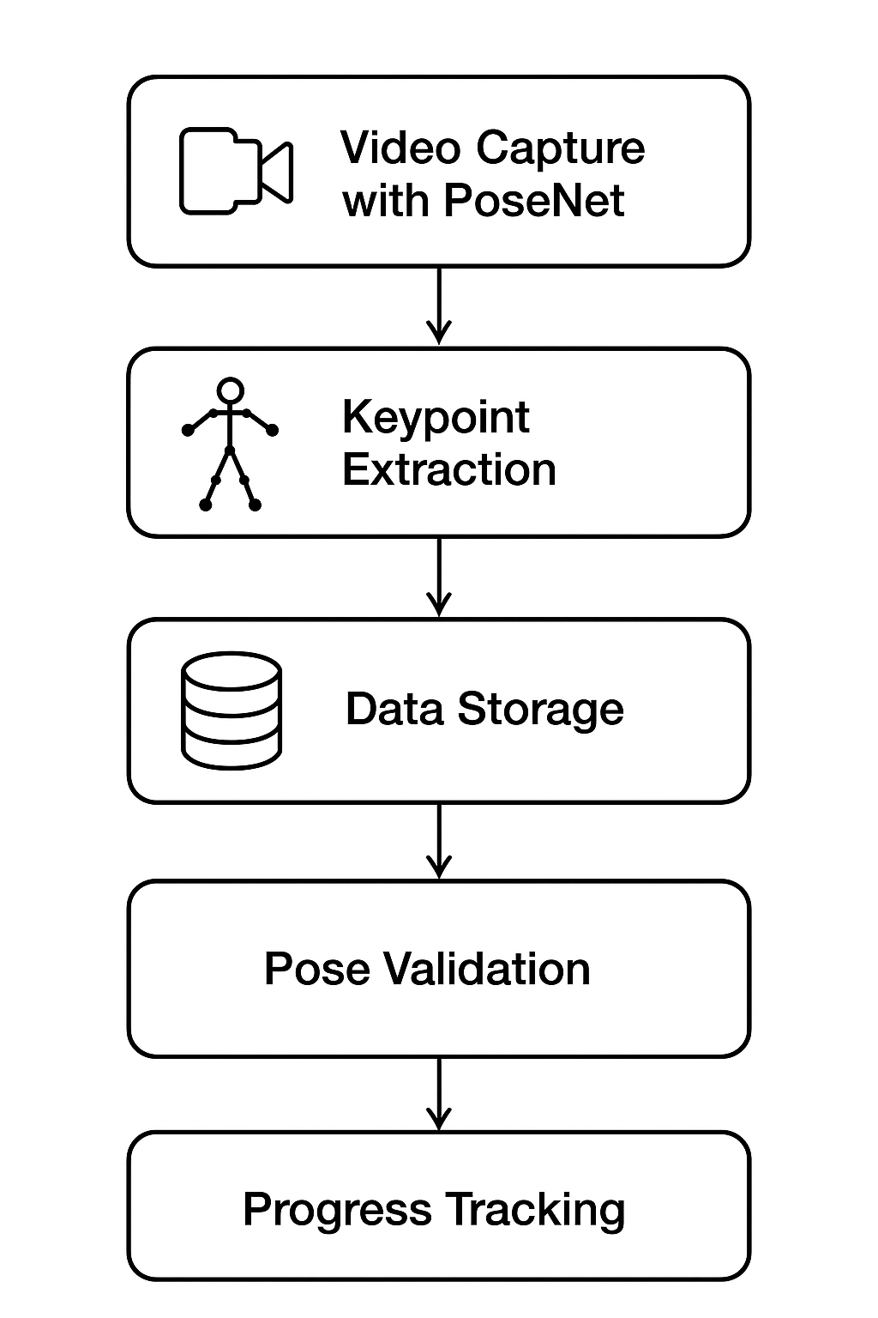
Objective of the Project
Launch a virtual yoga studio with AI features
Provide real-time posture correction and feedback
Enable safer and consistent yoga practice

Slide 5
Expected Outcomes
Real-time yoga pose recognition
AI-driven posture correction
Safer practice with fewer injuries
Encourages consistent yoga practice

Slide 6
Timeline of the project
Phase | Task | Status
Phase 1 | Dataset preparation & preprocessing | ✅ Completed
Phase 1 | Model training & tuning | ✅ Completed
Phase 2 | Integration with UI | ✅ Completed
Phase 2 | Testing & Evaluation | ✅ Completed
Phase 2 | Final presentation | ✅ Completed
Phase 2 | Final documentation | 🟡 In Progress

Slide 7
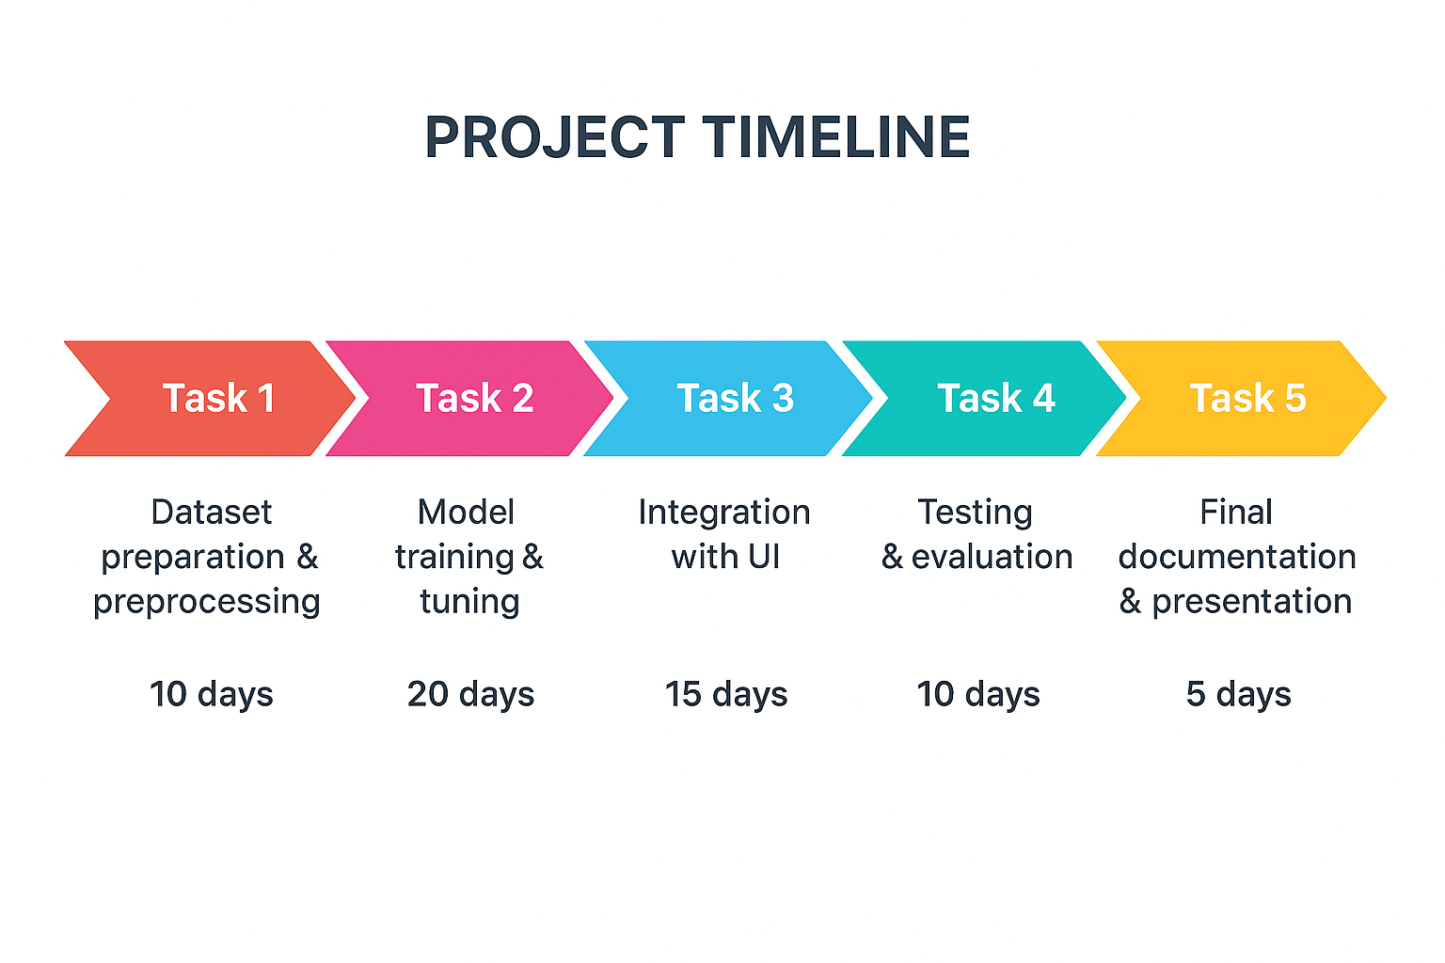
Timeline of the project

Slide 8
PoseNet / ml5.js
Browser-based pose estimation detecting 17 keypoints (body joints).
ml5.js wraps PoseNet for easy integration and simple API.
Pros: real-time inference in-browser, minimal backend dependency.

Slide 9
p5.js (Visualization & UI)
Lightweight JS library for creative coding and canvas drawing.
Used to render keypoints, skeleton overlays, and feedback UI.
Keeps frontend interactive while remaining performant on browsers.

Slide 10
TensorFlow.js
Runs ML models directly in the browser using JavaScript.
Allows client-side inference and model exporting from TensorFlow.
Enables low-latency feedback without server round-trips.

Slide 11
Backend: Python & TensorFlow
Used for initial model training and heavier experiments.
Leverages TensorFlow (Python) for training, experimentation, and exporting models.
Facilitates offline training on GPU-enabled environments.

Slide 12
TensorFlow Lite & Mobile Deployment
Model optimization for edge devices and mobile apps.
Reduces model size & latency for deployment on mobile/embedded devices.
Supports conversion from TensorFlow models to lightweight formats.

Slide 13
React Native (Mobile Interface)
Cross-platform framework for mobile UI and native features.
Integrates camera stream, model inference hooks, and app UX.
Enables packaging web-models or TFLite-based inference on mobile.

Slide 14
Drawbacks of Other Libraries
Mediapipe – High accuracy but complex for browser integration.
OpenPose – Requires GPU support; heavy and slower for mobile.

Slide 15
Advantages of PoseNet.js and ml5.js:
Easy integration for browser and mobile-based applications.
Real-time inference without backend dependency.
Lower setup time and supports cross-platform devices.\t size.

Slide 16
Existing Model Limitations & Mitigation
Accuracy drops in complex backgrounds → Use data augmentation.
Limited pose set → Extend dataset with more yoga postures.
Latency on low-end devices → Optimize model and reduce input size.

Slide 17
Development & Tooling
Git for version control; feature-branch & PR workflow followed.
Prefect (if used) for pipeline orchestration and reproducibility.
CI: GitHub Actions for testing, linting, and Prefect dry-run simulations.

Slide 18
Data & Preprocessing
Data augmentation, normalization, and resizing to improve robustness.
Angle-based joint computations for rule-based posture correction.
Handling occlusions and varying lighting through augmentation strategies.

Slide 19
Privacy & Performance Considerations
Client-side inference reduces uploaded personal data exposure.
Model size and input resolution tuned to balance accuracy & latency.
Fallbacks for low-end devices: lower-res input, simplified feedback.

Slide 20
Next Plan of Action
Prepare final report.
Incorporate user feedback and final polish.

Slide 21
Results and Discussion
System achieved consistent pose detection accuracy across varied lighting
Angle-based evaluation proved effective for identifying posture deviations
Feedback improved user alignment over multiple trials
Limitations: camera alignment sensitivity, challenges with occluded joints

Slide 22
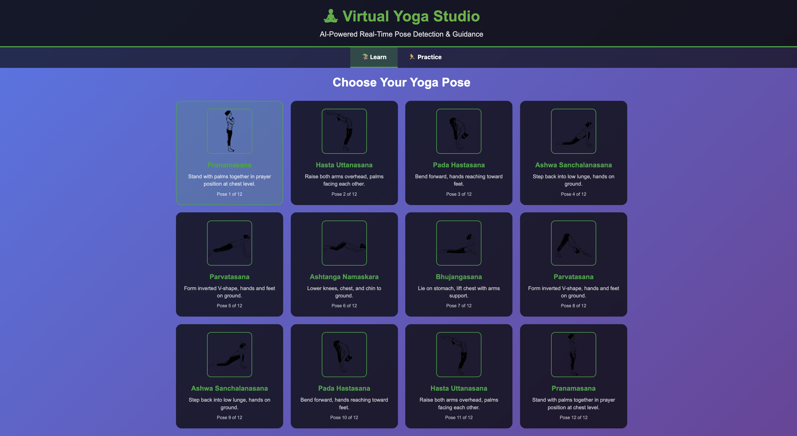

Slide 23
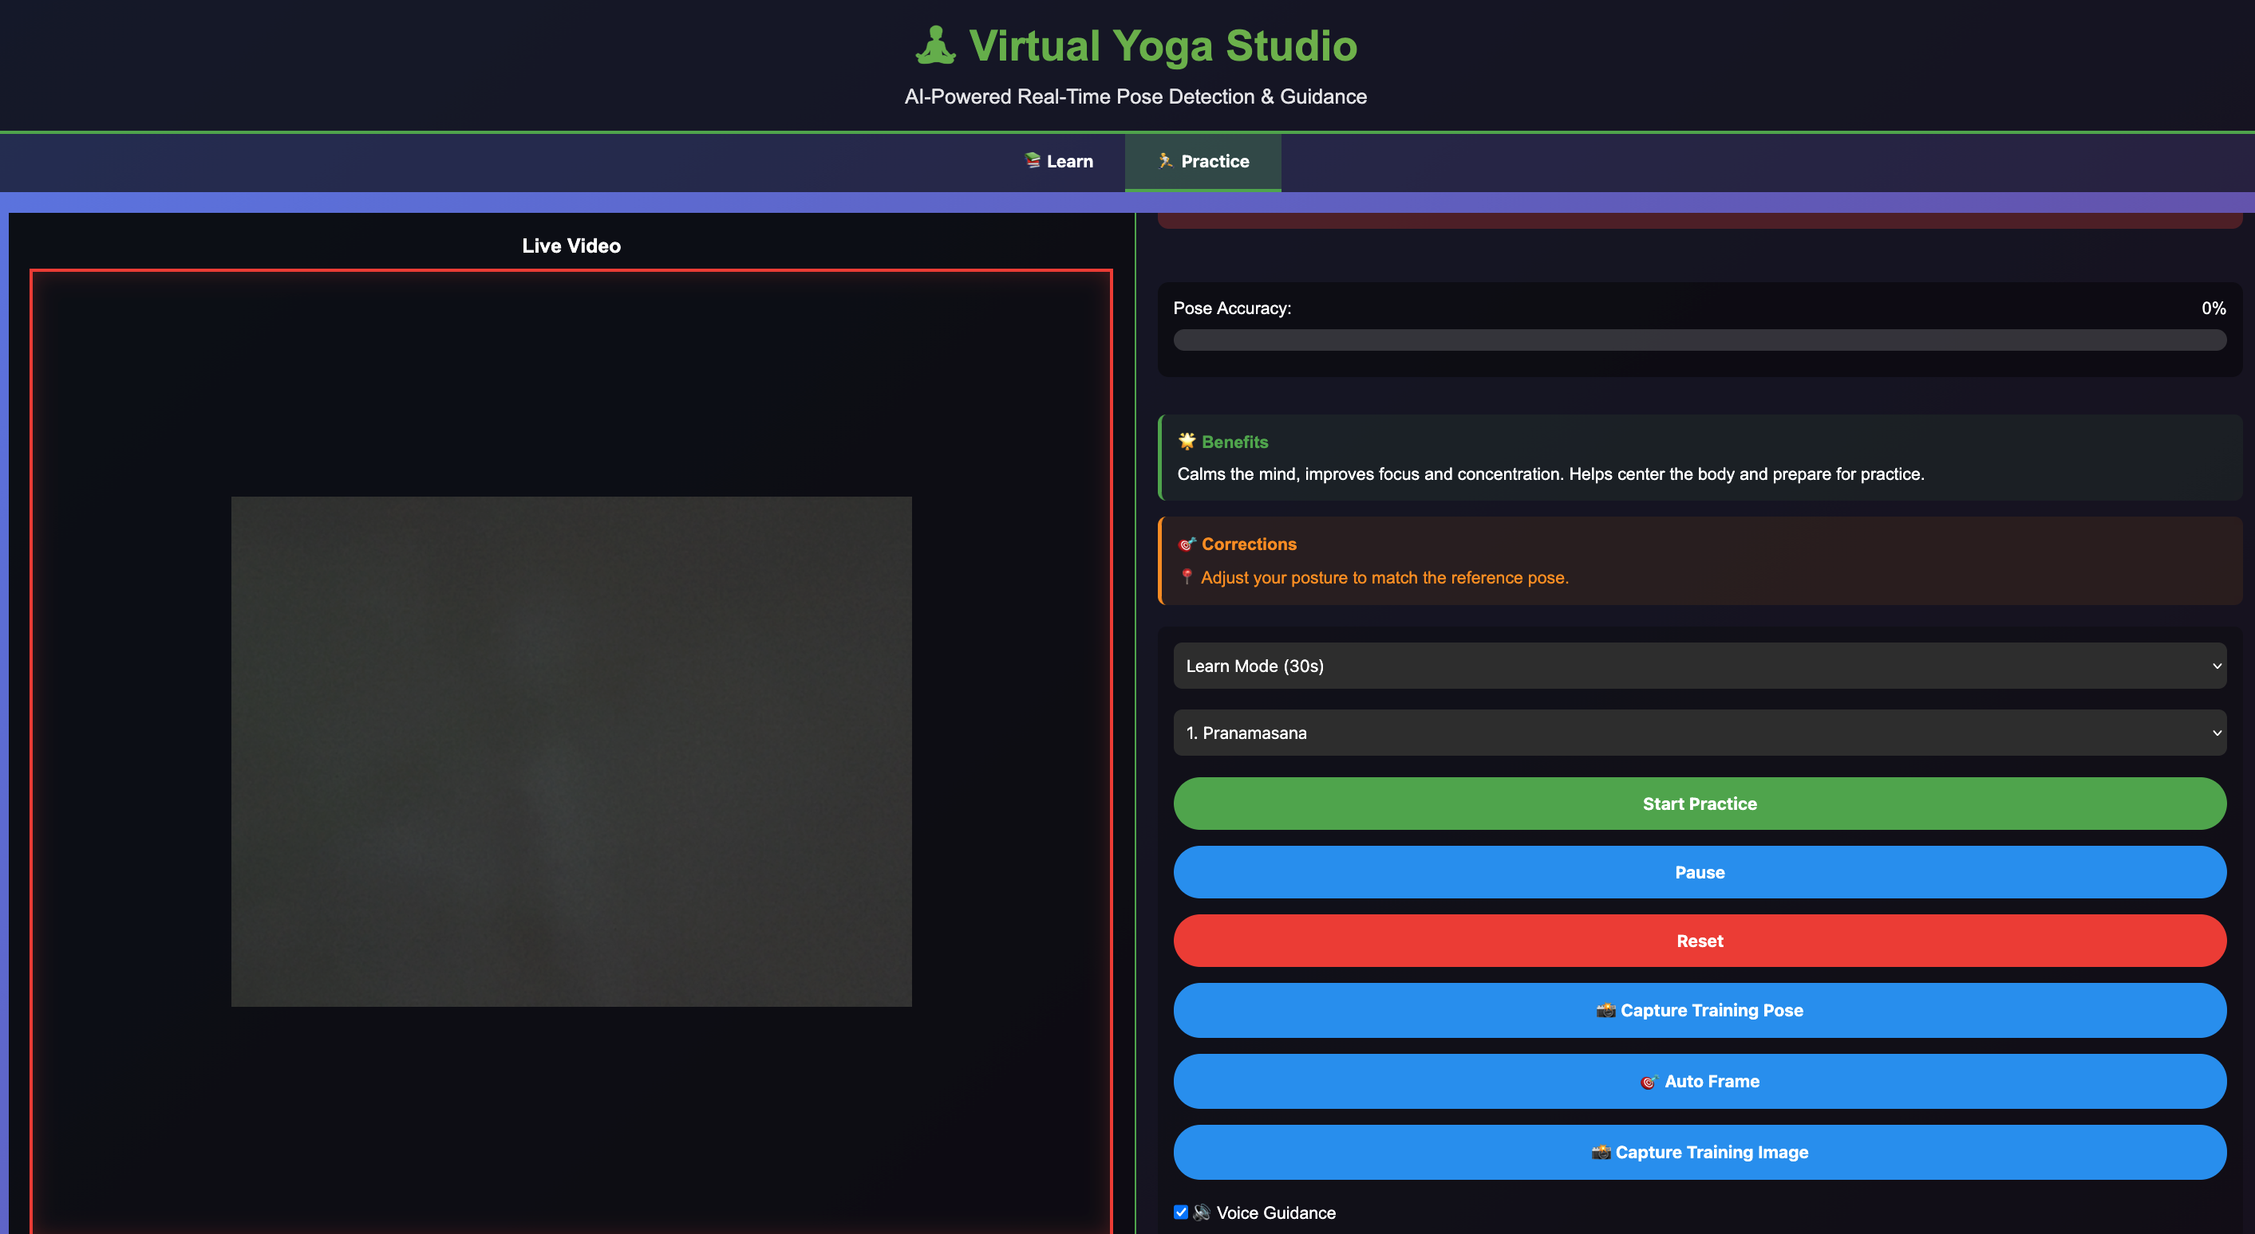

Slide 24
Conclusion
Virtual Yoga Trainer successfully guides users to correct postures.
PoseNet-based analysis provides reliable joint detection.
Angle-based correction method enhances usability.
Future work: hardware extension, larger dataset training, improved 3D pose estimation.

Slide 25
References
PosePilot: Edge-AI Posture Correction (2025)
Yoga Pose Recognition & Motion Analysis (2025)
Image-Based Yoga Pose Recognition with Attention (2024)
GTA-Net: IoT-based 3D Pose Estimation (2024)

Slide 26
Thank you

