Slide 1

Visvesvaraya National Institute of Technology, Nagpur
Electronics and Communication Engineering Department
Executive M.Tech. in Applied AI and Communications
Cohort 3B sem. 2, Winter 2025
Eval. 1 (20/09/2025)
Virtual Yoga Trainer
Pose Detection & Correction using Deep Learning
Presented by
Sai Sudha Vadisina (MT24AAC019)
DevOPs Engineer III in Amazon
Under the supervision of
Dr.Pradnya H Ghare
VNIT Nagpur

Slide 2
Table of Contents:
Introduction
Objective for the project
Proposed Model
Deep Learning Components
Timeline of the project
Expected Outcomes
Conclusion
References

Slide 3
Introduction
This project is to launch a virtual yoga studio front-end by integrating deep learning for real-time pose detection and correction.
Goal: Leverage AI to analyze user poses, provide instant feedback, and guide users to correct postures for safer and more effective at-home yoga practice.

Slide 4
Objective of the Project
Launch a virtual yoga studio with AI features
Provide real-time posture correction and feedback
Enable safer and consistent yoga practice

Slide 5
Proposed Model
Pose Estimation with PoseNet (17 body keypoints)
Deep learning integration for pose validation
Real-time feedback through UI
Mobile support with React Native

Slide 6
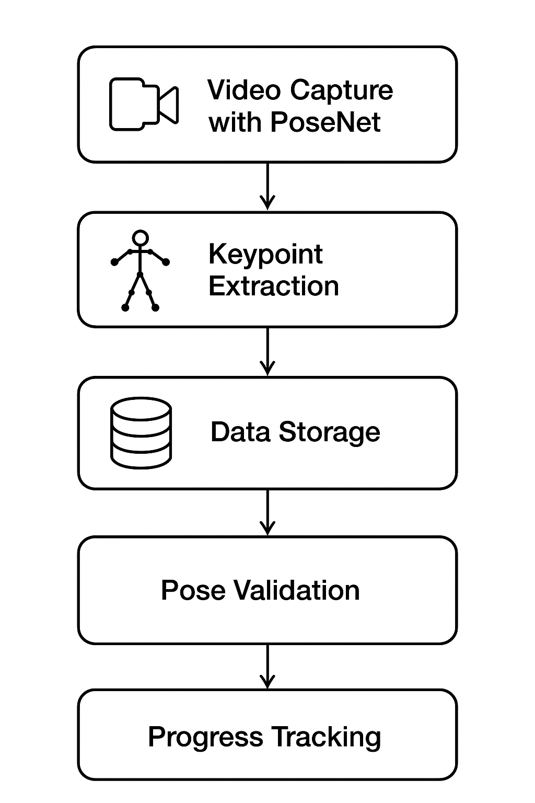
Proposed Model

Slide 7
Deep Learning Components
Pose Estimation Models:
PoseNet (MobileNet/ResNet)

Slide 8
Deep Learning Components
Core Libraries:
TensorFlow.js (browser-based)
ml5.js (simplified integration)
p5.js (visualization)

Slide 9
Deep Learning Components
Back-end Components:
Python/TensorFlow (training)
TensorFlow Lite (deployment)
React Native (mobile app)

Slide 10
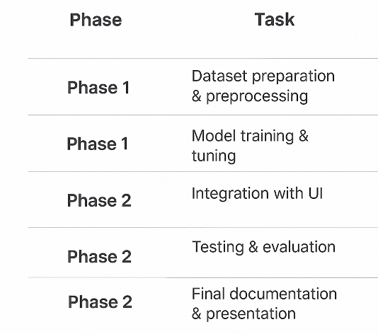
Timeline of the project

Slide 11
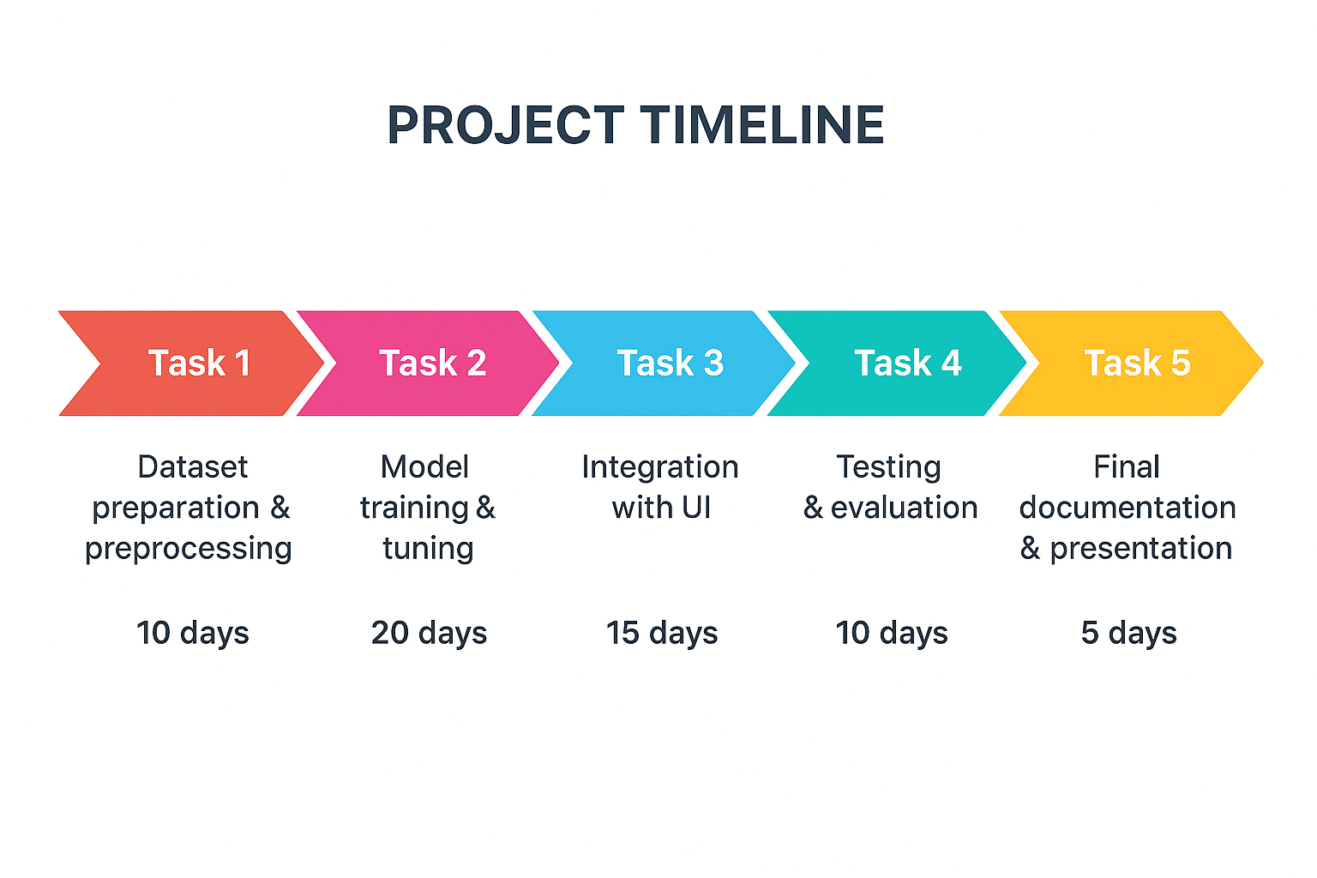
Timeline of the project

Slide 12
Expected Outcomes
Real-time yoga pose recognition
AI-driven posture correction
Safer practice with fewer injuries
Encourages consistent yoga practice

Slide 13
Conclusion
The Virtual Yoga Trainer demonstrates the application of deep learning in real-time health and fitness.
By integrating AI-driven posture correction, the system enhances user safety and engagement.

Slide 14
References
PosePilot: Edge-AI Posture Correction (2025)
Yoga Pose Recognition & Motion Analysis (2025)
Image-Based Yoga Pose Recognition with Attention (2024)
GTA-Net: IoT-based 3D Pose Estimation (2024)

Slide 15
Thank you

