Slide 1

Visvesvaraya National Institute of Technology, Nagpur
Electronics and Communication Engineering Department
Executive M.Tech. in Applied AI and Communications
Cohort 3B sem. 2, Winter 2025
Eval. 1 (20/09/2025)
Virtual Yoga Trainer
Pose Detection & Correction using Deep Learning
Presented by
Sai Sudha Vadisina (MT24AAC019)
DevOPs Engineer III in Amazon
Under the supervision of
Dr.Pradnya H Ghare
VNIT Nagpur

Slide 2
Table of Contents:
Introduction
Objective for the project
Deep Learning Components
Timeline of the project
Drawbacks and Advantages
Next Plan of Action
Conclusion
References

Slide 3
Introduction
This project is to launch a virtual yoga studio front-end by integrating deep learning for real-time pose detection and correction.
Goal: Leverage AI to analyze user poses, provide instant feedback, and guide users to correct postures for safer and more effective at-home yoga practice.

Slide 4
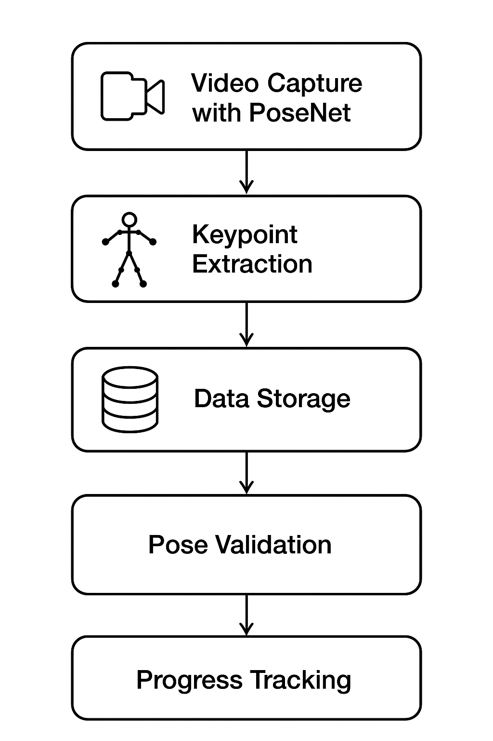
Objective of the Project
Launch a virtual yoga studio with AI features
Provide real-time posture correction and feedback
Enable safer and consistent yoga practice

Slide 5
Expected Outcomes
Real-time yoga pose recognition
AI-driven posture correction
Safer practice with fewer injuries
Encourages consistent yoga practice

Slide 6
Deep Learning Components
Frontend Libraries:
ml5.js – Simplifies the integration of PoseNet in browser.
p5.js – Handles visualization and UI rendering.

Slide 7
Deep Learning Components
Machine Learning Frameworks:
TensorFlow.js – For browser-based deep learning.
PoseNet.js – Detects 17 human body keypoints for yoga poses.

Slide 8
Deep Learning Components
Backend & Deployment:
Python, TensorFlow (for initial training)
TensorFlow Lite (for lightweight deployment)
React Native (for mobile app interface)

Slide 9
Timeline of the project
Phase | Task | Status
Phase 1 | Dataset preparation & preprocessing | ✅ Completed
Phase 1 | Model training & tuning | ✅ Completed
Phase 2 | Integration with UI | 🟡 In Progress
Phase 2 | Testing & Evaluation | 🔜 Planned
Phase 2 | Final documentation & presentation | 🔜 Planned

Slide 10
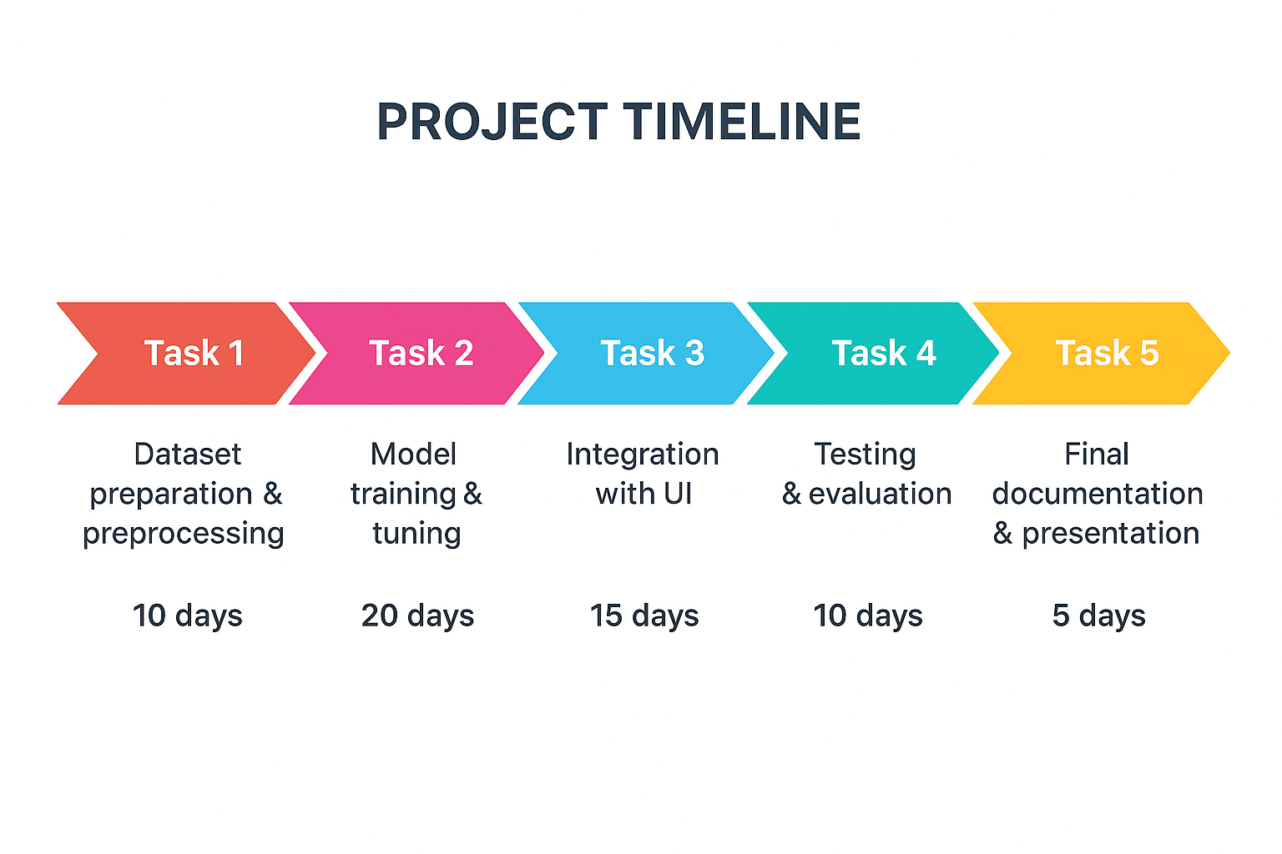
Timeline of the project

Slide 11
Drawbacks of Other Libraries
Mediapipe – High accuracy but complex for browser integration.
OpenPose – Requires GPU support; heavy and slower for mobile.

Slide 12
Advantages of PoseNet.js and ml5.js:
Easy integration for browser and mobile-based applications.
Real-time inference without backend dependency.
Lower setup time and supports cross-platform devices.\t size.

Slide 13
Existing Model Limitations & Mitigation
Accuracy drops in complex backgrounds → Use data augmentation.
Limited pose set → Extend dataset with more yoga postures.
Latency on low-end devices → Optimize model and reduce input size.

Slide 14
Next Plan of Action
Integrate the pose detection model with the UI.
Implement posture correction logic and feedback visualization.
Conduct real-time tests for multiple yoga poses.
Complete end-to-end testing and debugging.
Prepare final report, demo, and presentation.
Incorporate user feedback and final polish.

Slide 15
Conclusion
The Virtual Yoga Trainer demonstrates the application of deep learning in real-time health and fitness.
By integrating AI-driven posture correction, the system enhances user safety and engagement.

Slide 16
References
PosePilot: Edge-AI Posture Correction (2025)
Yoga Pose Recognition & Motion Analysis (2025)
Image-Based Yoga Pose Recognition with Attention (2024)
GTA-Net: IoT-based 3D Pose Estimation (2024)

Slide 17
Thank you

