Slide 1
Graph Based Methods for Personalised News Recommendation
Naga Satya Sai Sumakar Kothamasu
CS22B1077
Prof. Sivaselvan B
Dept. of CSE
IIITDM Kancheepuram

Slide 2
Table of Contents
Introduction
Problem Definition
Literature Survey
Contribution
Progress/ Work done
Results/ Analysis
Conclusion
Future Work

Slide 3
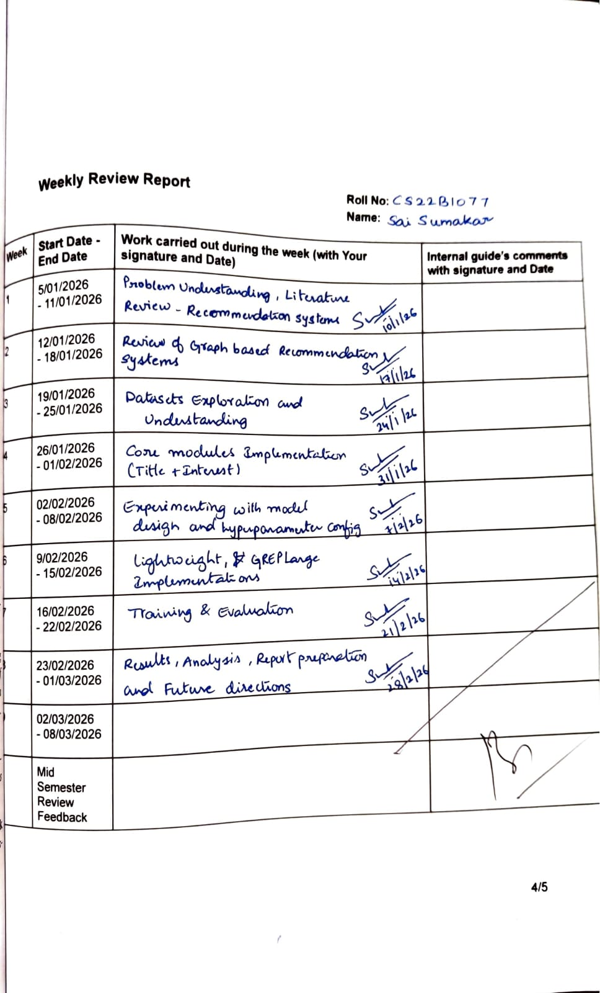
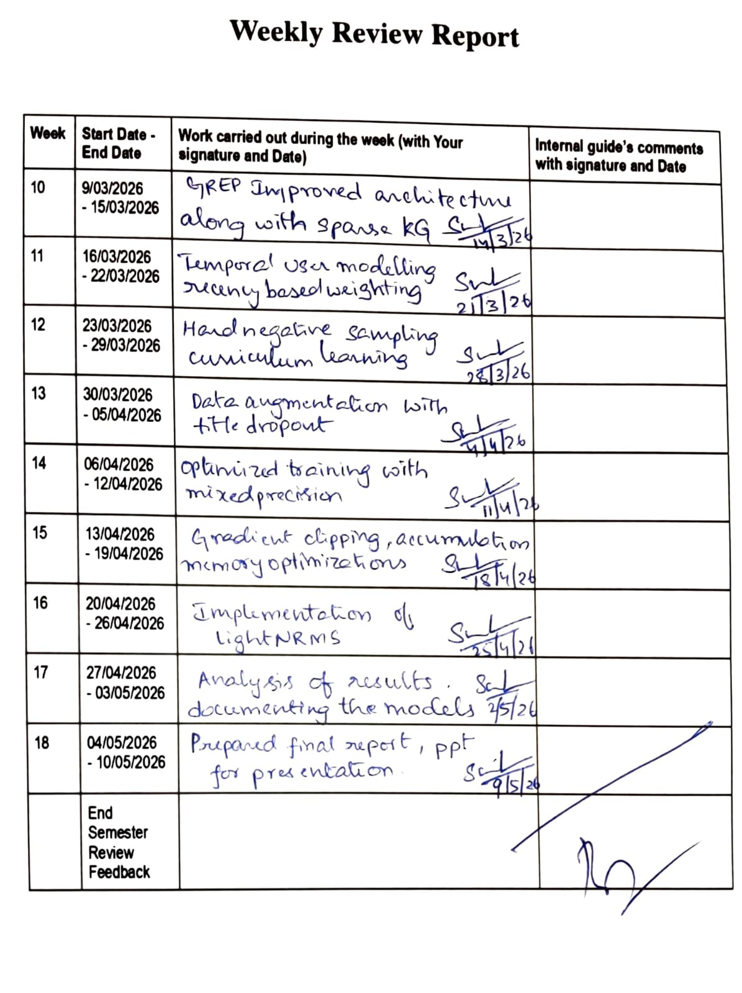
Weekly Review Report

Slide 4
Introduction
Information overload in online news platforms requires personalized recommendation systems.
Traditional recommendation methods fail to model dynamic user interests effectively.
News recommendation involves short-lived content and rapidly changing preferences.
Graph Neural Networks (GNNs) capture high-order user-news relationships.
Proposed work enhances GREP using Transformer and graph-based learning.

Slide 5
Problem Definition
The Problem:
Traditional models fail to capture high-order user-news relationships.
Data sparsity limits effective preference learning.
Cold start problem for new users and newly published news and user interests evolve dynamically over time.
Limited use of graph structure in news recommendation.
Existing GNN models are often over-complex and inefficient.
What does this solve?
Leverages graph-based embedding propagation to model high-order connectivity.
Improves performance under sparse data settings.
Reduces cold start impact via structural information modelling.
Designs a simplified and efficient GNN-based framework for news recommendation.

Slide 6
Literature Survey
Collaborative Filtering and Matrix Factorization capture only shallow interactions.
NRMS uses multi-head self-attention for news and user representation learning.
CAUM introduces candidate-aware user interest modelling.
LightGCN simplifies graph propagation for efficient recommendation.
GREP combines knowledge graph propagation with existing and potential interest modelling.
Advantages of GNNs: Captures high-order connectivity, Explicit collaborative signal modeling
Limitations: computational complexity, not tailored specifically for news dynamics

Slide 7
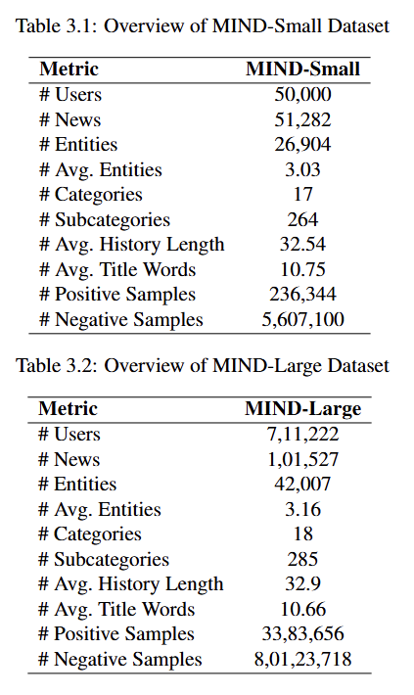
Work Done
Implemented GREP Small, GREP Large, and GREP Improved architectures.
Built Transformer-based title encoder with multi-head self-attention.
Modelled existing and potential interests using GNN-based propagation.
Integrated bi-directional interaction between title and entity representations.
Trained and evaluated models on MIND-Small and MIND-Large datasets.
Compared performance using AUC, MRR, nDCG@5, and nDCG@10 metrics.

Slide 8
Contributions
Developed Sparse KG Computation with dynamic batch-wise subgraphs, reducing computation from O(|E|) to O(|E_batch|) and improving scalability for large knowledge graphs.
Added Temporal User Modeling using recency-based weighting to better capture changing user interests and prioritize recent interactions.
Implemented Hard Negative Sampling with Curriculum Learning, gradually increasing difficult negative samples to improve recommendation ranking performance.
Designed a Data Augmentation Pipeline with title dropout, history cropping, and entity enrichment to improve robustness and generalization.
Optimized training using Mixed Precision, Gradient Accumulation, and Learning Rate Scheduling, achieving faster training with lower memory usage.
Improved model stability and efficiency through gradient clipping, NaN handling, memory-efficient tensor operations, and fine-tuned entity embedding learning rates.

Slide 9
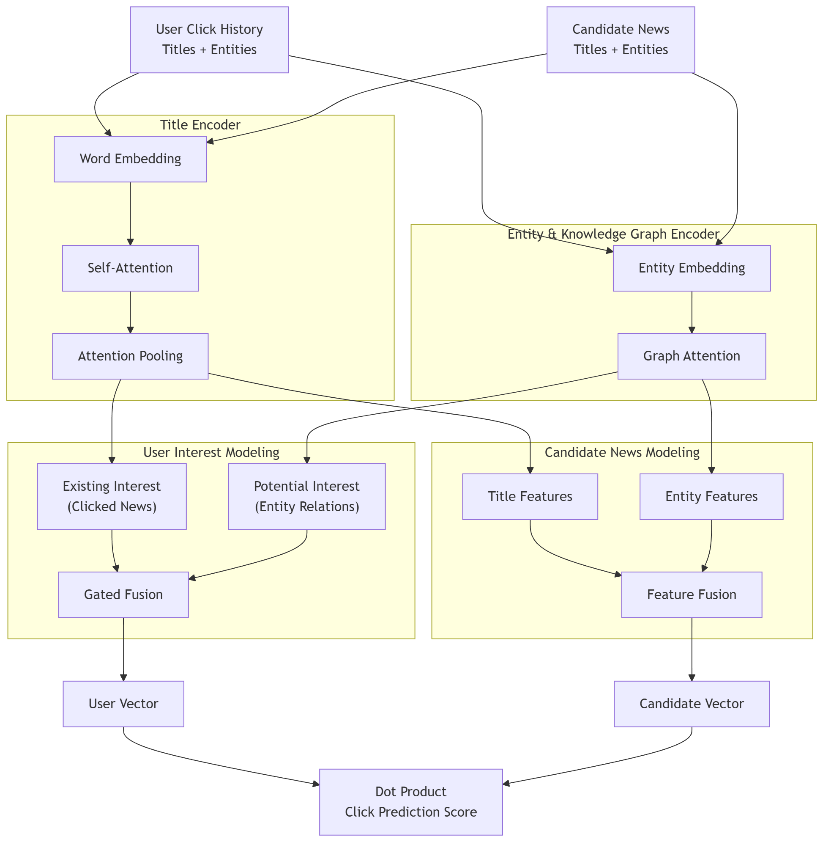
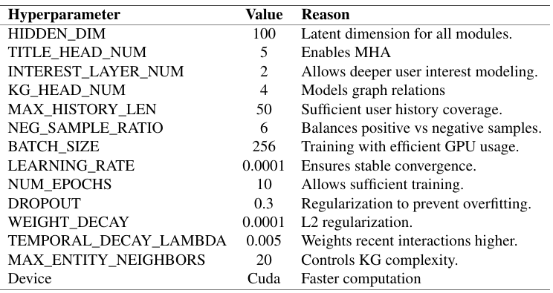
GREP Improved

Slide 10
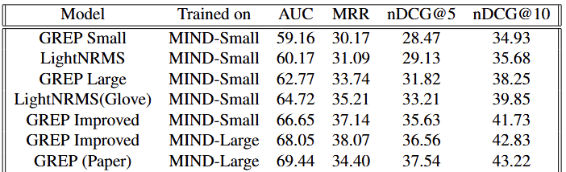
Analysis/ Results
GREP Improved consistently outperformed baseline models across all metrics.
Temporal user modelling significantly improved recommendation relevance.
Multi-head attention and graph transformers enhanced semantic understanding.
Sparse KG computation improved scalability and reduced computation overhead.
Training optimizations improved convergence stability and memory efficiency.
Model achieved strong ranking performance and generalized well on larger datasets.

Slide 11
Conclusion
Proposed a GNN-based personalized news recommendation framework.
Combined Transformer attention with graph-based interest propagation.
Temporal and graph-aware modelling improved recommendation accuracy.
Achieved significant performance gains over GREP lighter variants and LightNRMS.
Demonstrated effective balance between recommendation quality and efficiency.

Slide 12
Future Work
Adaptive history modelling for short-term and long-term interests.
Hierarchical knowledge graph construction with multi-level semantics.
Incorporation of contrastive learning for better user representations.
Explore advanced fusion mechanisms for text and graph features.
Improve scalability using graph compression and model distillation.
Enhance interpretability using explainable recommendation techniques.

Slide 13
References
Q. Qiu, F. Wu, C. Wu, Y. Huang, and X. Xie, “GREP: Graph neural news recommendation with user existing and potential interest modelling,” ACM Transactions on Knowledge Discovery from Data (TKDD), vol. 16, no. 4, pp. 1–25, 2022.
C. Gao, Y. Zheng, N. Li, Y. Li, Y. Qin, J. Piao, Y. Quan, J. Chang, D. Jin, X. He, and Y. Li, “A survey of graph neural networks for recommender systems: Challenges, methods, and directions,” ACM Transactions on Recommender Systems, vol. 1, no. 1, p. Article 3, 2023.
C. Wu, F. Wu, T. Qi, Y. Huang, and X. Xie, “Neural news recommendation with multi-head self-attention,” Proceedings of the 2019 Conference on Empirical Methods in Natural Language Processing (EMNLP), 2019.
T. Qi, F. Wu, C. Wu, and Y. Huang, “News recommendation with candidate-aware user modeling,” in Proceedings of the 45th International ACM SIGIR Conference on Research and Development in Information Retrieval (SIGIR). Association for Computing Machinery, 2022.

Slide 14
Thank You Any Questions?

