Slide 1
Graph Based Methods for Personalised News Recommendation
Naga Satya Sai Sumakar Kothamasu
CS22B1077
Prof. Sivaselvan B
Dept. of CSE
IIITDM Kancheepuram

Slide 2
Table of Contents
Introduction
Problem Definition
Literature Survey
Progress/ Work done
Results/ Analysis
Conclusion
Future Work

Slide 3

Weekly Review Report

Slide 4
Introduction
Explosion of online news - information overload
Personalized news recommendation is essential
Traditional models:
Collaborative Filtering (MF, NCF)
Deep Learning models (RNN, CNN, Attention)
Recent trend: Graph Neural Networks (GNNs) capture high-order user–item relationships
Key Motivation: User interests are dynamic, multi-faceted, and structurally connected - Graph models can model this better.

Slide 5
Problem Definition
The Problem:
Traditional models fail to capture high-order user–news relationships.
Data sparsity limits effective preference learning.
Cold start problem for new users and newly published news.
Limited use of graph structure in news recommendation.
Existing GNN models are often over-complex and inefficient.
What does this solve?
Leverages graph-based embedding propagation to model high-order connectivity.
Improves performance under sparse data settings.
Reduces cold start impact via structural information modelling.
Designs a simplified and efficient GNN-based framework for news recommendation.

Slide 6
Literature Survey
Deep Learning Based News Models: Mostly model local or sequential patterns. Limited high-order structural modeling.
Graph Neural Network Based Recommenders
NGCF - Embedding propagation over user-item graph
LightGCN - Simplified propagation (no feature transform, no activation)
Knowledge-aware models (Ripple-style propagation)
GREP, DivHGNN, etc.
Advantages:
Captures high-order connectivity
Explicit collaborative signal modeling
Limitations:
Over-smoothing
Computational complexity
Not tailored specifically for news dynamics

Slide 7
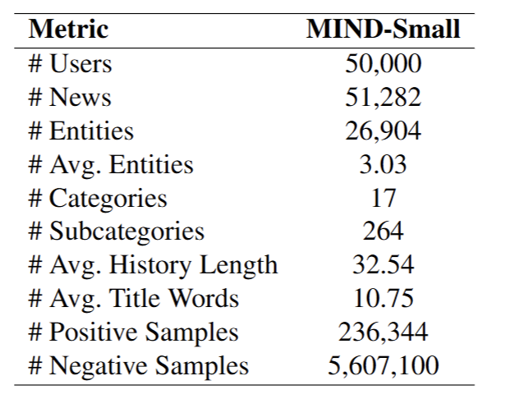
Work Done
Completed comprehensive literature review on GNN-based and news recommendation models.
Analyzed and selected graph-based architecture suitable for news recommendation.
Implemented baseline GNN model (GREP) with user-news interaction graph construction.
Developed training and evaluation pipeline with ranking metrics (AUC, MRR, nDCG@5, nDCG@10).
Conducted experiments and analyzed effects of propagation depth and model simplification.
Dataset Used: MIND Small
Dataset description
(MIND Small)

Slide 8
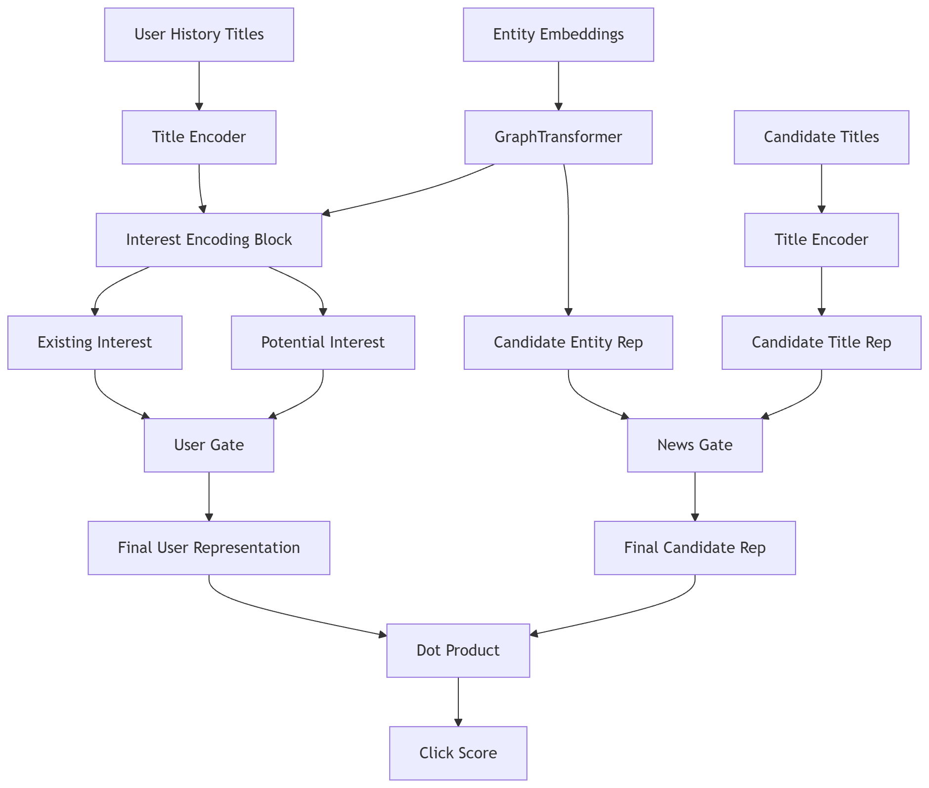
GREP Large Architecture
News Encoder
User–News Interaction Graph
Graph Transformer
Existing Interest
Potential Interest
Interest Fusion
Click Prediction

Slide 9
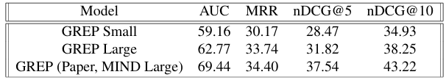
Analysis/ Results
Full GREP > Lightweight Variants across all evaluation metrics, confirming the effectiveness of full structural modeling.
GREP Large outperforms GREP Small, showing that multi-layer interest encoding and graph transformer propagation improve recommendation quality.
MRR closely matches the original paper (33.74 vs 34.40), indicating strong top-click ranking performance even with limited data.
Lower AUC and nDCG compared to the paper are mainly due to using MIND Small, fewer training epochs, random embeddings, and limited hyperparameter tuning.
Entity-based graph propagation and gated fusion mechanisms effectively capture semantic and structural signals, validating the architecture implementation.

Slide 10
Conclusion
The implemented GREP architecture effectively captures semantic and structural signals, achieving competitive MRR performance on MIND Small despite computational constraints.
Structural modeling through entity graphs provides consistent performance gains, even on limited data.
Results show strong ranking capability, with MRR close to the original paper despite computational constraints.
Performance is sensitive to dataset scale and training setup.
The model shows clear scalability potential, with expected improvements on larger datasets and better tuning.

Slide 11
Future Work
Temporal & Dynamic Interest Modeling: Incorporate time-aware attention and recency-based graph propagation to model evolving user interests.
Cold-Start: Improve performance for new users and new news articles using entity-level propagation and knowledge-aware representations.
Explore adaptive propagation depth, improved interest fusion strategies, and lightweight vs deeper graph designs.
Integrate pre-trained embeddings(GloVe) and explore graph contrastive learning to improve embedding stability and generalization.
Validate scalability and generalization on MIND Large and other public news datasets.

Slide 12
References
Q. Qiu, F. Wu, C. Wu, Y. Huang, and X. Xie, “GREP: Graph neural news recommendation with user existing and potential interest modelling,” ACM Transactions on Knowledge Discovery from Data (TKDD), vol. 16, no. 4, pp. 1–25, 2022.
C. Gao, Y. Zheng, N. Li, Y. Li, Y. Qin, J. Piao, Y. Quan, J. Chang, D. Jin, X. He, and Y. Li, “A survey of graph neural networks for recommender systems: Challenges, methods, and directions,” ACM Transactions on Recommender Systems, vol. 1, no. 1, p. Article 3, 2023.
G. Zhang, D. Li, H. Gu, T. Lu, and N. Gu, “Heterogeneous graph neural network with personalized and adaptive diversity for news recommendation,” ACM Trans actions on the Web, vol. 18, no. 3, p. Article 34, 2024.
X. He, K. Deng, X. Wang, Y. Li, Y. Zhang, and M. Wang, “Lightgcn: Simplifying and powering graph convolution network for recommendation,” in Proceedings of the 43rd International ACM SIGIR Conference on Research and Development in Information Retrieval (SIGIR).

Slide 13
Thank You Any Questions?

