Slide 1
Book Recommendation System
Using Apache Spark, Python, Spark Mllib
Presented By:
Sai Swetha Vadrevu
YA34810

Slide 2
Objective
The project's objective is to develop a book recommendation system using a dataset sourced from Kaggle, incorporating user reviews and ratings. This project aims to implement a sophisticated Book Recommendation System that offers personalized book suggestions using content-based recommendations and machine learning algorithms. The challenge addressing revolves around the necessity for a personalized book recommendation system, aiming to elevate users' literary journeys while providing authors and publishers with meaningful insights.

Slide 3
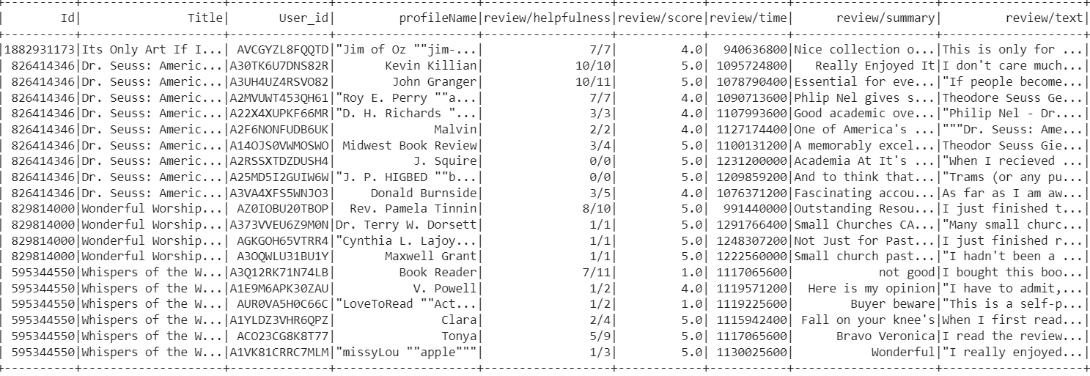
Dataset
No. of rows: 2420111
Size: 2.5GB
Data types: String, Float, Integers

Slide 4
Data Cleaning
01
03
02
04
Null Values were dropped
Input variables were converted to numerical
Duplicate Values were dropped
Text Preprocessing

Slide 5
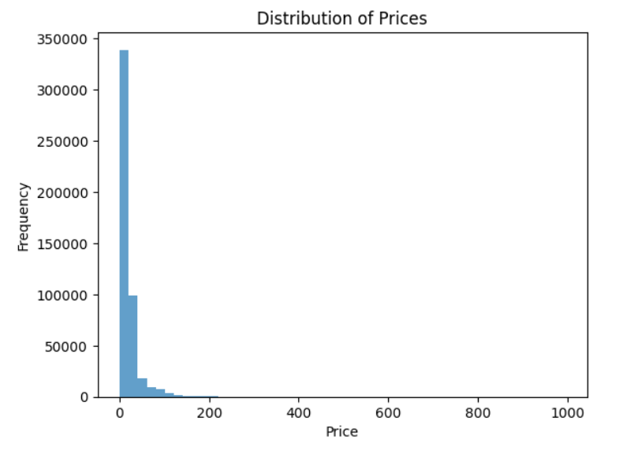
Exploratory Data Analysis
Examined the correlation between the 'Price' and 'review/score' columns to understand potential relationships between these features.
Plotted the distribution of prices in the dataset.
Based on the findings and distribution analysis, opted to drop the 'Price' column.

Slide 6
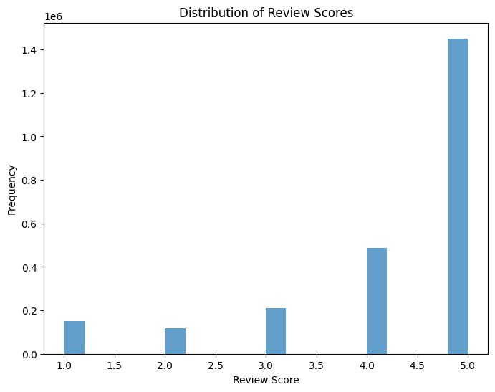
Exploratory Data Analysis

Slide 7
Model Evaluation
Content-Based Recommendation System:
A content-based recommendation system is a type of recommender system that suggests items to users based on the characteristics or features of the items themselves and the preferences expressed by the user.
Implemented a robust content-based recommendation system by developing a Linear Regression Model to predict user ratings based on features derived from the content of book reviews.
Root Mean Square Error (RMSE) | Mean Absolute Error (MAE) | R-Square Error
1.0635 | 0.8131 | 0.1854

Slide 8
Model Evaluation
Regression Models:
Models | Root Mean Square Error (RMSE) | Mean Absolute Error (MAE) | R-Square Error
Random Forest | 1.1801 | 0.9251 | 0.0011
Gradient Boost | 1.1780 | 0.9230 | 0.0013

Slide 9
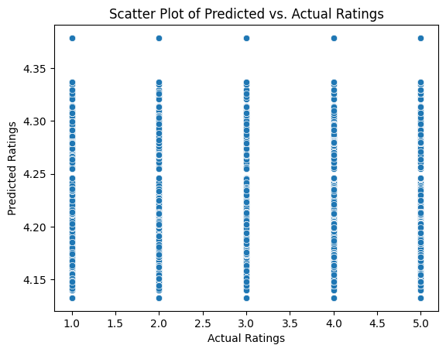
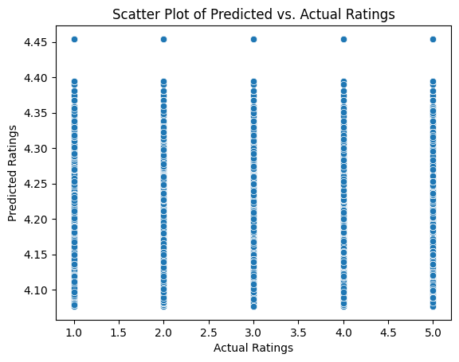
Model Evaluation
Random Forest Model
Gradient Boost Model

Slide 10
Conclusion
Implemented Book Recommendation System blends content-based modeling with machine learning (Random Forest, Gradient Boosting).
Content-Based Model demonstrates superior performance compared to traditional machine learning models.
Validates the effectiveness of personalized recommendations rooted in content analysis.
Successfully addresses the challenge of enhancing user engagement and satisfaction.
Explore combining collaborative filtering with content-based features to create a more robust recommendation system.
Investigate the implementation of deep learning, such as neural collaborative filtering, for improved accuracy and enhance the system to provide real-time recommendations by incorporating streaming data.

Slide 11
Dataset Source: https://www.kaggle.com/datasets/pigment/big-sales-data

Slide 12
THANK YOU

