Slide 1
Visual Amigo Team Guide: Mrs. V. BABY
Team Members:
S. Naga SAI TEJA
CH. AJAY VARMA
K. ANIL KUMAR
P. Raj Kishore
S. SANDEEP

Slide 2

ABSTRACT
This is an android application which is based on object detection for blind people. This application recognizes the object in the image and convey the related information to the person using it.
In additional to the object recognition, the application contains an assistant which takes the commands(input) from the user and performs it. And shares the real time location with the people who cares for him.
This application is mainly intended for the blind people. This makes to recognize the objects in front of them and also do their tasks based on their voice.

Slide 3
EXISTING SYSTEM
Android Applications which only detects the images and does not contain any voice modules.

Slide 4
DRAWBACKS OF EXISTING SYSTEM
As the existing applications does not contain any voice modules they are not at all useful for blind people. They also don’t contain special modules which acts as an assistant based on their voice commands.

Slide 5
PROPOSED SYSTEM
By taking a snapshot, identifying the objects in it and letting the user know by voice.
An assistant totally based on voice commands.
Live sharing of his location to his friends so that they can easily track them.

Slide 6
SYSTEM REQUIREMENTS
For Usage
- Android Phone with minimum 5.0 android version
- Proper Working of Camera
- Proper Internet Connection
For Development
- Android Studio as tool
- Firebase as Database
- Google API
- Emulator for Testing

Slide 7
MODULES
Registration
Tracking
Object Recognition
Personal Assistant

Slide 8
WORKFLOW
Registration
1
Object Recognition
3
Personal Assistant
5
Capturing Image
2
Object Name Spell-Out
4

Slide 9
UML DIAGRAMS
Use case Diagram
Class Diagram
Sequence Diagram
Activity Diagram

Slide 10
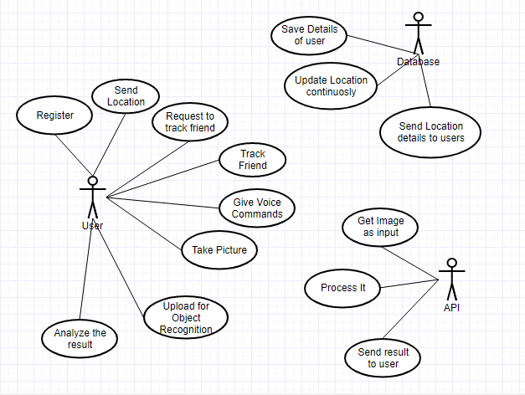
USECASE DIAGRAM

Slide 11
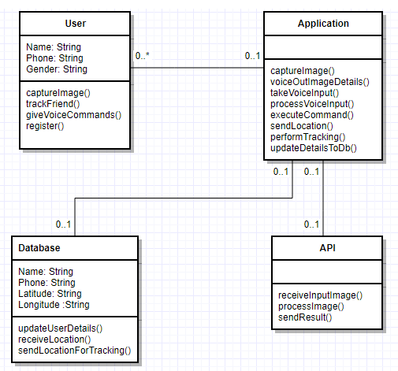
CLASS DIAGRAM

Slide 12
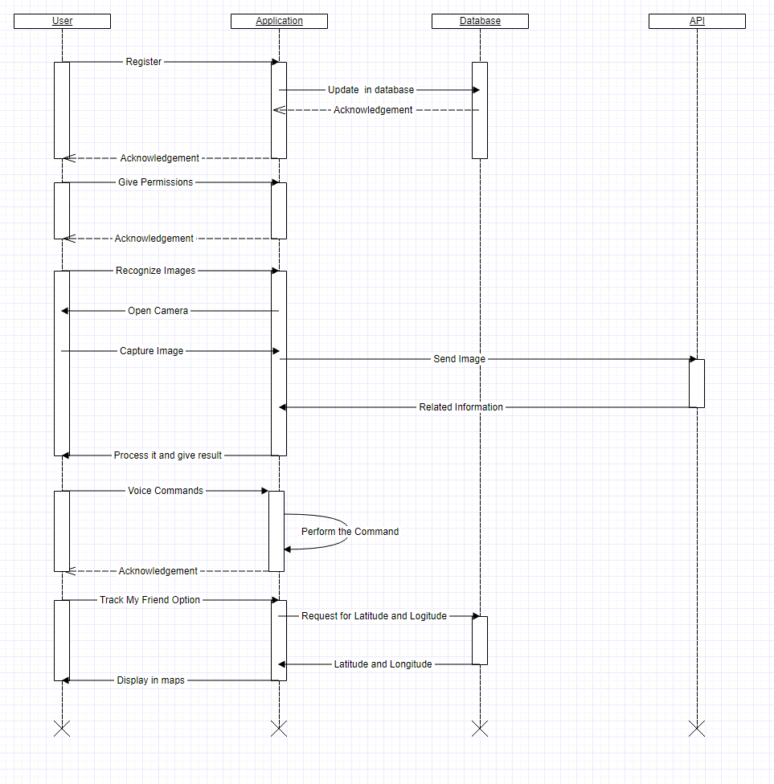
SEQUENCE DIAGRAM

Slide 13
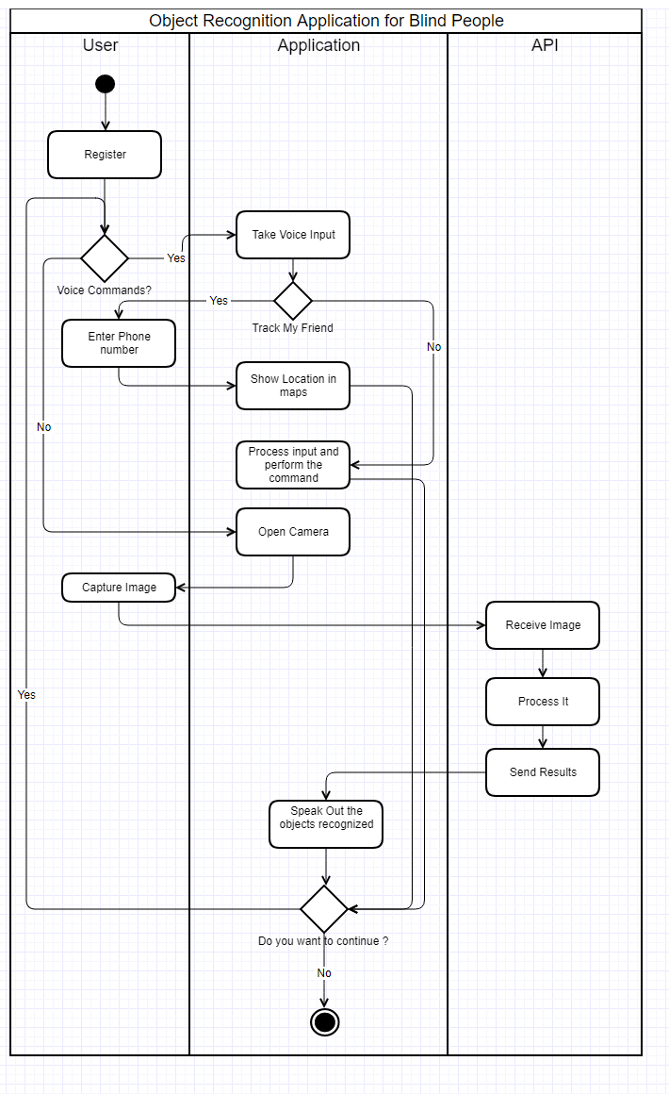
ACTIVITY DIAGRAM

Slide 14
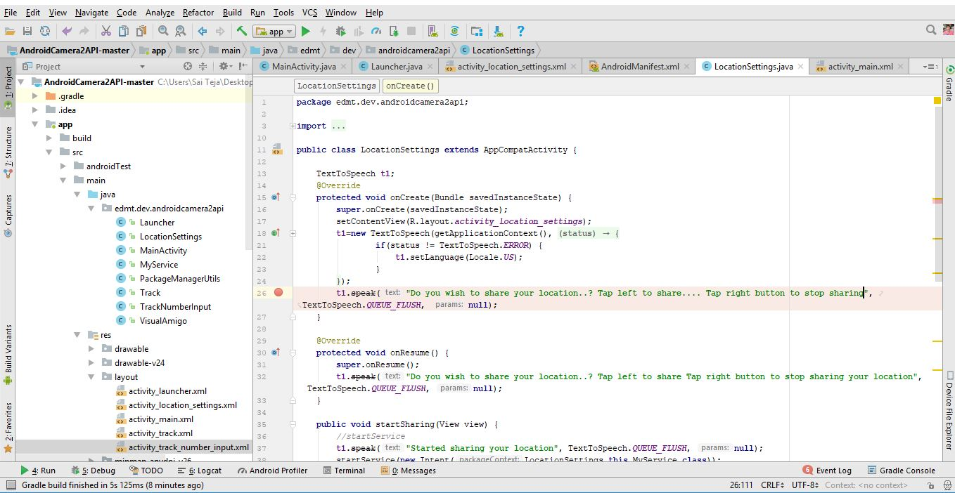
Implementation
Code Editor used to develop application

Slide 15

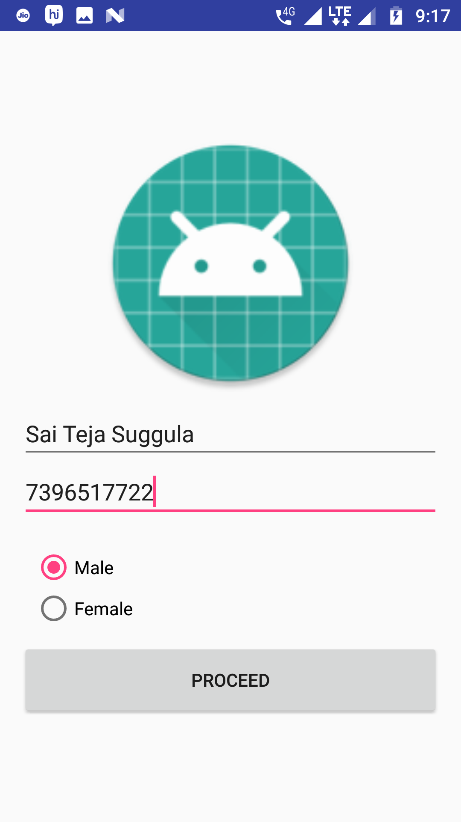



Implementation
Registration Page

Slide 16
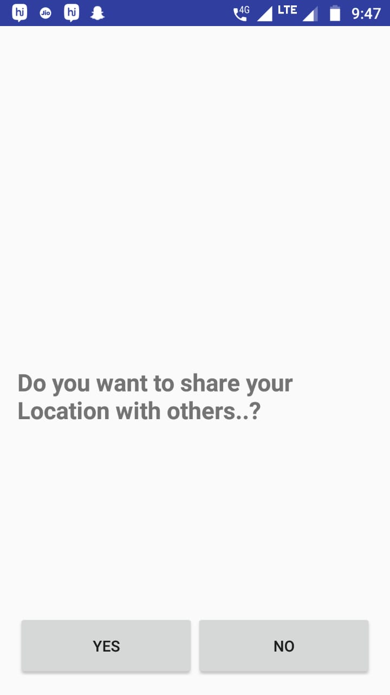
Implementation
Asking permission to share location

Slide 17
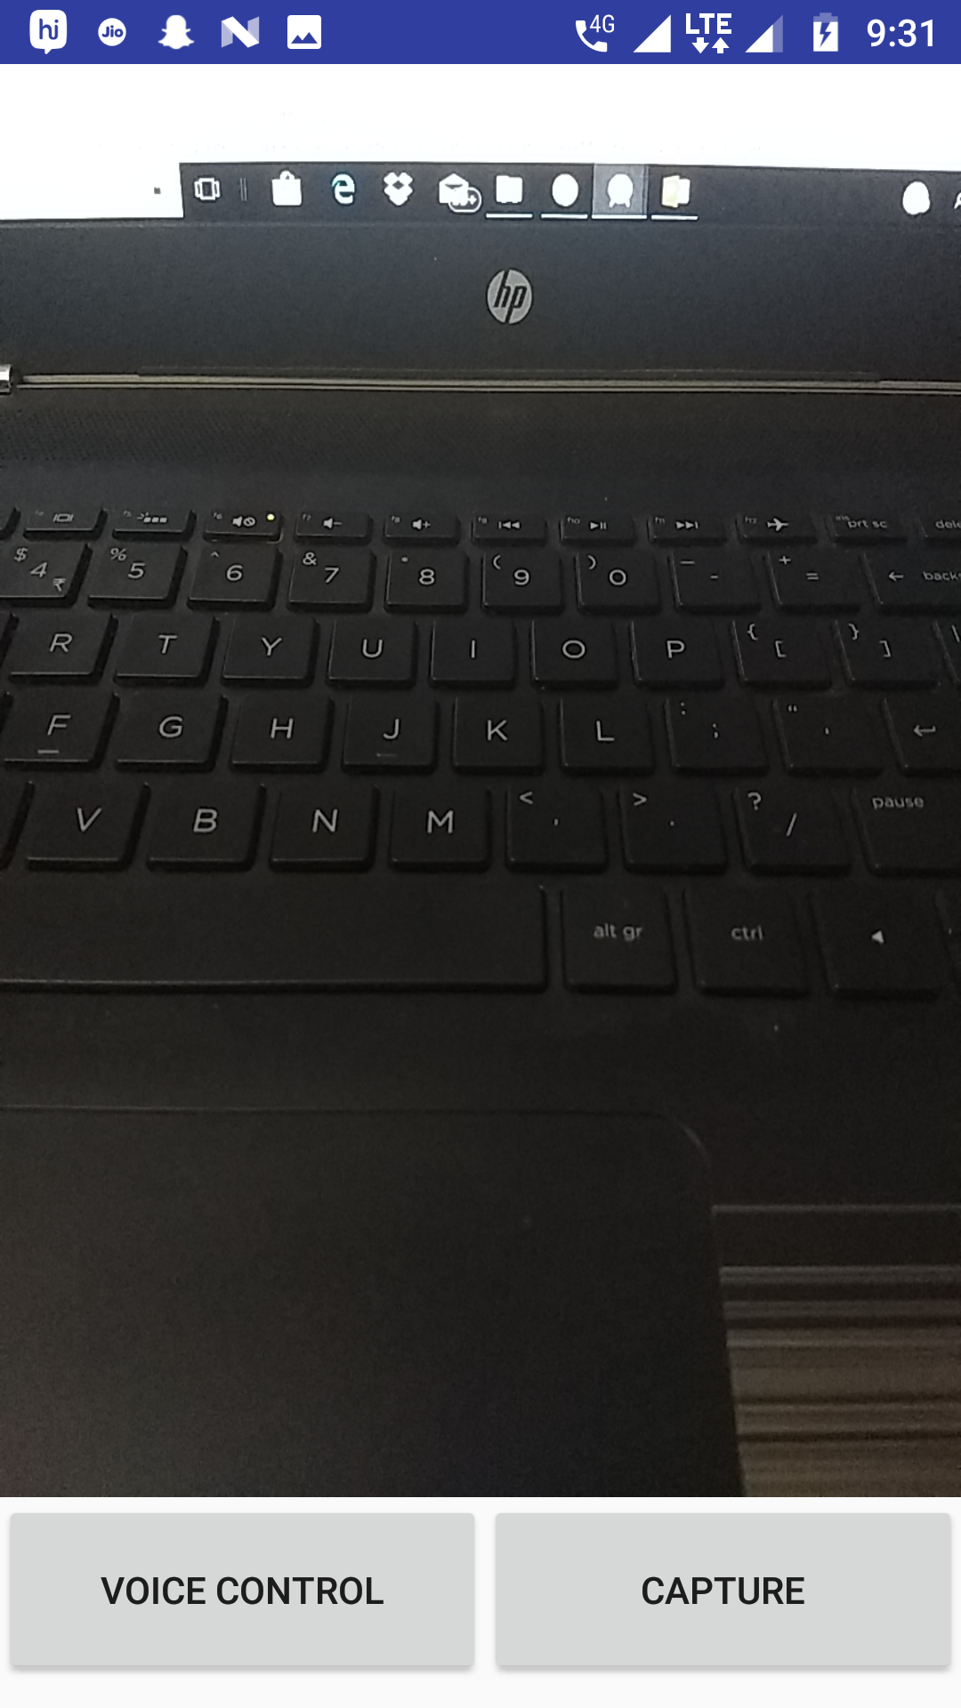
Implementation
Camera Module to detect images

Slide 18
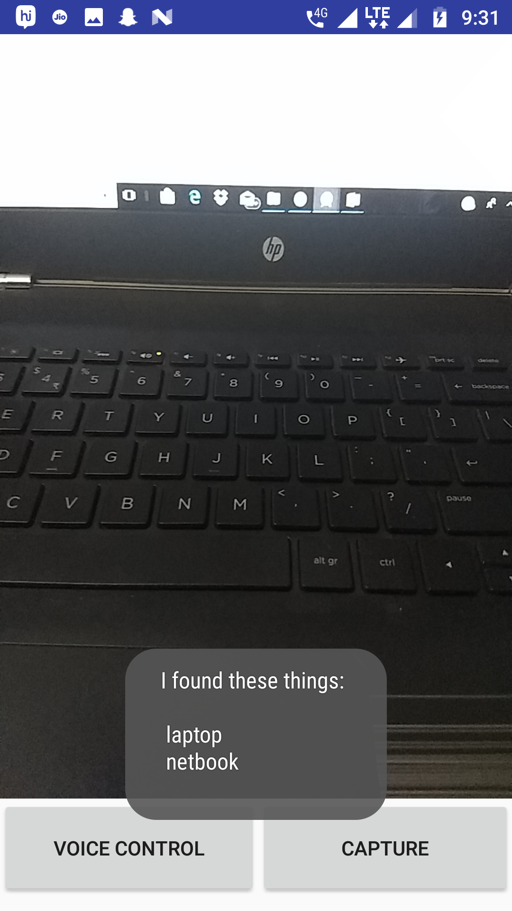
Implementation
Camera Module detecting objects
in image and giving voice output

Slide 19
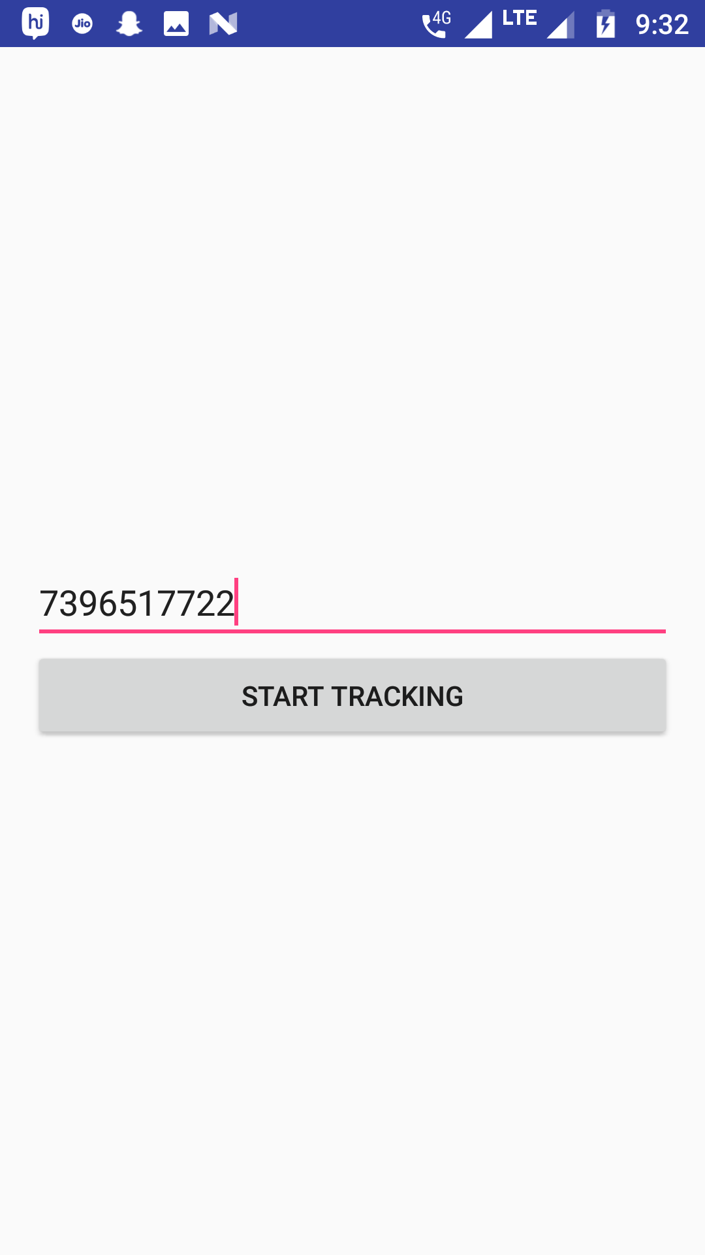
Implementation
Asking phone number to track person

Slide 20
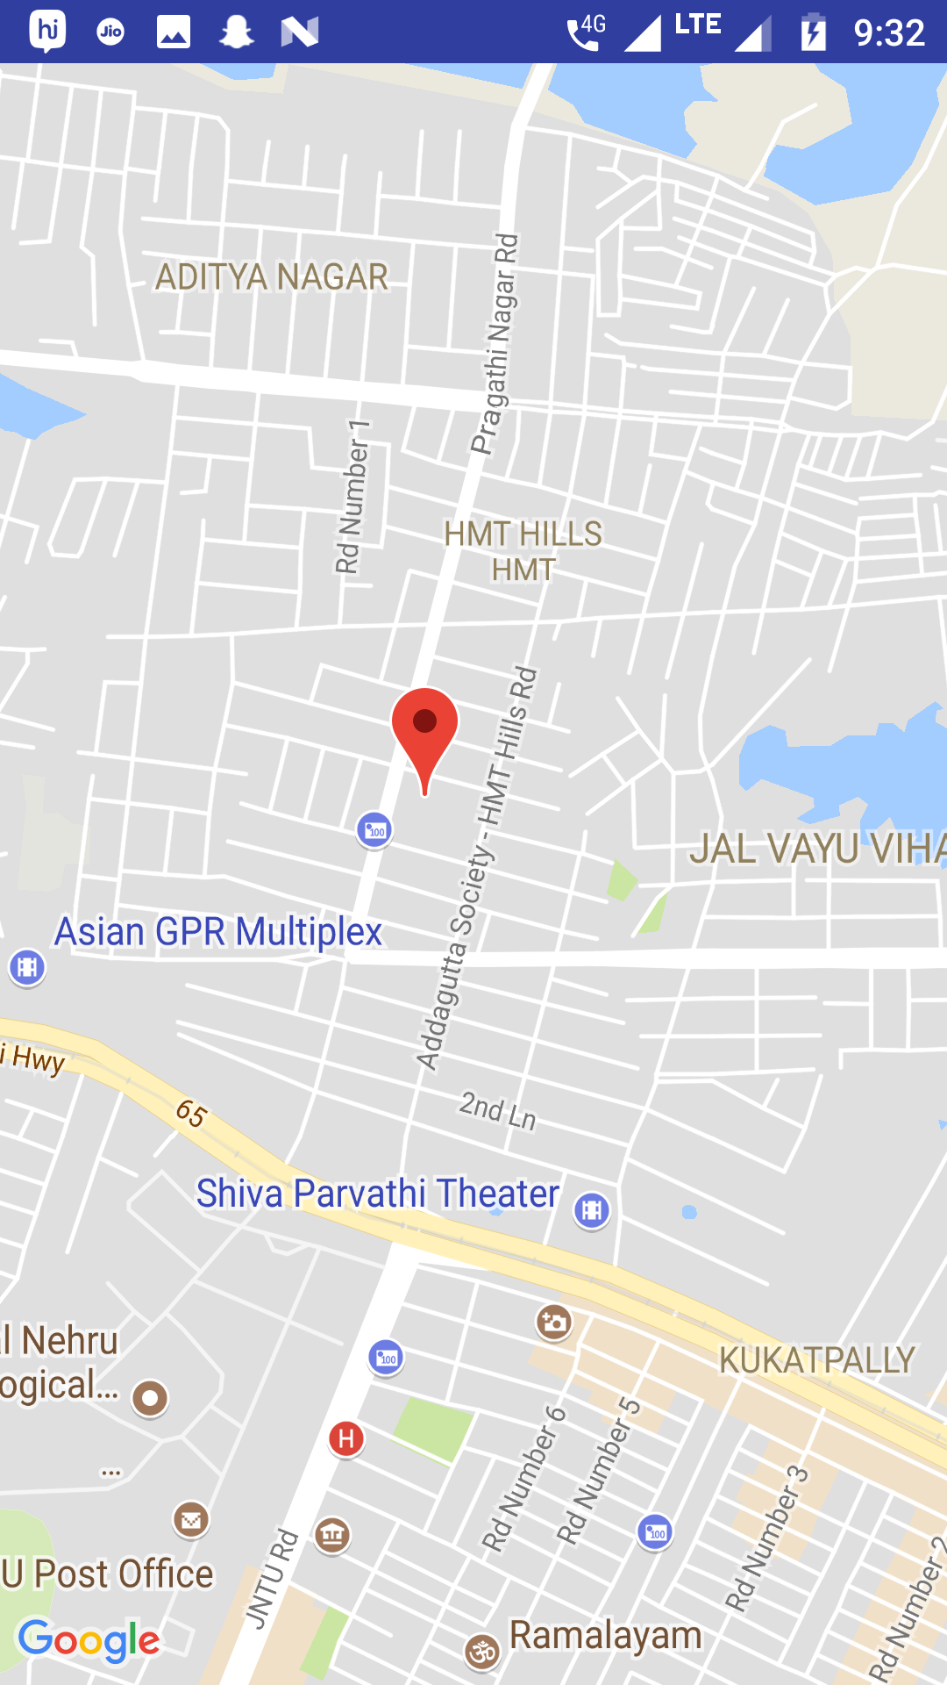
Implementation
Showing the location using marker
in maps module

Slide 21
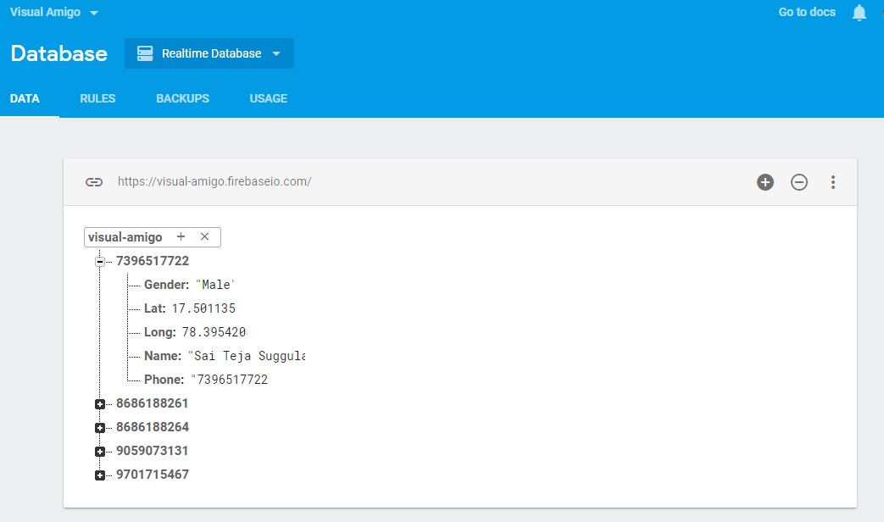
Implementation
Database to store User Location

Slide 22
Test Cases
Test case ID | Test case title | Expecting Behaviour | Exhibiting Behaviour | Result
1 | Registering | Validate Fields | Fields are being validated | Pass
2 | Updating values to database | Details need to be updated in Database | Details are uploaded in Database | Pass
3 | Capture Images and Identify objects | Voice output of objects recognized in images | Voice output of objects in images | Pass
4 | Sharing of location | Latitude and Longitude to be uploaded to database | Latitude and Longitude values are uploaded to database | Pass
5 | Live Tracking | Location showed in maps | Location of used showed in maps | Pass
6 | Voice Assistant | Take voice command and perform actions | Taking voice input and performing actions | Pass

Slide 23
Conclusions
With this application, Visually impaired people can identify the objects surrounding them and act accordingly.
Relatives or friends of these people can be able to track them continuously and reach them easily.
Voice assistant gives better output in performing their personal tasks.

Slide 24
Future Scope
This application can be integrated in an instrument which is of small size and can be used more efficiently.
We can integrate text recognition modules, so that it make users to read text(Avoid using Braille script).
Convert the voice message into multiple languages, so that it can be used to speak in new environment.

Slide 25
References
https://developer.android.com (Android documentation for App Development)
https://firebase.google.com/docs (Database Documentation)
https://cloud.google.com/vision/docs (Object Detection API Documentation)

Slide 26
THANK YOU

