Slide 1
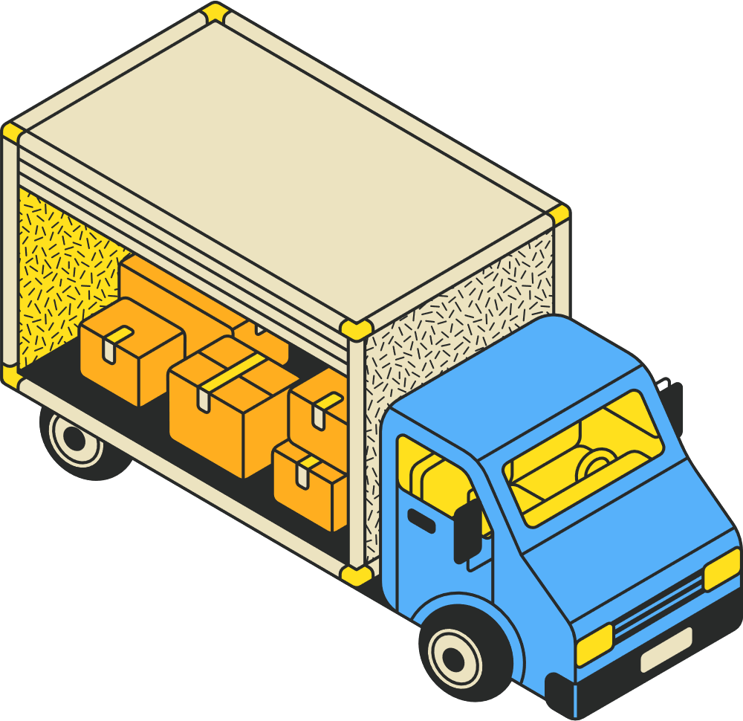
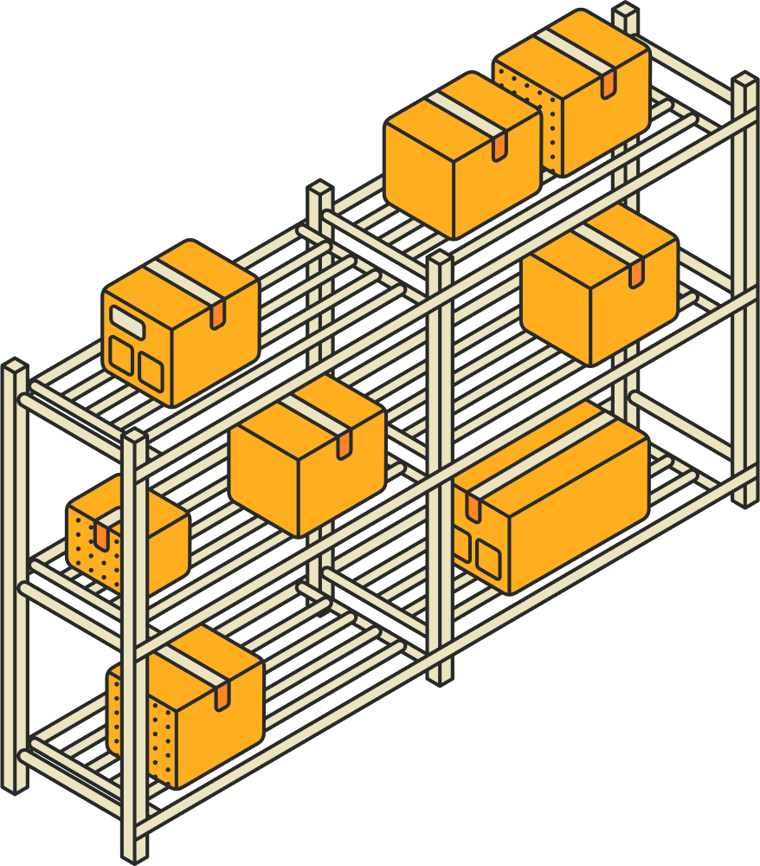

Smart Delivery Load & Route Optimization System
A Data-Driven Decision Support System for Truck Loading & Delivery Routing
MIS - 6940 - Project Seminar
By: Sai Teja Vemulapalli
Oakland University

Slide 2
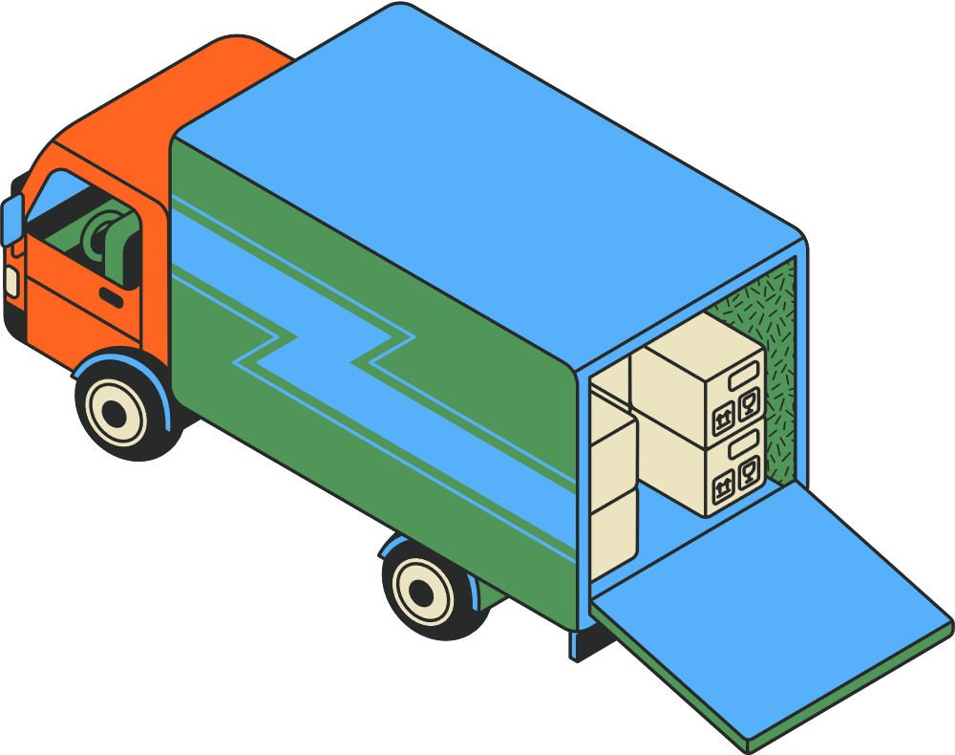
Industry Description
Industry Context:
Logistics & Transportation(e.g., large parcel delivery and e-commerce fulfillment companies)
  Logistics organizations manage high volumes of packages that must be loaded, tracked, and delivered daily.
  Operations involve warehouses, trucks of different sizes, dispatch schedules, and multiple delivery locations.
  Efficiency depends on how well packages are packed into trucks, sequenced for delivery, and monitored through execution.
This project is designed to reflect real-world logistics operations at a warehouse and dispatch level

Slide 3
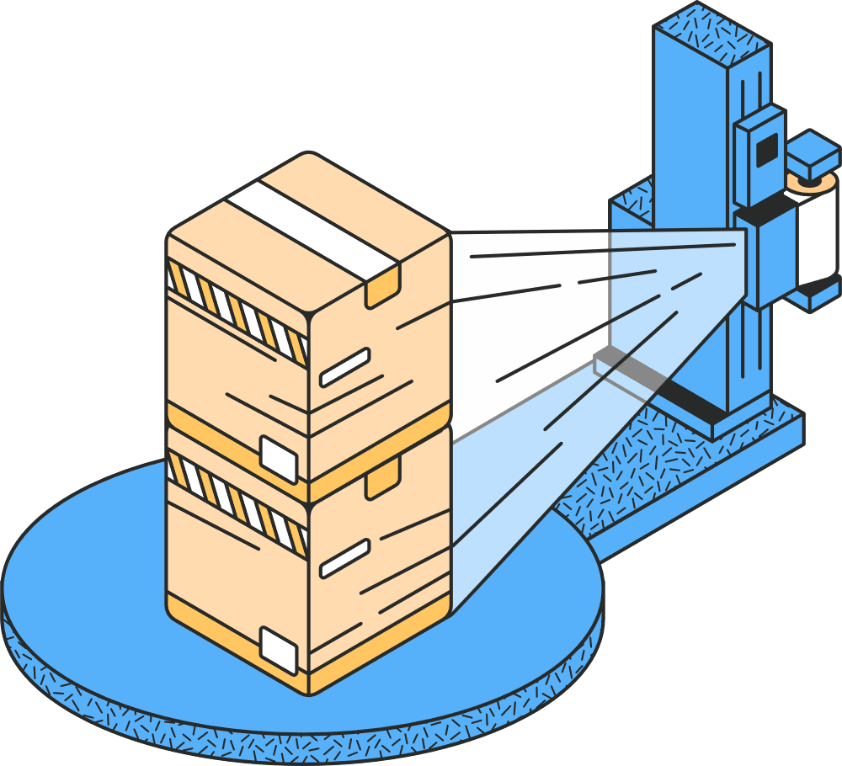
Problem Statement
Logistics organizations face several interconnected business problems:
Inefficient truck space usage
  Poor loading decisions increase fuel costs and the number of trips required.
Fragile package damage
  Fragile items may be stacked improperly without visibility into load structure.
Limited package visibility
  Managers and employees often lack real-time clarity on package status (warehouse, loaded, delivered).
Disconnected systems
  Routing, loading, and tracking are frequently handled in separate tools.
Operational complexity
  Large datasets make it difficult to manually assess utilization, routes, and delivery readiness.

Slide 4
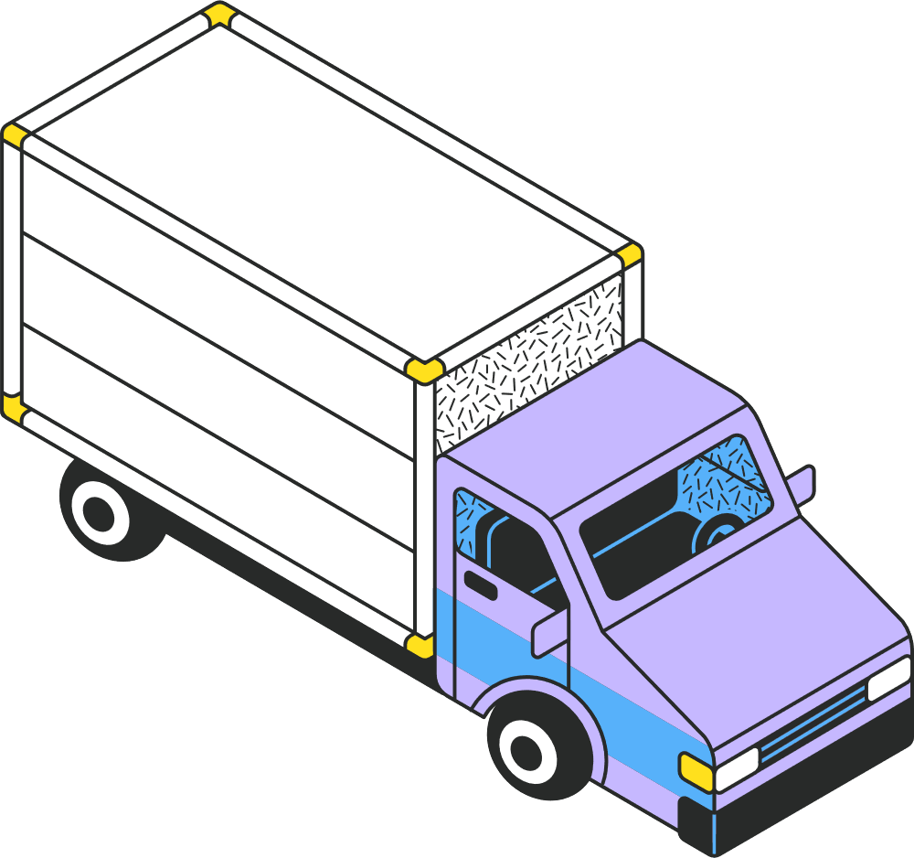
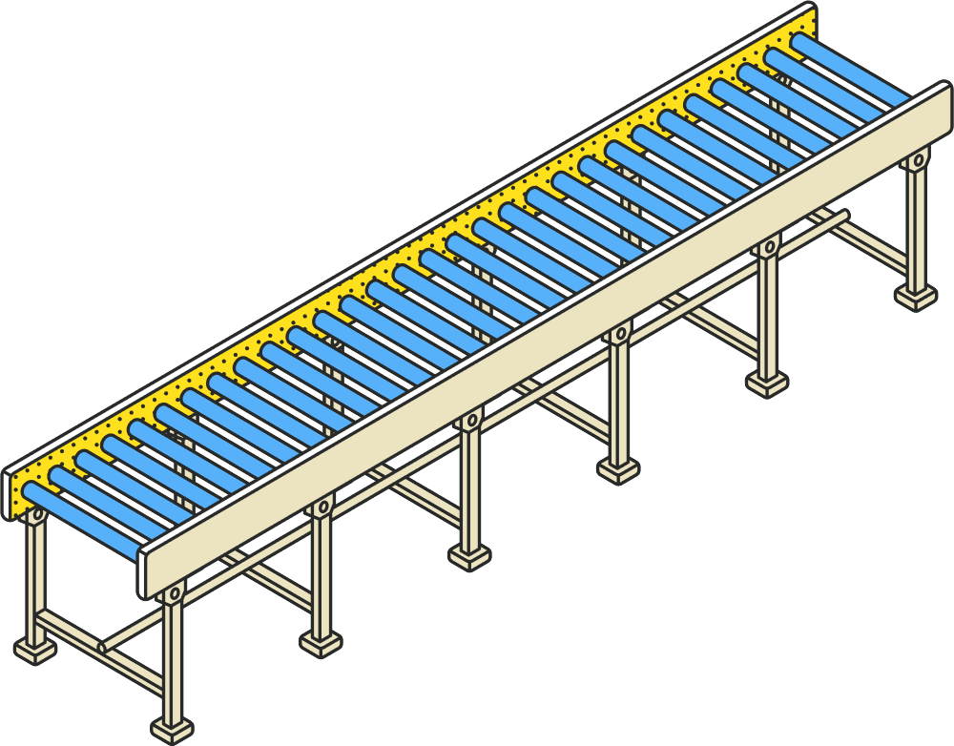

Project Objectives
This project addresses operational inefficiencies in last-mile logistics, including underutilized truck capacity, unclear package visibility, and non-transparent delivery routing.
A prototype system was developed to model deliveries using structured warehouse data, 3D truck load visualization, and route mapping.
The solution enables managers and dispatchers to monitor package states, loading efficiency, and routing decisions without direct database or code access.
The system demonstrates improved decision support, transparency, and extensibility for future optimization.

Slide 5
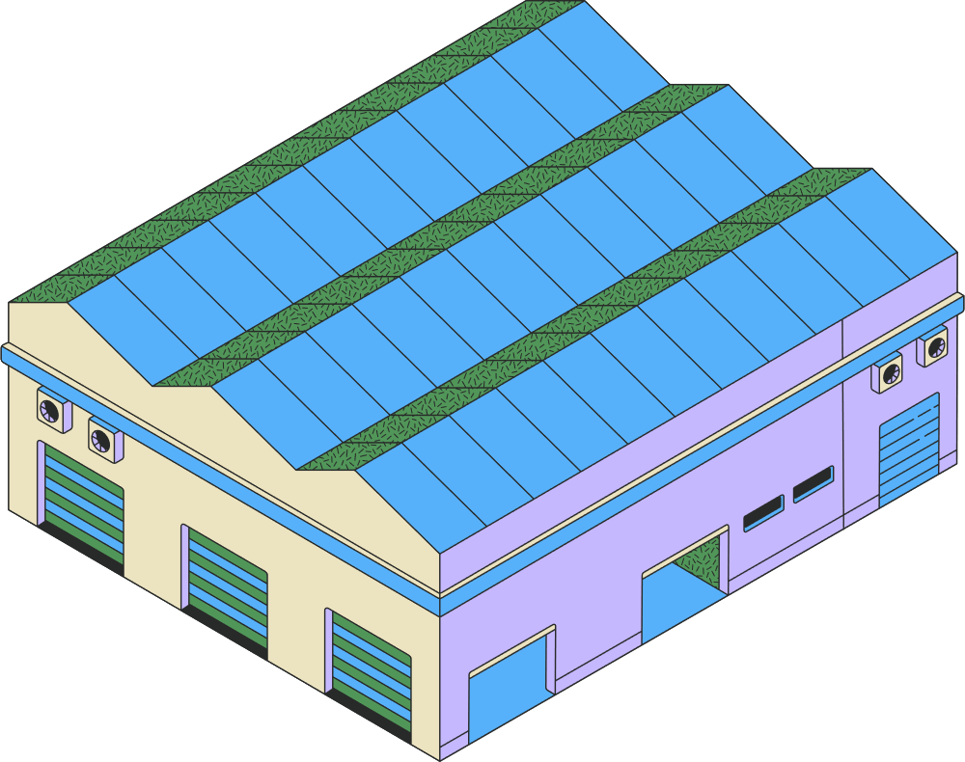
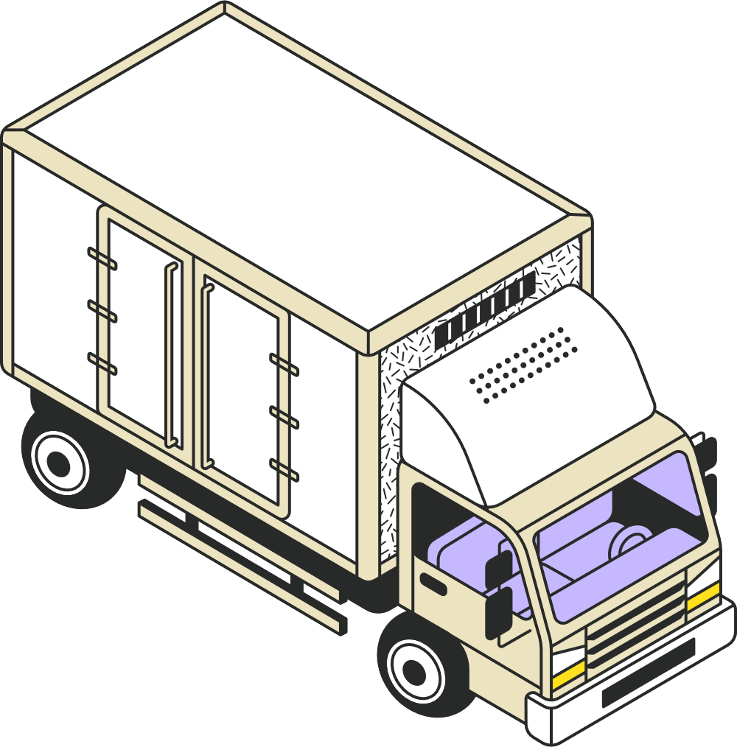
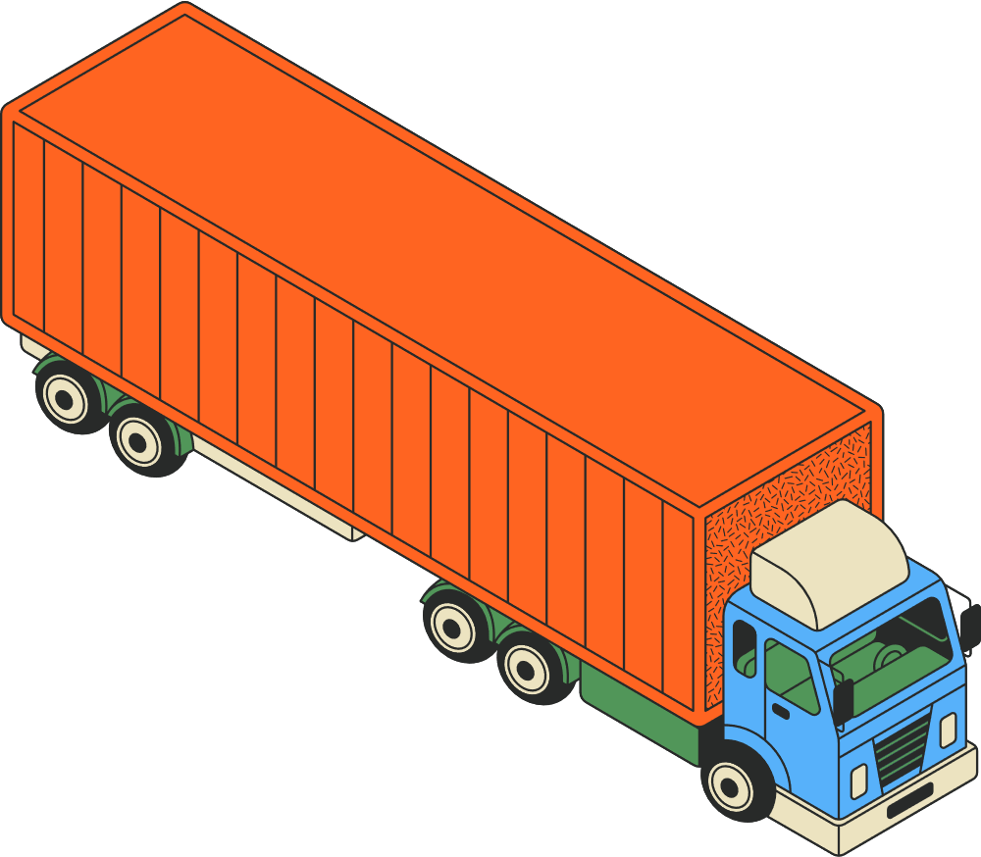
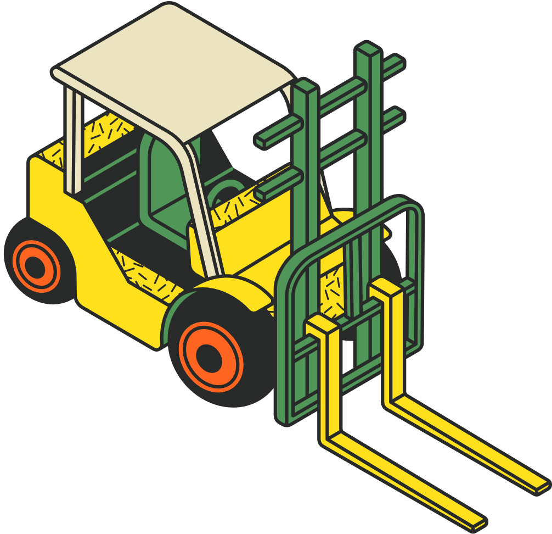
Organizational Stakeholders
The solution is guided by industry practices and stakeholder perspectives, including:
Primary Users:
  Warehouse Managers
  Dispatch Planners
  Operations Analysts
  Delivery Supervisors
How They Benefit:
  Managers see utilization and efficiency KPIs
  Dispatchers understand route and stop structure
  Warehouse staff load trucks with fewer errors
  Supervisors track package status clearly

Slide 6
System Capabilities
The system is expected to support the following key capabilities:
Automated Truck Loading
  Determines package placement based on dimensions, weight, and fragility.
Truck Utilization Analysis
  Calculates weight and volume utilization for each dispatch.
Package Lifecycle Tracking
  Tracks packages from creation through delivery.
Route Planning & Visualization
  Displays delivery stops and sequences using geographic coordinates.
3D Load Visualization
  Shows how packages are physically arranged inside the truck.
Manager-Friendly Frontend
  Allows non-technical users to explore operations without accessing code or databases.

Slide 7
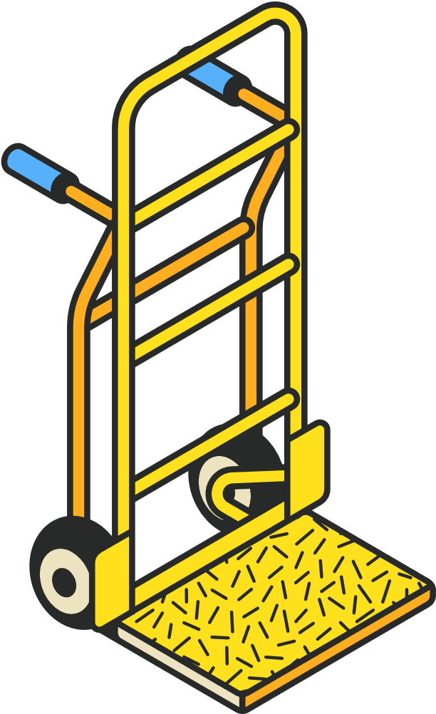
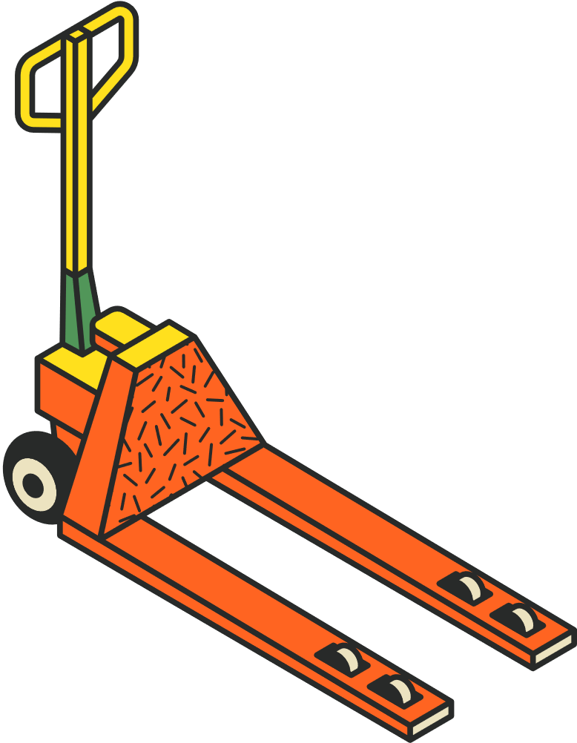
Business Benefits
Cost
Reduction
Operational Efficiency
Damage Prevention
Improved truck utilization reduces fuel and transportation costs.
Automated loading reduces manual decision time.
Fragile handling awareness reduces breakage and returns.
Transparency
Improved Planning
Visual analytics help managers plan future dispatches more effectively.
Clear visibility into package and dispatch status.

Slide 8
Project Deliverables
Relational Database Design (ERD)
  Tables for packages, trucks, dispatches, stops, load plans, and placements.
Operational Dataset
  Realistic synthetic data for packages, addresses, trucks, and delivery routes.
Truck Loading Algorithm
  Python-based logic for placement and utilization calculation.
3D Truck Load Visualization
  Graphical representation of package placement inside trucks.
Route Map Visualization
  Map showing delivery stops and route sequence.
Frontend Dashboard
  Interactive interface for KPIs, package search, utilization, and route views.

Slide 9
Feasibility Analysis And Solution Evaluation
Feasibility Analysis
Technical Feasibility
  Uses widely available technologies (relational databases, Python, visualization libraries).
Operational Feasibility
  Aligns with real logistics workflows and stakeholder roles.
Economic Feasibility
  Concept demonstrates value without requiring expensive hardware or proprietary software.
Solution Evaluation
The completed system helps solve the identified problems by:
  Automating complex truck loading decisions.
  Providing visibility into fragile handling and utilization.
  Integrating package tracking, loading, and routing in one system.
  Offering intuitive visualizations for managers and employees.

Slide 10
Lessons Learned, Limitations & Future Work
Lessons Learned
  Optimization is not purely mathematical operational practicality matters.
  Visualization is critical for stakeholder understanding.
  Data modeling decisions strongly influence system flexibility.
  Balancing realism with prototype constraints is essential in academic projects.
Limitations & Future Work
Current Limitations:
  Route sequencing does not yet fully optimize for time windows or fuel cost.
  3D visualization is static rather than fully interactive.
  Real-time GPS tracking is not implemented.
Future Work:
  Stop-wise package grouping for easier unloading.
  Interactive 3D truck visualization (rotation and filtering).
  Advanced routing optimization (distance, time, fuel).
  Real-time delivery monitoring.

Slide 11


THANK YOU
Smart Delivery Load, Routing, and Package Management System

