Slide 1

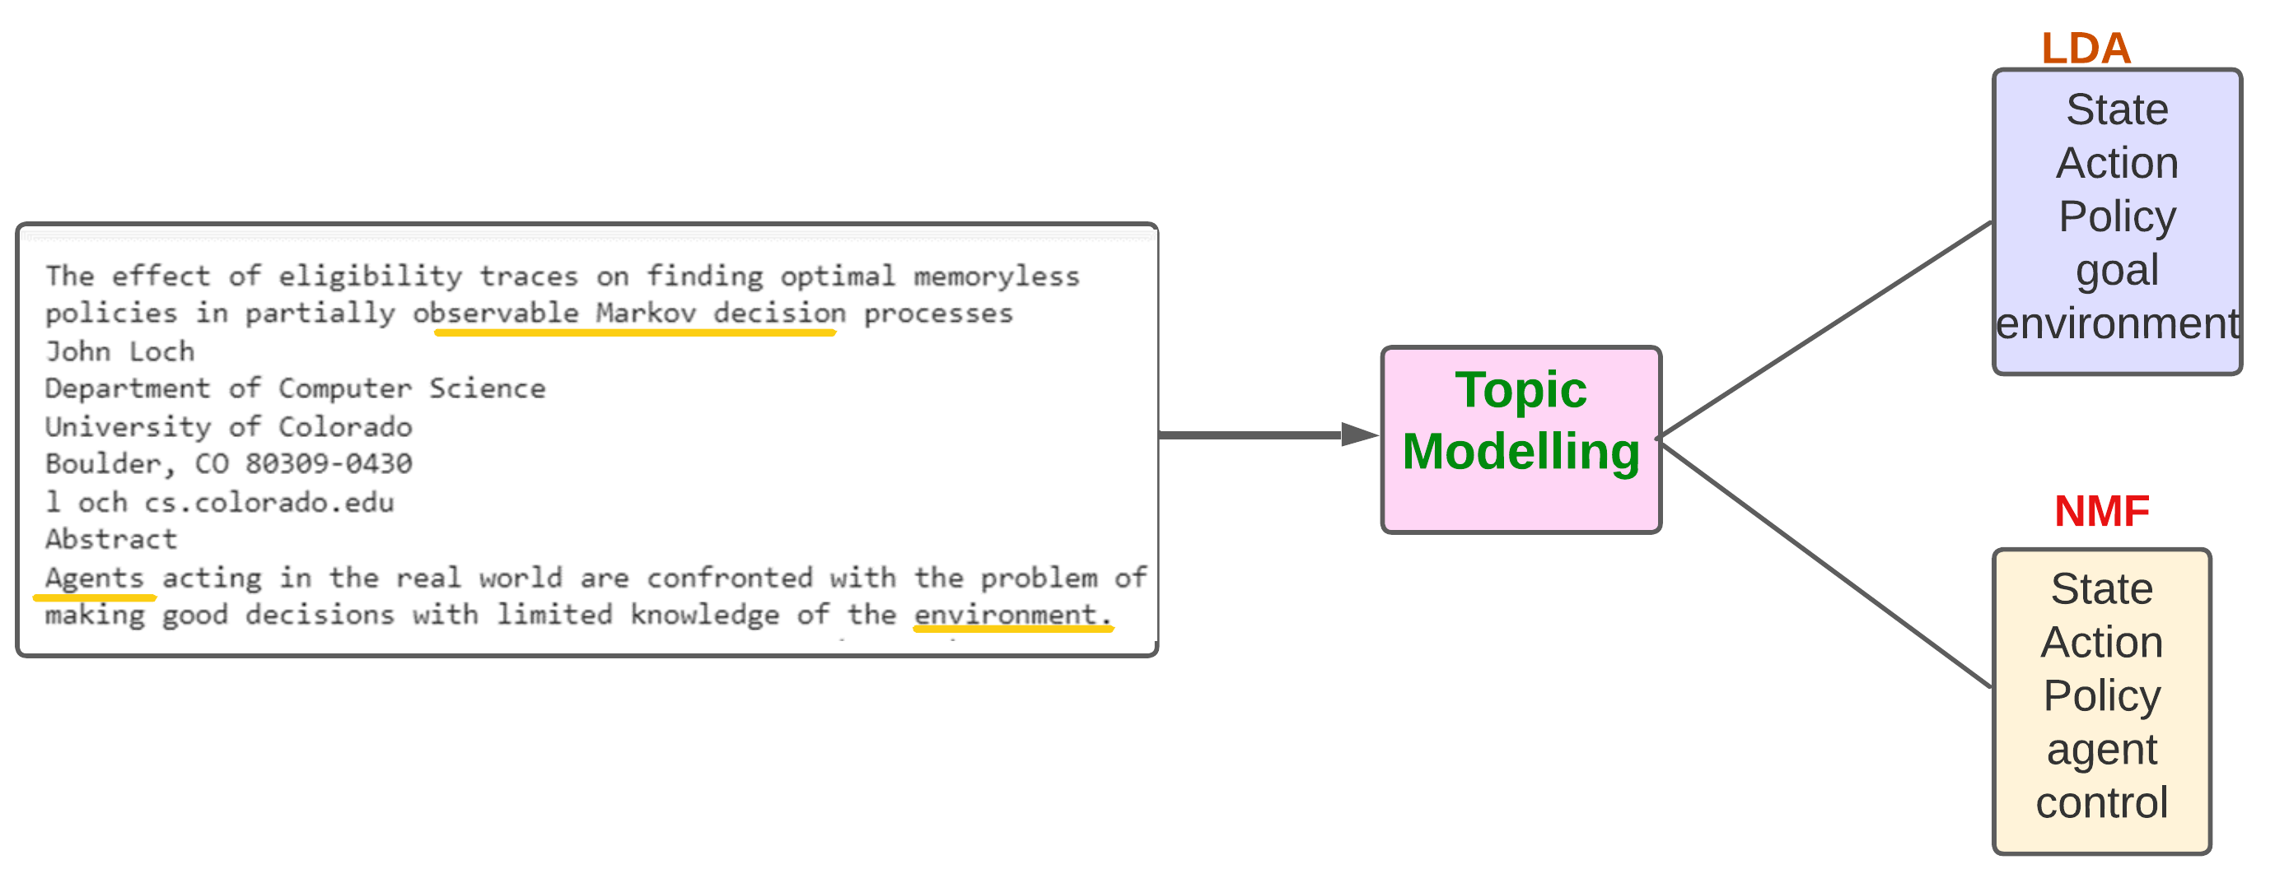
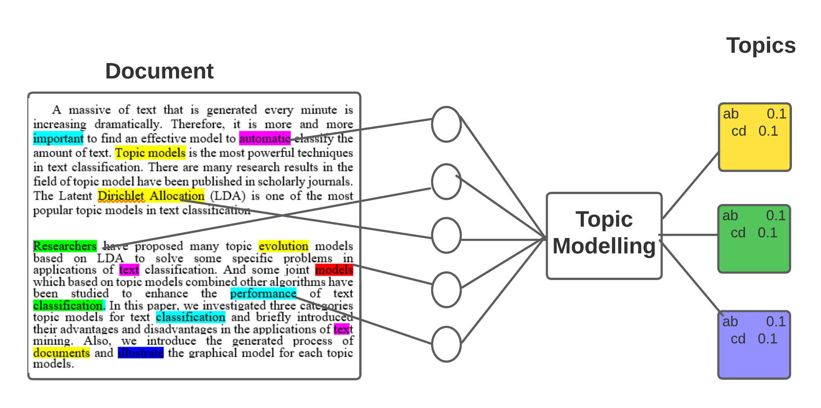
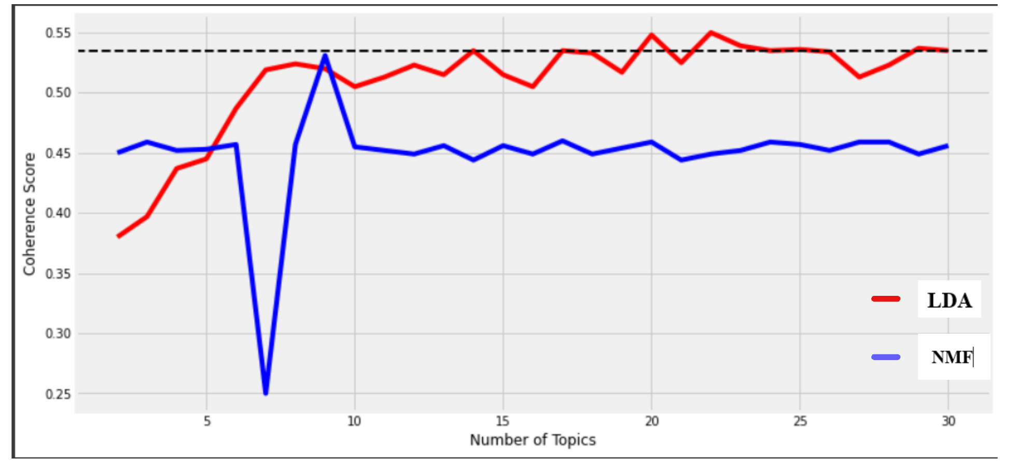

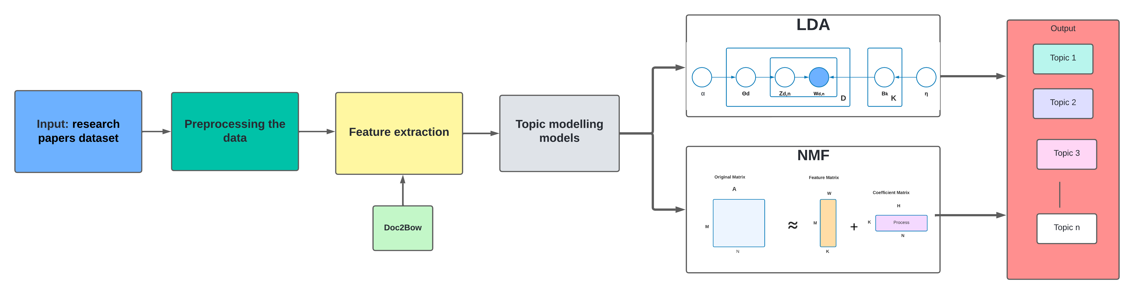
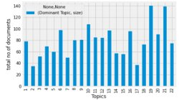
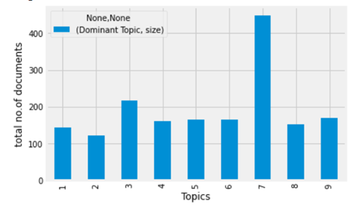
Comparative Study Analysis on Research Papers Categorization using Topic Modelling Approaches LDA and NMF
Bandi Rupendra Reddy, Darukumalli Sai Tharun Reddy, Sandeep Preetham M C, Deepa Gupta
Department of Computer Science, Amrita School of Engineering, Bengaluru, Amrita Vishwa Vidyapeetham, India
ABSTRACT
INTRODUCTION
METHODS AND MATERIALS
RESULTS
Research paper classification using two generative topic modeling methodologies.
LDA is a probabilistic generative model.
NMF is a matrix factorization technique.
The dataset consists 1740 papers extracted from the NYC university website.
Comparison by evaluating the coherence score.
It becomes increasingly difficult to efficiently cluster, organize number of research publications .
An automated approach to classify the papers with lesser time complexity and higher coherence score is required.
LDA divides big clusters of text into fictional groups and categorizes it.
NMF divides input matrix into two matrices consisting only positive elements.
Natural language pre-processing techniques are performed on the dataset.
Feature extraction using Bag Of Words.
Use topic modeling methods (LDA and NMF) for classification.
Find the optimal number of topics for both models.
Evaluate the coherence of the model.
There is no optimal algorithm in general topic modelling algorithms.
The proposed NMF yields optimal performance with just 9 topics with coherence score of 0.51.
LDA yields optimal performance with over 22 topics with slightly higher coherence score of 0.54.
COMPARISION
Figure 4. result of Document Word Matrix
CONCLUSIONS
MODEL ARCHITECTURE
In this paper, We categorize the papers using two topic modeling techniques (LDA and NMF).
LDA being a probabilistic model yield a slight better coherence score with a larger number of topics.
NMF can be a very optimal approach for categorizing the data under a smaller number of topics and reduce the individuality between the topics.
FIGURE 2. Comparison of coherence scores for LDA and NMF models
REFERENCES
[1] Owa, D. (2021) Identification of Topics from Scientific Papers through Topic Modeling. Open Journal of Applied Sciences, 11, 541-548. Doi: 10.4236/ojapps.2021.104038.
[2] Kim, SW., Gil, JM. Research paper classification systems based on TF-IDF and LDA schemes. Hum. Cent. Comput. Inf. Sci. 9, 30 (2019).
[3] Guha Neogi, Pinaki Prasad & Das, Amit & Goswami, Saptarsi & Mustafi, Joy. (2020). Topic Modeling for Text Classification. 10.1007/978-981-13-7403-6_36
Figure 3. System Architecture
Chart 1 Total no. of documents for each topics for NMF
Chart 2 Total no. of documents for each topic for NMF

