Slide 1
Traffic Signs Recognition using Deep learning methods
Done By: Team Utopia
B Rupendra Reddy – AIE19009
D Sai Tharun Reddy – AIE19016
Sandeep Preetham M C - AIE19058

Slide 2
Contents:
Introduction
Dataset Explanation
Workflow
Models
Demo codes
Models Evalution's
Results
Conclusion and Future Wolk

Slide 3
Problem Statement :
The goal of the Traffic Sign Recognition project is to build a Deep Neural Network (DNN) which is used to classify traffic signs by using various CNN models(CNN-2Layers, CNN-3Layers, and VGG-16) and has to get best accuracies for this model by using the deep learning methods.

Slide 4
Introduction:
With the improvement of material life, the expressway has also become complicated which leads to the frequent occurrence of traffic accidents.
Developing automated traffic sign recognition systems helps assisting the driver in different ways in order to guarantee his/her safety.
In this project , we will build a deep neural network model that can classify traffic signs present in the image into different categories.

Slide 5
Dataset:
Dataset Name: Traffic Sign Recognition .
Training Set has 34799 Images , Test set has 12630 images and the validation set has 4410 images.
Train.csv file contains below information about each training image :
Width : Width of image in number of pixels.
Height : Height of image in number of pixels.
Roi.X1 : Upper left X-coordinate of the bounding box.
Roi.Y1 : Upper left Y-coordinate of the bounding box.
Roi.X2 : Lower right X-coordinate of the bounding box.
Roi.Y2 : Lower right Y-coordinate of the bounding box.
ClassId : Class label of the image. It is an Integer between 0 and 43.
Path : Path where the image is present in the Train folder.

Slide 6
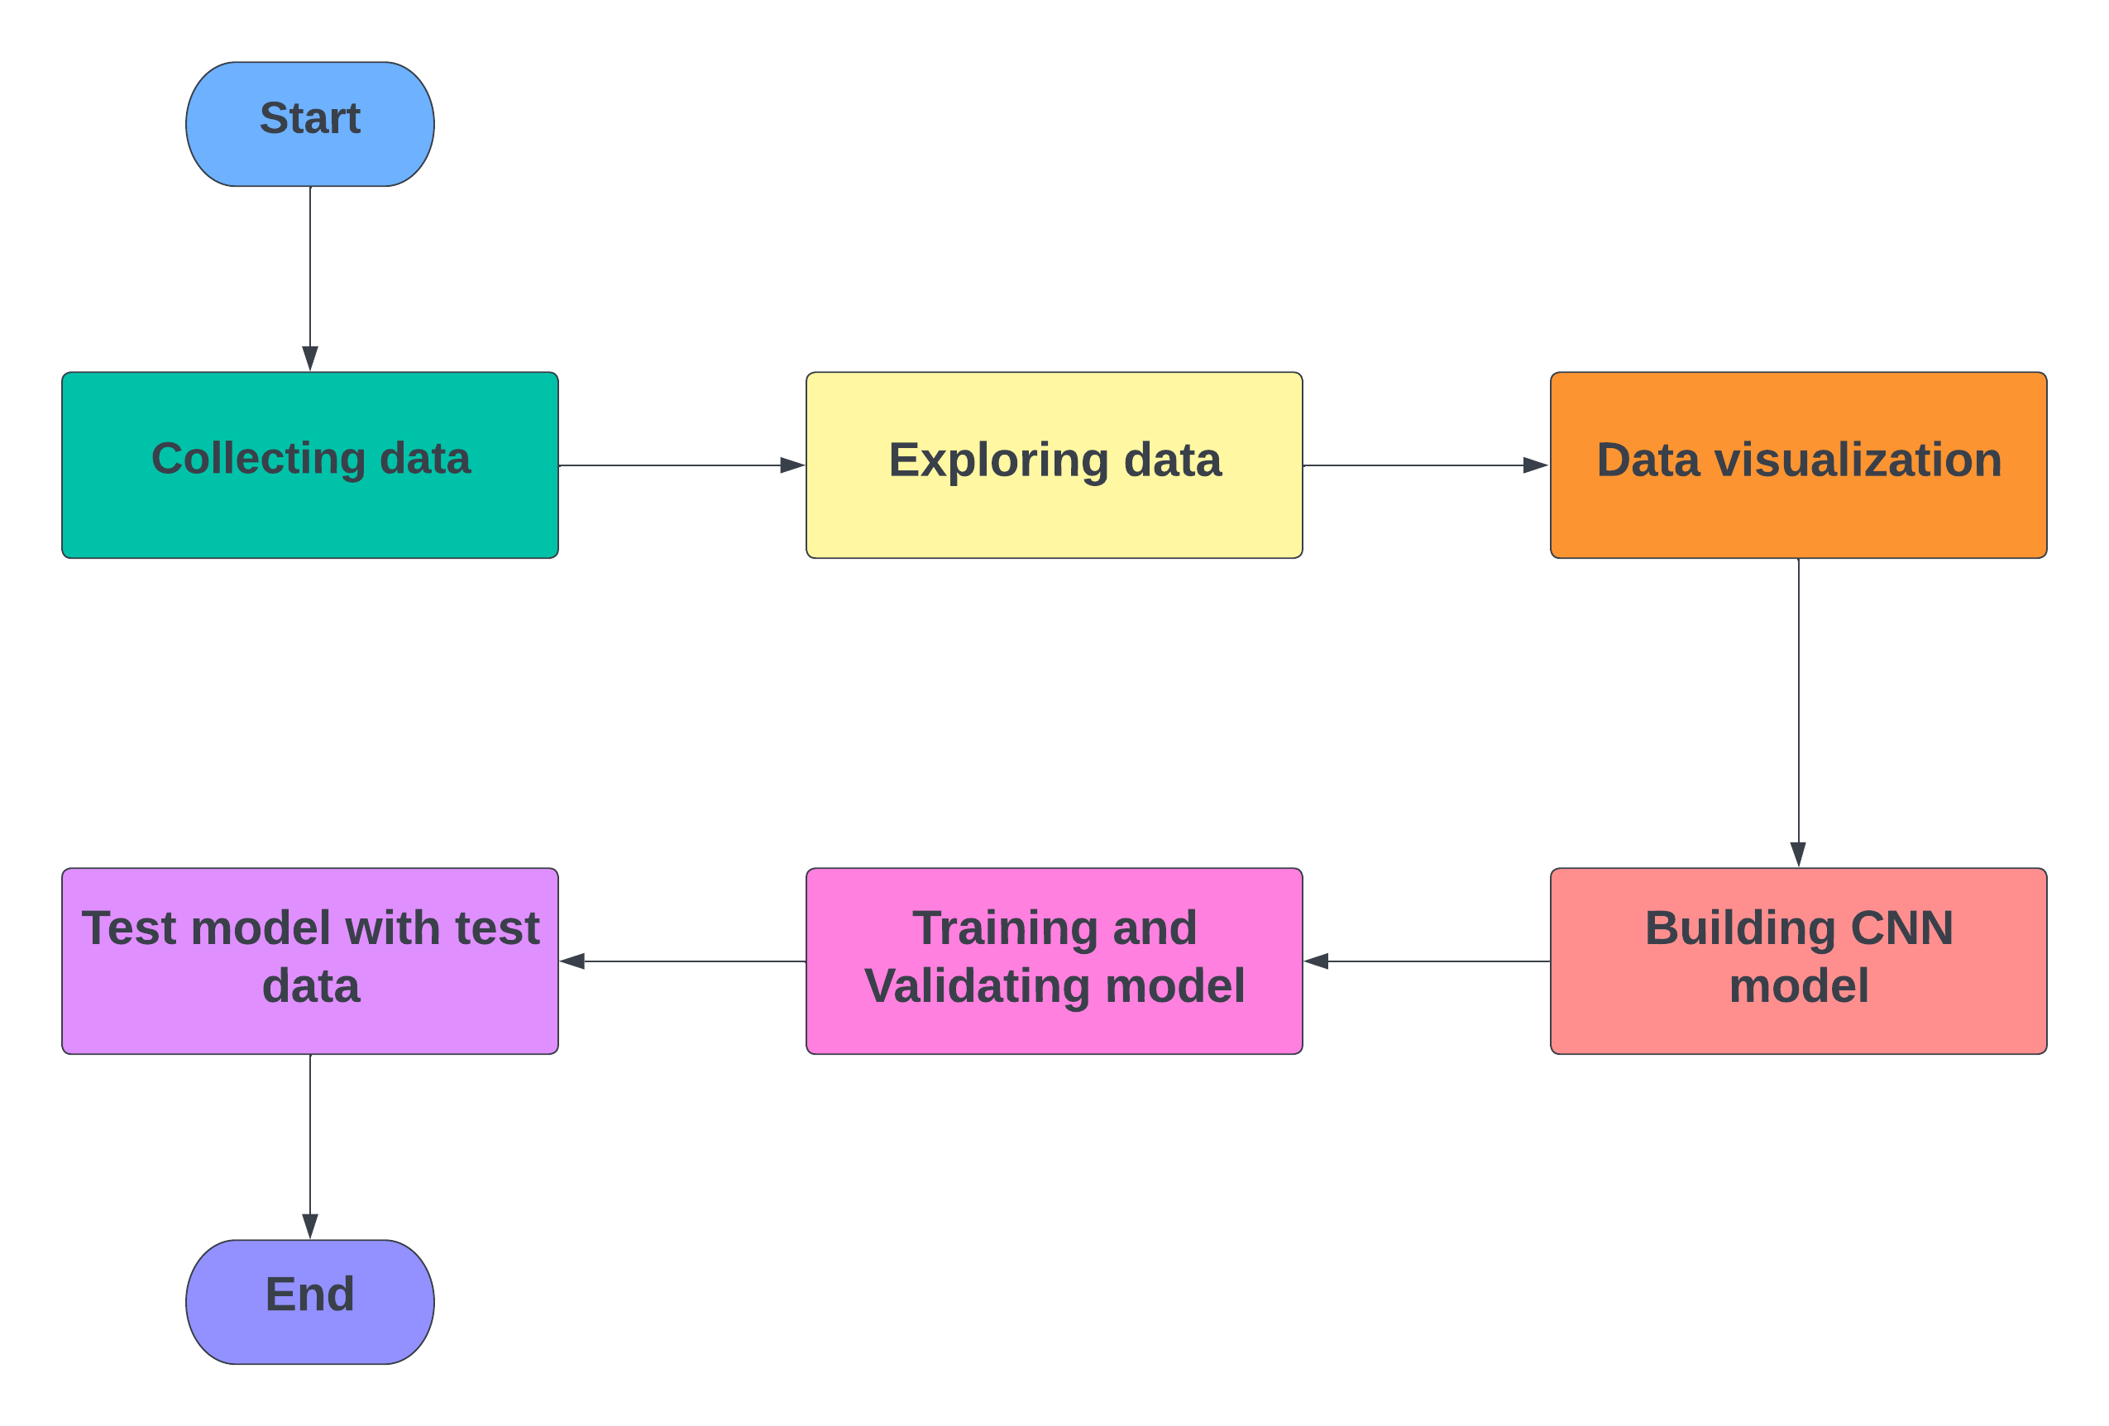
Workflow:

Slide 7
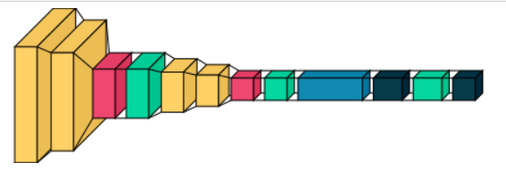
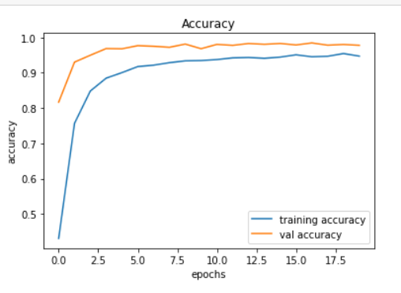
CNN (2 Layers) Architecture:
Input image
Kernel
Stride
Padding
Pooling
Flatten

Slide 8
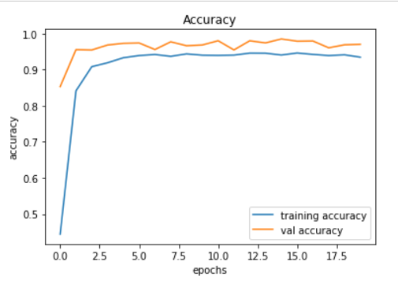
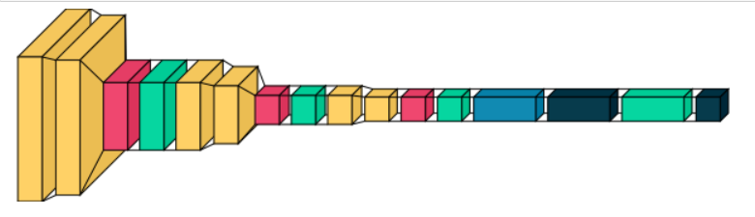
CNN (3 Layers) Architecture:

Slide 9
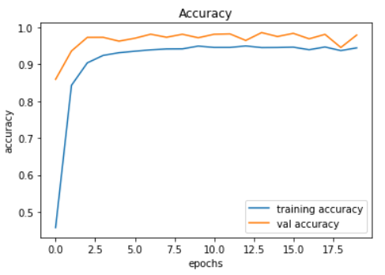
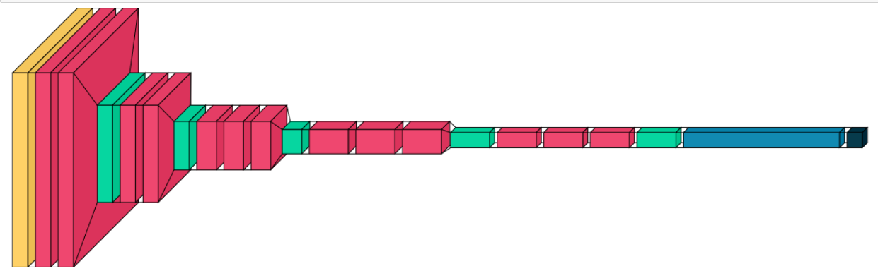
VGG-16:

Slide 10
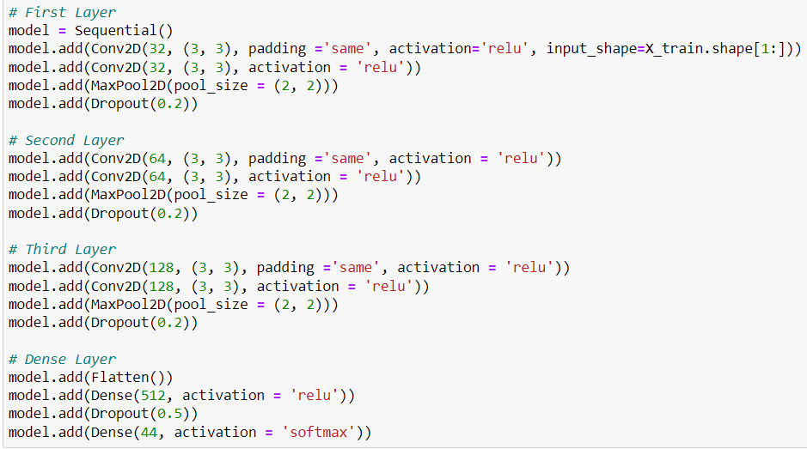
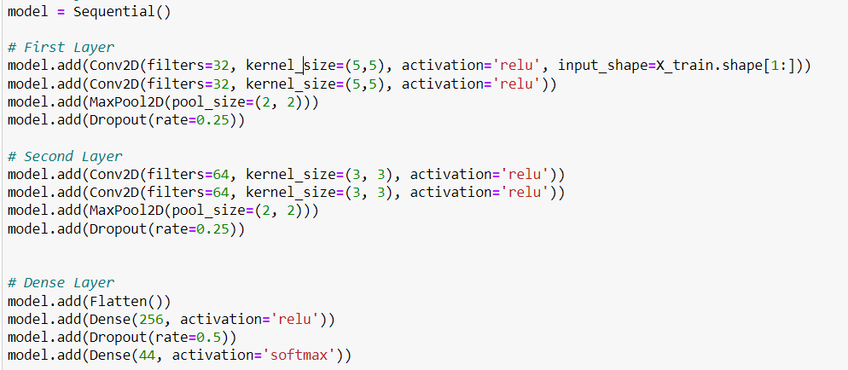
Demo Codes:

Slide 11
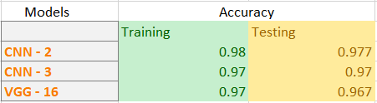
Models Evaluation:

Slide 12
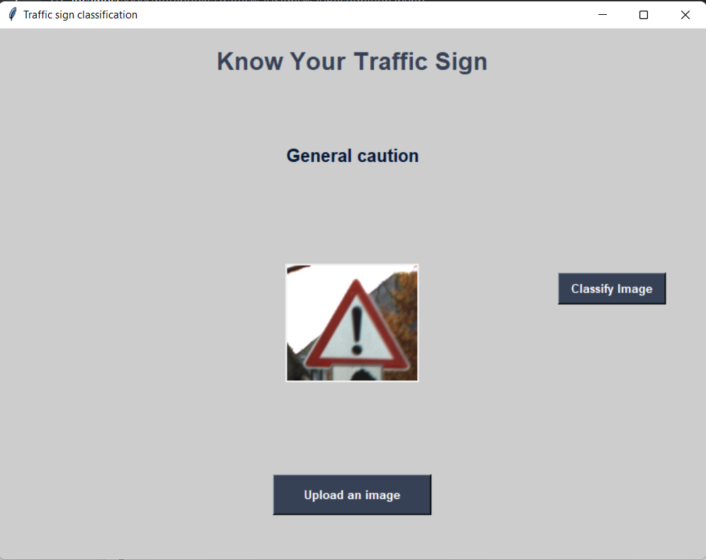
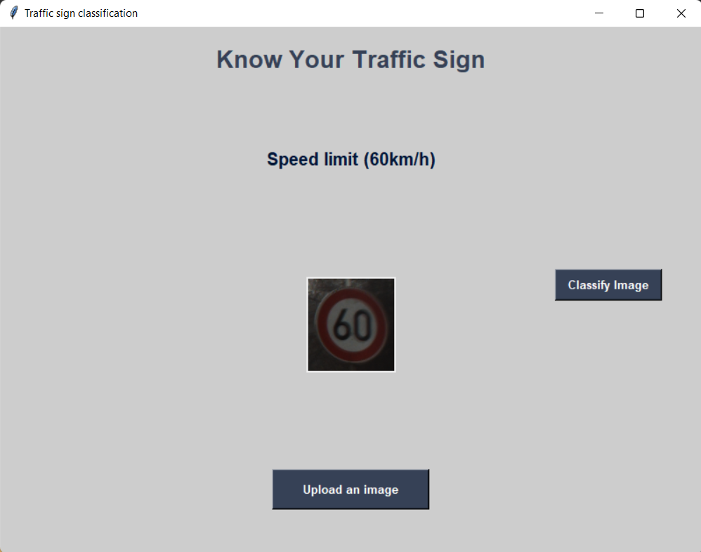
Results:

Slide 13
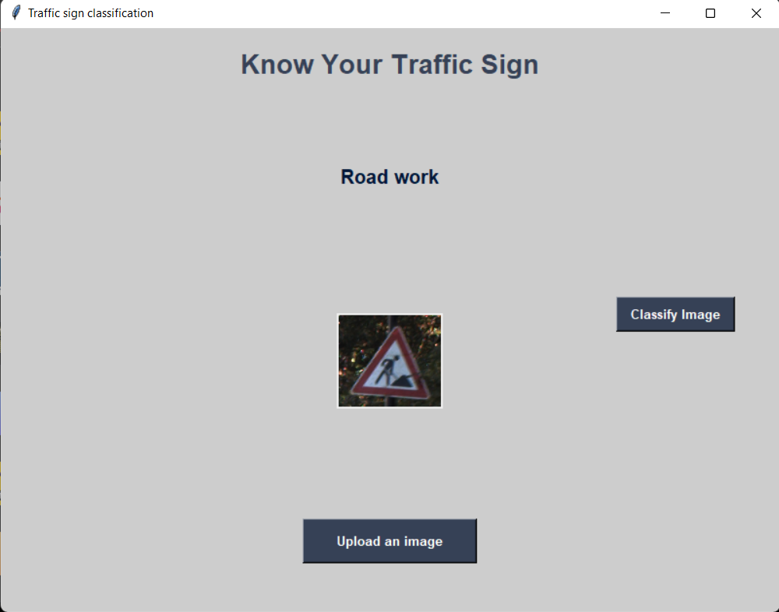
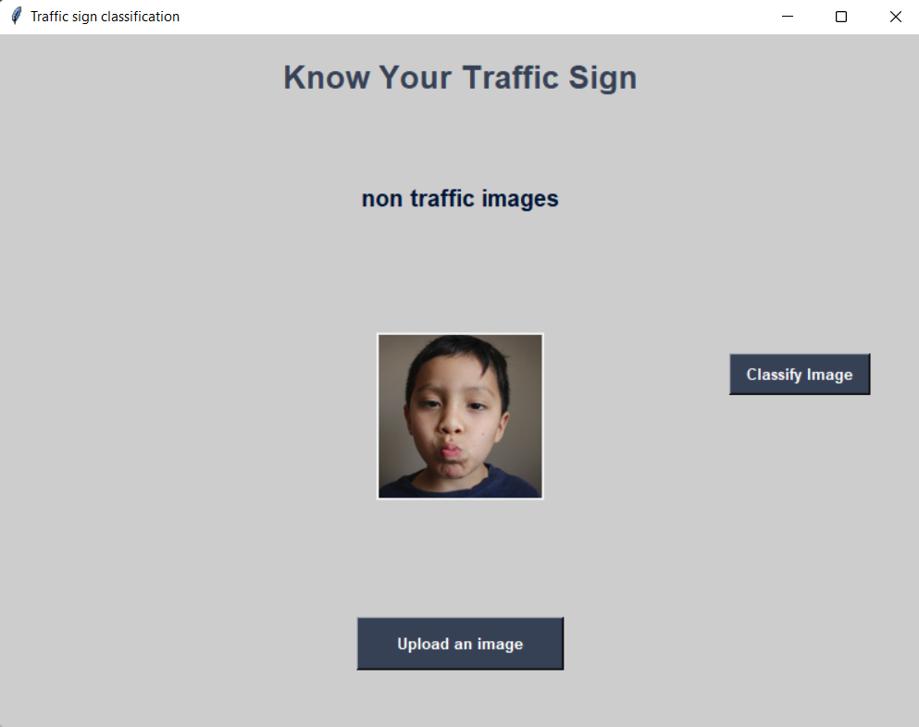
Results:

Slide 14
Conclusion:
In this project, we demonstrated and developed a traffic sign recognition system using different models of deep learning models.
We have successfully classified the traffic signs classifier with 3 different models of accuracies.
For CNN(2 Layers)-97.7%
For CNN(3 Layers)-97%
For VGG-16-96.7%

Slide 15
Future Scope:
Our classification does a pretty good job at accurately detecting traffic signs, but we wish to improve our accuracy and get yet better result.
We also intend on expanding our database to make our application available on a global level.

Slide 16

Thank You

