Slide 1
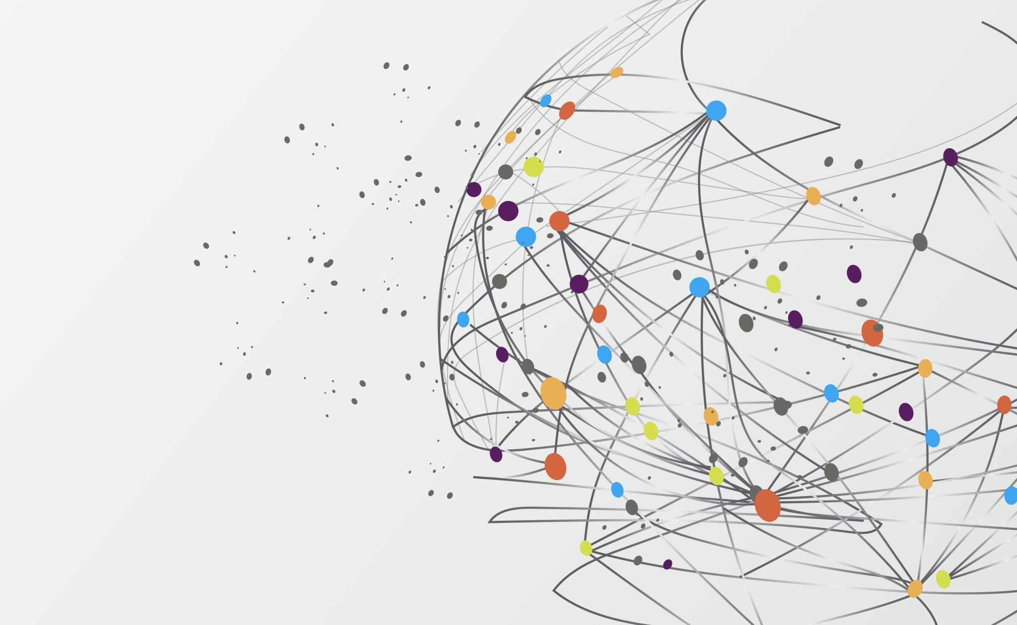
Lung Cancer Detection using Image Processing

Slide 2
Team members B Rupendra Reddy
D Sai Tharun Reddy
M C Sandeep Preetham
under the guidance of
Dr . Suja P.

Slide 3
Content
Introduction
Methodology
Implementation
Results

Slide 4
Introduction
Cancer is the most prevalent terminal disease globally and lung cancer is the second most common cancer in both men and women.
About 13% of new cancers are lung cancer, accounting for an estimated 10.6 million deaths in 2020.
In recent years, the people showing the symptoms of lung cancer can be detected by a test is known as a CT scan
CT scanner takes many detailed pictures or images of the internal organ which are combined by computer into the image of slices of the part of the body in which few nodules or the non-pathological structures

Slide 5
Methodology
The proposed methodology we used is explained step by step as given below:-
Preprocessing
Histogram equalization
Segmentation
Morphological operations
Filtering
Dilation
Filling
Feature Extraction
Classification

Slide 6
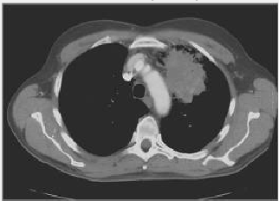
Pre-processing:
CT scan image is taken as the input and convert it into the grey scale image.
Image quality is affected by noise, motions so pre-processing is done basically for the better-quality images

Slide 7
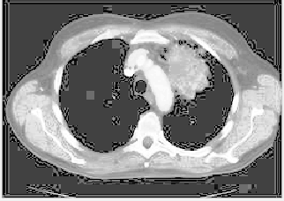
Histogram Equalization:
It is a method that uses an image’s histogram to adjust the contrast in image processing.
Histogram of chest CT scan input image consists of peak and valleys representing different regions of the lungs which are equalized and a clear, crisper image with sharp borders and edges is obtained.

Slide 8
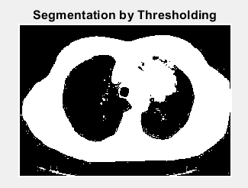
Segmentation:
In these step the image is converted into a binary image or black and white image. As the binary image is a digital image and its pixels can be represented in 0 and 1 which are two discrete levels. Level 1 indicates the presence of data that is white colour and level 0 indicates the absence of the data that is black colour.
The segmentation of the CT scan input image is done by removing those pixels which are below or above the constant level called discrete level (threshold value).

Slide 9
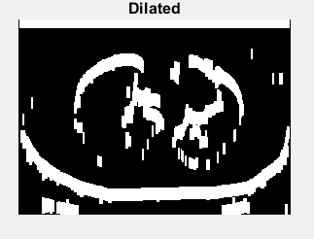
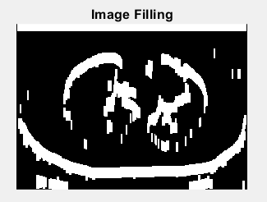
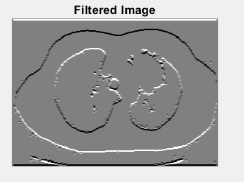
Morphological operations
The morphological operations are performed before feature extraction. These operations are used to extract the image components which are useful in the description of region shapes and give better representation.
The operations done in these are filtering, image filling, and Dilation.

Slide 10
GLCM(Gray level Co-occurrence matrix):
The extraction of the texture features using GLCM has been considered as the significant technique and it has been used in several applications of remote sensing for analysis of the texture.
GLCM exhibits how the pixel brightness occurs in an image.
GLCM texture picks up the relation between two pixels at a time, called the Neighbour and the reference pixel. GLCM calculates the distance and angular spatial relationship over an image sub- region of specific size. GLCM is prepared by using gray scale values.

Slide 11
GLCM(Gray level Co-occurrence matrix):
The extraction of features is done as the follows:
1. Divide the planes of the image into RGB
2. Calculate the matrices of GLCM as per given equation.
3. Calculate the geometric features for the obtained GLCM matrix:
Energy, Contrast, Entropy, Homogeneity.

Slide 12
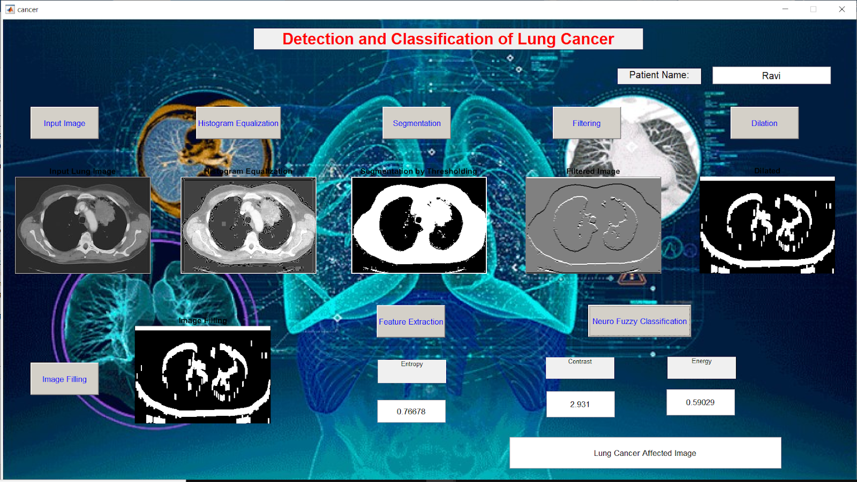
Feature Extraction
Entropy
Contrast
Energy

Slide 13
Classification:
For the classification of the input images, a deep learning method is used that is a class of deep neural networks known as CNN (convolutional neural network).
The input image is fed into the network which consists of different layers including the input layer, hidden layer, and the output layer.
The hidden layer consists of multiple layers it including the convolutional layer, pooling layer, ReLU (rectified linear unit) layer (it is an activation function), and fully connected layer in them.
The network processes the features, and the fully connected layer provides the classification and categorizes the tumor-affected images and the normal images.

Slide 14
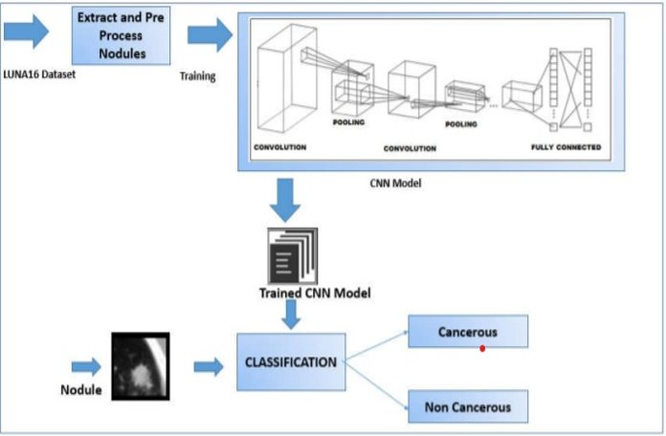
Block Diagram

Slide 15
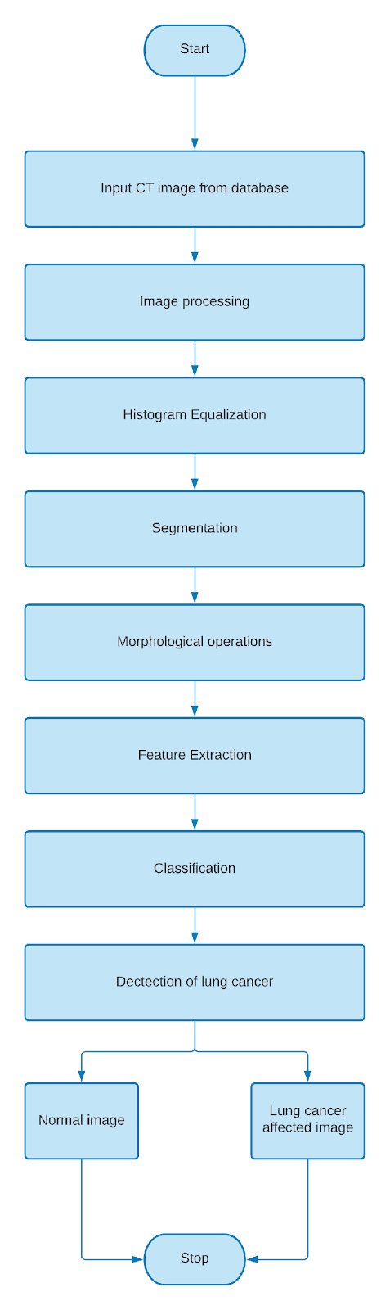
Flow Chart

Slide 16
Result

Slide 17
Conclusion and Future Work:
Image processing techniques are widely used in some medical areas for image improvement in earlier detection and treatment stages, where the time factor is very important to discover the abnormality issues in target images
The approach of GLCM and CNN will be used in this project work for localizing and characterizing cancer portion from the CT scan image.
The proposed approach is implemented in MATLAB and results are analyzed in terms of accuracy, sensitivity, and specificity.
For future work, the proposed methods can also be applied to some other cancer types like brain tumors, skin cancer, stomach cancer, breast cancer, etc.

Slide 18

.
Thank You

