Slide 1
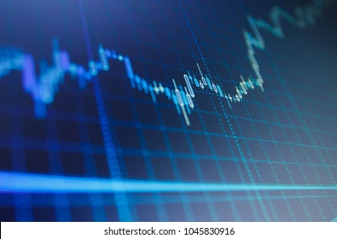
Done by : TEAM UTOPIA
B. Rupendra Reddy
D. Sai Tharun Reddy Sandeep Preetham MC
Stock Market Prediction Using Deep
Reinforcement learning​: Ensemble strategy

Slide 2
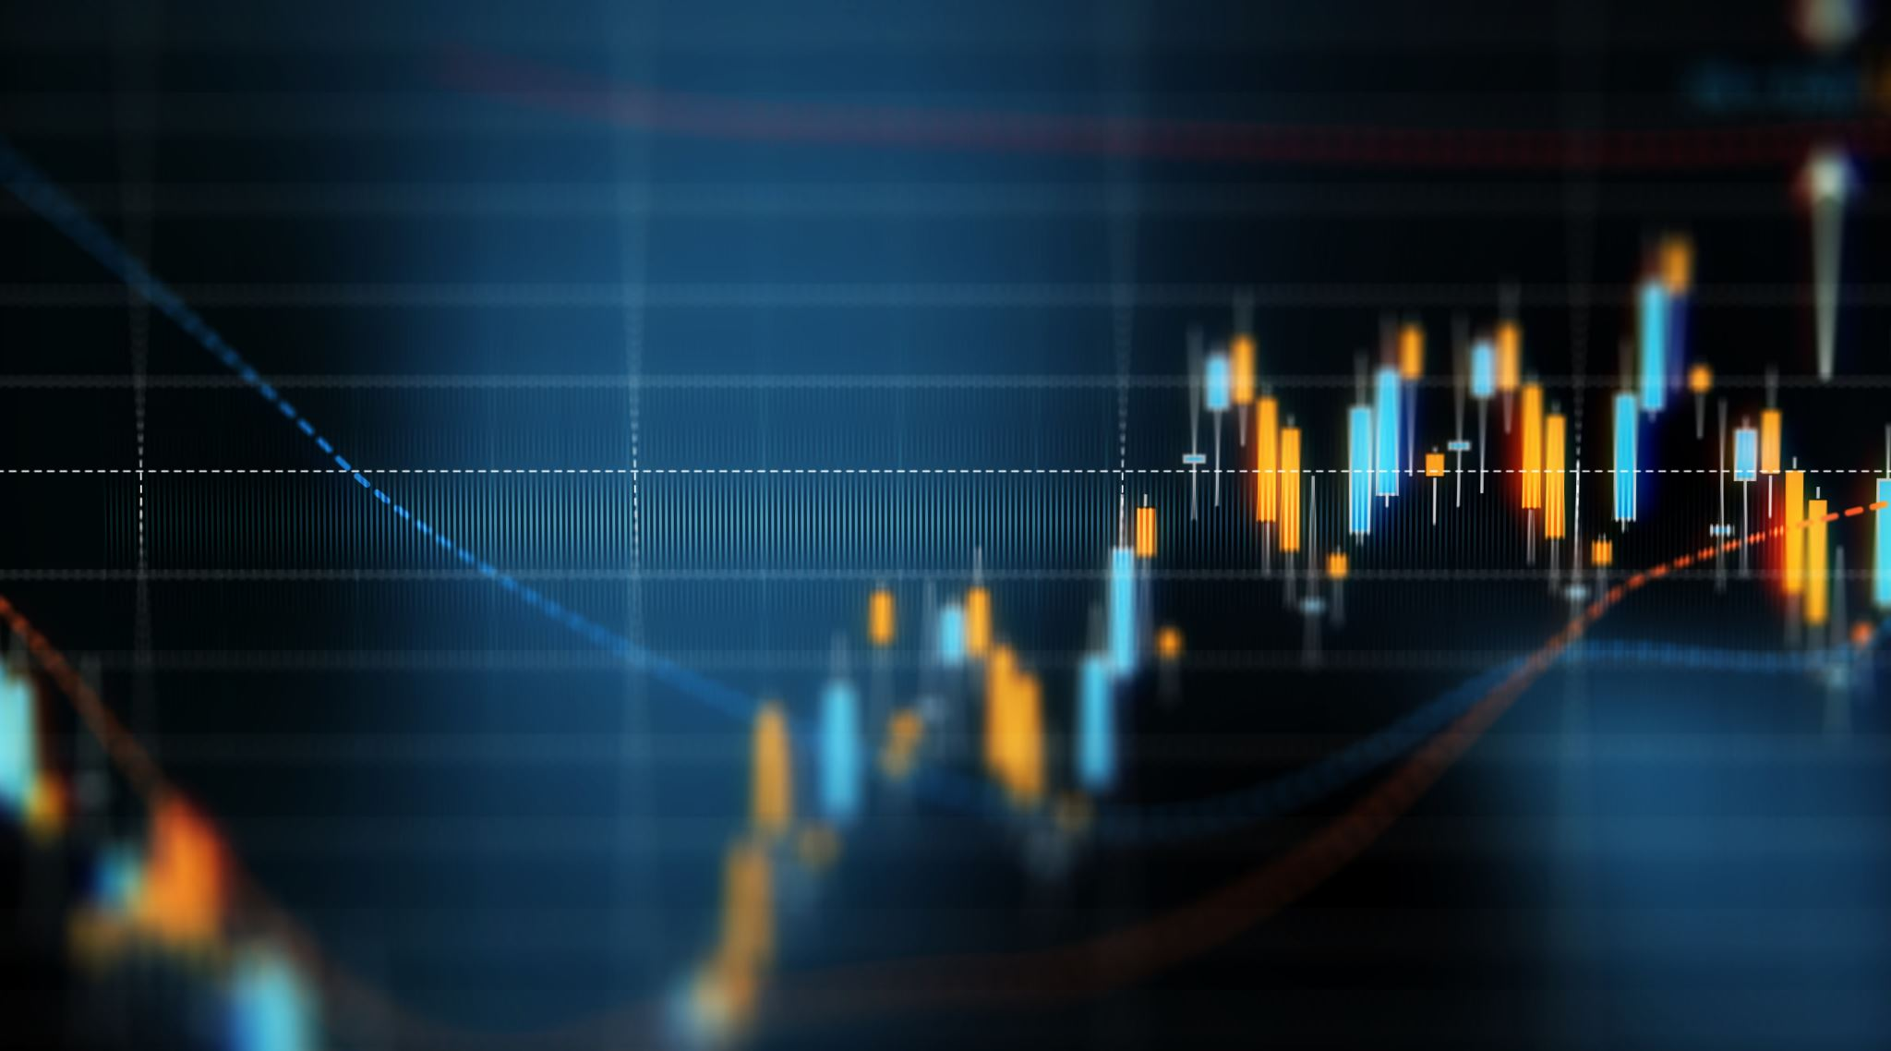
Problem Statement:
Our Problem statement is to build the Stock Market prediction model using Reinforcement learning and then we have to model stock trading as a Markov Decision Process (MDP) and formulate our trading objective as a maximization of expected return and then we have to Build an Ensemble Deep Reinforcement Learning Trading Strategy which includes three actor-critic-based algorithms. It further combines the best features extracted from the 3 algorithms so the agent can mold itself for the dynamic change in the environment.

Slide 3
Introduction:
The prediction of stock market movement is considered to be a challenging task due to the complexity of the stock market with its noisy and volatile environment.
Reinforcement learning solves the sequential decision-making problem and can be used to learn dynamic trading techniques in stock trading.
DRL tends to provide more profit with stock trading than traditional Reinforcement Learning.
The FinRL library also provides standard evaluation metrics in order to easily evaluate the performance of the automated stock trading.

Slide 4
Literature Survey:
FinRL utilizes a combination of value based, policy based, and actor-critic based algorithms to build the financial DRL models. These types of algorithms are also used by many other reinforcement learning libraries, such as:
- OpenAl Gym
- Google Dopamine
- RLlib
- Horizon
Automated stock trading is considered particularly difficult due to noisy and volatile features, and DRL can be used to help account for said volatility.
More information can also be accounted for by utilizing news headline sentiments and hedging strategies to improve upon the model further.

Slide 5
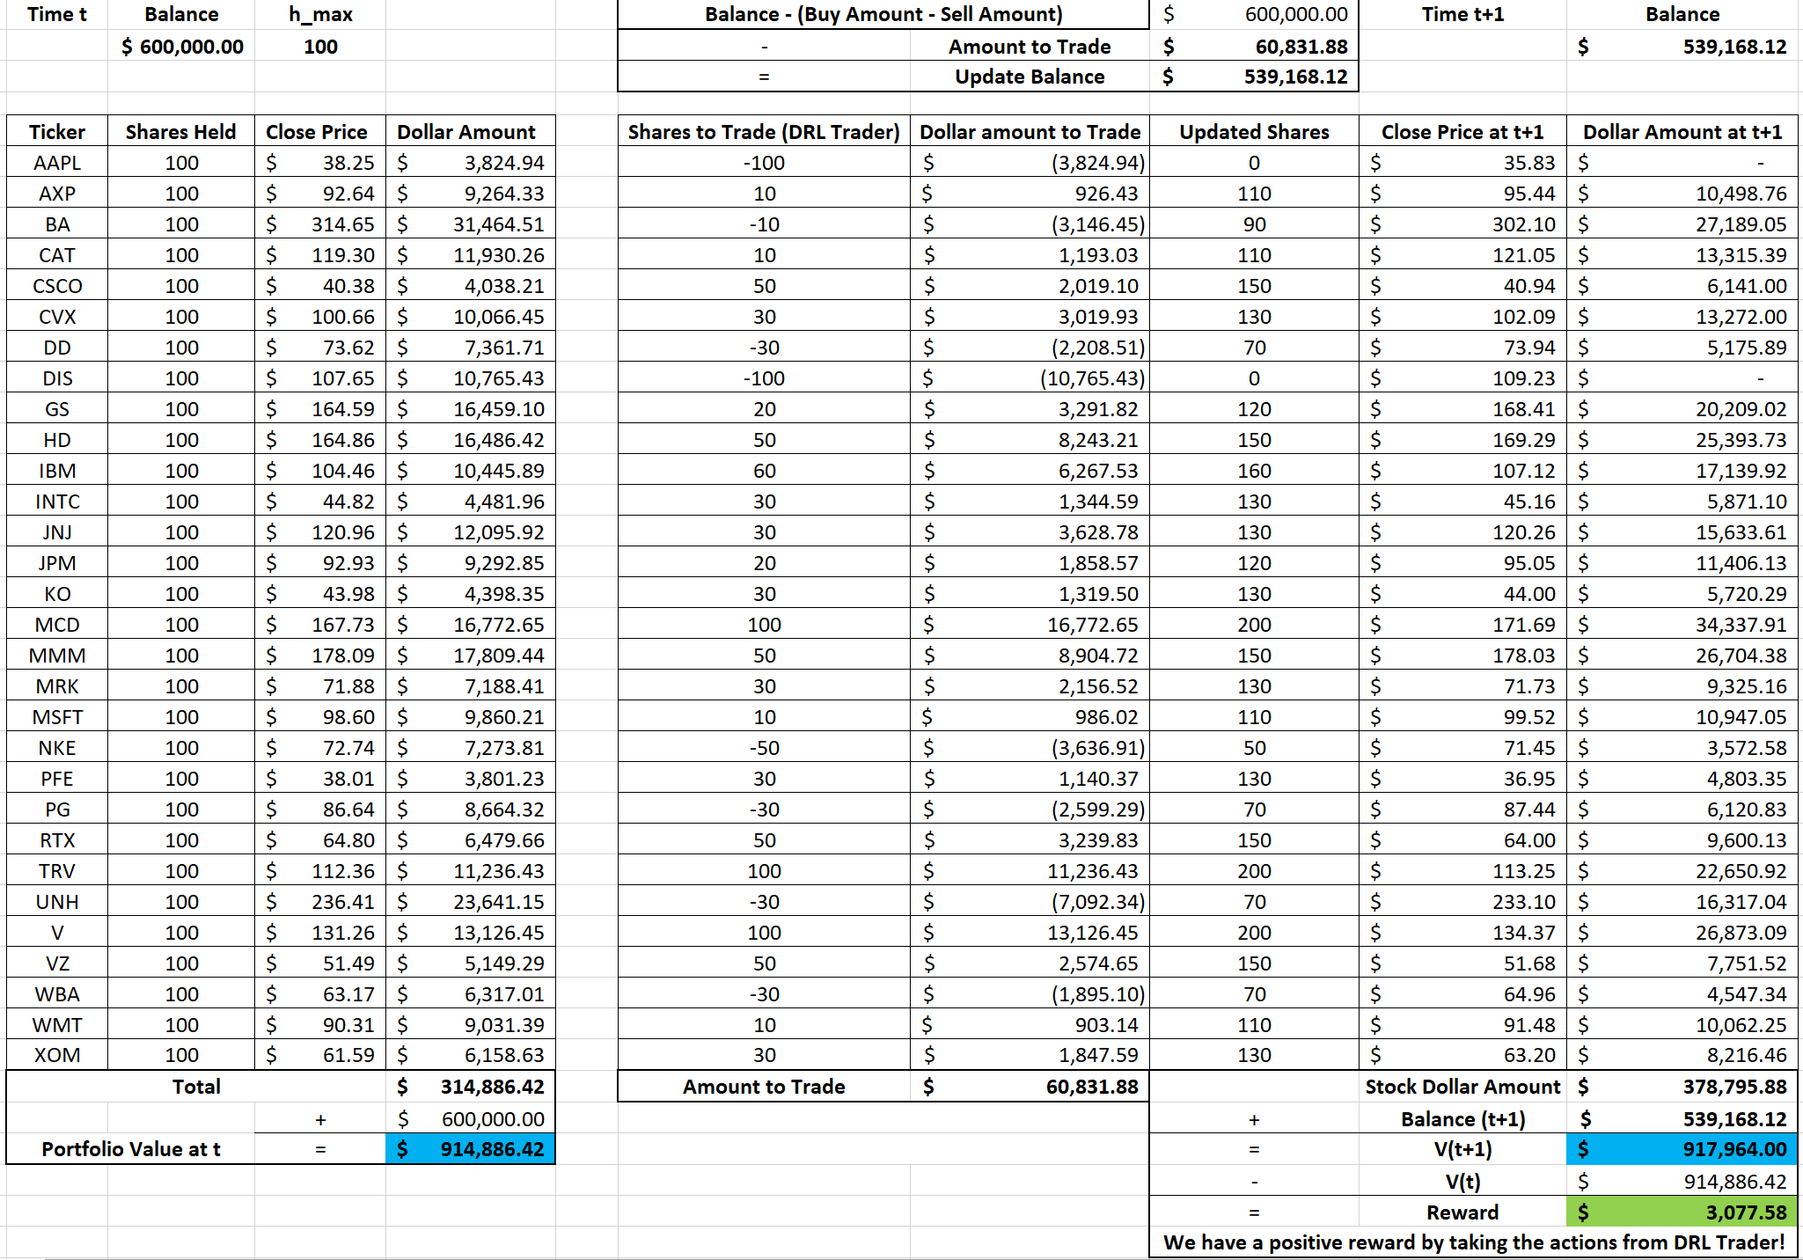
Environment:

Slide 6
RL Formulation:
Environment
Markov Decision Process (MDP)
Training the Model
Price Change
Actions
Adjustments to the strategy - rewarded to maximize profits
OpenAI Gym
Simulating real-time market data
Time-driven simulation
Built from six datasets across five stock exchanges

Slide 7
RL Formulation:
State Space
The observations from the environment
Options
Balance
Shares
Opening, closing, high, low, Price
Indicators
Granularity

Slide 8
RL Formulation:
Action Space
The allowed actions to take place within the environment
Options
Sell
Hold
Buy
Reward
Incentive to learn better actions
Options
Change in portfolio Arriving at a new state
Periods
User defined rewards

Slide 9
Gaps and Challenges:
RL formulation
Learning the architecture of the stock market with respect to RL
ensemble strategy for the three chosen Actor –Critic algorithms

Slide 10
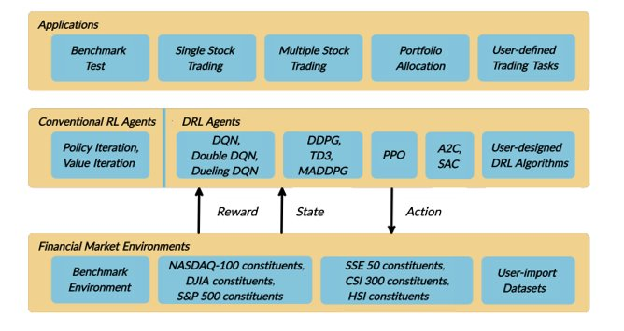
FinRL Architecture:
FinRL is an open-source library built by AI4Finance, whose main purpose was to serve quantitative finance.
The agent here interacts in an exploration-exploitation manner hoping to converge the epsilon value by the end of the training phase.
The lower layer provides APIs for the upper layer, making the lower layer transparent to the upper layer.

Slide 11
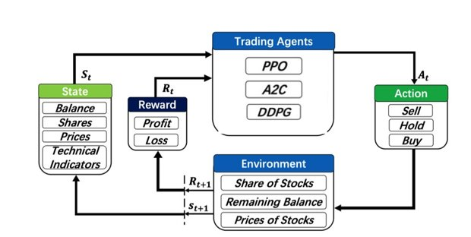
A high-level view of how FinRL construct the problem in DRL

Slide 12
RL Models:
FinRL library uses fine-tuned algorithms such as DQN, DDPG, PPO, SAC, A2C, and TD3 and more models.
We are going to implement these 3 different models provided by FinRL:
Advantage Actor Critic (A2C)
Deep Deterministic Policy Gradient (DDPG)
Proximal Policy Optimization (PPO)

Slide 13
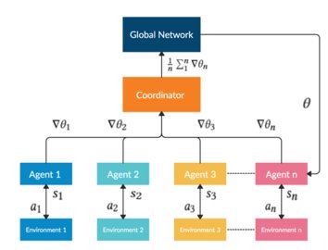
Advantage Actor Critic (A2C):
A2C is a typical actor-critic algorithm which we use as a component in the ensemble method.
A2C utilizes an advantage function to reduce the variance of the policy gradient.
Instead of only estimates the value function, the critic network estimates the advantage function.

Slide 14
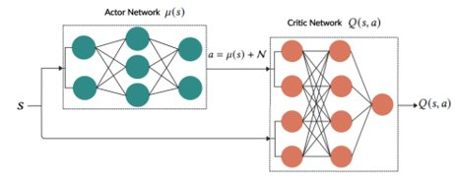
Deep Deterministic Policy Gradient (DDPG):
DDPG is an actor-critic based algorithm which we use as a component in the ensemble strategy to maximize the investment return.
DDPG combines the frameworks of both Q-learning and policy gradient and uses neural networks as function approximators.

Slide 15
Proximal Policy Optimization (PPO):
PPO is introduced to control the policy gradient update and ensure that the new policy will not be too different from the older one.
PPO improves the stability of the policy networks training by restricting the policy update at each training step.
We select PPO for stock trading because it is stable, fast, and simpler to implement and tune.

Slide 16
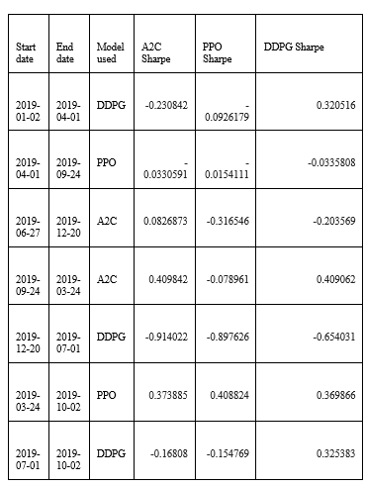
Ensemble Strategy:
Then, in order to construct a highly robust trading strategy for our model, we create our own ensemble strategy.
So, depending on the Sharpe ratio, we employ an ensemble technique to automatically choose the best performing agent among PPO, A2C, and DDPG to trade. The ensemble process is described as follows:

Slide 17
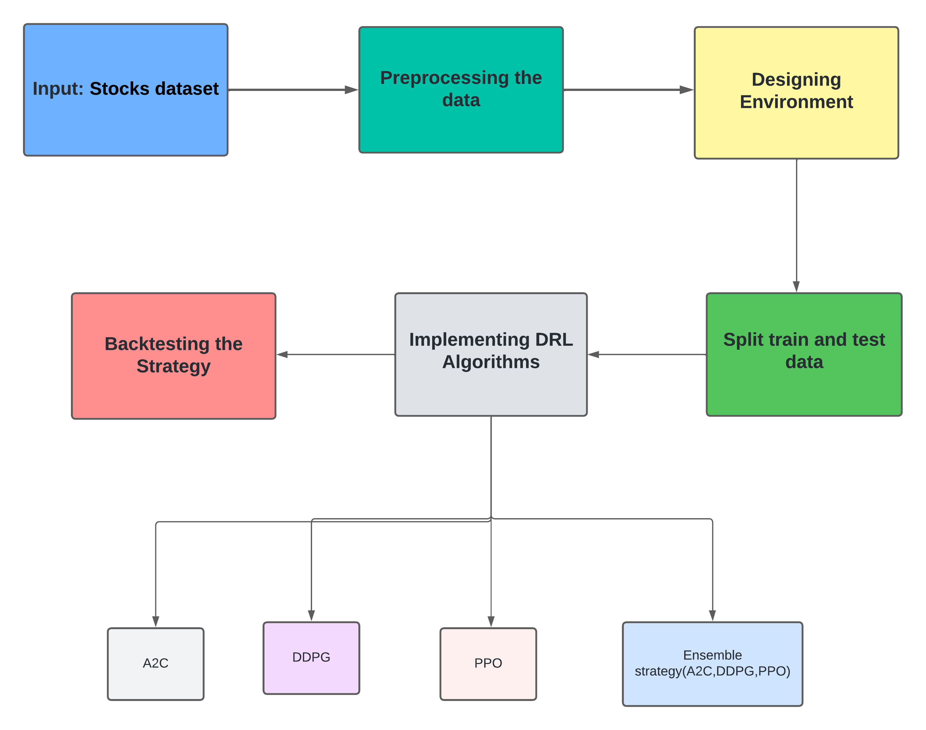
Implementation:

Slide 18
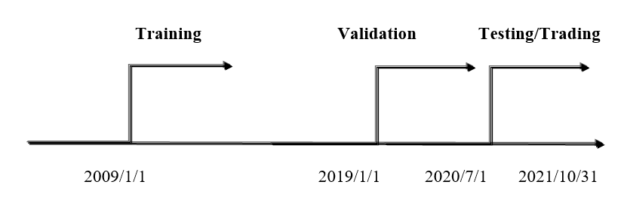
Training
Training set is a sample of data which fits to DRL model
Validation data is to perform hyperparameter tuning.
Test data is used to provide unbiased Evalution of a fine-tuned model.

Slide 19

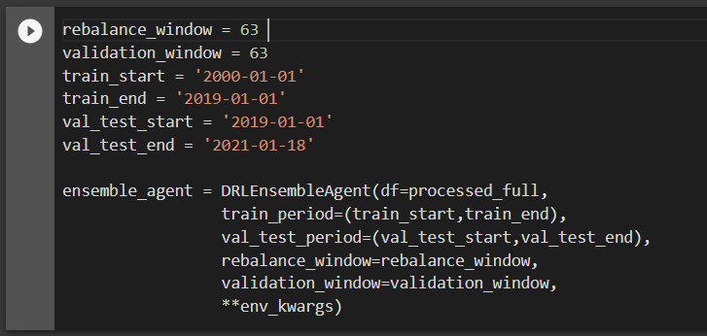

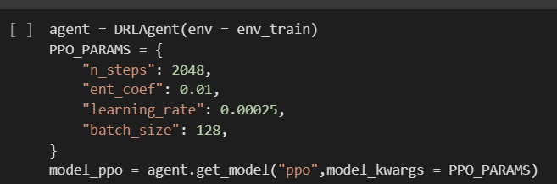
Demo Code:

Slide 20
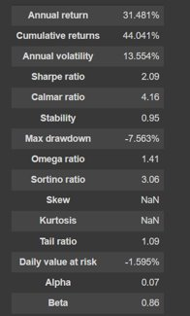
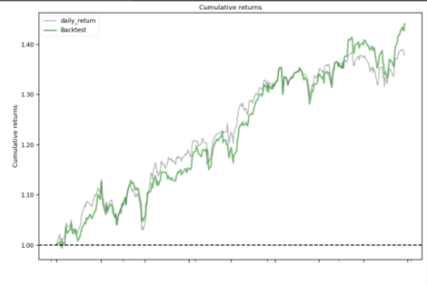
Results:

Slide 21
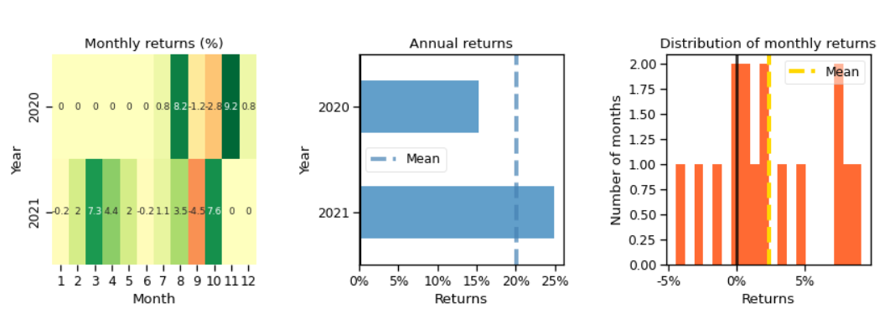
Results:

Slide 22
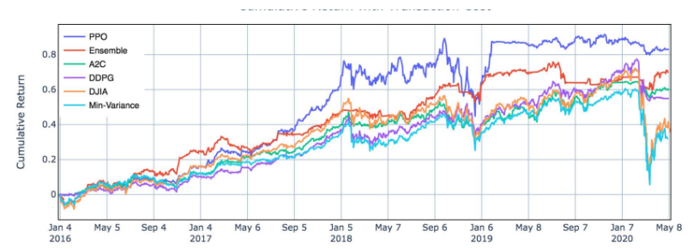
Results:

Slide 23
Conclusion:
We looked into the possibilities of using actor-critic-based algorithms to learn stock trading strategy.
The library provides automated training, validation, and testing in order to improve upon trading strategy techniques.
Each of the trading strategies implemented within the library can be used to demonstrate easily reproducible results.

Slide 24
Future Scope:
It will be interesting to research more complicated models; overcome empirical issues such as Deal with largescale data such as S&P 500 constituent stocks in future studies.
And also, more features for the state space can be added to our observations, such as an enhanced transaction cost and liquidity model, fundamental analysis indicators

Slide 25
References:
https://www.analyticsvidhya.com/blog/2021/01/bear-run-or-bull-run-can-reinforcement-learning-help-in-automated-trading/
https://ieeexplore.ieee.org/document/931880
https://www.analyticsvidhya.com/blog/2022/04/how-to-use-algorithmic-trading-with-machine-learning-in-python/

Slide 26
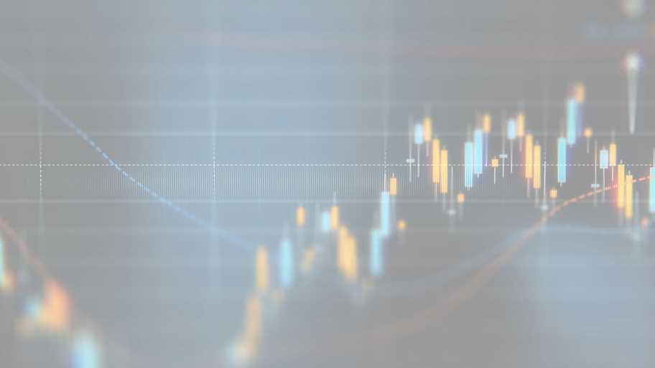
Thank You

