Slide 1
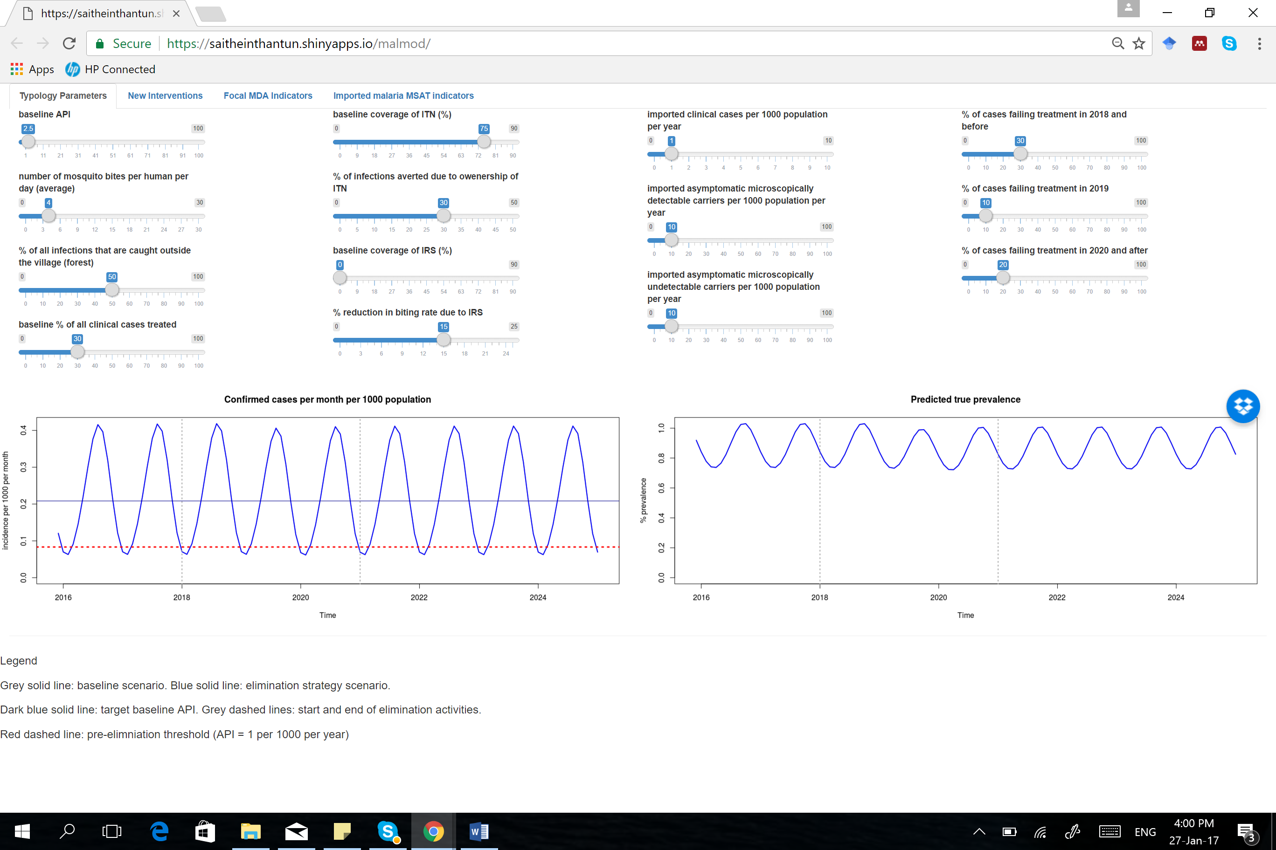
Pre-elimination threshold (1 case per 1000 per year)

Slide 2
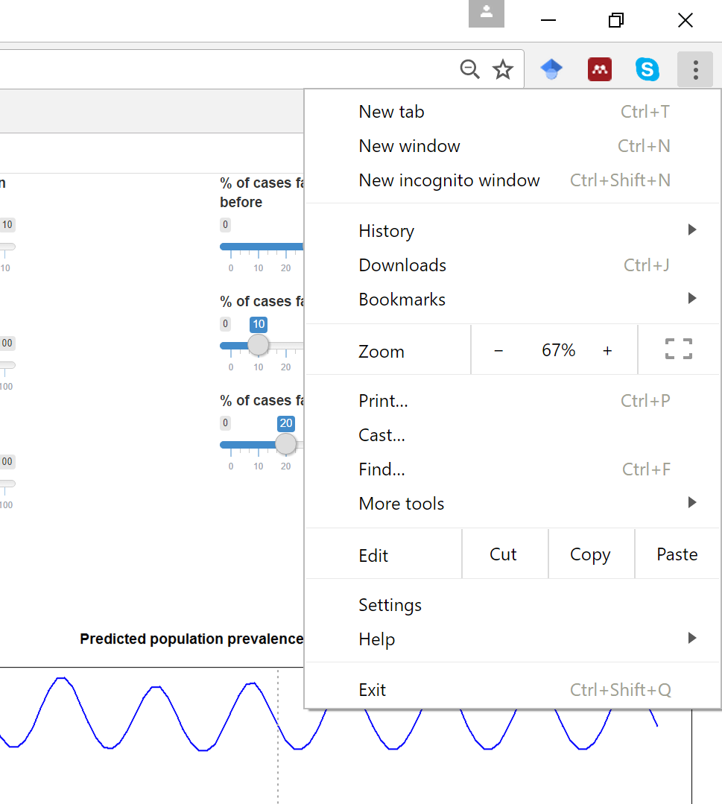
Zoom in or out

Slide 3
Increase biting
to shift predicted incidence up
Reduce biting
to shift predicted incidence down

Slide 4
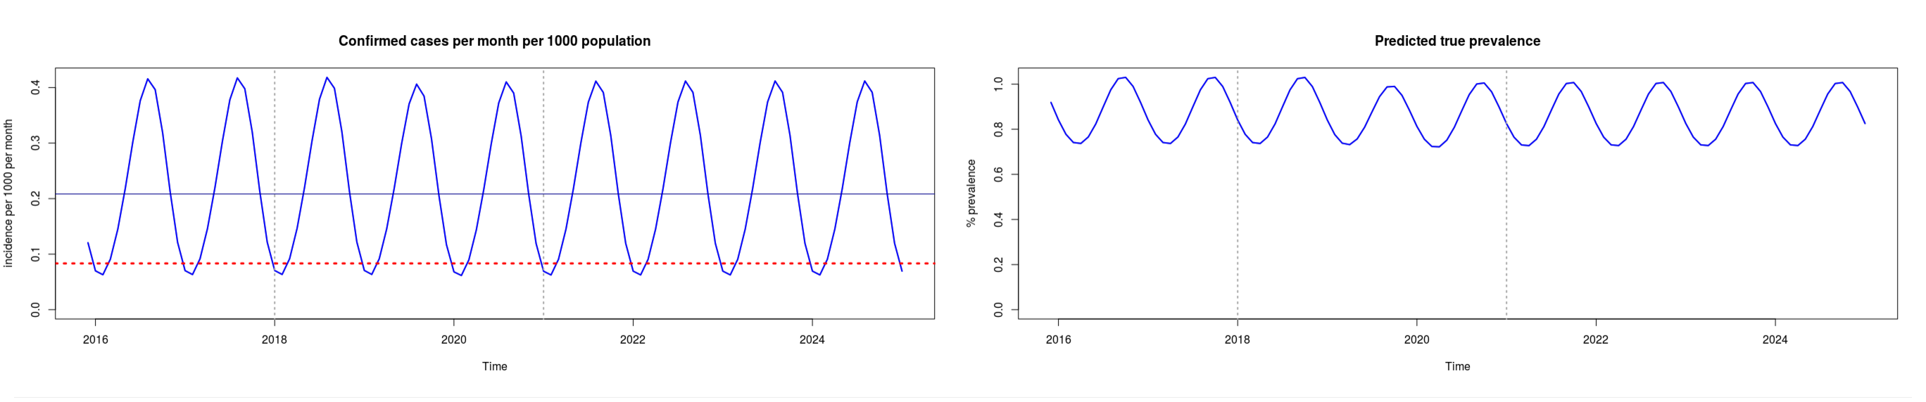
Graphs turn pale as the model runs

Slide 5
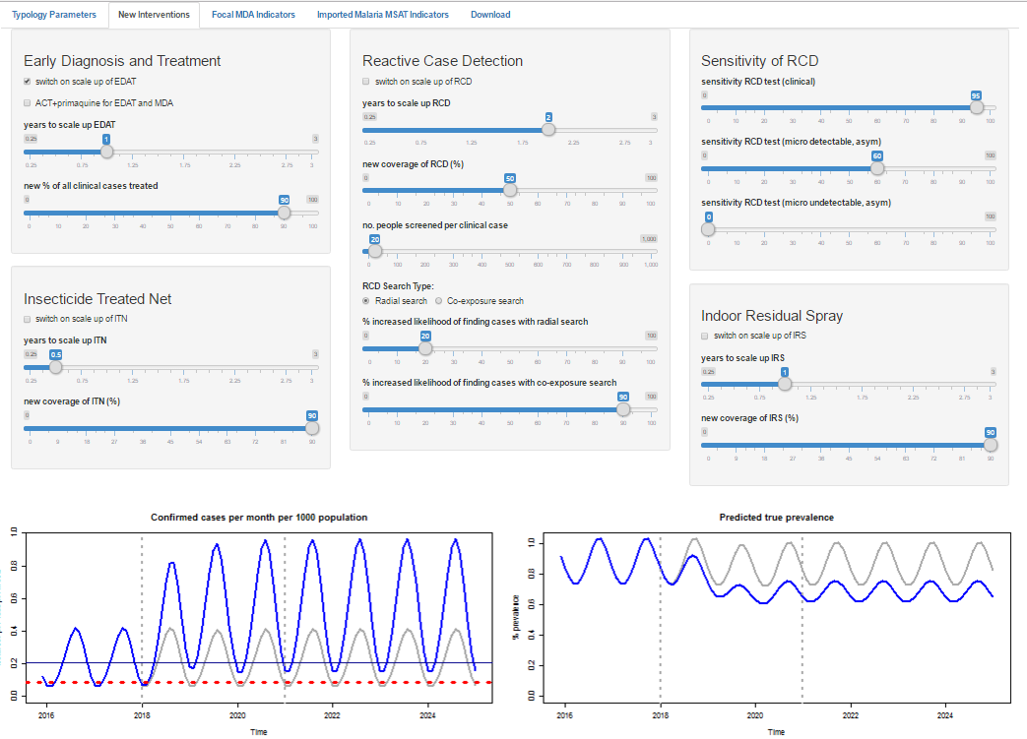
Prediction of the baseline strategy
Prediction of the new strategy

Slide 6
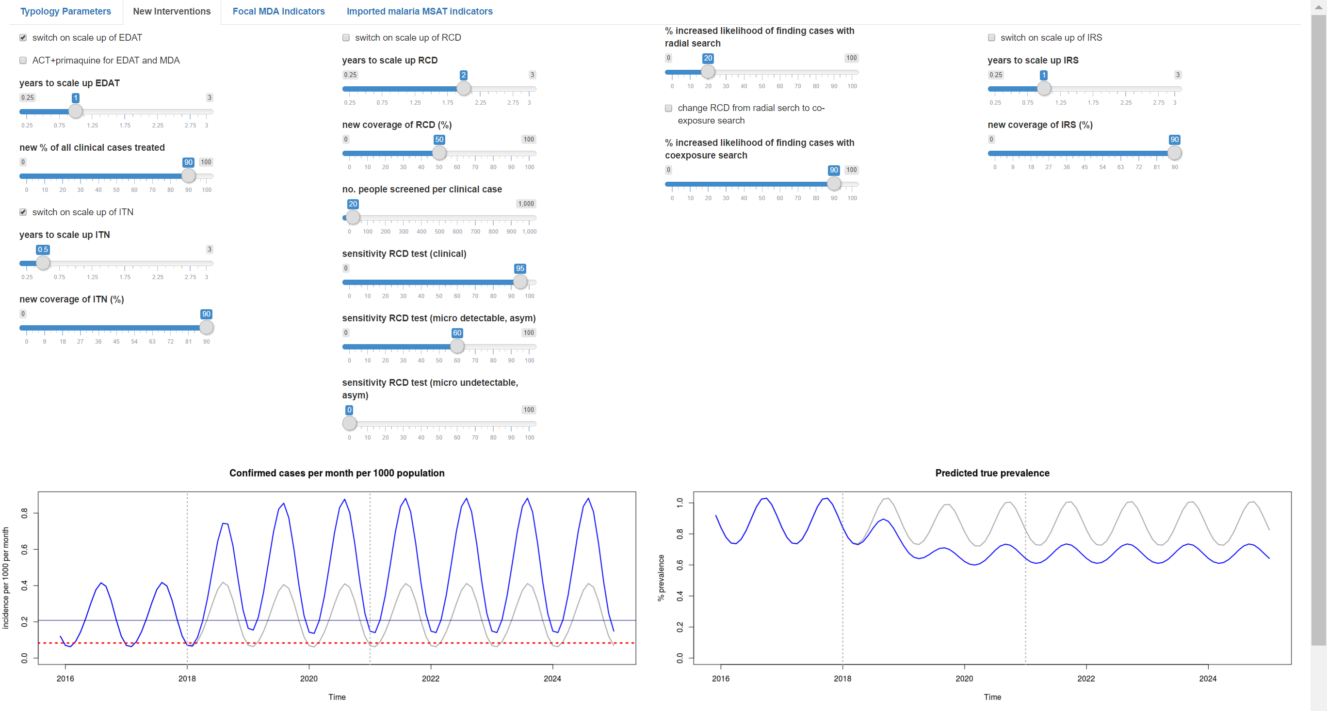
Prediction of the baseline strategy
Prediction of the new strategy

Slide 7
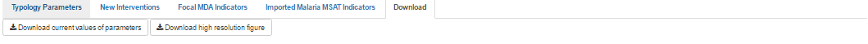
Download Tab
Download Buttons

Slide 8
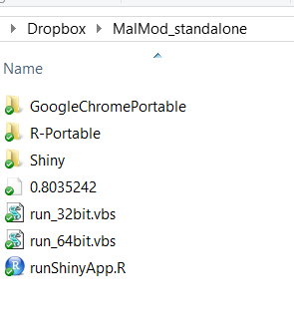
Double click one of these files depending on your computer version.
*It will not work if the wrong version is executed. Then you’ll need to restart your PC to make it work again!!

Slide 9
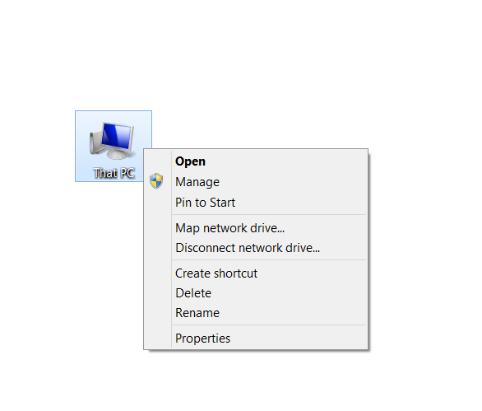

Slide 10
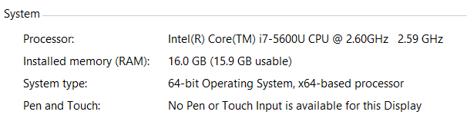
Run this file

Slide 11
Imported cases sliders

