Slide 1
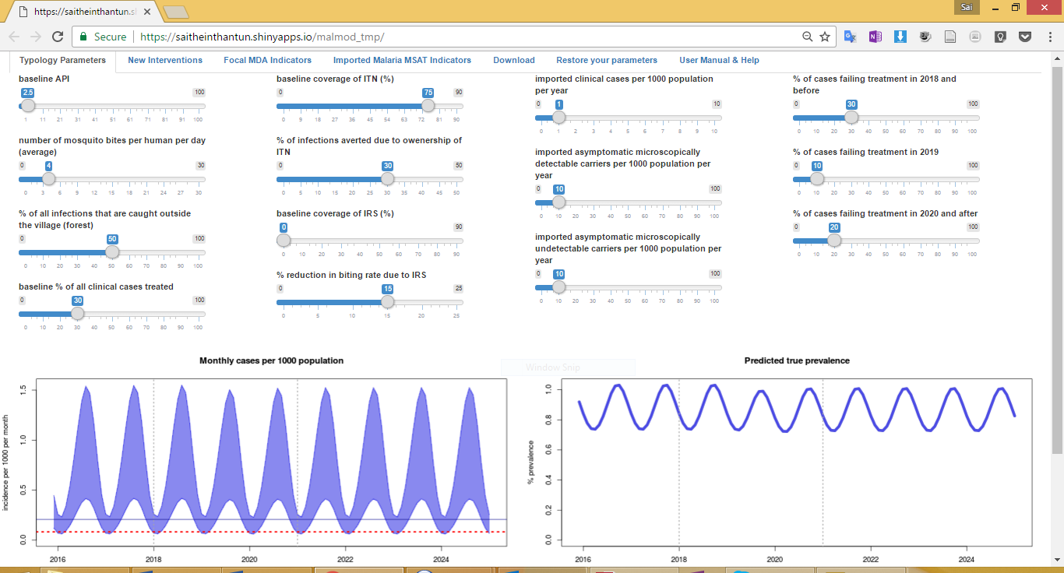
Pre-elimination threshold (1 case per 1000 per year)

Slide 2
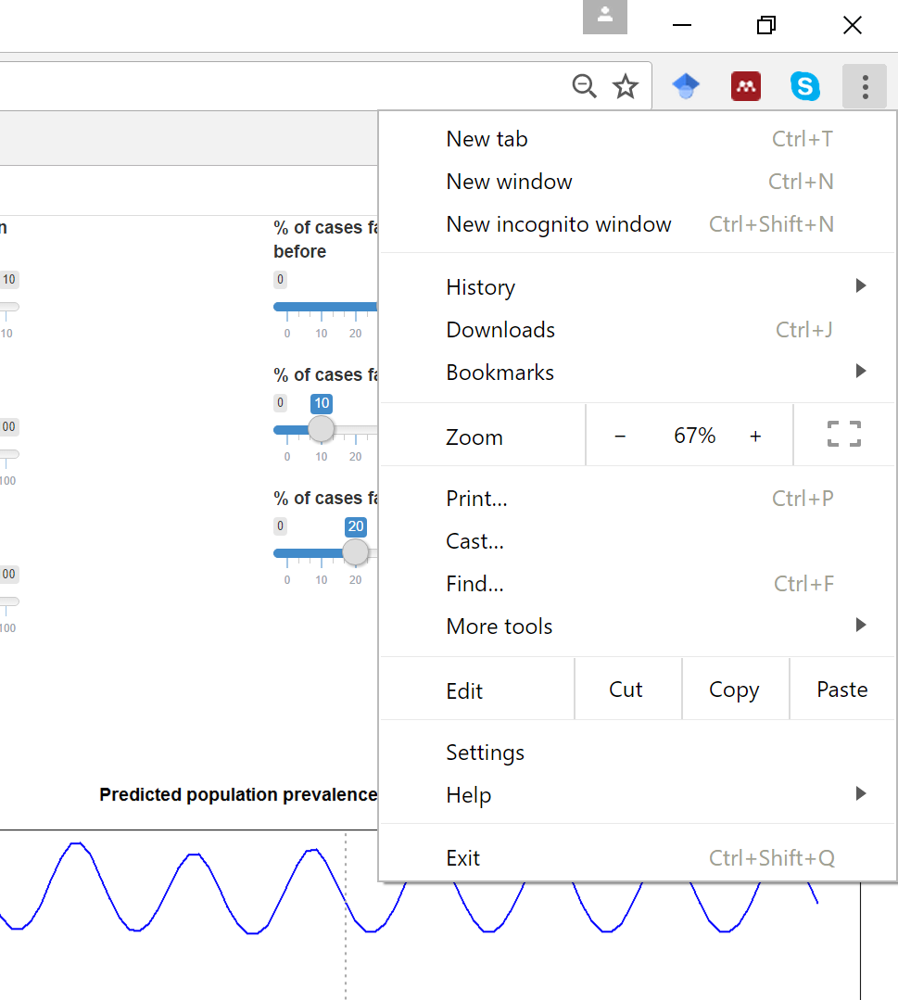
Zoom in or out

Slide 3
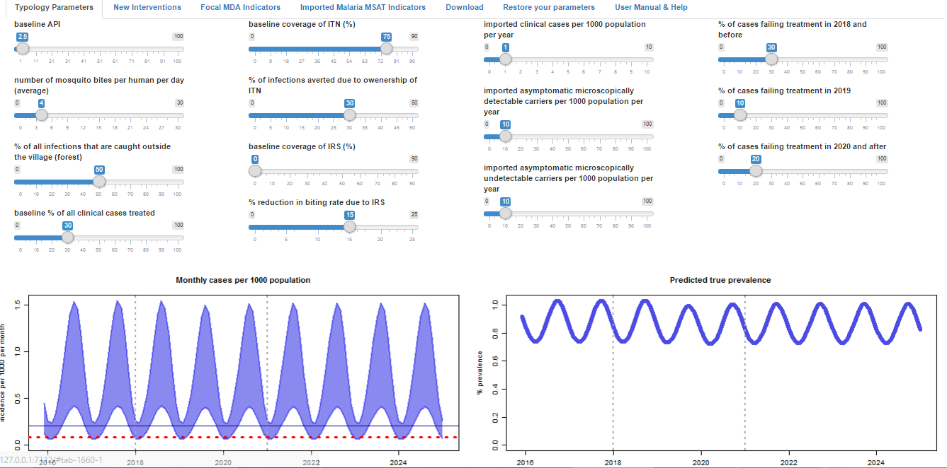
User-selected API converted to monthly cases
Monthly cases
% prevalence

Slide 4
Increase biting
to shift predicted incidence up
Reduce biting
to shift predicted incidence down

Slide 5
Imported cases slider

Slide 6
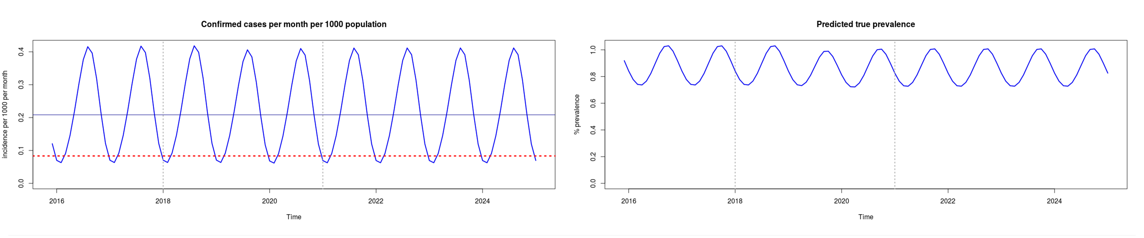
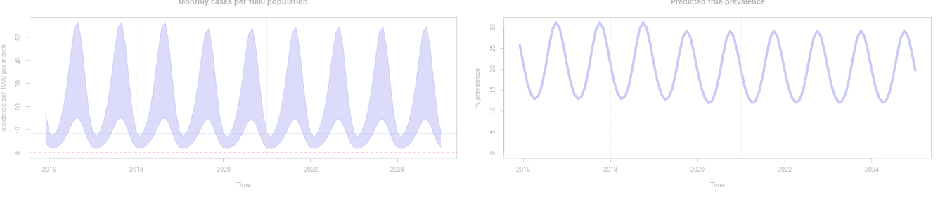
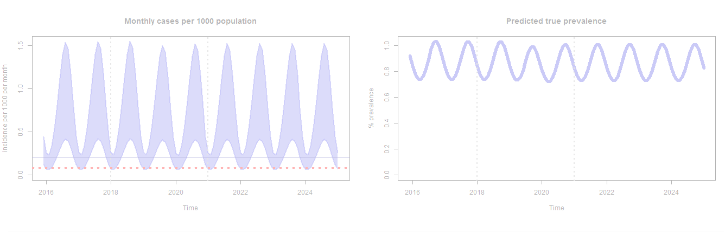
Graphs turn pale as the model runs

Slide 7
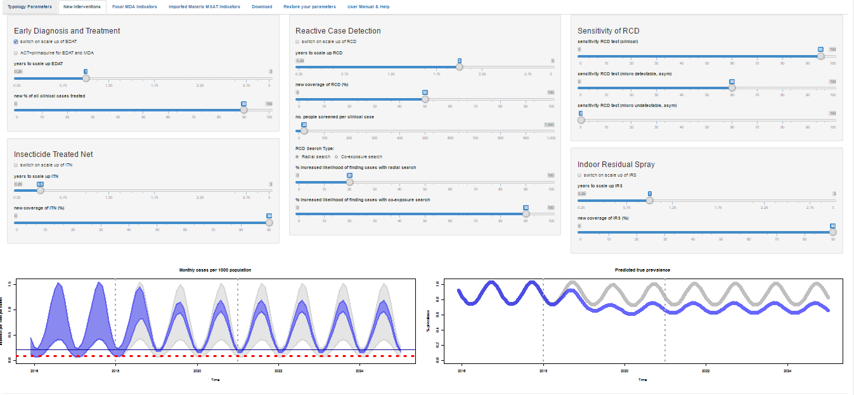
Prediction of the baseline strategy
Prediction of the new strategy

Slide 8
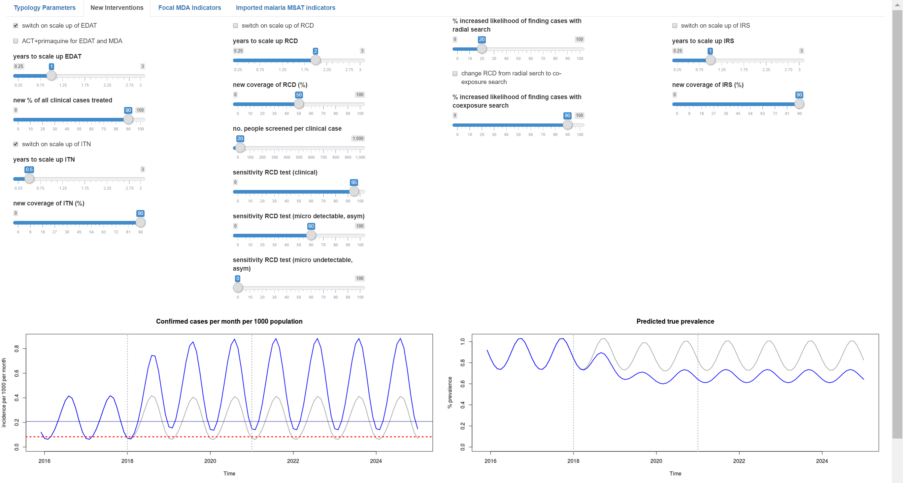
Prediction of the baseline strategy
Prediction of the new strategy

Slide 9
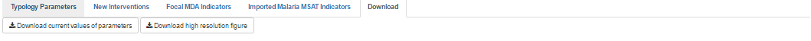
Download Tab
Download Buttons

Slide 10
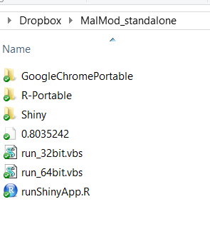
Double click one of these files depending on your computer version.
*It will not work if the wrong version is executed. Then you’ll need to restart your PC to make it work again!!

Slide 11
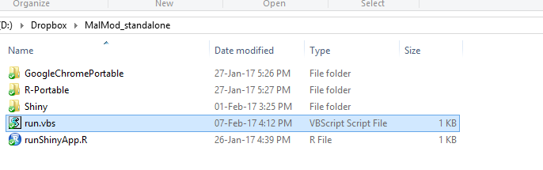
Double click this “run.vbs” file will open up the application.

Slide 12
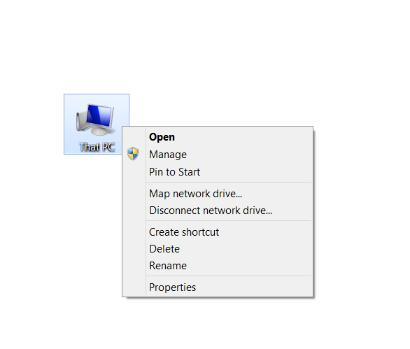

Slide 13
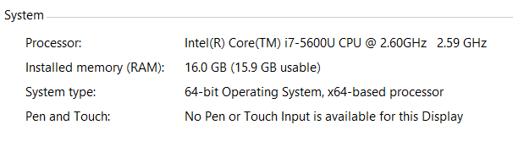
Run this file

Slide 14
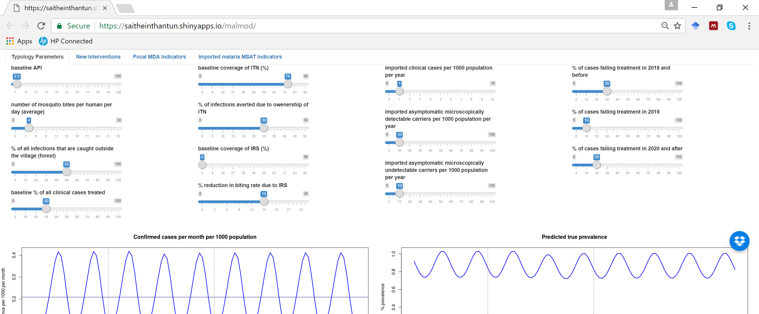
Imported cases sliders

Slide 15
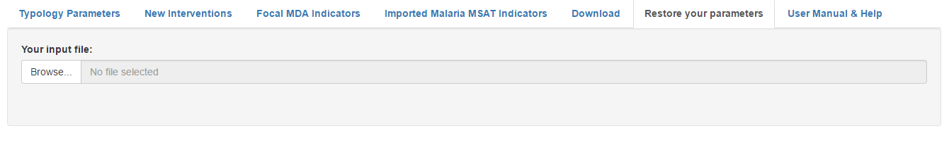
1. Click on this tab
2. Click Browse

Slide 16
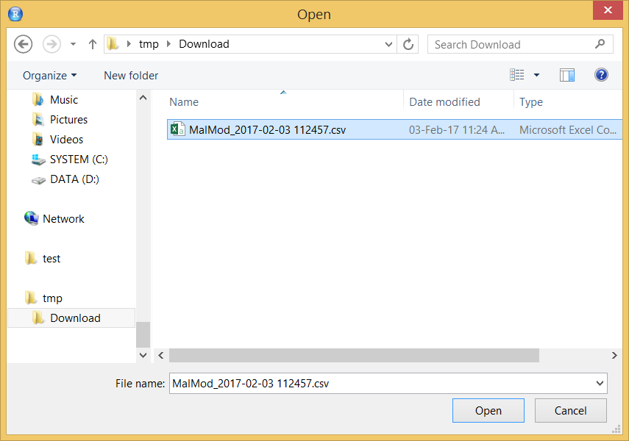
3. Choose your previously saved csv file and Open

